Slide 1
Big Data Platforms
Class Session#6

Slide 2
Why or Why not BQML
Pros and Cons of BGML in compared with other languages to implement an ML application:
Pros | Cons
You don’t have to use multiple languages to run ML project | Lack of ML model supports
Easy management of a ML workflow | Works like a black box
Easy to test | Lack of useful ML libraries, like Explainable AI libraries
Magically Fast compute engine
Easy management of both store and computing

Slide 3
Create ML models in BQML
A query for start training and creating the saved model
{CREATE MODEL | CREATE MODEL IF NOT EXISTS | CREATE OR REPLACE MODEL}
3. example :
CREATE `the name of dataset and table`
4. In supervised learning we need to define the label of our dataset to the algorithm,
input_label_cols=[‘name of col’]
5. define the features that the trained model would be build based on
SELECT list of features
6. defining the dataset
FROM `dataset.table`

Slide 4
Set Options for the ML models in BQML
[OPTIONS(MODEL_TYPE = { 'LINEAR_REG' | 'LOGISTIC_REG' },
INPUT_LABEL_COLS = string_array,
OPTIMIZE_STRATEGY = { 'AUTO_STRATEGY' | 'BATCH_GRADIENT_DESCENT' | 'NORMAL_EQUATION' },
L1_REG = float64_value,
L2_REG = float64_value,
MAX_ITERATIONS = int64_value,
LEARN_RATE_STRATEGY = { 'LINE_SEARCH' | 'CONSTANT' },
LEARN_RATE = float64_value,
EARLY_STOP = { TRUE | FALSE },
MIN_REL_PROGRESS = float64_value,
DATA_SPLIT_METHOD = { 'AUTO_SPLIT' | 'RANDOM' | 'CUSTOM' | 'SEQ' | 'NO_SPLIT' },
DATA_SPLIT_EVAL_FRACTION = float64_value,
DATA_SPLIT_COL = string_value,
LS_INIT_LEARN_RATE = float64_value,
WARM_START = { TRUE | FALSE },
AUTO_CLASS_WEIGHTS = { TRUE | FALSE },
CLASS_WEIGHTS = struct_array,
ENABLE_GLOBAL_EXPLAIN = { TRUE | FALSE },
CALCULATE_P_VALUES = { TRUE | FALSE },
CATEGORY_ENCODING_METHOD = { 'ONE_HOT_ENCODING`, 'DUMMY_ENCODING' }
)];

Slide 5
MODEL_TYPE
'LINEAR_REG' Linear regression for forecasting; for example, the sales of an item on a given day. Labels are real-valued: they cannot be +/- infinity or NaN.
'LOGISTIC_REG' Logistic regression for classification; for example, determining whether a customer will make a purchase. This model can be of two types:
MODEL_TYPE = { 'LINEAR_REG' |
'LOGISTIC_REG' |
'KMEANS' |
'MATRIX_FACTORIZATION' |
'PCA' |
'AUTOENCODER' |
'AUTOML_CLASSIFIER' |
'AUTOML_REGRESSOR' |
}

Slide 6
Linear Regression
Linear regression is a statistical tool used to help predict future values from past values. It is commonly used as a quantitative way to determine the underlying trend and when prices are overextended.
The saved model from creating a linear reg model contains the calculated parameters for each instance in the training dataset.
https://www.youtube.com/watch?v=dVH4kMcKvEA
note: The concept of how linear reg works is just for your general information.

Slide 7
Logistic Regression
Logistic regression models the probability of the default class (e.g. the first class).
For example, if we are modeling people’s sex as male or female from their height, then the first class could be male and the logistic regression model could be written as the probability of male given a person’s height, or more formally:
P(sex=male|height)
Linear Regression is used to predict continuous values and Logistic Regression is used to predict discrete values. There is no point of having a decision boundary for a set of continuous set of values. That is why we don't talk about a decision boundary in Linear Regression.
the decision boundary is a weight vector which is the second parameters need to be calculated by the logistic reg model.
Can you guess the computation complexity of logistic regression?
Read more : https://machinelearningmastery.com/logistic-regression-for-machine-learning/
Tutorial : https://www.youtube.com/watch?v=EVEXFAciqkE
logistic vs linear regression
https://www.youtube.com/watch?v=OCwZyYH14uw , https://www.youtube.com/watch?v=yIYKR4sgzI8

Slide 8
Matrix Factorization
https://www.youtube.com/watch?v=8LRT2gjHNVc&t=4s
https://www.youtube.com/watch?v=J1dk2Ib11cM&t=337s
{CREATE MODEL | CREATE MODEL IF NOT EXISTS | CREATE OR REPLACE MODEL} model_name
OPTIONS(MODEL_TYPE = 'MATRIX_FACTORIZATION’
FEEDBACK_TYPE = {'EXPLICIT' | 'IMPLICIT’},
NUM_FACTORS = int64_value,
USER_COL = string_value,
ITEM_COL = string_value,
RATING_COL = string_value,
WALS_ALPHA = float64_value,
L2_REG = float64_value,
MAX_ITERATIONS = int64_value,
EARLY_STOP = { TRUE | FALSE },
MIN_REL_PROGRESS = float64_value,
DATA_SPLIT_METHOD = { 'AUTO_SPLIT' | 'RANDOM' | 'CUSTOM' | 'SEQ' | 'NO_SPLIT' }, DATA_SPLIT_EVAL_FRACTION = float64_value, DATA_SPLIT_COL = string_value) AS query_statement

Slide 9
Set learning options
L1_REG = float64_value,
L2_REG = float64_value,
MAX_ITERATIONS = int64_value,
LEARN_RATE_STRATEGY = { 'LINE_SEARCH' | 'CONSTANT' },
LEARN_RATE = float64_value,
EARLY_STOP = { TRUE | FALSE },
Explain them one by one in one sentence
in ML course you will be learned more about the parameters then you can set the learning option with more confident

Slide 10
Split train and validation data
DATA_SPLIT_METHOD = { 'AUTO_SPLIT' | 'RANDOM' | 'CUSTOM' | 'SEQ' | 'NO_SPLIT' },
DATA_SPLIT_EVAL_FRACTION = float64_value,
DATA_SPLIT_COL = string_value,
For each method we will define the arguments and descriptions here,
You can find the example query of them on the nexus, sixth session, file named S#6-BGML
Custom:
'CUSTOM' Split data using a customer provided column of type BOOL. The rows with a value of TRUE are used as evaluation data. The rows with a value of FALSE are used as training data.
SEQ:
'SEQ' Split data sequentially using a customer-provided column. The column can have any orderable data type: NUMERIC, BIGNUMERIC, STRING, or TIMESTAMP. All rows with split values smaller than the threshold are used as training data. The remaining rows including NULLs are used as evaluation data.
'AUTO_SPLIT' The automatic split strategy is as follows:
When there are fewer than 500 rows in the input data, all rows are used as training data.
When there are between 500 and 50,000 rows in the input data, 20% of the data is used as evaluation data in a RANDOM split.
When there are more than 50,000 rows in the input data, only 10,000 of them are used as evaluation data in a RANDOM split.

Slide 11
Split train and validation data
Before start learning the split method, lets review the concept of
Training table
Validation table
Test table
To create a high accurate ML model, you should know well about these tables and data.

Slide 12
Split train and validation
DATA_SPLIT_METHOD = { 'AUTO_SPLIT' | 'RANDOM' | 'CUSTOM' | 'SEQ' | 'NO_SPLIT' },
DATA_SPLIT_EVAL_FRACTION = float64_value,
DATA_SPLIT_COL = string_value,
For each method we will define the arguments and descriptions here,
You can find the example query of them on the nexus, sixth session, file named S#6-BGML
'RANDOM' Split data randomly. A random split is deterministic: different training runs produce the same split results if the underlying training data remains the same.
DATA_SPLIT_EVAL_FRACTION
Syntax
DATA_SPLIT_EVAL_FRACTION = float64_value
Description
This option is used with 'RANDOM' and 'SEQ' splits. It specifies the fraction of the data used for evaluation, accurate to two decimal places.

Slide 13
Make test database
#pick the random rows and insert it into new table we made before named ‘test_data”
INSERT `baby_weight.test_data`
SELECT *
FROM `baby_weight.natality`
WHERE rand() < 0. 1 ;
the test dataset need to have the same schema with the baby weight, training table
so one easy way is
copy baby weight save it as a test data the
TRUNCATE TABLE `baby_weight.info_copy`
to delete the content but keep the same schema
find the example query of each splitting of training and validation set on the nexus, sixth session, file named S#6-BGML
And implement it on Natality table, compare the method, which method can be more useful for splitting the data to train and validation table

Slide 14
Make training, validation and test tables
find the example query of each splitting of training and validation set on the nexus, sixth session, file named S#6-BGML
And implement it on Natality table, compare the method, which method can be more useful for splitting the data to train and validation table

Slide 15
Model Performance Metrics
In regression model, in purpose of forcasting, the most commonly known evaluation metrics include:
R-squared (R2), which is the proportion of variation in the outcome that is explained by the predictor variables. In multiple regression models, R2 corresponds to the squared correlation between the observed outcome values and the predicted values by the model. The Higher the R-squared, the better the model.
Root Mean Squared Error (RMSE), which measures the average error performed by the model in predicting the outcome for an observation. Mathematically, the RMSE is the square root of the mean squared error (MSE), which is the average squared difference between the observed actual outome values and the values predicted by the model. So, MSE = mean((observeds - predicteds)^2) and RMSE = sqrt(MSE). The lower the RMSE, the better the model.
Residual Standard Error (RSE), also known as the model sigma, is a variant of the RMSE adjusted for the number of predictors in the model. The lower the RSE, the better the model. In practice, the difference between RMSE and RSE is very small, particularly for large multivariate data.
Mean Absolute Error (MAE), like the RMSE, the MAE measures the prediction error. Mathematically, it is the average absolute difference between observed and predicted outcomes, MAE = mean(abs(observeds - predicteds)). MAE is less sensitive to outliers compared to RMSE.
http://www.sthda.com/english/articles/38-regression-model-validation/158-regression-model-accuracy-metrics-r-square-aic-bic-cp-and-more/
https://www.youtube.com/watch?v=uJNAl9tovCw

Slide 16
Model Performance Metrics
In regression model, in purpose of classification, the most commonly known evaluation metrics include:
Confusion Matrix
Accuracy
Precision
Recall
F1-score
All those metrics use for both binary and multiclass ML classification.

Slide 17


Confusion Matrix
Predicted labels by a ML model
Actual labels

Slide 18
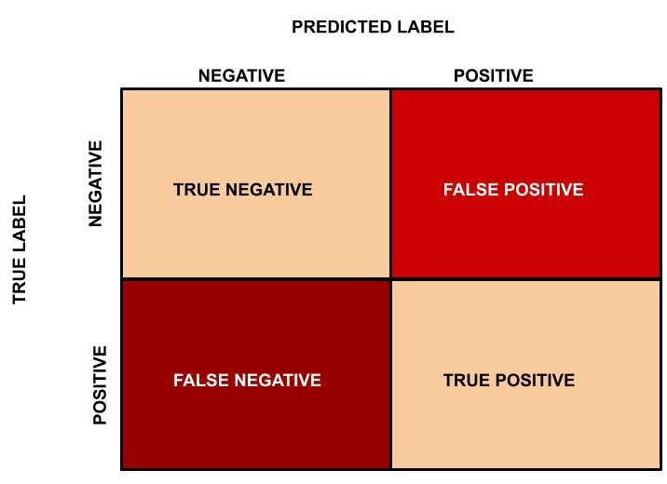
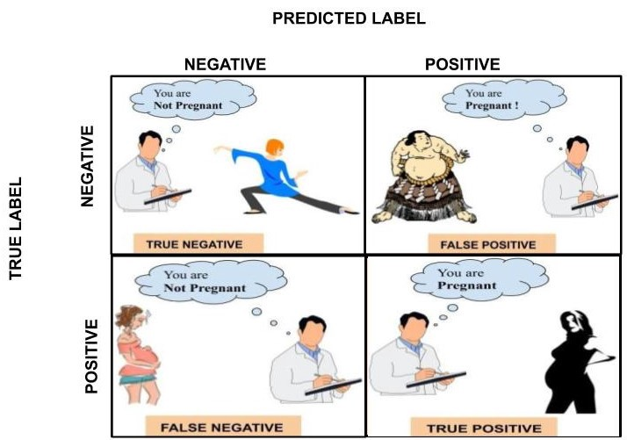
Confusion Matrix

Slide 19
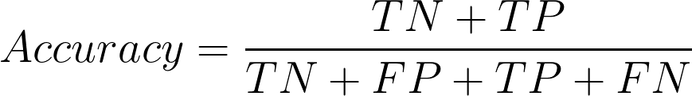
Model Performance Metrics
Accuracy may not be a good measure if the dataset is not balanced (both negative and positive classes have different number of data instances).

Slide 20
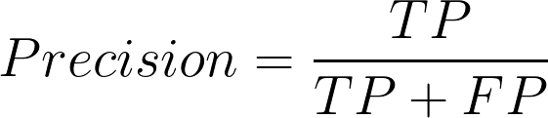
Precision
Precision should ideally be 1 for a good classifier. The higher value of precision, the more accurate classifier we will have.
Precision becomes 1 only when FP is zero. As FP increases the precision value decreases

Slide 21
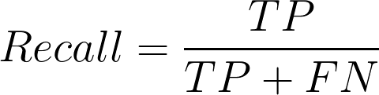
Recall
Recall should ideally be 1 (high) for a good classifier. Recall becomes 1 only when FN is zero.
So ideally in a good classifier, we want both precision and recall to be one which also means FP and FN are zero.

Slide 22
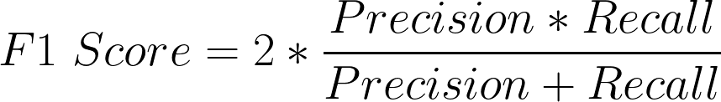
F1-Score
F1 Score becomes 1 only when precision and recall are both 1.
F1 score becomes high only when both precision and recall are high.
F1 score is the harmonic mean of precision and recall and is a better measure than accuracy.

Slide 23
Model Performance Metrics
the precision is the fraction of correct positive predictions.
It answers the question: what proportion of predicted positives is truly positive? It is defined
as TP
TP+FP, FP is the number of incorrectly predicted positives (false positives).
Recall, on the
other hand, answers the question: what proportion of actual positives is predicted positive?
It is defined as TP
TP+FN , FN is the number of incorrectly predicted negatives (false negatives).
Accuracy answers the question: what proportion of images — both positive and negative —
were correctly classified? It is defined as TP+TN
TP+FP+TN+FN
While both precision and recall are
important, to be able to compare two classifiers, the F1-score is used. It is a way to combine
precision and recall into a single number. It is defined as 2⇥precision⇥recall
precision+recall . F1-score is a
harmonic mean of precision and recall that gives larger weight to lower numbers

Slide 24
Classification example
4 student in a group and solve it
I’ll ask them randomly about the process you did
determine if its classification or forecasting problem
What data preprocessing you have done
Explain your code
Explain how your network work

Slide 25
Refrences
Cloud.google.com
https://cloud.google.com/bigquery-ml/docs
https://cloud.google.com/bigquery-ml/docs/logistic-regression-prediction
https://cloud.google.com/bigquery-ml/docs/reference/standard-sql/bigqueryml-syntax-create-glm#data_split_method
https://medium.com/analytics-vidhya/introduction-to-machine-learning-in-google-bigquery-452194ec2bed

