Slide 1
Big Data Platforms
Class Session#8

Slide 2
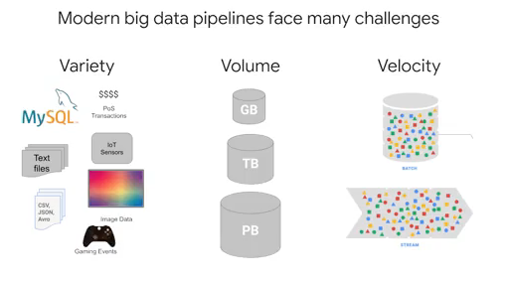
Streaming data Challenges
A variety of input sources
A variable volume of data
To handle if our data arrives late

Slide 3
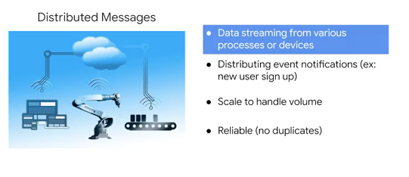
Distributed Messages Challenges

Slide 4
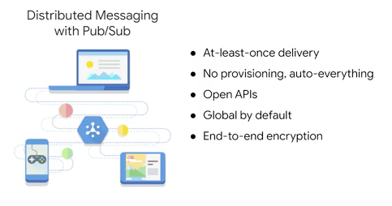
Pub/Sub offers reliable, real-time messaging

Slide 5
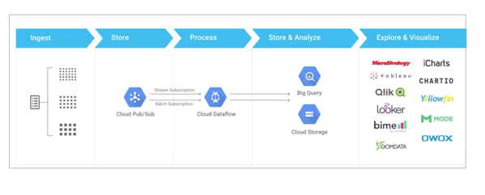
Google Cloud Serverless Big Data Pipeline
Pub/sub is a first point of contact with our system that reads, stores and publishes messages out to any subscribers.
Dataflow as a subscriber, ingests and transforms those messages into a streaming pipeline.
You can output those messages wherever you want. To do analytics, transfer messages to BigQuery.

Slide 6
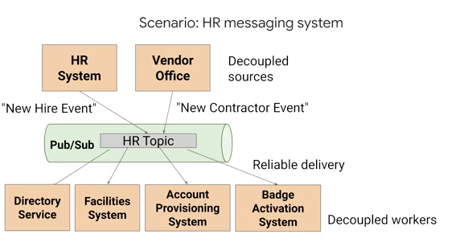
The Architecture of Pub/Sub
To explain more about the Pub/Sub model, we can assume pub/sub as an antenna or HR (Human Resources) topic.
A new person joins your company, and then this notification should allow other applications they care about a new user joining your company to subscribe and then get that message when it happens.
Once Pub/Sub receives the message, downstream applications like the company’s directory service, the facilities system, account provisioning, and badge activation systems, can all listen in and process their own next steps independent of one another.
Pub/Sub is that good solution to buffering changes from those lightly coupled architectures like this one here with many different upstream sources and potentially many different downstream sinks or subscribers.

Slide 7
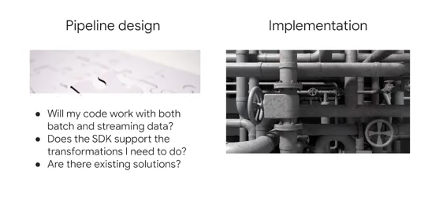
Pipeline architecture
A pipeline model contains two part, designing and implementing

Slide 8
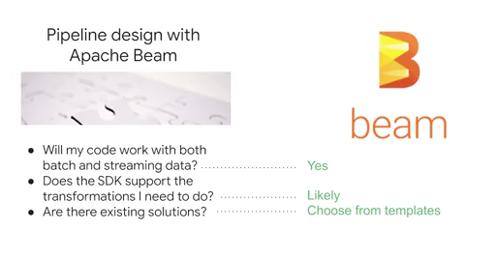
Pipeline architecture
Apache beam is an open-source application that you can access to many libraries related to the designing pipeline for both batch data or streaming data.

Slide 9
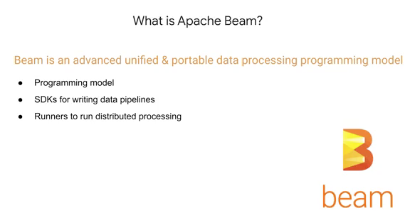
Pipeline architecture

Slide 10
Why Apache Beam?
Unified - Use a single programming model for both batch and streaming use case
Portable - Execute pipelines on multiple execution environments, Spark, AWS and other platforms
Extensible - Write and Share a new SDKs, IO connectors, and transformation libraries.
Google Dataflow is a popular chose to run Apache Beam as its engine.

Slide 11
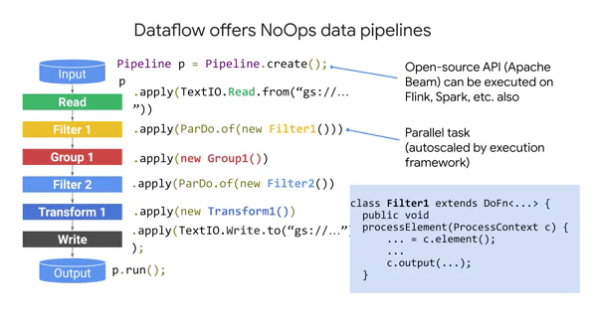
Data Pipeline using Apache Beam

Slide 12
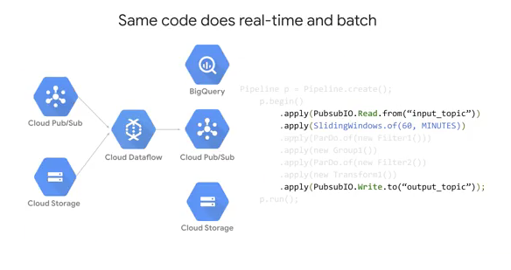
Data Pipeline using Apache Beam

Slide 13
Data Pipeline using Apache Beam

Slide 14
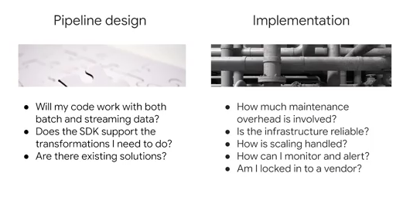
Data Pipeline Implementation
Implementing streaming pipelines on Cloud Dataflow

Slide 15
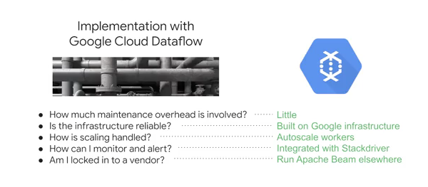
Data Pipeline Implementation

Slide 16
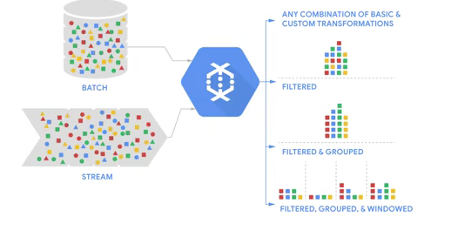
Data Pipeline Implementation
Dataflow does ingest, transform, and load

Slide 17
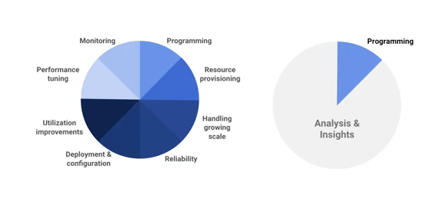
Data Pipeline Implementation
Dataflow is serverless and designed to be No-Ops.
Google manages the infrastructure pipeline tasks, like resource provisioning and performance tuning, as well as ensuring that your pipeline is reliable.
That means you can spend more of your time analyzing the insights from your datasets coming out of the pipeline.

Slide 18
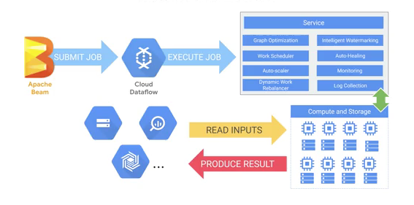
Data Pipeline Implementation
Workflow with Dataflow

Slide 19
Cloud Pub/Sub
DataFlow templates
https://github.com/GoogleCloudPlatform/DataflowTemplates

Slide 20
Wordcount dataflow template
The WordCount template is a batch pipeline that reads text from Cloud Storage, tokenizes the text lines into individual words, and performs a frequency count on each of the words. For more information about WordCount, see WordCount Example Pipeline.
Used PCollection which represents a distributed data set that the Apache Beam pipeline operates on. The data set can be bounded, meaning it comes from a fixed source like a file, or unbounded, meaning it comes from a continuously updating source via a subscription or other mechanism.
Used Apache Maven is a software project management and comprehension tool. Maven can manage a project's build, reporting and documentation from a central piece of information.
Parameter | Description
inputFile | The Cloud Storage input file's path.
output | The Cloud Storage output file's path and prefix.

Slide 21
Wordcount dataflow template
A simple example of pipeline
the code for creating the pipeline
https://github.com/tuanavu/google-dataflow-examples/blob/master/examples/wordcount.py
tutorial
to run the Wordcount pipeline project
https://codelabs.developers.google.com/codelabs/cloud-dataflow-starter#0

Slide 22
Refrences
Cloud.google.com
https://cloud.google.com/bigquery-ml/docs
https://cloud.google.com/bigquery-ml/docs/logistic-regression-prediction
https://cloud.google.com/bigquery-ml/docs/reference/standard-sql/bigqueryml-syntax-create-glm#data_split_method
https://medium.com/analytics-vidhya/introduction-to-machine-learning-in-google-bigquery-452194ec2bed

