Slide 1

Introduction to NLTK
(A Tool Kit for Natural Language Processing)

Slide 2
Natural Language Toolkit (NLTK)
• A collection of Python programs, modules, data set and tutorial to
support research and development in Natural Language Processing
(NLP).
• NLTK is
• Free and Open source
• Easy to use
• Modular
• Well documented
• Simple and extensible
• http://www.nltk.org/

Slide 3
Installing NLTK
• If you do not have Python yet, go to Python.org and download the
Python.
• The easiest method to install the NLTK module is with pip.
• pip install nltk

Slide 4
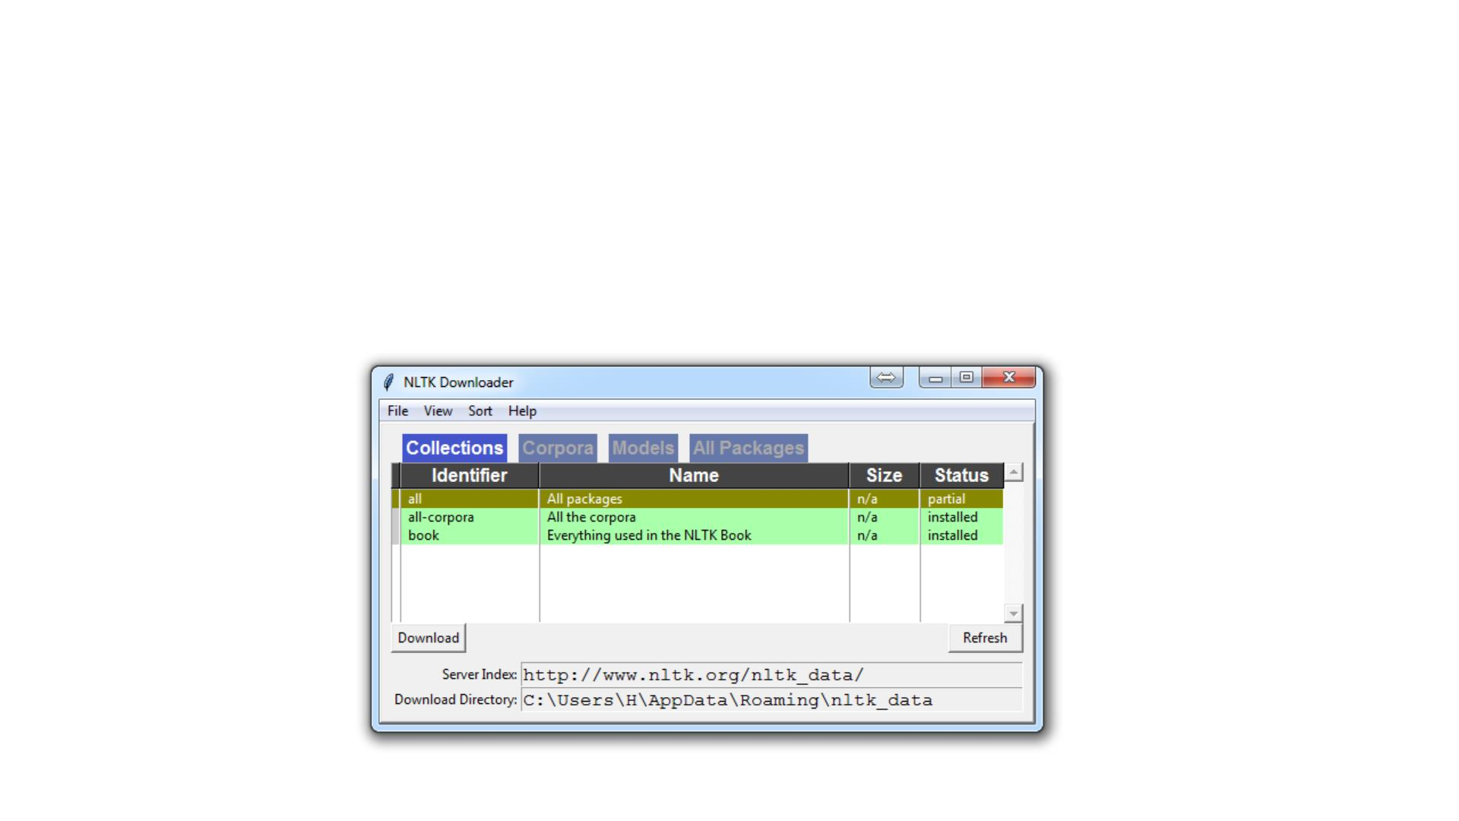
Download NLTK data
• import nltk
• nltk.download()

Slide 5
Some definitions
• Corpus - Body of text. Corpora is the plural of Corpus.
• Example: A collection of news documents.
• Lexicon - Words and their meanings.
• Example: English dictionary.
• Token - Each "entity" that is a part of whatever was split up based on
rules.
• For examples, each word is a token when a sentence is "tokenized" into
words. Each sentence can also be a token, if you tokenized the sentences out
of a paragraph.

Slide 6
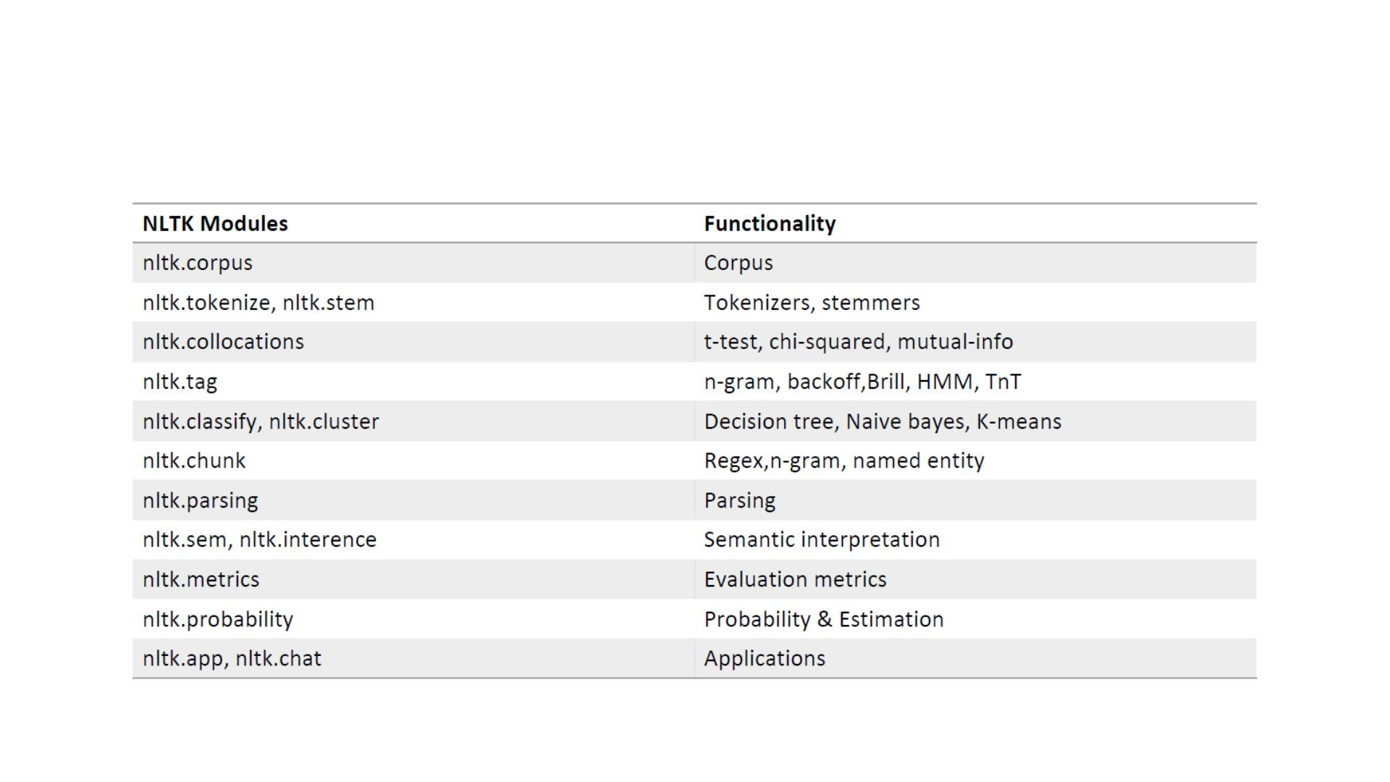
NLTK Modules & Functionality

Slide 7
Tokenization
• Tokenization is the process of breaking a stream of text up into words,
phrases, symbols, or other meaningful elements called tokens.
>>> from nltk.tokenize import word_tokenize, wordpunct_tokenize, sent_tokenize
>>> s = '''Good muffins cost $3.88\nin New York. Please buy me two of them.\n\nThanks.''‘
• Word Punctuation Tokenization
>>> wordpunct_tokenize(s)
['Good', 'muffins', 'cost', '$', '3', '.', '88', 'in', 'New', 'York', '.', 'Please', 'buy', 'me', 'two', 'of', 'them', '.', 'Thanks', '.']
• Sentence Tokenization
>>> sent_tokenize(s)
['Good muffins cost $3.88\nin New York.', 'Please buy me\ntwo of them.', 'Thanks.']
• Word Tokenization
>>> [word_tokenize(t) for t in sent_tokenize(s)]
[['Good', 'muffins', 'cost', '$', '3.88', 'in', 'New', 'York', '.'], ['Please', 'buy', 'me', 'two', 'of','them', '.'], ['Thanks', '.']]

Slide 8
Regular Expression Tokenizer
• First you need to decide how you want to tokenize a piece of text then you
construct your regular expression. The choices are:
• Match on the tokens
• Match on the separators, or gaps
>>> from nltk.tokenize import RegexpTokenizer
>>> tokenizer = RegexpTokenizer("[\w']+")
>>> tokenizer.tokenize("Natural Language Processing is very interesting")
['Natural', 'Language', 'Processing', 'is', 'very', 'interesting']

Slide 9
Filtering stopwords
• Stopwords are common words that generally do not contribute to the
meaning of a sentence.
• Most search engines will filter stopwords out of search queries and
documents in order to save space in their index.
• Stopwords can be found in the directory
• nltk_data/corpora/stopwords/
>>> from nltk.corpus import stopwords
>>> english_stops = set(stopwords.words('english'))
>>> words = ['The', ‘natural', 'language', 'processing', 'is', 'very', 'interesting']
>>> [word for word in words if word.lower() not in english_stops]
[‘natural', 'language', 'processing', 'interesting']

Slide 10
Edit Distance
• The edit distance is the number of character changes necessary to
transform the given word into the suggested word.
>>> from nltk.metrics import edit_distance
>>> edit_distance("Birthday", "Bday")
4

Slide 11
Normalizing Text
• The goal of both stemming and lemmatization is to "normalize" words
to their common base form, which is useful for many text-processing
applications.
• Stemming = heuristically removing the affixes of a word, to get its
stem (root).
• Lemmatization = Lemmatization process involves first determining
the part of speech of a word, and applying different normalization
rules for each part of speech.

Slide 12
Consider:
• I was taking a ride in the car.
• I was riding in the car.
• Imagine every word in the English language, every possible tense and affix you
can put on a word.
• Having individual dictionary entries per version would be highly redundant and
inefficient.

Slide 13
Stemming
• One of the most popular stemming algorithms is the Porter stemmer,
which has been around since 1979.
from nltk.stem import PorterStemmer
ps = PorterStemmer()
example_words = ["python","pythoner","pythoning","pythoned","pythonly"]
for w in example_words:
print(ps.stem(w))
Output:
python
python
python
python
pythonli

Slide 14
Lemmatization
• Lemmatize takes a part of speech parameter, "pos." If not supplied,
the default is "noun".
>>> from nltk.stem import WordNetLemmatizer
>>> lemmatizer = WordNetLemmatizer()
>>> lemmatizer.lemmatize('cooking')
'cooking'
>>> lemmatizer.lemmatize('cooking', pos='v')
'cook'

Slide 15
Comparison between stemming and lemmatizing
• The major difference between these is, as you saw earlier, stemming
can often create non-existent words, whereas lemmas are actual
words, you can just look up in an English dictionary.
>>> stemmer.stem('believes')
'believ'
>>> lemmatizer.lemmatize('believes')
'belief'

Slide 16
Part-of-speech Tagging
• Part-of-speech Tagging is the process of marking up a word in a text
(corpus) as corresponding to a particular part of speech.
>>> from nltk.tokenize import word_tokenize
>>> from nltk.tag import pos_tag
>>> words = word_tokenize('And now for something completely different')
>>> pos_tag(words)
[('And', 'CC'), ('now', 'RB'), ('for', 'IN'), ('something', 'NN'), ('completely', 'RB'), ('different','JJ')]
• https://www.ling.upenn.edu/courses/Fall_2003/ling001/penn_treebank_pos.html

Slide 17
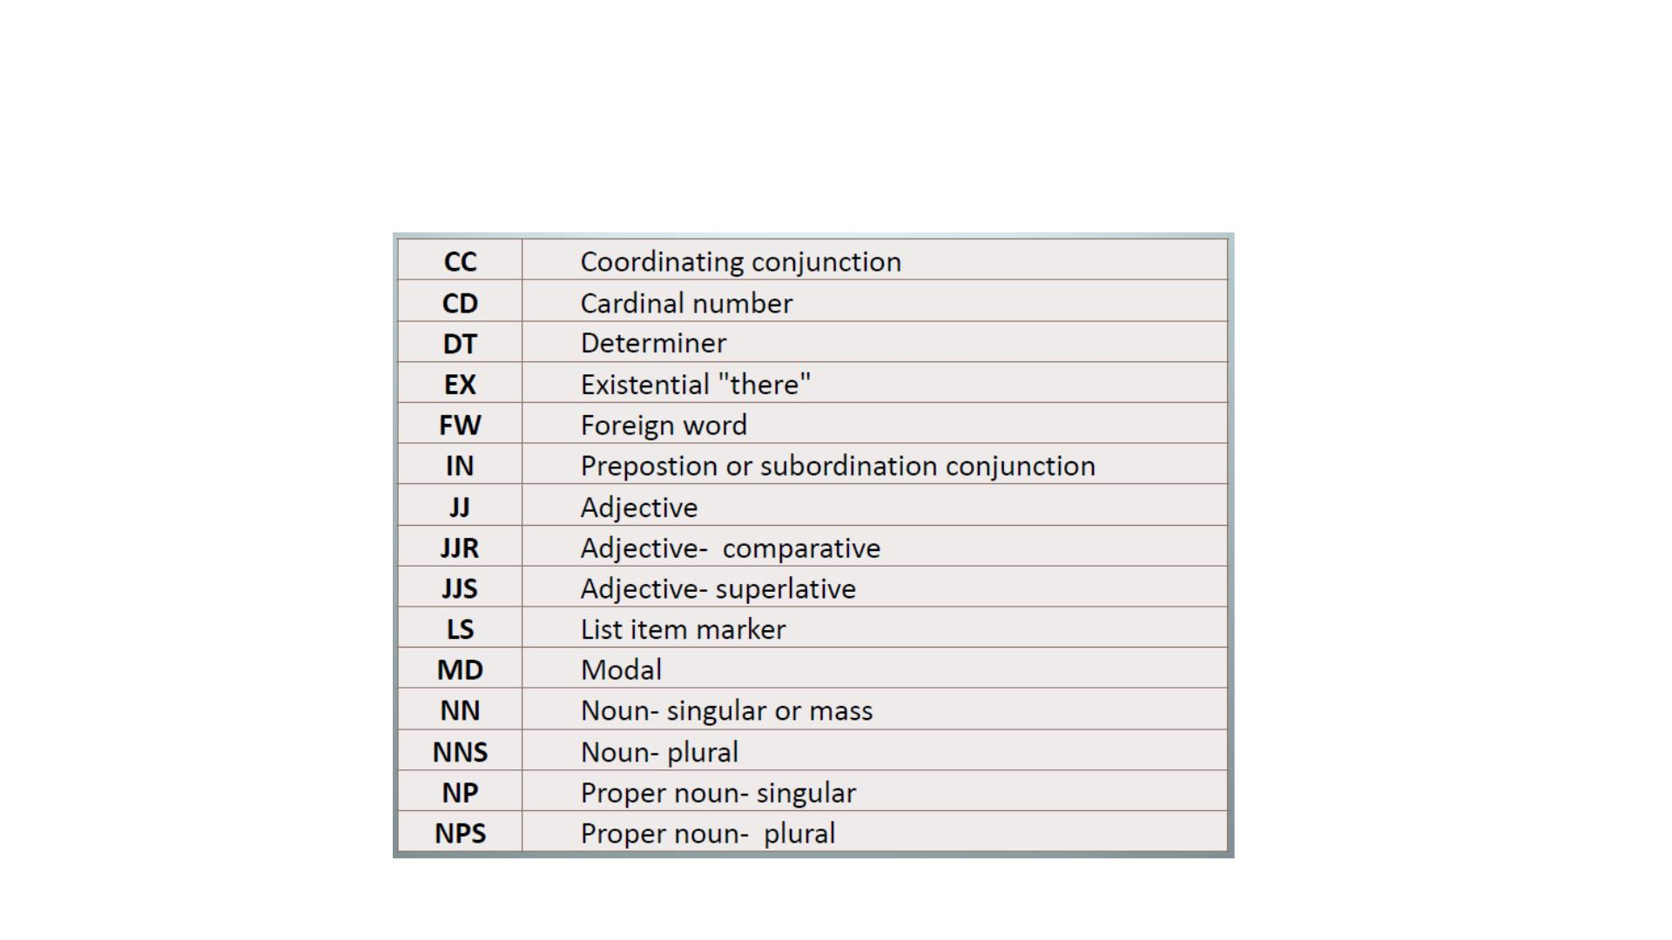
Penn Bank Part-of-Speech Tags

Slide 18
Named-entity Recognition
• Named-entity recognition is a subtask of information extraction that
seeks to locate and classify elements in text into pre-defined
categories such as the names of persons, organizations, locations,
expressions of times, quantities, monetary values, percentages, etc.
>>> from nltk import pos_tag, ne_chunk
>>> from nltk.tokenize import wordpunct_tokenize
>>> sent = 'Jim bought 300 shares of Acme Corp. in 2006.'
>>> ne_chunk(pos_tag(wordpunct_tokenize(sent)))
Tree('S', [Tree('PERSON', [('Jim', 'NNP')]), ('bought', 'VBD'), ('300', 'CD'), ('shares', 'NNS'),('of', 'IN'),
Tree('ORGANIZATION', [('Acme', 'NNP'), ('Corp', 'NNP')]), ('.', '.'), ('in', 'IN'),('2006', 'CD'), ('.', '.')])

Slide 19
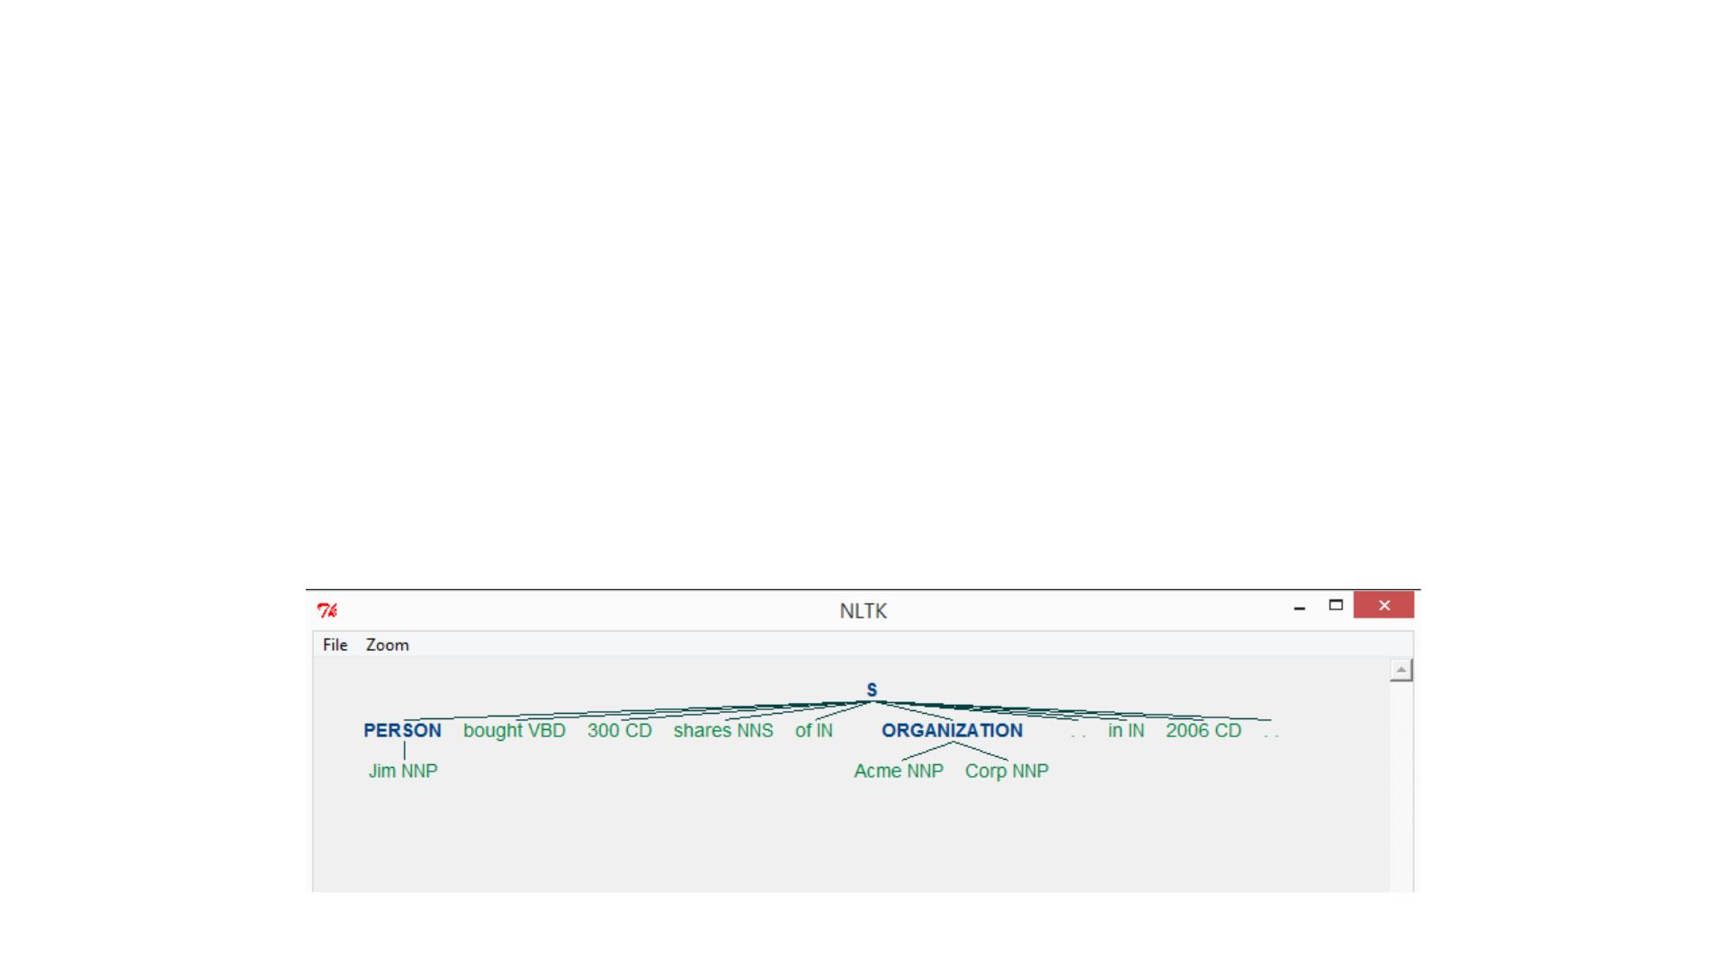
NE Type and Examples
ORGANIZATION - Georgia-Pacific Corp., WHO
PERSON - Eddy Bonte, President Obama
LOCATION - Murray River, Mount Everest
DAT E - June, 2008-06-29
TIME - two fifty a m, 1:30 p.m.
MONEY - 175 million Canadian Dollars, GBP 10.40
PERCENT - twenty pct, 18.75 %
FACILITY - Washington Monument, Stonehenge
GPE - South East Asia, Midlothian
>>> ne_chunk(pos_tag(wordpunct_tokenize(sent))).draw()

Slide 20
WordNet
• WordNet is a lexical database for the English language. In other
words, it's a dictionary designed specifically for natural language
processing, which was created by Princeton, and is part of the NLTK
corpus.
• You can use WordNet alongside the NLTK module to find the
meanings of words, synonyms, antonyms, similarity and more. Let's
cover some examples.

Slide 21
Some Examples
>>> from nltk.corpus import wordnet
>>> syns = wordnet.synsets("program")
>>> print syns
[Synset('plan.n.01'), Synset('program.n.02'), Synset('broadcast.n.02'),
Synset('platform.n.02'), Synset('program.n.05'), Synset('course_of_study.n.01'),
Synset('program.n.07'), Synset('program.n.08'), Synset('program.v.01'),
Synset('program.v.02')]
>>> print(syns[0].name())
plan.n.01
>>> print syns[0].pos()
N
>>> print(syns[0].definition())
a series of steps to be carried out or goals to be accomplished
>>> print(syns[0].examples())
[u'they drew up a six-step plan', u'they discussed plans for a new bond issue']

Slide 22
Bag of Words model
• All texts need to be converted to numbers before starts processing by
the machine.
• Consider these two short texts.
1. Julie loves me more than Linda loves me
2. Jane likes me more than Julie loves me
• We want to know how similar these texts are, purely in terms of word
counts (and ignoring word order). We begin by making a list of the
words from both texts:
[ me Jane Julie Linda likes loves more than]

Slide 23
• Now we count the number of • We are interested only in those
times each of these words two vertical vectors of counts.
appears in each text.
• a: [2, 0, 1, 1, 0, 2, 1, 1]
• b: [2, 1, 1, 0, 1, 1, 1, 1]
S1 S2
me 2
2
1
1
0
1
1
1
1
• The cosine of the angle
between them defines the
similarity between the texts.
[Cosine Similarity]
Jane 0
Julie 1
Linda 1
likes 0
loves 2
more 1
than 1
• The cosine of the angle
between them is about 0.822.

Slide 24
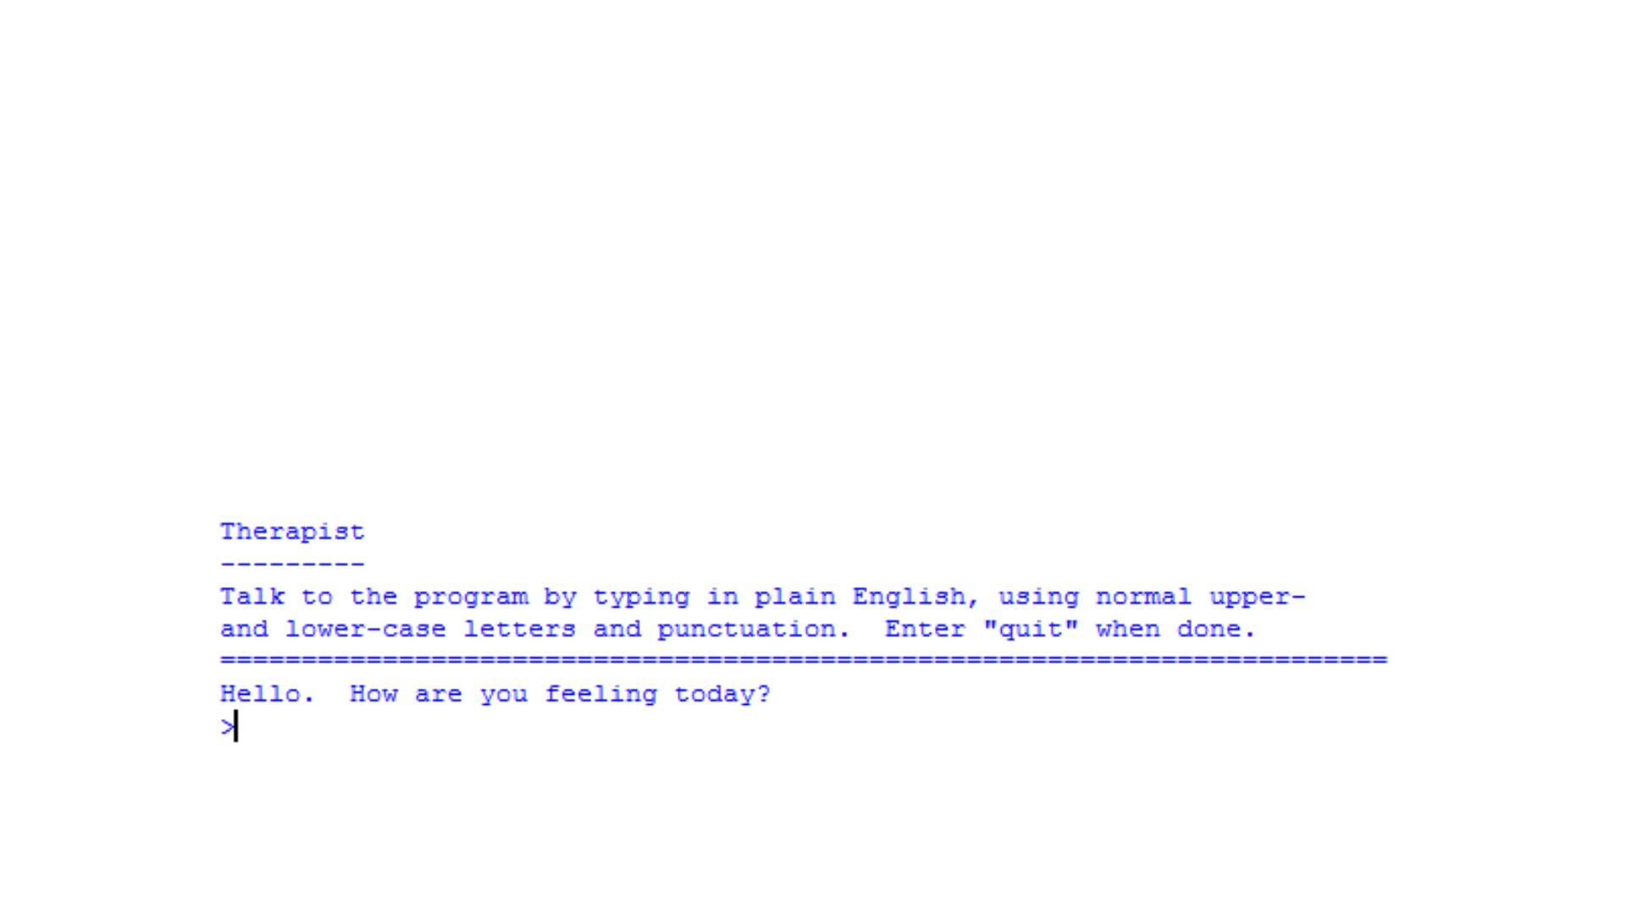
Feeling lonely?
• Eliza is there to talk to you all day!
>>> from nltk.chat import eliza
>>> eliza.eliza_chat()
……starts the chatbot

Slide 25
Thanks! ☺
Any Questions?

