Slide 1
Natural Language Processing (NLP) basics
N AT U R A L L A N G U AG E P R O C E S S I N G W I T H S PAC Y
Azadeh Mobaher
Principal Data Scientist

Slide 2
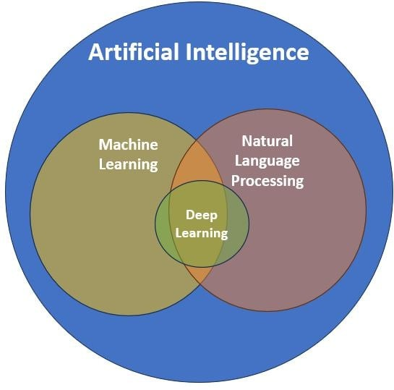
Natural Language Processing (NLP)
A subfield of Artificial Intelligence (AI)
Helps computers to understand human language
Helps extract insights from unstructured data
Incorporates statistics, machine learning models and deep learning models

Slide 3
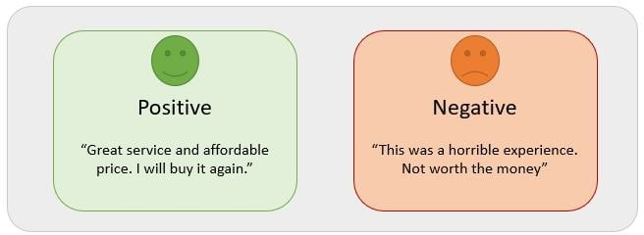
NLP use cases
Sentiment analysis
Use of computers to determine the underlying subjective tone of a piece of writing

Slide 4
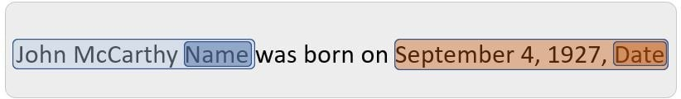
NLP use cases
Named entity recognition (NER)
Locating and classifying named entities mentioned in unstructured text into pre-defined categories
Named entities are real-world objects such as a person or location

Slide 5

NLP use cases
Generate human-like responses to text input, such as ChatGPT

Slide 6

Introduction to spaCy
spaCy is a free, open-source library for NLP in
Python which:
Is designed to build systems for information extraction
Provides production-ready code for NLP use cases
Supports 64+ languages
Is robust and fast and has visualization libraries

Slide 7
Install and import spaCy
As the first step, spaCy can be installed using the Python package manager pip
spaCy trained models can be downloaded
Multiple trained models are available for English language at spacy.io
$ python3 pip install spacy
python3 -m spacy download en_core_web_sm spacy
nlp = spacy.load("en_core_web_sm")

Slide 8
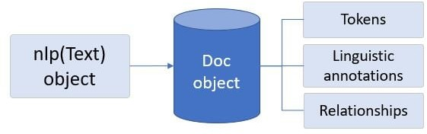
Read and process text with spaCy
Loaded spaCy model en_core_web_sm = nlp object
nlp object converts text into a Doc object (container) to store processed text

Slide 9

spaCy in action
Processing a string using spaCy
spacy
nlp = spacy.load("en_core_web_sm")
text = "A spaCy pipeline object is created." doc = nlp(text)
Tokenization
A Token is defined as the smallest meaningful part of the text.
Tokenization: The process of dividing a text into a list of meaningful tokens
print([token.text token doc])
['A', 'spaCy', 'pipeline', 'object', 'is', 'created', '.']

Slide 10
Let's practice!
N AT U R A L L A N G U AG E P R O C E S S I N G W I T H S PAC Y

Slide 11
spaCy basics
N AT U R A L L A N G U AG E P R O C E S S I N G W I T H S PAC Y
Azadeh Mobasher
Principal Data Scientist

Slide 12
spaCy NLP pipeline
spacy
nlp = spacy.load("en_core_web_sm") doc = nlp("Here's my spaCy pipeline.")
Import spaCy
Use spacy.load() Language class
to return nlp , a
The Language object is the text processing pipeline
Apply nlp() on any text to get a Doc
container

Slide 13
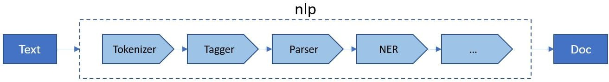
spaCy NLP pipeline
spaCy applies some processing steps using its Language class:

Slide 14
Container objects in spaCy
There are multiple data structures to represent text data in spaCy :
Name | Description
 | A container for accessing linguistic annotations of text
 | A slice from a Doc object
 | An individual token, i.e. a word, punctuation, whitespace, etc.

Slide 15
Pipeline components
The spaCy language processing pipeline always depends on the loaded model and its capabilities.
Component | Name | Description
Tokenizer | Tokenizer | Segment text into tokens and create Doc object
Tagger | Tagger | Assign part-of-speech tags
Lemmatizer | Lemmatizer | Reduce the words to their root forms
EntityRecognizer | NER | Detect and label named entities

Slide 16
Pipeline components
Each component has unique features to process text
Language
DependencyParser Sentencizer

Slide 17
Tokenization
Always the first operation
All the other operations require tokens
Tokens can be words, numbers and punctuation
spacy
nlp = spacy.load("en_core_web_sm")
doc = nlp("Tokenization splits a sentence into its tokens.") print([token.text token doc])
['Tokenization', 'splits', 'a', 'sentence', 'into', 'its', 'tokens', '.']

Slide 18
Sentence segmentation
More complex than tokenization
Is a part of DependencyParser component
spacy
nlp = spacy.load("en_core_web_sm")
text = "We are learning NLP. This course introduces spaCy." doc = nlp(text)
sent doc.sents: print(sent.text)
We are learning NLP.
This course introduces spaCy.

Slide 19
Lemmatization
A lemma is a the base form of a token The lemma of eats and ate is eat Improves accuracy of language models
spacy
nlp = spacy.load("en_core_web_sm")
doc = nlp("We are seeing her after one year.") print([(token.text, token.lemma_) token
doc])
[('We', 'we'), ('are', 'be'), ('seeing', 'see'), ('her', 'she'),
('after', 'after'), ('one', 'one'), ('year', 'year'), ('.', '.')]

Slide 20
Let's practice!
N AT U R A L L A N G U AG E P R O C E S S I N G W I T H S PAC Y

Slide 21
Linguistic features in spaCy
N AT U R A L L A N G U AG E P R O C E S S I N G W I T H S PAC Y
Azadeh Mobasher
Principal Data Scientist

Slide 22
POS tagging
Categorizing words grammatically, based on function and context within a sentence
POS | Description | Example
VERB | Verb | run, eat, ate, take
NOUN | Noun | man, airplane, tree, flower
ADJ | Adjective | big, old, incompatible, conflicting
ADV | Adverb | very, down, there, tomorrow
CONJ | Conjunction | and, or, but

Slide 23
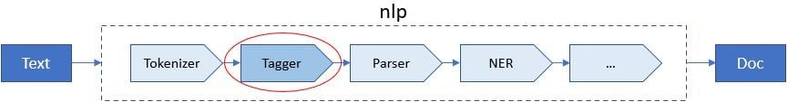
POS tagging with spaCy
POS tagging confirms the meaning of a word
Some words such as watch can be both noun and verb
spaCy captures POS tags in the pos_ feature of the nlp pipeline
spacy.explain() explains a given POS tag

Slide 24
POS tagging with spaCy
verb_sent = "I watch TV."
print([(token.text, token.pos_, spacy.explain(token.pos_))
token nlp(verb_sent)])
noun_sent = "I left without my watch."
print([(token.text, token.pos_, spacy.explain(token.pos_))
token nlp(noun_sent)])
[('I', 'PRON', 'pronoun'),
('watch', 'VERB', 'verb'),
('TV', 'NOUN', 'noun'),
('.', 'PUNCT', 'punctuation')]
[('I', 'PRON', 'pronoun'),
('left', 'VERB', 'verb'),
('without', 'ADP', 'adposition'),
('my', 'PRON', 'pronoun'),
('watch', 'NOUN', 'noun'),
('.', 'PUNCT', 'punctuation')]

Slide 25
Named entity recognition
A named entity is a word or phrase that refers to a specific entity with a name
Named-entity recognition (NER) classifies named entities into pre-defined categories
Entity type | Description
PERSON | Named person or family
ORG | Companies, institutions, etc.
GPE | Geo-political entity, countries, cities, etc.
LOC | Non-GPE locations, mountain ranges, etc.
DATE | Absolute or relative dates or periods
TIME | Time smaller than a day

Slide 26
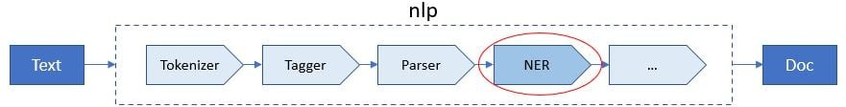
NER and spaCy
spaCy models extract named entities using the NER pipeline component
Named entities are available via the doc.ents property
spaCy will also tag each entity with its entity label ( .label_ )

Slide 27
NER and spaCy
spacy
nlp = spacy.load("en_core_web_sm") text = "Albert Einstein was genius." doc = nlp(text)
print([(ent.text, ent.start_char, ent.end_char, ent.label_) ent
doc.ents])
>>> [('Albert Einstein', 0, 15, 'PERSON')]

Slide 28
NER and spaCy
We can also access entity types of each token in a Doc
container
spacy
nlp = spacy.load("en_core_web_sm") text = "Albert Einstein was genius." doc = nlp(text)
print([(token.text, token.ent_type_)
token
doc])
>>> [('Albert', 'PERSON'), ('Einstein', 'PERSON'), ('was', ''), ('genius', ''), ('.', '')]

Slide 29
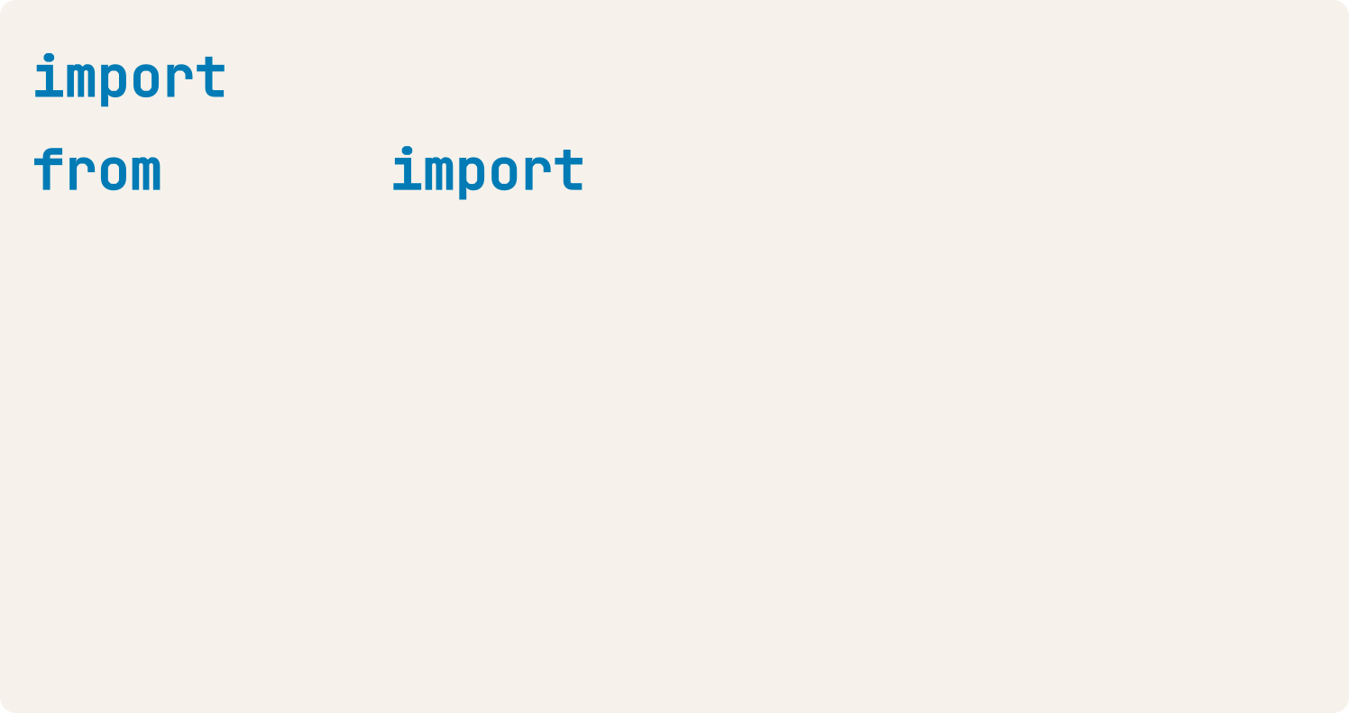

displaCy
spacy
spacy displacy
text = "Albert Einstein was genius." nlp = spacy.load("en_core_web_sm") doc = nlp(text)
displacy.serve(doc, style="ent")
spaCy is equipped with a modern visualizer: displaCy
The displaCy entity visualizer highlights named entities and their labels

