Slide 1
Language Modeling
Introduction to N-grams

Slide 2
Probabilistic Language Models
Today’s goal: assign a probability to a sentence
      Machine Translation:
        P(high winds tonite) > P(large winds tonite)
      Spell Correction
        The office is about fifteen minuets from my house
          P(about fifteen minutes from) > P(about fifteen minuets from)
      Speech Recognition
        P(I saw a van) >> P(eyes awe of an)
      + Summarization, question-answering, etc., etc.!!
Why?

Slide 3
Probabilistic Language Modeling
Goal: compute the probability of a sentence or sequence of words:
  P(W) = P(w₁,w₂,w₃,w₄,w₅…w_{n})
Related task: probability of an upcoming word:
  P(w₅|w₁,w₂,w₃,w₄)
A model that computes either of these:
  P(W) or P(w_{n}|w₁,w₂…w_{n-1}) is called a language model.
Better: the grammar But language model or LM is standard

Slide 4
How to compute P(W)
How to compute this joint probability:
  P(its, water, is, so, transparent, that)
Intuition: let’s rely on the Chain Rule of Probability

Slide 5
Reminder: The Chain Rule
Recall the definition of conditional probabilities
  p(B|A) = P(A,B)/P(A) Rewriting: P(A,B) = P(A)P(B|A)
More variables:
  P(A,B,C,D) = P(A)P(B|A)P(C|A,B)P(D|A,B,C)
The Chain Rule in General
P(x₁,x₂,x₃,…,x_{n}) = P(x₁)P(x₂|x₁)P(x₃|x₁,x₂)…P(x_{n}|x₁,…,x_{n-1})

Slide 6
The Chain Rule applied to compute joint probability of words in sentence
P(“its water is so transparent”) =
P(its) × P(water|its) × P(is|its water)
× P(so|its water is) × P(transparent|its water is so)

Slide 7
How to estimate these probabilities
Could we just count and divide?
No! Too many possible sentences!
We’ll never see enough data for estimating these

Slide 8
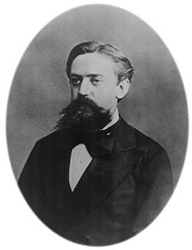
Markov Assumption
Simplifying assumption:
Or maybe
Andrei Markov

Slide 9
N grams
In other words, we approximate each component in the product

Slide 10
Simplest case: Unigram model
Some automatically generated sentences from a unigram model
fifth, an, of, futures, the, an, incorporated, a, a, the, inflation, most, dollars, quarter, in, is, mass
thrift, did, eighty, said, hard, 'm, july, bullish
that, or, limited, the

Slide 11
Bigram model
Condition on the previous word:
texaco, rose, one, in, this, issue, is, pursuing, growth, in, a, boiler, house, said, mr., gurria, mexico, 's, motion, control, proposal, without, permission, from, five, hundred, fifty, five, yen
outside, new, car, parking, lot, of, the, agreement, reached
this, would, be, a, record, november

Slide 12
N-gram models
We can extend to trigrams, 4-grams, 5-grams
In general this is an insufficient model of language
  because language has long-distance dependencies:
  “The computer(s) which I had just put into the machine room on the fifth floor is (are) crashing.”
But we can often get away with N-gram models

Slide 13
Language Modeling
Introduction to N-grams

Slide 14
Language Modeling
Estimating N-gram Probabilities

Slide 15
Estimating bigram probabilities
The Maximum Likelihood Estimate

Slide 16

An example
<s> I am Sam </s>
<s> Sam I am </s>
<s> I do not like green eggs and ham </s>

Slide 17
More examples:
Berkeley Restaurant Project sentences
can you tell me about any good cantonese restaurants close by
mid priced thai food is what i’m looking for
tell me about chez panisse
can you give me a listing of the kinds of food that are available
i’m looking for a good place to eat breakfast
when is caffe venezia open during the day

Slide 18
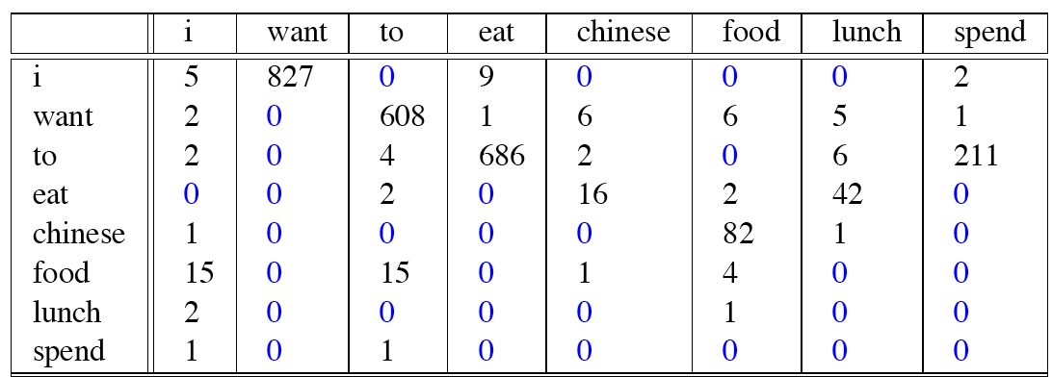
Raw bigram counts
Out of 9222 sentences

Slide 19
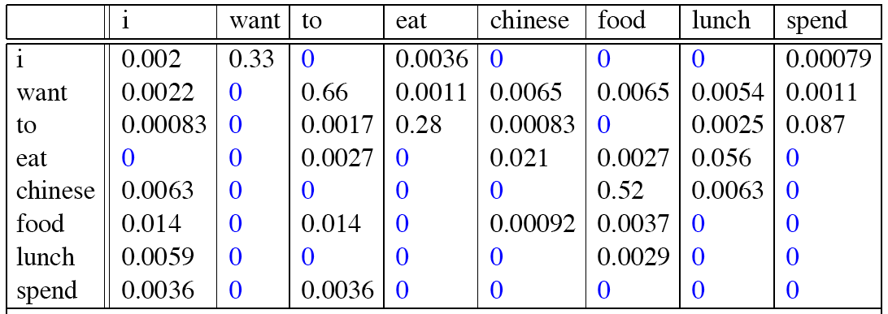
Raw bigram probabilities
Normalize by unigrams:
Result:

Slide 20
Bigram estimates of sentence probabilities
P(<s> I want english food </s>) =
P(I|<s>)
× P(want|I)
× P(english|want)
× P(food|english)
× P(</s>|food)
= .000031

Slide 21
What kinds of knowledge?
P(english|want) = .0011
P(chinese|want) = .0065
P(to|want) = .66
P(eat | to) = .28
P(food | to) = 0
P(want | spend) = 0
P (i | <s>) = .25

Slide 22
Practical Issues
We do everything in log space
  Avoid underflow
  (also adding is faster than multiplying)

Slide 23
Language Modeling Toolkits
SRILM
  http://www.speech.sri.com/projects/srilm/
KenLM
  https://kheafield.com/code/kenlm/

Slide 24
Google N-Gram Release, August 2006
…

Slide 25
Google N-Gram Release
serve as the incoming 92
serve as the incubator 99
serve as the independent 794
serve as the index 223
serve as the indication 72
serve as the indicator 120
serve as the indicators 45
serve as the indispensable 111
serve as the indispensible 40
serve as the individual 234
http://googleresearch.blogspot.com/2006/08/all-our-n-gram-are-belong-to-you.html

Slide 26
Google Book N-grams
http://ngrams.googlelabs.com/

