Slide 1
Natural Language Processing (NLP)
Very Simple Introduction

Slide 2
What is NLP
Branch of AI
2 Goals
  Science Goal: Understand the way language operates
  Engineering Goal: Build systems that analyse and generate language; reduce the man machine gap

Slide 3
Applications of NLP
spelling and grammar checking
optical character recognition (OCR) screen readers
augmentative and alternative communication
machine aided translation lexicographers’ tools
information retrieval
document classiﬁcation
document summarizers/others
information extraction question answering summarization
text segmentation
exam marking report generation
machine translation natural language interfaces to databases
email understanding dialogue systems

Slide 4
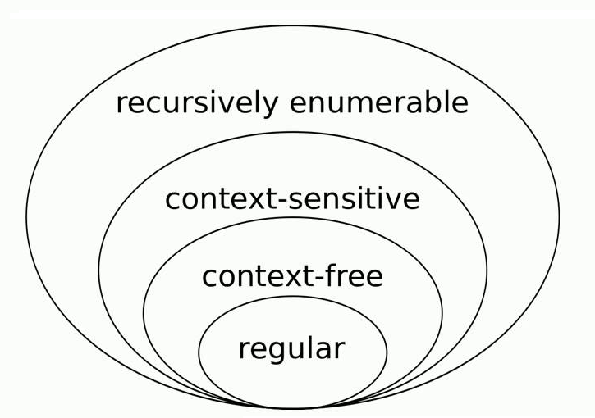
NLP

Slide 5
The famous Turing Test: Language Based Interaction
Test conductor
Machine
Human
Can the test conductor find out which is the machine and which
the human

Slide 6
Inspired Eliza
http://www.manifestation.com/neurotoys/eliza.php3

Slide 7
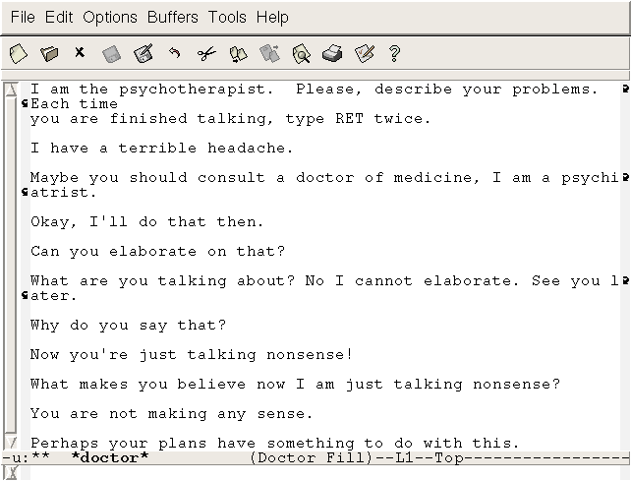
Inspired Eliza (another sample interaction)
A Sample of Interaction:

Slide 8
Ambiguity
This is what makes NLP challenging:
The Crux of the problem

Slide 9
Stages of language processing
Phonetics and phonology
Morphology
Lexical Analysis
Syntactic Analysis
Semantic Analysis
Pragmatics
Discourse

Slide 10
Phonetics
Processing of speech
Challenges
  Homophones: bank (finance) vs. bank (river
  bank)
  Near Homophones: bear vs. bare
  Word Boundary
    aajaayenge (aa jaayenge (will come) or aaj aayenge (will come today)
    I got [ua]plate
  Phrase boundary
    AI students are especially exhorted to attend as such seminars are integral to one's post-graduate education
  Disfluency: ah, um, ahem etc.

Slide 11
Morphology
Word formation rules from root words
Nouns: Plural (boy-boys); Gender marking (naseem-naseema)
Verbs: Tense (stretch-stretched); Aspect (e.g. perfective sit-had sat); Modality (e.g. request khaanaa→ khaaiie)
First crucial first step in NLP
Languages rich in morphology: e.g., Dravidian, Hungarian, Turkish
Languages poor in morphology: Chinese, English
Languages with rich morphology have the advantage of easier processing at higher stages of processing
A task of interest to computer science: Finite State Machines for Word Morphology

Slide 12
Lexical Analysis
Essentially refers to dictionary access and obtaining the properties of the word
e.g. dog
noun (lexical property)
take-’s’-in-plural (morph property)
animate (semantic property)
4-legged (-do-)
carnivore (-do)
Challenge: Lexical or word sense disambiguation

Slide 13
Lexical Disambiguation
First step: part of Speech Disambiguation
    Dog as a noun (animal)
    Dog as a verb (to pursue, to follow closely)
Sense Disambiguation
    Dog (as animal)
    Dog (as a very detestable person)
Needs word relationships in a context
    e.g., Ground breaking ceremony/research

Slide 14
Technological developments bring in new terms, additional meanings/nuances for existing terms
  Justify as in justify the right margin (word processing context)
  Xeroxed: a new verb
  Digital Trace: a new expression
  Communifaking: pretending to talk on mobile when you are actually not
  Discomgooglation: anxiety/discomfort at not being able to access internet
  Helicopter Parenting: over parenting

Slide 15
Syntax Processing Stage
Structure Detection
S
VP
NP
V
NP
I
like
mangoes

Slide 16
Challenges in Syntactic Processing: Structural Ambiguity
Scope
    1.The old men and women were taken to safe locations
    (old men and women) vs. ((old men) and women)
    2. No smoking areas will allow Hookas inside
Preposition Phrase Attachment
    I saw the boy with a telescope
    (who has the telescope?)
    I saw the mountain with a telescope
    (world knowledge: mountain cannot be an instrument of seeing)
    I saw the boy with the pony-tail
    (world knowledge: pony-tail cannot be an instrument of seeing)

Slide 17
Structural Ambiguity…
Overheard
  I did not know my PDA had a phone for 3 months
An actual sentence in the newspaper
  The camera man shot the man with the gun when he was near Nadal
(P.G. Wodehouse, Ring in Jeeves) Jill had rubbed ointment on Mike the Irish Terrier, taken a look at the goldfish belonging to the cook, which had caused anxiety in the kitchen by refusing its ant’s eggs…
(The Jung, 26/2/15) Aid for kins of cops killed in terrorist attacks

Slide 18
Higher level knowledge needed for disambiguation
Semantics
  I saw the boy with a pony tail (pony tail cannot be an instrument of seeing)
Pragmatics
  ((old men) and women) as opposed to (old men and women) in “Old men and women were taken to safe location”, since women- both and young and old- were very likely taken to safe locations
Discourse:
  No smoking areas allow hookas inside, except the one in Hotel Grand.
  No smoking areas allow hookas inside, but not cigars.

Slide 19
Headache for Parsing: Garden Path sentences
Garden Pathing
  The horse raced past the garden fell.
  The old man the boat.
  Twin Bomb Strike in Baghdad kill 25

Slide 20
Semantic Analysis
Representation in terms of
    Predicate calculus/Semantic Nets/Frames/Conceptual Dependencies and Scripts
John gave a book to Mary
    Give action: Agent: John, Object: Book, Recipient: Mary
Challenge: ambiguity in semantic role labeling
  (Eng) Visiting aunts can be a nuisance
  (Urdu) aapko mujhe mithaai khilaanii padegii

Slide 21
Pragmatics
Very hard problem
Model user intention
  Tourist (in a hurry, checking out of the hotel, motioning to the service boy): Boy, go upstairs and see if my sandals are under the divan. Do not be late. I just have 15 minutes to catch the train.
  Boy (running upstairs and coming back panting): yes sir, they are there.
World knowledge
  WHO is the winner of Kargal War?

Slide 22
Discourse
Processing of sequence of sentences
Mother to John:
John go to school. It is open today. Should you bunk? Father will be very angry.
Ambiguity of open
bunk what?
Why will the father be angry?
Complex chain of reasoning and application of world knowledge
Ambiguity of father
  father as parent
  or
  father as headmaster

Slide 23
Complexity of Connected Text
John was returning from school dejected – today was the math test
He couldn’t control the class
Teacher shouldn’t have made him
responsible
After all he is just a janitor

Slide 24
Two Views of NLP
Classical View
Statistical/Machine Learning View

Slide 25
Books etc.
Main Text(s):
  Speech and NLP: Jurafsky and Martin
  Foundations of Statistical NLP: Manning and Schutze
  Natural Language Understanding: James Allan
Other References:
  Statistical NLP: Charniak
Journals
  Computational Linguistics, Natural Language Engineering, AI, AI Magazine, IEEE SMC
Conferences
  ACL, EACL, COLING, MT Summit, EMNLP, IJCNLP, HLT, ICON, SIGIR, WWW, ICML, ECML

