Slide 1
William Stallings
Computer Organization and Architecture
9th Edition
Chapter 10
Instruction Sets:
Characteristics
and Functions

Slide 2
What is an instruction set?
The complete collection of instructions that are understood by a CPU
Machine Code
Binary
Usually represented by assembly codes
Notes:
2

Slide 3
Elements of an Instruction
Operation code (Op code)
  Do this
Source Operand reference
  To this
Result Operand reference
  Put the answer here
Next Instruction Reference
  When you have done that, do this...
Notes:
3

Slide 4
Where have all the Operands gone?
Main memory (or virtual memory or cache)
CPU register
I/O device
Notes:
4

Slide 5
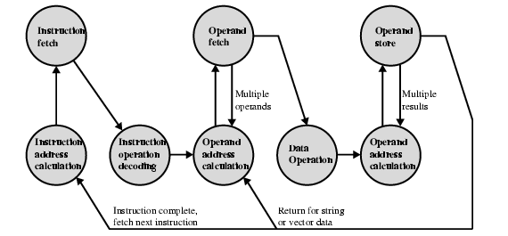
Instruction Cycle State Diagram

Slide 6
Instruction Representation
In machine code each instruction has a unique bit pattern
For human consumption (well, programmers anyway) a symbolic representation is used
  e.g. ADD, SUB, LOAD
Operands can also be represented in this way
  ADD A,B
Notes:
5

Slide 7
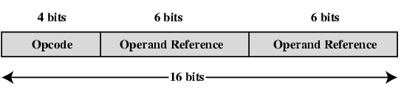
Simple Instruction Format

Slide 8
Instruction Types
Data processing (arithmetic & logic inst.)
Data storage (main memory, memory inst.)
Data movement (I/O inst.)
Program flow control
Notes:
6

Slide 9
Number of Addresses
One of the traditional ways of describing processor architecture is in terms of no. of addresses contained in each inst.
  What is the max no. of addresses one might need in an inst.?
  Arithmetic & logic inst. will require the most operands
  All arithmetic & logical op are either one or two operands, thus we would need a max of 2 addresses to reference operands
  Result of an op must be stored, suggesting a third address, finally, after completion of an inst., next inst. must be fetched & its address is needed (concluding)
  An inst. could possibly be required to contain 4-address references: two op, one result & address of next inst. (in practice 4-address inst. are extremely rare)
Notes:
7

Slide 10
Number of Addresses (a)
3 addresses
  Operand 1, Operand 2, Result
  a = b + c;
  May be a forth - next instruction (usually implicit)
  3-address inst. formats are not common, because they require a relatively long inst. Format to hold three address references
  Needs very long words to hold everything
  Compare (1,2,3 address inst.) to compute
  Y = (A-B) / (C+D*E)
Notes:
7

Slide 11
Number of Addresses (b)
2 addresses
  One address doubles as operand and result
  a = a + b
  Reduces length of instruction
  Requires some extra work
    Temporary storage to hold some results
Notes:
8

Slide 12
Number of Addresses (c)
1 address
  Implicit second address
  Usually a register (accumulator)
  Common on early machines
  e.g., LOAD B (AC ← B), implicit AC address
Notes:
9

Slide 13
Number of Addresses (d)
0 (zero) addresses
  All addresses implicit
  Uses a stack
  e.g. push a
  push b
  add
  pop c
  c = a + b
Notes:
10

Slide 14
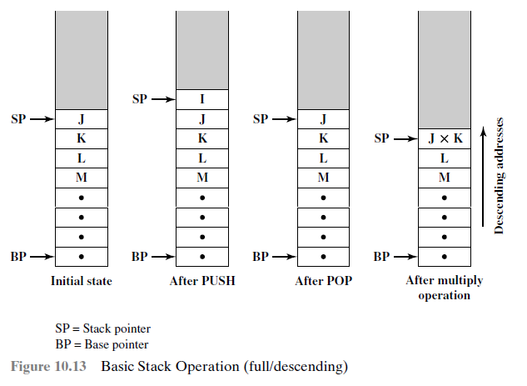
Number of Addresses (d)
0 (zero) addresses
Notes:
10

Slide 15
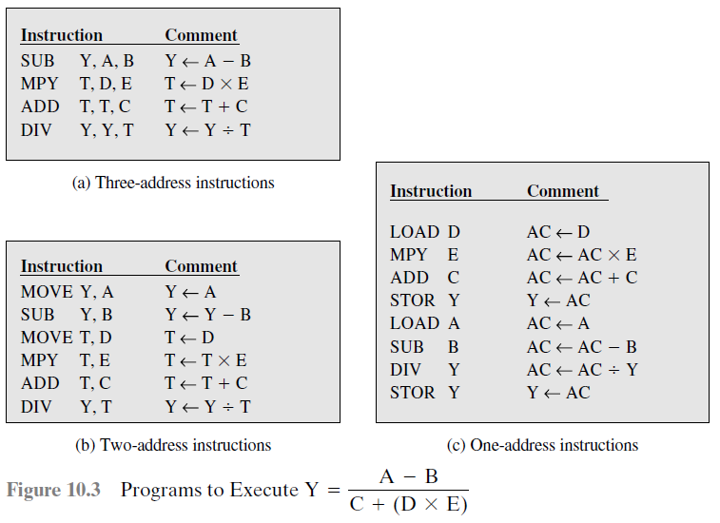
Number of Addresses (Example)
Notes:
10

Slide 16
How Many Addresses
More addresses
  More complex (powerful?) instructions
  More registers
    Inter-register operations are quicker
  Fewer instructions per program
Fewer addresses
  Less complex (powerful?) instructions
  More instructions per program
  Faster fetch/execution of instructions
Notes:
11

Slide 17
How Many Addresses
Compares typical one, two, three addresses instructions:
Programs to Execute e.g.,
Y = (A – B) / (C + D * E)
Notes:
12

Slide 18
Design Decisions (1)
Operation-Wise
  How many ops?
  What can they do?
  How complex are they?
Data types
Instruction formats
  Length of op code field
  Number of addresses
Notes:
12

Slide 19
Design Decisions (2)
Registers
  Number of CPU registers available
  Which operations can be performed on which registers?
Addressing modes (later… ch: 11)
RISC v CISC (later… ch: 13)
Notes:
13

Slide 20
Types of Operand
Addresses
Numbers
  Integer/floating point
Characters
  ASCII etc.
Logical Data
  Bits or flags
(Aside: Is there any difference between numbers and characters? Ask a C programmer!)
Notes:
14

Slide 21
Example- Pentium & Power PC Data Types
8 bit Byte
16 bit word
32 bit double word
64 bit quad word
Addressing is by 8 bit unit
Notes:
15

Slide 22
Types of Operation
Data Transfer
Arithmetic
Logical
Conversion
I/O
System Control
Transfer of Control
Notes:
18

Slide 23
Arithmetic
Add, Subtract, Multiply, Divide
Signed Integer
Floating point ?
May include
  Increment (a++)
  Decrement (a--)
  Negate (-a)
Notes:
20

Slide 24
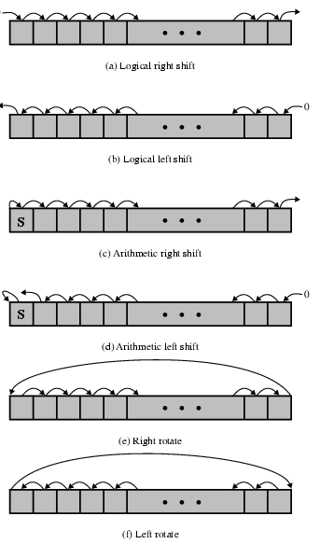
Shift and Rotate Operations

Slide 25
Logical
Bitwise operations
AND, OR, NOT
Notes:
21

Slide 26
Conversion
E.g. Binary to Decimal
Notes:
22

Slide 27
Transfer of Control
Branch
  e.g. branch to x if result is zero
Skip
  e.g. increment and skip if zero
  ISZ Register1
  Branch xxxx
  ADD A
Subroutine call
  c.f. interrupt call
Notes:
25

Slide 28
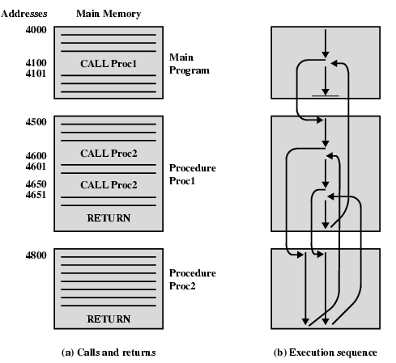
Nested Procedure Calls

Slide 29
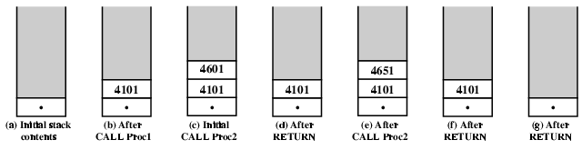
Use of Stack

Slide 30
Exercise For Reader
Find out about instruction set for Pentium and PowerPC
Start with Stallings
Visit web sites

Slide 31
Byte Order
(A portion of chips?)
What order do we read numbers that occupy more than one byte
e.g. (numbers in hex to make it easy to read)
12345678 can be stored in 4x8bit locations as follows
Notes:
27

Slide 32
Byte Order (example)
Address Value (1) Value(2)
184 12 78
185 34 56
186 56 34
186 78 12
i.e. read top down or bottom up?
Notes:
28

Slide 33
Byte Order Names
The problem is called Endian
The system on the left has the least significant byte in the lowest address
This is called big-endian
The system on the right has the least significant byte in the highest address
This is called little-endian
Notes:
29

Slide 34
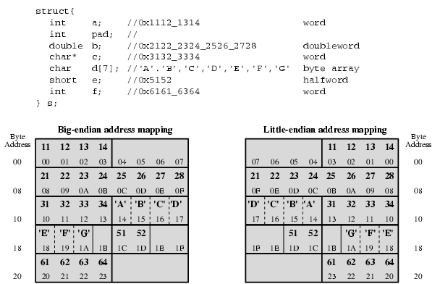
Example of C Data Structure

Slide 35
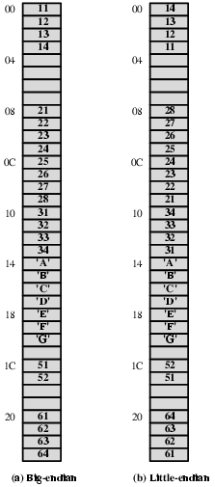
Alternative View of Memory Map

Slide 36
Question…
Assume a stack-oriented processor that includes the stack operations PUSH and POP. Arithmetic operations automatically involve the top one or two stack elements. Begin with an empty stack. What stack elements remain after the following instructions are executed?
PUSH 4
PUSH 7
PUSH 8
ADD
PUSH 10
SUB
MUL
PUSH 9
ADD
Notes:
30

