Slide 1
William Stallings
Computer Organization and Architecture
9th Edition
Chapter 11
Instruction Sets:
Addressing Modes
and Formats

Slide 2
Addressing Modes
This section turns to the question of how to specify the operands and operations of instructions. Two issues arise: First, how is the address of an operand specified, and Second, how are the bits of an instruction organized to define the operand addresses and operation of that instruction?
Address field in a typical ins. format are small
Like to be able to reference a large range of locations (e.g., main memory, virtual memory)
For this, a variety of addressing techniques has been employed
Involve some trade-off b/w address range and/or addressing flexibility, number of memory addresses, complexity of address calculation etc.
Notes:
2

Slide 3
Addressing Modes
Immediate
Direct
Indirect
Register
Register Indirect
Displacement (Indexed)
Stack
Notes:
2

Slide 4
Immediate Addressing
Operand is part of instruction
Operand = address field
e.g. ADD 5
  Add 5 to contents of accumulator
  5 is operand
No memory reference to fetch data
Fast
Limited range
Notes:
3

Slide 5
Immediate Addressing Diagram
Instruction
Opcode
Operand
Notes:
4

Slide 6
Direct Addressing
Address field contains address of operand
Effective address (EA) = address field (A)
e.g. ADD A
  Add contents of cell A to accumulator
  Look in memory at address A for operand
Single memory reference to access data
No additional calculations to work out effective address
Limited address space
Notes:
5

Slide 7
Direct Addressing Diagram
Instruction
Opcode
Address A
Memory
Operand
Notes:
6

Slide 8
Indirect Addressing (1)
Memory cell pointed to by address field contains the address of (pointer to) the operand
EA = ((A))
  Look in A, find address (A) and look there for operand
e.g. ADD (A)
  Add contents of cell pointed to by contents of A to accumulator
Notes:
7

Slide 9
Indirect Addressing (2)
Large address space
2^{n} where n = word length
May be nested, multilevel, cascaded
  e.g. EA = (((A)))
    Draw the diagram yourself
Multiple memory accesses to find operand
Hence slower
Notes:
8

Slide 10
Indirect Addressing Diagram
Instruction
Opcode
Address A
Memory
Pointer to operand
Operand
Notes:
9

Slide 11
Register Addressing (1)
Operand is held in register named in address filed
EA = R
Limited number of registers
Very small address field needed
  Shorter instructions
  Faster instruction fetch
Notes:
10

Slide 12
Register Addressing (2)
No memory access
Very fast execution
Very limited address space
Multiple registers helps performance
  Requires good assembly programming or compiler writing
  N.B. C programming
    register int a;
c.f. Direct addressing
Notes:
11

Slide 13
Register Addressing Diagram
Instruction
Opcode
Register Address R
Registers
Operand
Notes:
12

Slide 14
Register Indirect Addressing
C.f. indirect addressing
EA = (R)
Operand is in memory cell pointed to by contents of register R
Large address space (2^{n})
One fewer memory access than indirect addressing
Notes:
13

Slide 15
Register Indirect Addressing Diagram
Instruction
Opcode
Register Address R
Memory
Registers
Pointer to Operand
Operand
Notes:
14

Slide 16
Displacement Addressing
EA = A + (R)
Address field hold two values
  A = base value
  R = register that holds displacement
  or vice versa
Notes:
15

Slide 17
Displacement Addressing Diagram
Instruction
Opcode
Register R
Address A
Memory
Registers
Pointer to Operand
+
Operand
Notes:
16

Slide 18
Relative Addressing
A version of displacement addressing
R = Program counter, PC
EA = A + (PC)
i.e. get operand from A cells from current location pointed to by PC
c.f locality of reference & cache usage
Notes:
17

Slide 19
Stack Addressing
Operand is (implicitly) on top of stack
e.g.
  ADD Pop top two items from stack and add
Notes:
21

Slide 20
Base-Register Addressing
A holds displacement
R holds pointer to base address
R may be explicit or implicit
e.g. segment registers in 80x86
Notes:
18

Slide 21
Indexed Addressing
A = base
R = displacement
EA = A + R
Good for accessing arrays
  EA = A + R
  R++
Notes:
19

Slide 22
Combinations
Postindex
EA = (A) + (R)
Preindex
EA = (A+(R))
(Draw the diagrams)
Notes:
20

Slide 23
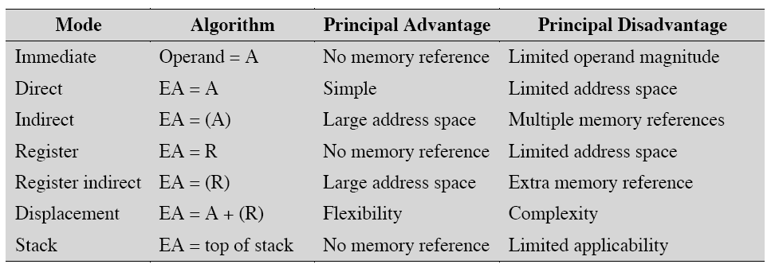
Addressing Mode Summary
Notes:
20

Slide 24
Pentium Addressing Modes
12 addressing modes available
  Immediate
  Register operand
  Displacement
  Base
  Base with displacement
  Scaled index with displacement
  Base with index and displacement
  Base scaled index with displacement
  Relative

Slide 25
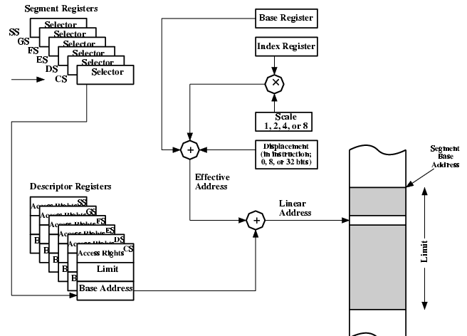
Pentium Addressing Mode Calculation

Slide 26
PowerPC Addressing Modes
Load/store architecture
  Indirect
    Instruction includes 16 bit displacement to be added to base register (may be GP register)
    Can replace base register content with new address
  Indirect indexed
    Instruction references base register and index register (both may be GP)
    EA is sum of contents
Branch address
  Absolute
  Relative
  Indirect
Arithmetic
  Operands in registers or part of instruction
  Floating point is register only

Slide 27
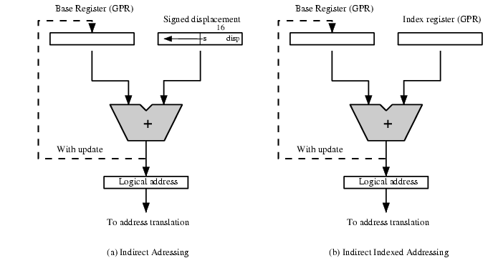
PowerPC Memory Operand
Addressing Modes

Slide 28
Instruction Formats
Layout of bits in an instruction
Includes opcode
Includes (implicit or explicit) operand(s)
Usually more than one instruction format in an instruction set

Slide 29
Instruction Length
Affected by and affects:
  Memory size
  Memory organization
  Bus structure
  CPU complexity
  CPU speed
Trade off between powerful instruction collection and saving space

Slide 30
Allocation of Bits
Number of addressing modes
Number of operands
Register versus memory
Number of register sets
Address range
Address granularity

Slide 31
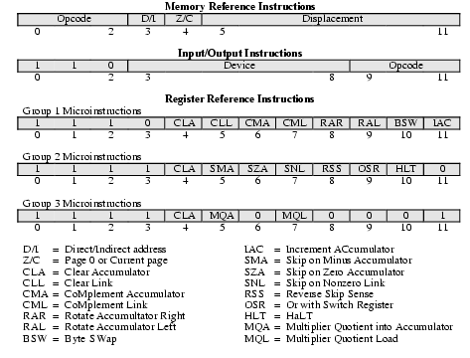
PDP-8 Instruction Format

Slide 32
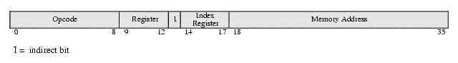
PDP-10 Instruction Format

Slide 33
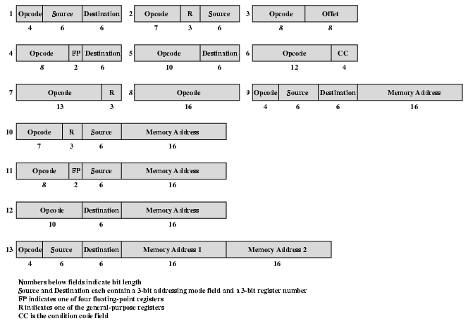
PDP-11 Instruction Format

Slide 34
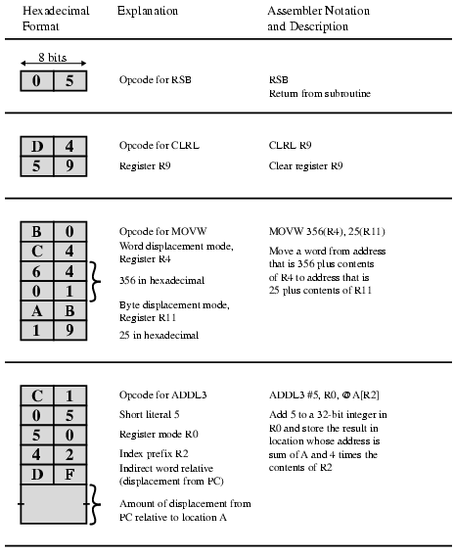
VAX Instruction Examples

Slide 35
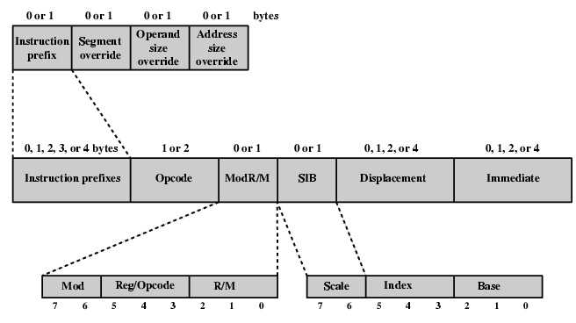
Pentium Instruction Format

Slide 36
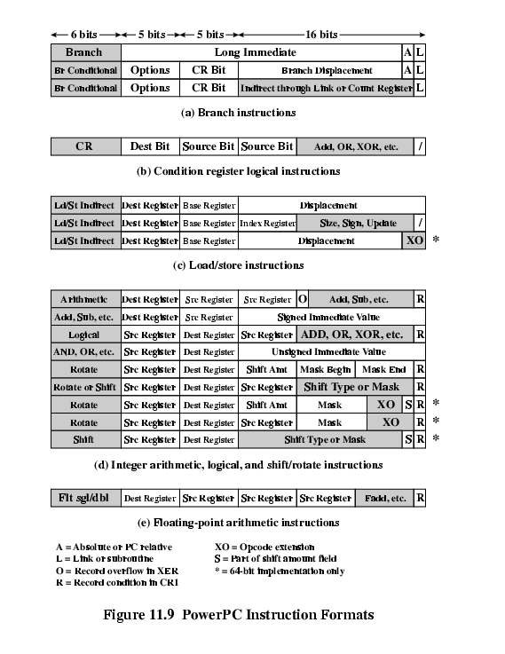
PowerPC Instruction Formats (1)

Slide 37
PowerPC Instruction Formats (2)

Slide 38
Foreground Reading
Stallings chapter 11
Intel and PowerPC Web sites

