Slide 1
William Stallings
Computer Organization and Architecture
10th Edition
Chapter 12
CPU Structure and Function
Instruction Pipelining

Slide 2
CPU Structure
CPU must:
  Fetch instructions
  Interpret instructions
  Fetch data
  Process data
  Write data
Notes:
22

Slide 3
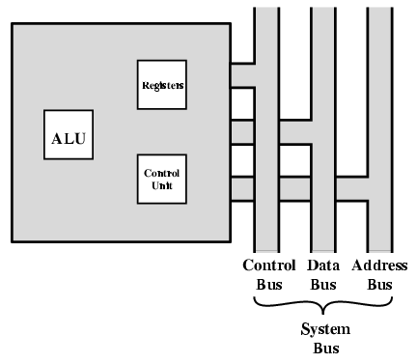
CPU With Systems Bus

Slide 4
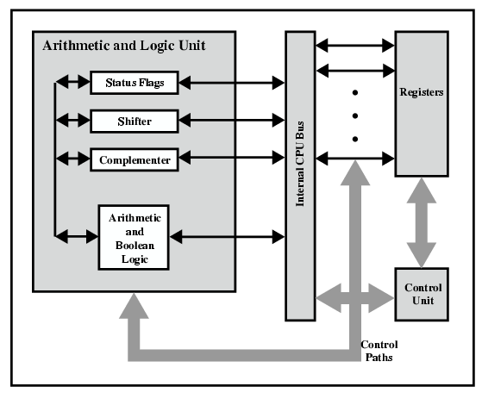
CPU Internal Structure

Slide 5
Registers
CPU must have some working space (temporary storage)
Called registers
Number and function vary between processor designs
One of the major design decisions
Top level of memory hierarchy
Notes:
23

Slide 6
User Visible Registers
General Purpose
Data
Address
Condition Codes
Notes:
24

Slide 7
How Many GP Registers? How big?
Between 8 – 32 GP Registers
Large enough to hold full address
Large enough to hold full word
Often possible to combine two data registers
  C programming
  double int a;
  long int a;
Notes:
28

Slide 8
Condition Code Registers
Sets of individual bits
  e.g. result of last operation was zero
Can be read (implicitly) by programs
  e.g. Jump if zero
Can not (usually) be set by programs
Notes:
29

Slide 9
Control & Status Registers
Program Counter
Instruction Decoding Register
Memory Address Register
Memory Buffer Register
Revision: what do these all do?
Notes:
30

Slide 10
Program Status Word
A set of bits
Includes Condition Codes
Sign of last result
Zero
Carry
Equal
Overflow
Interrupt enable/disable
Supervisor
Notes:
31

Slide 11
Other Registers
May have registers pointing to:
  Process control blocks (see O/S)
  Interrupt Vectors (see O/S)
N.B. CPU design and operating system design are closely linked
Notes:
33

Slide 12

Example Register Organizations

Slide 13
Data Flow (Instruction Fetch)
Depends on CPU design
In general:
Fetch
  PC contains address of next instruction
  Address moved to MAR
  Address placed on address bus
  Control unit requests memory read
  Result placed on data bus, copied to MBR, then to IR
  Meanwhile PC incremented by 1

Slide 14
Data Flow (Data Fetch)
IR is examined
If indirect addressing, indirect cycle is performed
  Right most N bits of MBR transferred to MAR
  Control unit requests memory read
  Result (address of operand) moved to MBR

Slide 15

Data Flow (Fetch Diagram)

Slide 16

Data Flow (Indirect Diagram)

Slide 17
Data Flow (Execute)
May take many forms
Depends on instruction being executed
May include
  Memory read/write
  Input/Output
  Register transfers
  ALU operations

Slide 18
Data Flow (Interrupt)
Simple
Predictable
Current PC saved to allow resumption after interrupt
Contents of PC copied to MBR
Special memory location (e.g. stack pointer) loaded to MAR
MBR written to memory
PC loaded with address of interrupt handling routine
Next instruction (first of interrupt handler) can be fetched

Slide 19

Data Flow (Interrupt Diagram)

Slide 20
Instruction Pipelining
Instruction pipelining is similar to the use of an assembly line in a manufacturing plant. An assembly line takes advantage of the fact that a product goes through various stages of production. By laying the production process out in an assembly line, products at various stages can be worked on simultaneously. This process is also referred to as pipelining,
because, as in a pipeline, new inputs are accepted at one end before previously accepted inputs appear as output at the other end.
Notes:
38

Slide 21

Pipelining- Instruction Cycle State Diagram
To apply this concept to instruction execution: in fact an instruction has a number of stages.
As above fig breaks inst cycle up into 10 tasks, which occur in sequence. Clearly, there should be some opportunity for pipelining.

Slide 22
Instruction Prefetch
As a simple approach, consider subdividing inst processing into two stages: fetch instruction and execute instruction
The pipeline has two independent stages. The first stage fetches an inst and buffers it. When the second stage is free, the first stage passes it the buffered instruction. While the second stage is executing the inst., the first stage takes advantage of any unused memory cycles to fetch and buffer the next inst.
This is called instruction prefetch or fetch overlap.
It should be clear that this process will speed up inst execution. If the fetch and execute stages were of equal duration, the inst cycle time would be halved.
Notes:
36

Slide 23
Instruction Pipelining: Factors Affected
Execution rate is unlikely (varies) for two reasons:
The execution time will generally be longer than the fetch time. Execution will involve reading and storing operands and the performance of some operation. Thus, the fetch stage may have to wait for some time before it can empty its buffer.
A conditional branch inst makes the address of the next inst to be fetched unknown. Thus, the fetch stage must wait until it receives the next inst address from the execute stage. The execute stage may then have to wait while the next inst is fetched.
Notes:
36

Slide 24
Instruction Pipelining Strategy
Guessing can reduce the time loss from the second reason
A simple rule is the following: When a conditional branch inst is passed on from the fetch to the execute stage, the fetch stage fetches the next inst in memory after the branch inst. Then, if the branch is not taken, no time is lost. If the branch is taken, the fetched inst must be discarded and a new inst fetched.
Notes:
36

Slide 25
Instruction Pipelining Strategy
Following are the decomposition of the inst processing
Fetch instruction (FI)
Decode instruction (DI)
Calculate operands (CO)
Fetch operands (FO)
Execute instructions (EI)
Write operand or result (WO)
Notes:
38

Slide 26
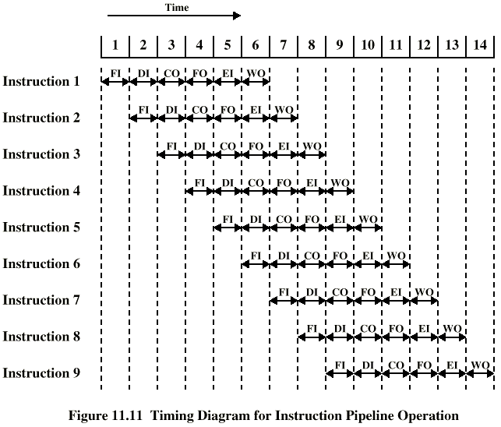
Timing of Pipeline (Example)
The diagram assumes that each inst goes through all six stages of the pipeline.
This will not always the case, e.g. a load inst don’t need the WO stage. Several other factors serve to limit performance enhancement.
If the six stages are not of equal duration, there will be some waiting involved at various pipeline stages.
Another difficulty is conditional branch inst, which can invalidate several instruction fetches.
Figure shows that a six-stage pipeline can reduce the execution time for 9 instructions from 54 time units to 14 time units.
Notes:
39

Slide 27
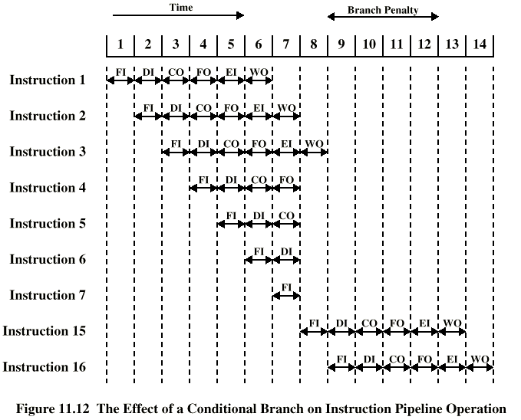
Branch in a Pipeline
Assume that inst 3 is a conditional branch to inst 15.
Until the inst is executed, there is no way of knowing which inst will come next.
Pipeline, in this example simply loads next inst in sequence (inst 4) and proceeds.
In previous example branch is not taken and we get full performance. But here branch is taken.
The pipeline must be cleared of inst that are not useful. During time unit 8, inst 15 enters pipeline.
No inst complete during time unit 9 through 12; (i.e. performance penalty)
Figure shows the effect of a Conditional Branch on inst Pipeline Operation
Notes:
40

Slide 28
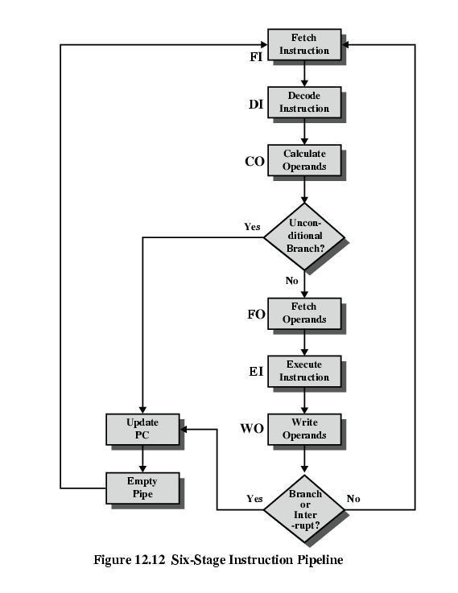
Six Stage
Instruction Pipeline
Figure shows the Six-Stage CPU Instruction Pipeline

Slide 29
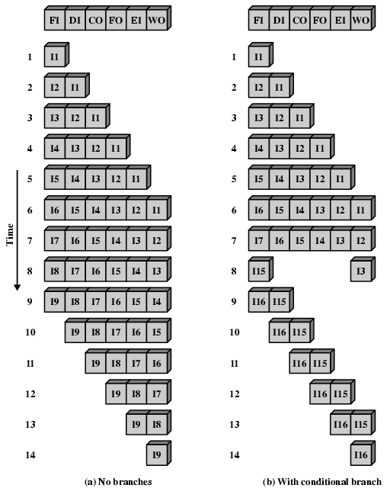
Alternative
Pipeline
Depiction
Fig (a) shows that pipeline is full at time 6, with 6 different inst in various stages of execution, and remains full through time 9. I-9 is the last inst to be executed.
Fig (b) shows that pipeline is full at times 6 and 7.
At time 7, I-3 is in execute stage and execute a branch to I-15. At this point inst I-4 through I-7 are flushed from pipeline, so that at time 8, only two inst are in pipeline, I-3 and I-15.
It appears that greater number of stages in pipeline, faster execution rate.
Inst Pipelining is a power full technique for enhancing performance but requires careful design to achieve optimum results with reasonable complexity.

Slide 30
Pipelining: Improved Performance
But not doubled:
  Fetch usually shorter than execution
    Prefetch more than one instruction?
  Any jump or branch means that prefetched instructions are not the required instructions
Add more stages to improve performance
Notes:
37

Slide 31
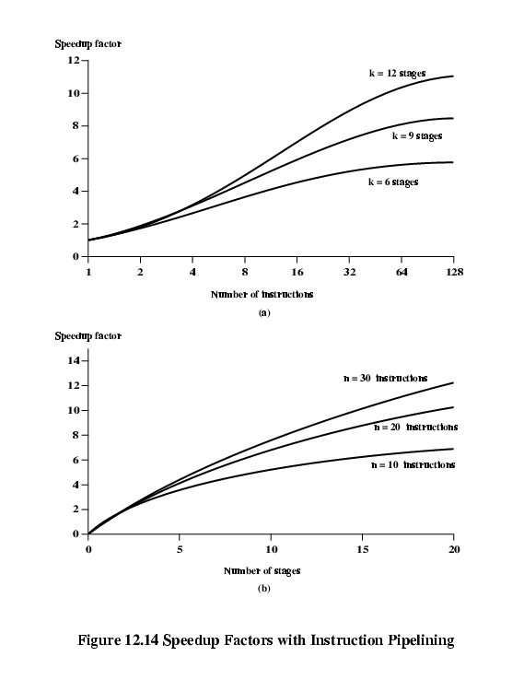
Speedup Factors with Instruction Pipelining

Slide 32
Notes:
41

Slide 33
Dealing with Branches
Multiple Streams
Prefetch Branch Target
Loop buffer
Branch prediction
Delayed branching
Notes:
41

Slide 34
Multiple Streams
Have two pipelines
Prefetch each branch into a separate pipeline
Use appropriate pipeline
Leads to bus & register contention
Multiple branches lead to further pipelines being needed
Notes:
42

Slide 35
Prefetch Branch Target
Target of branch is prefetched in addition to instructions following branch
Keep target until branch is executed
Used by IBM 360/91
Notes:
43

Slide 36
Loop Buffer
Very fast memory
Maintained by fetch stage of pipeline
Check buffer before fetching from memory
Very good for small loops or jumps
c.f. cache
Used by CRAY-1
Notes:
44

Slide 37
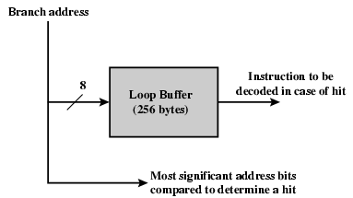
Loop Buffer Diagram

Slide 38
Branch Prediction (1)
Predict never taken
  Assume that jump will not happen
  Always fetch next instruction
  68020 & VAX 11/780
  VAX will not prefetch after branch if a page fault would result (O/S v CPU design)
Predict always taken
  Assume that jump will happen
  Always fetch target instruction
Notes:
45

Slide 39
Branch Prediction (2)
Predict by Opcode
  Some instructions are more likely to result in a jump than thers
  Can get up to 75% success
Taken/Not taken switch
  Based on previous history
  Good for loops
Notes:
46

Slide 40
Branch Prediction (3)
Delayed Branch
  Do not take jump until you have to
  Rearrange instructions
Notes:
47

Slide 41
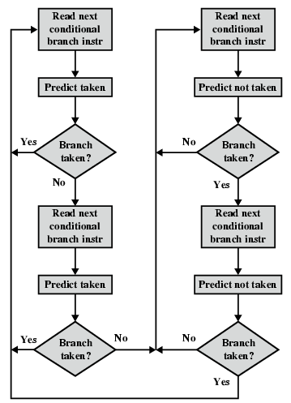
Branch Prediction Flowchart

Slide 42
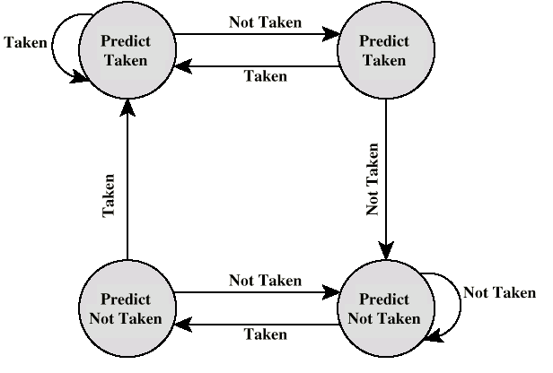
Branch Prediction State Diagram

Slide 43
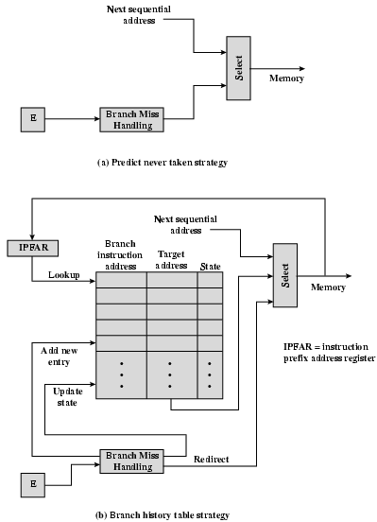
Dealing With
Branches

Slide 44
Intel 80486 Pipelining
Fetch
  From cache or external memory
  Put in one of two 16-byte prefetch buffers
  Fill buffer with new data as soon as old data consumed
  Average 5 instructions fetched per load
  Independent of other stages to keep buffers full
Decode stage 1
  Opcode & address-mode info
  At most first 3 bytes of instruction
  Can direct D2 stage to get rest of instruction
Decode stage 2
  Expand opcode into control signals
  Computation of complex address modes
Execute
  ALU operations, cache access, register update
Writeback
  Update registers & flags
  Results sent to cache & bus interface write buffers

Slide 45
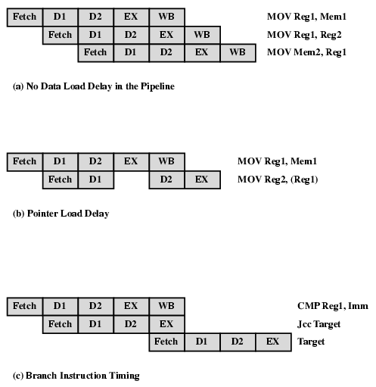
80486 Instruction Pipeline Examples

Slide 46
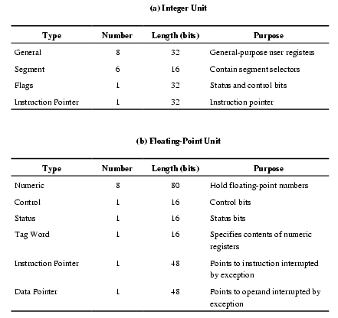
Pentium 4 Registers

Slide 47
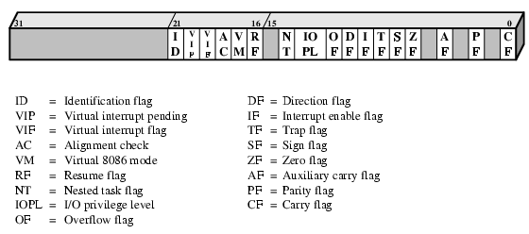
EFLAGS Register

Slide 48
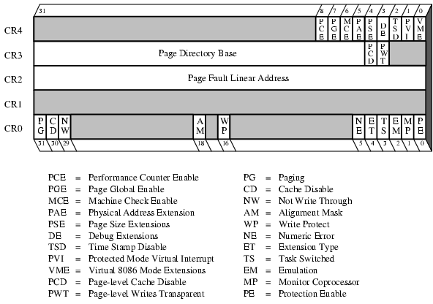
Control Registers

Slide 49
MMX Register Mapping
MMX uses several 64 bit data types
Use 3 bit register address fields
  8 registers
No MMX specific registers
  Aliasing to lower 64 bits of existing floating point registers

Slide 50
Pentium Interrupt Processing
Interrupts
  Maskable
  Nonmaskable
Exceptions
  Processor detected
  Programmed
Interrupt vector table
  Each interrupt type assigned a number
  Index to vector table
  256 * 32 bit interrupt vectors
5 priority classes

Slide 51
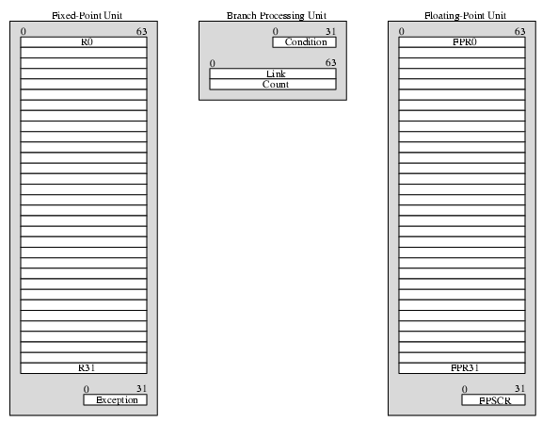
PowerPC User Visible Registers

Slide 52
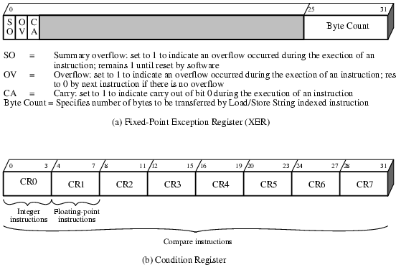
PowerPC Register Formats

Slide 53
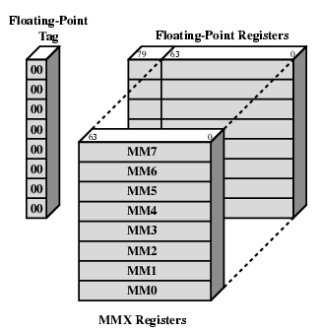
MMX Register Mapping Diagram

Slide 54
Foreground Reading
Processor examples
Stallings Chapter 12
Web pages etc.
Notes:
48

