Slide 1
CRYPTOGRAPHY
Hash Functions

Slide 2
Hash Function
A hash function H is a computationally efficient function that maps fixed binary chains of arbitrary {0,1}* to bit sequences H(M) of fixed length. H(M) is the hash value, hash code or digest of M
In words, Let M be a message of an arbitrary length. A hash function operates on M and returns a fixed length value h as shown in Fig below
The value h is commonly called as hash code. It is also referred to as a message digest or hash value
The main applications of hash functions lie on producing fingerprint of a file, message or other blocks of data
H
M
h = H(M)

Slide 3
Hash Function
Hash functions do not use a particular key, instead, it is highly non-linear function of all message bits. The code changes with the change of any bit or bits in the input messages and thus provide error detection capabilities
Modern hash functions are now designed to produce shorted hash code. Thus instead signing the whole message, it could be more practical to sign HASH CODE of the message
Example:
Let Ana received $500 from Bill, she signed hash code of the message
M1= Ana received $500 from Bill
h1 = H(M1)=89CB0C238A3C7A78D0DD7063C4153B65
Bill can never claim that Ana received $5000 from Bill
M2= Ana received $5000 from Bill
h2= H(M2)=CCD40B907C543D96FDB7203979E55E8B
why?

Slide 4
Hash Function
Alternatively, Bill may try to find another message M3 whose value corresponds to the hash value of message M1, and then claim that Ana actually signed message M3, not M1
If we can find any two messages producing the same message digest, we say, we have found Collision
Collision is not desired characteristics of hash functions but at the same time it is unavoidable

Slide 5
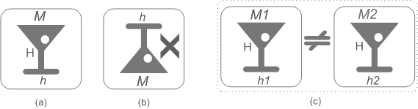
Requirements of a Hash Function
H applies to any block of data
H returns a fixed-length output.
For any given value x, H(x) is relatively easy to compute. That feature makes hash function implementations more practical in both software and hardware (a).
Given x, it is easy to compute H(x). Given h, it is computationally infeasible to find x such that H(x)= h. That is sometimes referred to as one way property of hash function (b)
For any given block x, it is computationally infeasible to find y (y≠x), with H(y)=H(x). This is sometimes referred to as weak collision resistance
To find a pair (x,y) such that H(x)=H(y), is computationally infeasible. This is sometimes referred to as strong collision resistance (c)

Slide 6

A typical Hash Function
First proposed by Merkle and then followed by most hash function designs in use today
A typical hash function is iterative in nature-partition message into sub-blcoks (SBs) of some fixed length m bits and operates sequentially on each SB
The heart of hash function is the so-called compression function F.
A repeated use of function F is made by the hash algorithm
F takes 2 inputs: m-bit block message and n-bit input from previous step, called hash of that message block. The output is n-bit hash h, namely, hj=F(SBj, hj-1)
For first iteration, the value of h0 is provided by the algorithm
The term compression comes from the fact that output hash has a much shorter bit-length n as compared to the message length m

Slide 7
MD5
The series of Message Digest (MD) hash algorithms is due to Rivest
The orignal message digest algorithm was simply called MD
MD was quickly followed by MD2-work of MD3 started
In 1990, Ron Rivest proposed MD4 (128-bit output)
MD4 was also found weak-foundation for MD5 & SHA algorithms
In 1992 Ron Rivest proposed MD5 (128-bit output)
1993 NIST proposed SHA (Secure Hash Algorithm, 160 bits)
1995 NIST proposed SHA1
1996 MD4 was broken
2003 NIST proposed SHA-256,384,512
2006 MD5, SHA0 broken-theoretical attacks on SHA1

Slide 8
1990 | MD4
1991
1992 | MD5
1993 | SHA0
1994
1995 | SHA1
1996
1997
1998
1999
2000
2001
2002
2003 | SHA-256,384,512
2004
2005
2006
MD4 is broken
theoretical attack on SHA0
MD5, SHA0 broken, theoretical attack on SHA1

Slide 9
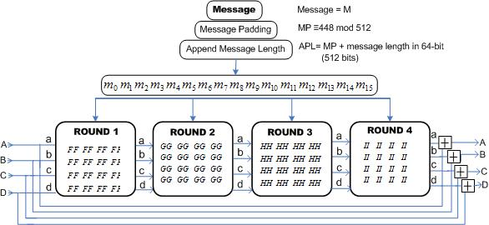
MD5
Operates on 512 input block & Produces 128-bit output. We can discuss MD5 in
the following four groups:
Message Preprocessing
Buffer Initialization
Main Loop
Final Transformation

Slide 10
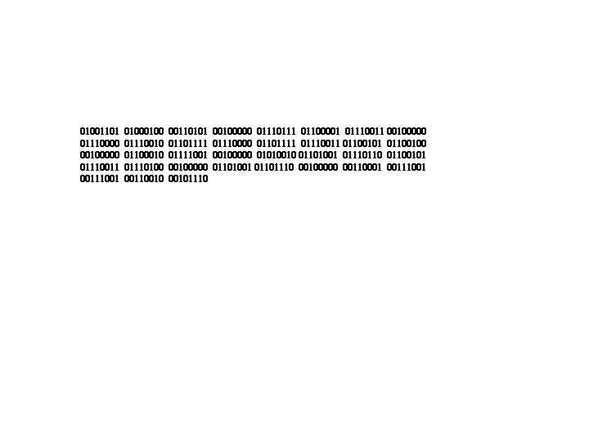
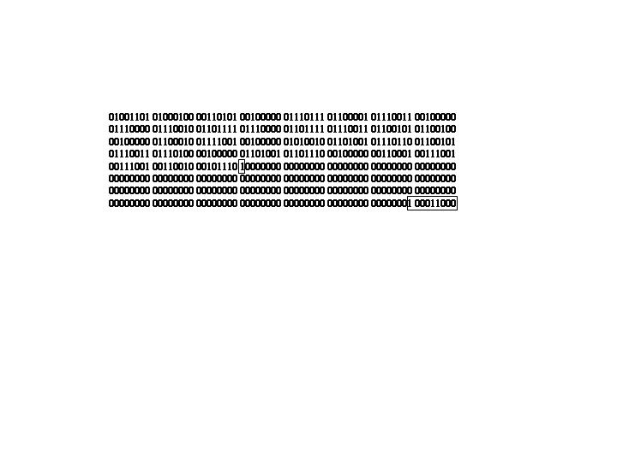
MD5
1. Message Preprocessing
Message is padded such that its length in bits in congruent to 448 mod 512
Message shorter than 448 bits are padded with first bit to ‘1’ and all the rest set to zero
The remaining 64 bits to complete a block of 512 bits are reserved for appending message length
Message : “MD5 was proposed by Ron Rivest in 1992”
Message ASCII representation
Padded Message

Slide 11
MD5
1. Message Preprocessing
Message is grouped into 16 words of 32-bits and presented in little endian format, but note last two 32-bit words for message length!!
Message in Hex
Message little endian format
0x4d443520, 0x2035444d,
0x77617320, 0x20736177,
0x70726f70, 0x706f7270,
0x6f736564, 0x6465736f,
0x20967920, 0x20796220,
0x526f6e20, 0x206e6f52,
0x52697665, 0x65766952,
0x69207473, 0x69207473,
0x6e203139, 0x3931206e,
0x39322e80, 0x802e3239,
0x00000000, 0x00000000,
0x00000000, 0x00000000,
0x00000000, 0x00000000,
0x00000000, 0x00000000,
0x00000000,0x00000138 0x00000138,0x00000000
A little endian format stores the least significant byte to the lowest byte address

Slide 12
MD5
2. MD Buffer Initialization
As compression function takes 2 inputs: message block and output of previous block (hi), what about first block? Initial values are provided by algorithm. A four word buffer a,b,c,d is used for buffer initialization
a = 0x01234567
b = 0x89abcdef
c = 0xfedcba98
d = 0x76543210
a = 0x67452301
b = 0xefcdab89
c = 0x98badcfe
d = 0x10325476
In little endian format

Slide 13
MD5
3. Main Loop
The main loop is composed of four rounds
Each round takes 16 words (32-bit each)
All rounds use an auxiliary function. For four rounds there are four auxiliary functions F, G, H and I for round 1,2,3 and 4 respectively
F(A,B,C) = (A AND B) OR ((NOT A) AND C)
G(A,B,C) = (A AND C) OR ( B AND (NOT C ))
H(A,B,C) = (A XOR B XOR C)
I(A,B,C) = B XOR ( A OR (NOT C ))
All four are non-linear and simple logical functions

Slide 14
MD5
3. Main Loop
Let << S denotes a left circular shift by S bits and let mi represents the ith sub-block (0 to 15) of the message, four operations corresponding to four MD5 rounds are given below:
FF(a,b,c,d, mi,S,K)⇒ a = b + ((a + F(b,c,d)+ mi + Ki)<< S)
GG(a,b,c,d, mi,S,K)⇒ a = b + ((a + G(b,c,d)+ mi + Ki)<< S)
HH(a,b,c,d, mi,S,K)⇒ a = b + ((a + H(b,c,d)+ mi + Ki)<< S)
II(a,b,c,d, mi,S,K)⇒ a = b + ((a + I(b,c,d)+ mi + Ki)<< S)
The values of Ki & S are provided by the algorithm
See for example next slide …….

Slide 15
MD5
3. Main Loop
Function | Output
FF(a, b, c, d, m₀ , 07, 0xd76aa478) | a = 0xbfc20e04
FF(d, a, b, c, m₁ , 12, 0xe8c7b756) | d =0x2445ea9a
FF(c, d, a, b, m₂ , 17, 0x242070db) | c = 0xbada24bf
FF(b, c, d, a, m₃ , 22, 0xc1bdceee) | b = 0xdae8f105
FF(a, b, c, d, m₄ , 07, 0xf57c0faf) | a = 0xd3e2a4f
FF(d, a, b, c, m₅ , 12, 0x4787c62a) | d = 0x618adec1
FF(c, d, a, b, m₆ , 17, 0xa8304613) | c = 0x605da696
FF(b, c, d, a, m₇ , 22, 0xfd469501) | b = 0xb10d4538
FF(a, b, c, d, m₈ , 07, 0x698098d8) | a = 0xf0ce7848
FF(d, a, b, c, m₉ , 12, 0x8b44f7af) | d = 0xadc2ea19
FF(c, d, a, b, m₁₀, 17, 0xffff5bb1) | c = 0x8ca10c71
FF(b, c, d, a, m₁₁, 22, 0x895cd7be) | b = 0xd06eda96
FF(a, b, c, d, m₁₂, 07, 0x6b901122) | a = 0xcfc79c1a
FF(d, a, b, c, m₁₃, 12, 0xfd987193) | d = 0xef0992d6
FF(c, d, a, b, m₁₄, 17, 0xa679438e) | c = 0x419bb7da
FF(b, c, d, a, m₁₅, 22, 0x49b40821) | b = 0xa41613f9
Function | Output
GG(a, b, c, d, m₁ , 05, 0xf61e2562) | a = 0x01816d6a
GG(d, a, b, c, m₆ , 09, 0xc040b340) | d = 0x8d2b14de
GG(c, d, a, b, m₁₁, 14, 0x265e5a51) | c = 0xf0ec903d
GG(b, c, d, a, m₀ , 20, 0xe9b6c7aa) | b = 0xfbb03b00
GG(a, b, c, d, m₅ , 05, 0xd62f105d) | a = 0x3c1fe25e
GG(d, a, b, c, m₁₀, 09, 0x02441453) | d = 0x53c87df3
GG(c, d, a, b, m₁₅, 14, 0xd8a1e681) | c = 0xefcf863a
GG(b, c, d, a, m₄ , 20, 0xe7d3fbc8) | b = 0x7a06c30d
GG(a, b, c, d, m₉ , 05, 0x21e1cde6) | a = 0x00fb73e8
GG(d, a, b, c, m₁₄, 09, 0xc33707d6) | d = 0x968fd037
GG(c, d, a, b, m₃ , 14, 0xf4d50d87) | c = 0x14952739
GG(b, c, d, a, m₈ , 20, 0x455a14ed) | b = 0xcf0e19b2
GG(a, b, c, d, m₁₃, 05, 0xa9e3e905) | a = 0xeec09e98
GG(d, a, b, c, m₂ , 09, 0xfcefa3f8) | d = 0xe0cb123e
GG(c, d, a, b, m₇ , 14, 0x676f02d9) | c = 0xadfb03b9
GG(b, c, d, a, m₁₂, 20, 0x8d2a4c8a) | b = 0x3d9b93ef
Round 1
Round 2

Slide 16
MD5
3. Main Loop
Function | Output
HH(a, b, c, d, m₅ , 04, 0xfffa3942) | a = 0x3ae82d36
HH(d, a, b, c, m₈ , 11, 0x8771f681) | d = 0xf21c9795
HH(c, d, a, b, m₁₁, 16, 0x6d9d6122) | c = 0x8043a89c
HH(b, c, d, a, m₁₄, 23, 0xfde5380c) | b = 0x3985c48b
HH(a, b, c, d, m₁ , 04, 0xa4beea44) | a = 0xf8dd0bbf
HH(d, a, b, c, m₄ , 11, 0x4bdecfa9) | d = 0x7a6540bb
HH(c, d, a, b, m₇ , 06, 0xf6bb4b60) | c = 0x7263dc17
HH(b, c, d, a, m₁₀, 23, 0xbebfbc70) | b = 0x79d86ca3
HH(a, b, c, d, m₁₃, 04, 0x289b7ec6) | a = 0xaf5015ec
HH(d, a, b, c, m₀ , 11, 0xeaa127fa) | d = 0xe9e2e73d
HH(c, d, a, b, m₃ , 16, 0xd4ef3085) | c = 0x860d260
HH(b, c, d, a, m₆ , 23, 0x4881d05) | b = 0xddfa26e9
HH(a, b, c, d, m₉ , 04, 0xd9d4d039) | a = 0x3aace80d
HH(d, a, b, c, m₁₂, 11, 0xe6db99e5) | d = 0xdf9a1e0c
HH(c, d, a, b, m₁₅, 16, 0x1fa27cf8) | c = 0xffda7edc
HH(b, c, d, a, m₂ , 23, 0xc4ac5665) | b = 0x4d718018
Function | Output
II(a, b, c, d, m₀ , 06, 0xf4292244) | a = 0xbc2cf190
II(d, a, b, c, m₇ , 10, 0x432aff97) | d = 0xc43bf785
II(c, d, a, b, m₁₄, 15, 0xab9423a7) | c = 0x9d557285
II(b, c, d, a, m₅ , 21, 0xfc93a039) | b = 0xbf063e88
II(a, b, c, d, m₁₂, 06, 0x655b59c3) | a = 0xc5ec3319
II(d, a, b, c, m₃ , 10, 0x8f0ccc92) | d = 0x20d2175b
II(c, d, a, b, m₁₀, 15, 0xffeff47d) | c = 0xc6863889
II(b, c, d, a, m₁ , 21, 0x85845dd1) | b = 0xf70ea106
II(a, b, c, d, m₈ , 06, 0x6fa87e4f) | a = 0x12f76270
II(d, a, b, c, m₁₅, 10, 0xfe2ce6e0) | d = 0xd40a121f
II(c, d, a, b, m₆ , 15, 0xa3014314) | c = 0xe4c960a4
II(b, c, d, a, m₁₃, 21, 0x4e0811a1) | b = 0x2fb93bf8
II(a, b, c, d, m₄ , 06, 0xf7537e82) | a = 0xadf1d7b5
II(d, a, b, c, m₁₁, 10, 0xbd3af235) | d = 0xfd93443b
II(c, d, a, b, m₂ , 15, 0x2ad7d2bb) | c = 0x5a402c56
II(b, c, d, a, m₉ , 21, 0xeb86d391) | b = 0x9f2895cb
Round 3
Round 4

Slide 17
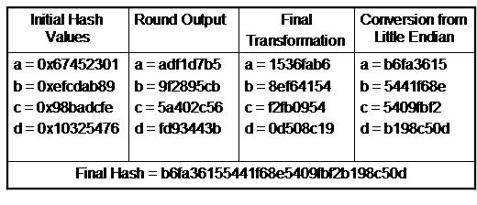
MD5
4. Final Transformation
The last step consists on adding the initial and final hash values. Hence addition is a simple integer addition modulo 2³² and not an XOR operation
The words are converted back from little endian
Finally words are concatenated

