Slide 1
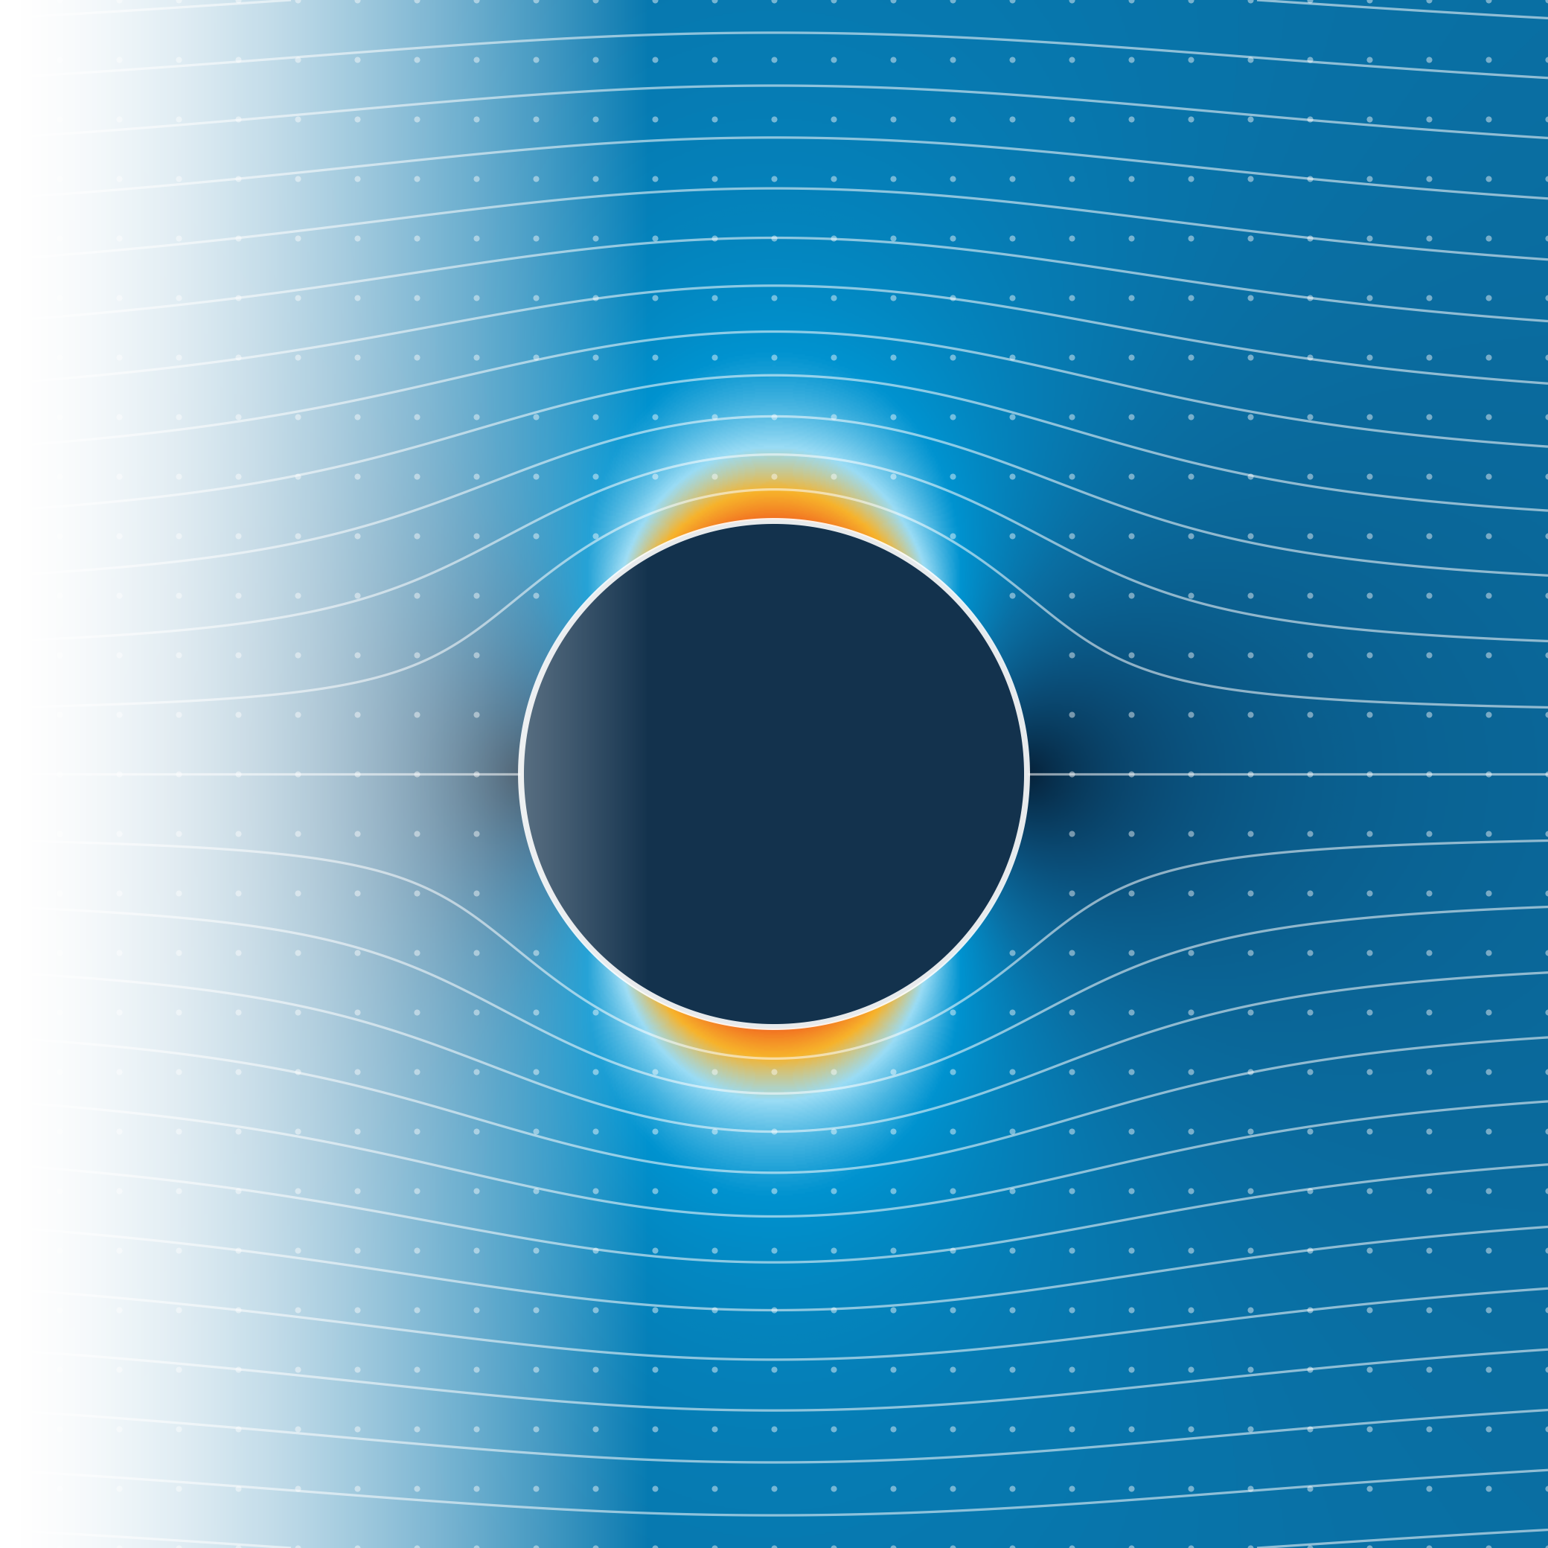





COMSOL Multiphysics
Workshop
KAUST AIChE STUDENT CHAPTER · WORKSHOP
From CFD fundamentals to hands-on simulation
Thursday, 29 October 2026
1:00 – 3:00 PM
B9-L2 Room 2223
Presented by Muhammed Ikbal
Notes:
Welcome everyone to the COMSOL Multiphysics workshop of the KAUST AIChE Student Chapter.
Today has two halves. In the first hour we build the foundations: what CFD is, the 7 pillars every CFD analysis rests on, and the finite difference method, which we will use to solve a real problem by hand. In the second hour we open COMSOL and build the same problems step by step.
Everything we use today comes from the open simple_CFD repository, so you can repeat it all at home.

Slide 2


Two hours, two parts
TODAY · 1:00 – 3:00 PM
PART 1 · 1:00 – 2:00
PART 2 · 2:00 – 3:00
CFD & FDM fundamentals
Hands-on COMSOL
1
What is CFD?
1
Problem 1 · Pin fin
ingredients, equations, why numerical methods
1D steady heat transfer
2
The 7 pillars of CFD
2
Problem 2 · Phosphorus diffusion
the full workflow, with a running example
1D time-dependent transport
3
Problem 1 by hand
3
Problem 3 · Square plate
the finite difference method with a calculator
2D conduction and a mesh study
… and more problems from the repo if time allows
Notes:
Plan for the afternoon. Part 1 (one hour) is the theory: what CFD is, the 7 pillars, and one complete worked example with the finite difference method (FDM), done by hand.
Part 2 (one hour) is hands-on: we start with Problem 1 in COMSOL, the same pin fin we solved by hand, so you can compare the two methods directly. Then we go as far as time allows: Problem 2 adds time dependence, Problem 3 goes to 2D.

Slide 3





Everything is in our repository
COURSE MATERIAL
Every problem folder contains
Problem statement
Step-by-step solution
FDM notebook
Whiteboard guide
COMSOL model
PDF
PDF
plain Python
solved by hand
.mph + guide
7 problems, from 1D conduction to the Navier–Stokes equations
github.com/maryamomer2004/simple_CFD
1
2
3
4
5
6
7
Scan to open the repo: PDFs, notebooks and COMSOL models
Pin fin
Diffusion
Plate
Brick column
Conv.–diff.
Cavity flow
Natural conv.
1D · steady
1D · unsteady
2D · Laplace
2D · Robin BC
1D · Péclet
2D · Navier–Stokes
2D · buoyancy
orange = today's hands-on
Notes:
All material is in the simple_CFD repository: scan the QR code now.
Every problem folder has the same structure: a problem statement, a step-by-step solution, a Jupyter notebook with the complete FDM solver in plain Python (no hidden library calls), a whiteboard guide that solves the problem by hand, and for Problems 1 to 6 a COMSOL model with a step-by-step student guide with screenshots.
The 7 problems go from a 1D steady fin all the way to natural convection with the Navier–Stokes equations. Today we do Problems 1 to 3 in COMSOL.

Slide 4
Introduction to CFD & the Finite Difference Method
PART 1 · 1:00 – 2:00 PM
What CFD is · the 7 pillars · Problem 1 solved by hand
Notes:
Part 1, about one hour. We go from the question 'what is CFD?' to the 7 pillars of every CFD analysis, and finish by solving Problem 1 completely by hand with the finite difference method.

Slide 5





It starts with a physical problem
WHAT IS CFD?
Something happens in the real world, and we want to predict it.
Air over a wing
Heat in an engine
Blood in an artery
Smoke from a chimney
lift and drag
hot spots and cooling
pressure and wall stress
where the pollution goes
Computational Fluid Dynamics = predicting flow and heat transfer by solving their equations on a computer
Notes:
Every CFD study starts with a physical problem, not with a computer. Air flowing over a wing, heat spreading through an engine block, blood pumping through an artery, smoke rising from a chimney.
In each case we want to predict something: the lift, the hottest spot, the wall stress, where the pollution goes. CFD is the set of tools that lets us make that prediction with a computer.

Slide 6



Every problem has three ingredients
WHAT IS CFD?
Geometry
Physics
Math model
Where?
What happens?
How to describe it?
A volume of space, the control volume, bounded by walls, inlets and outlets.
The event inside that volume: flow, heat transfer, mixing, reactions …
Conservation laws (mass, momentum, energy) as PDEs, plus boundary & initial conditions.
+
+
IN THE EXAMPLE
IN THE EXAMPLE
IN THE EXAMPLE
the inside of a duct with a cylinder in it
air flows in, speeds up around the cylinder and flows out
Navier–Stokes, or simply ∇²ψ = 0
Notes:
Every such problem has three ingredients.
Geometry answers WHERE: a defined region of space, the control volume, bounded by walls, inlets and outlets. Physics answers WHAT happens inside that volume. The mathematical model answers HOW we describe it: conservation of mass, momentum and energy written as partial differential equations, plus boundary and initial conditions.
In the example on the next slide: a duct with a cylinder, air speeding up around it, described by Navier–Stokes or, in the simplest model, the Laplace equation for the stream function.

Slide 7
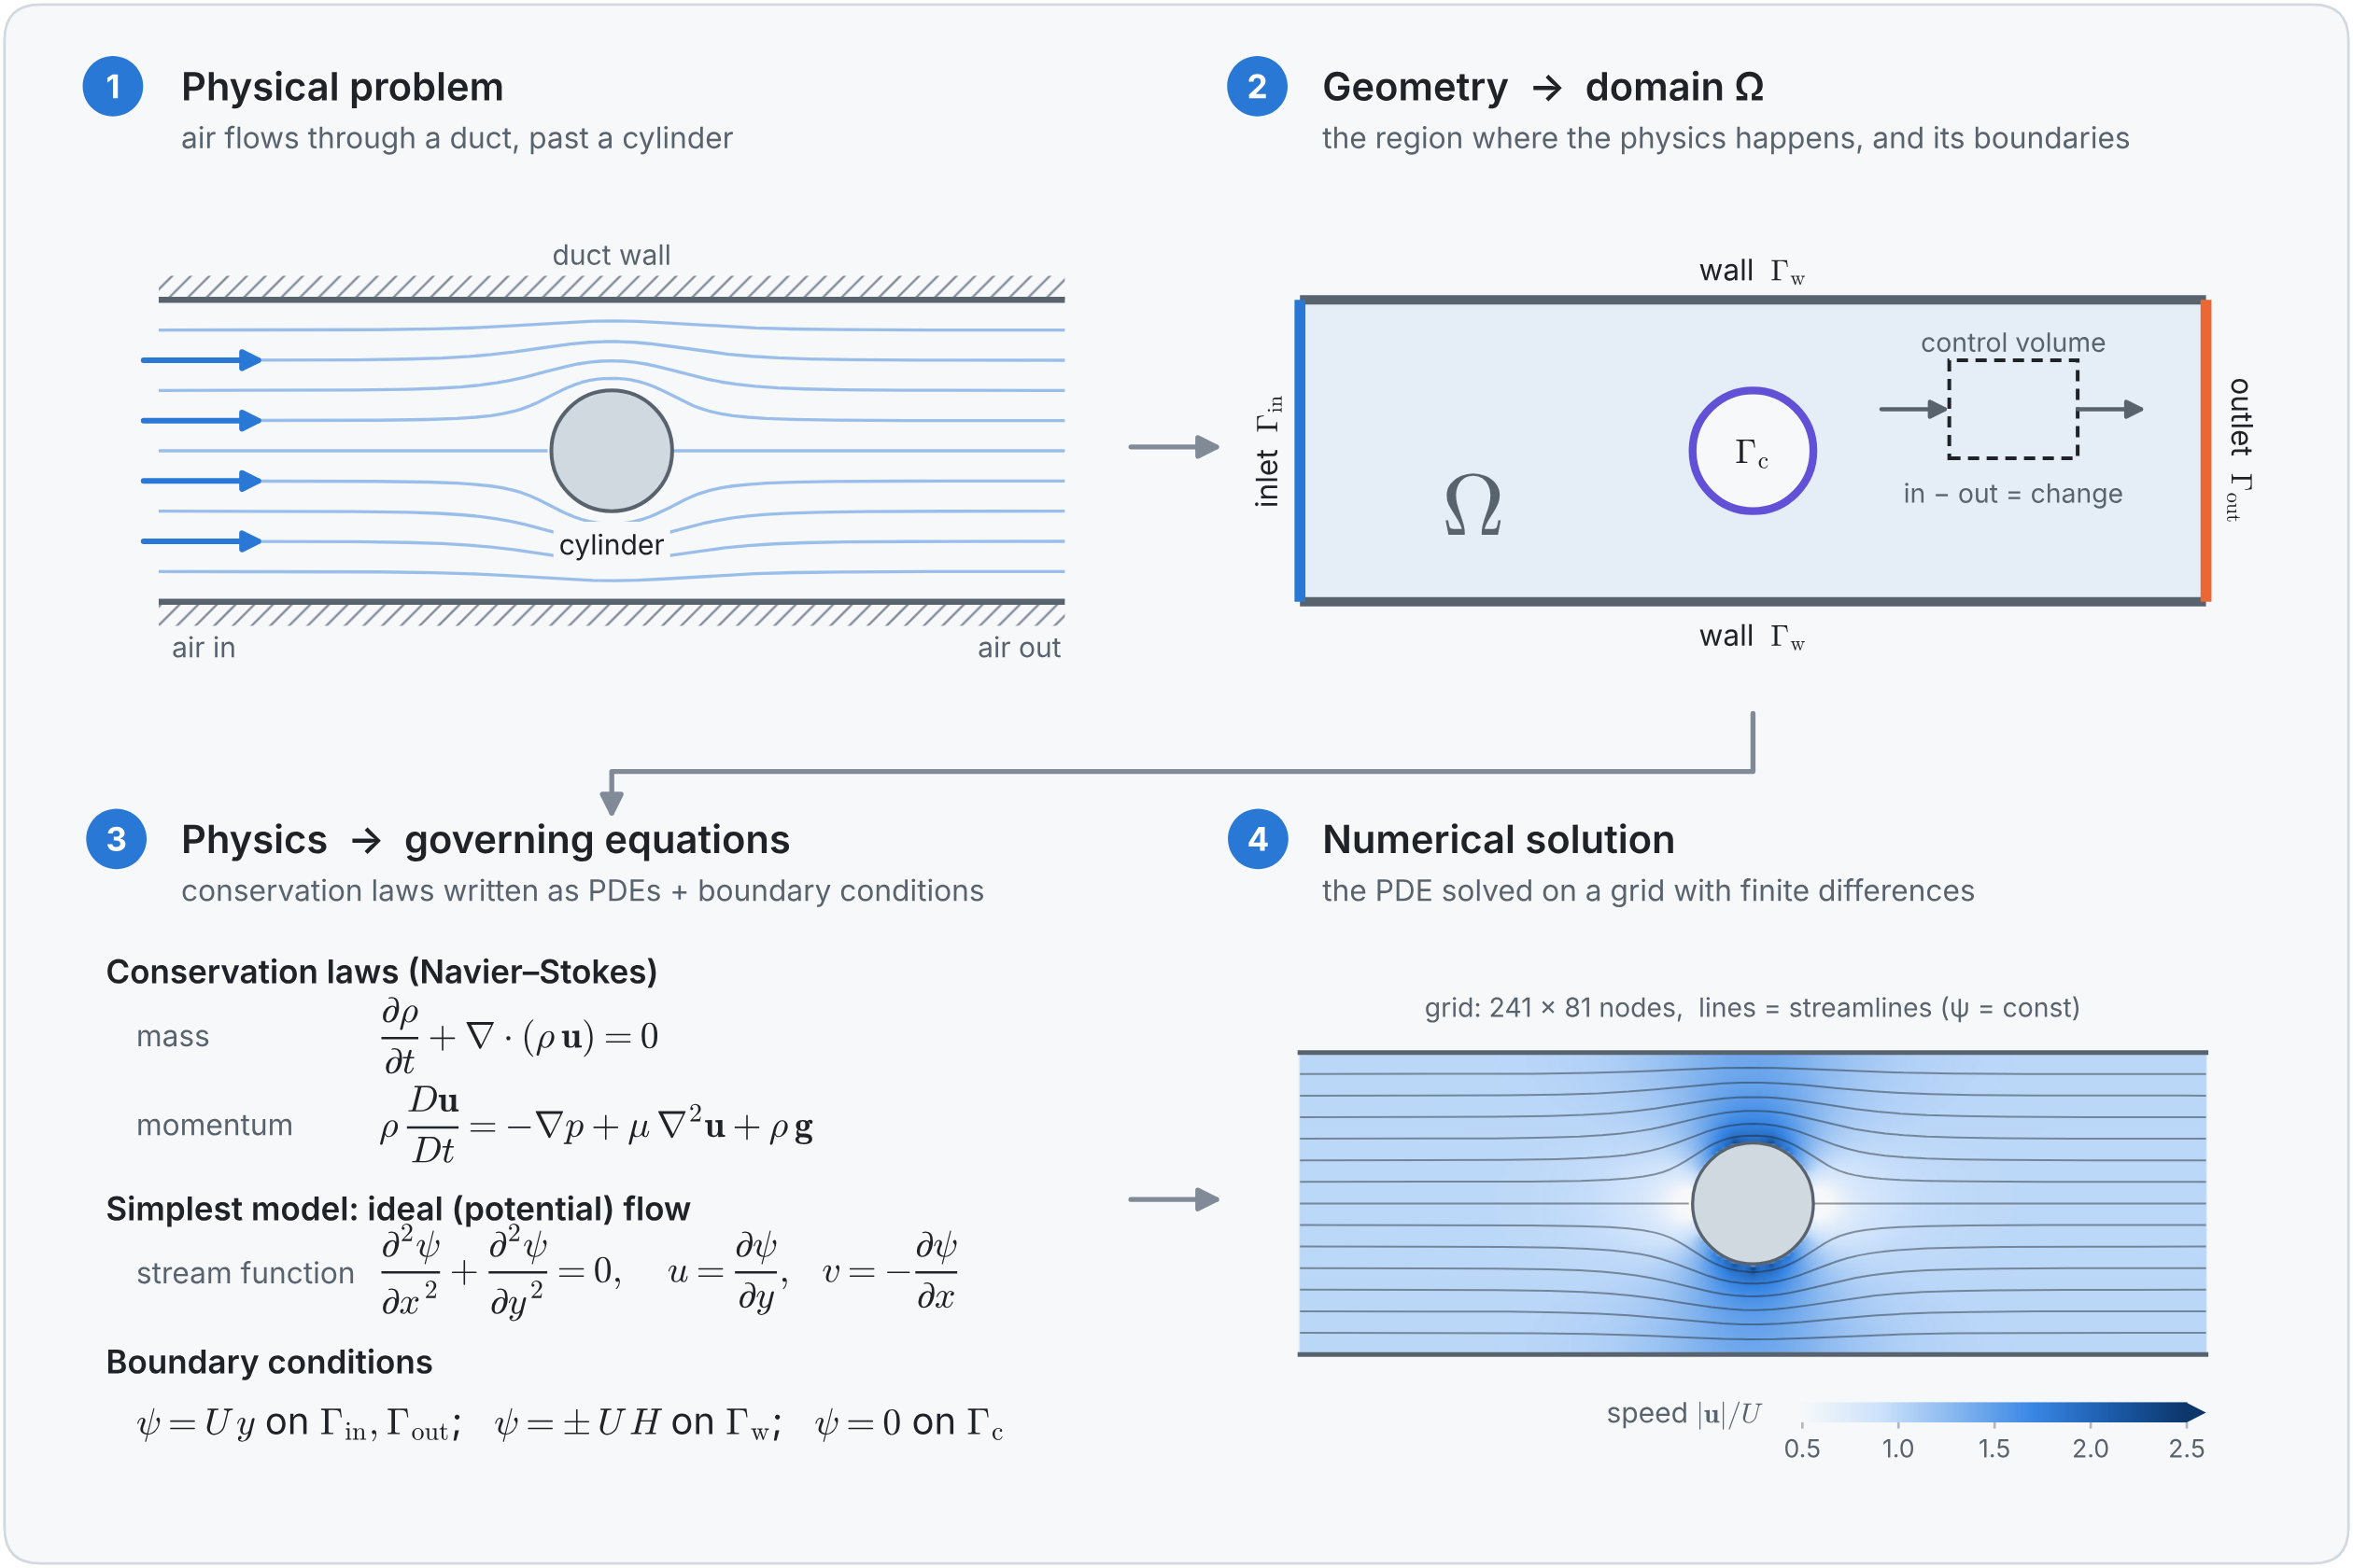

From a physical problem to numbers
WHAT IS CFD?
CFD IN ONE SENTENCE
We take a geometry in which a physical event happens, describe it with equations (PDEs) and, because they can almost never be solved by hand, solve them approximately, with numerical methods, on a computer.
Notes:
This figure from the repo shows the whole chain on one example. (1) The physical problem: air through a duct past a cylinder. (2) The geometry becomes a computational domain Omega with inlet, outlet, walls and the cylinder boundary. (3) The physics becomes governing equations: Navier–Stokes, or in the simplest ideal-flow model the Laplace equation for the stream function, with boundary conditions. (4) The numerical solution: the PDE solved on a 241 x 81 grid with finite differences, giving streamlines and speed.
CFD in one sentence: read the box on the right.

Slide 8



Analytical vs numerical solutions
WHY NUMERICAL METHODS?
Analytical
Numerical (CFD)
Geometry
simple: plates, pipes, spheres
arbitrary: cars, aircraft, arteries
Equations
linear, heavily simplified
nonlinear, coupled, 3D, unsteady
Result
a formula, valid everywhere
numbers at a finite set of grid points
Accuracy
exact (for the chosen model)
approximate: error shrinks as the grid is refined
Cost
pen and paper
computer time and memory
Analytical solutions are still precious: they are how we check a CFD code.
Notes:
The equations of fluid flow and heat transfer have exact solutions only in very simple situations, like a flat plate, a straight pipe or a sphere, and usually only after strong simplifications. Real problems combine complicated geometry with nonlinear coupled equations, and no formula exists.
Numerical methods trade the exact solution, known at every point, for an approximate one known at a finite number of points, which a computer can calculate. The error shrinks as we refine the grid.
But analytical solutions remain very important: wherever one exists, we use it to check our code. We will do exactly that with Problem 1.

Slide 9
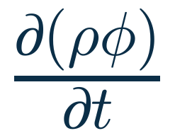

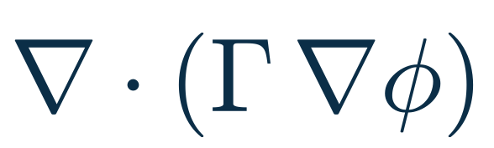




One equation, many physics
THE GOVERNING EQUATIONS
Most CFD equations are special cases of one generic transport equation for a quantity φ:
+
=
+
rate of change
convection: carried by the flow
diffusion: spreading
source
Choose φ =
φ = 1
φ = u, v, w
φ = T
φ = c
mass · continuity
momentum · Navier–Stokes
energy · heat transfer
a species · mixing, pollution
Notes:
Here is a powerful idea: almost every governing equation in CFD has the same structure. The rate of change of a quantity phi, plus convection (phi carried by the flow), equals diffusion (phi spreading out) plus a source.
Choose phi = 1 and you get conservation of mass. Choose the velocity components and you get momentum, the Navier–Stokes equations. Choose temperature and you get energy. Choose a concentration and you get species transport.
So if we learn how to discretize these four terms, we can handle a whole family of problems. Today we meet diffusion (Problems 1–3) and, in the take-home problems, convection.

Slide 10









Every CFD analysis rests on 7 pillars
THE 7 PILLARS OF CFD
PRE-PROCESSING
SOLVING
POST
1 · Geometry
4 · Numerical scheme
model the domain
PDE → algebraic equations
2 · Grid
5 · Solution setup
7 · Visualize
Physical problem
divide it into small pieces
algorithm, Δt, tolerance
plots, insight and verification
geometry + physics
3 · Physics
6 · Compute
choose the governing equations
run the program
Notes:
Whatever the problem and whatever the software, every CFD analysis rests on the same seven pillars, grouped into pre-processing, solving and post-processing.
Pre-processing: 1 geometry, 2 grid, 3 physics. Solving: 4 the numerical scheme that turns the PDE into algebraic equations, 5 the solution setup (which algorithm, time step, tolerance), 6 the computation itself. Post-processing: 7 visualize and verify.
Keep this diagram in mind: in Part 2 we will see that the COMSOL Model Builder tree follows exactly the same pillars.

Slide 11



Heating a rod: our running example
RUNNING EXAMPLE
At t = 0 the whole rod is at 20 °C. Then its left end is suddenly heated to 100 °C, while the right end stays at 20 °C.
100 °C
x = 0
colours: the temperature at some time t > 0
x = L
20 °C
How does the temperature inside the rod change with time?
We will follow this rod through all 7 pillars:
1
2
3
4
5
6
7
Geometry
Grid
Physics
Scheme
Setup
Compute
Visualize
Notes:
To make the pillars concrete, we follow one small problem through all seven: a thin metal rod starts at 20 °C, then its left end is suddenly heated to 100 °C while its right end is kept at 20 °C.
Question: how does the temperature inside the rod change with time? Ask the class to sketch what they expect: the heat creeps in from the left and, after a long time, the profile becomes a straight line between 100 and 20 °C.

Slide 12




Geometry: model the domain
PILLAR 1 · PRE-PROCESSING
Define where the physics happens: the domain Ω and its boundaries. The art is smart simplification:
1D, 2D or 3D?
Dimension
Symmetry
1D
Heat conduction along a thin rod
Can 3D become 2D, or even 1D? Each dimension removed cuts the cost enormously.
Symmetric geometry and physics: model only half, or a quarter.
a line, 0 ≤ x ≤ L
2D
Flow around a long cylinder, a heated plate
Defeaturing
Extent
a plane region
3D
Flow around a car
Remove bolts, fillets and logos that do not change the result.
Put inlets and outlets far enough away not to disturb the region of interest.
a volume
Rod: long and thin, so T varies only along its length → a 1D domain 0 ≤ x ≤ L, hot end at x = 0, cold end at x = L.
Notes:
Pillar 1: geometry. First define precisely where the physics happens, the computational domain and its boundaries. Good geometry modelling is mostly about smart simplification: reduce the dimension (3D to 2D to 1D), exploit symmetry, remove small features that do not matter, and place inlets and outlets far enough away.
In this course the geometries are simple enough to type in directly. Real projects use CAD tools like FreeCAD, SolidWorks or Gmsh.
Rod: the rod is long and thin, so its temperature varies only along its length. The domain is 1D, 0 ≤ x ≤ L, with one boundary at each end.

Slide 13
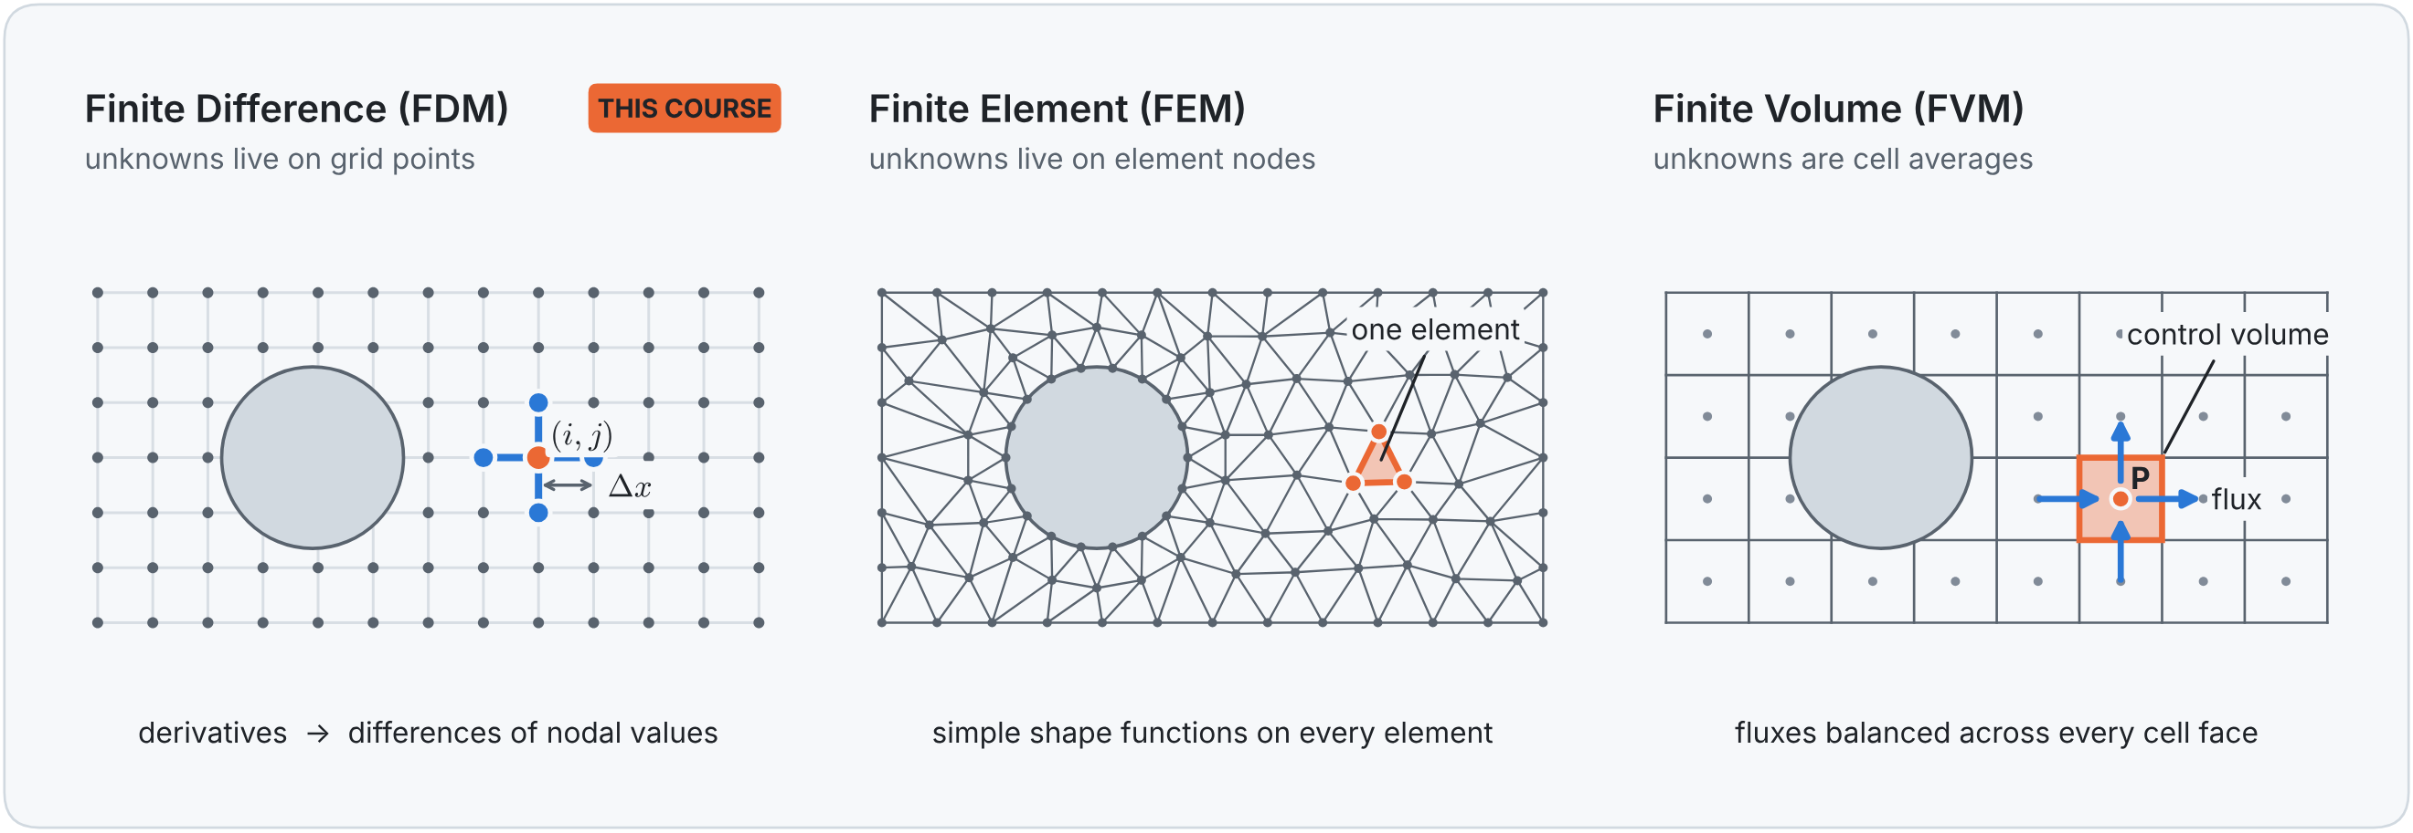




Grid: divide the domain into pieces
PILLAR 2 · PRE-PROCESSING
Node: where an unknown lives, index i or (i, j)
Grid spacing: Δx, Δy between neighbouring nodes
Structured / unstructured: rows & columns, or any shape
Grid independence: refine until the answer stops changing
Rod: N + 1 equally spaced nodes, x_{i} = iΔx with Δx = L/N. With N = 20, the whole rod is just 21 temperatures.
Notes:
Pillar 2: grid generation. A computer cannot store a value at the infinitely many points of a continuous domain, so we replace the domain with a finite number of small pieces, a grid or mesh, and compute the unknowns only there.
Three families of methods differ in what the pieces are: FDM stores unknowns at grid points; FEM uses elements, here triangles that follow the curved boundary; FVM uses cells and balances the fluxes through their faces.
Vocabulary: node, grid spacing, structured versus unstructured, and grid independence: refine until the answer stops changing.
Rod: N+1 equally spaced nodes; with N = 20 the whole rod is represented by 21 temperatures.

Slide 14

Three families of numerical methods
PILLAR 2 · NUMERICAL METHODS
Finite Difference (FDM)
Finite Element (FEM)
Finite Volume (FVM)
THIS COURSE · PART 1
COMSOL · PART 2
FLUENT · OPENFOAM
UNKNOWNS AT
UNKNOWNS AT
UNKNOWNS AT
grid points (nodes)
element nodes
cell centres (cell averages)
EQUATIONS IN
EQUATIONS IN
EQUATIONS IN
differential form
weak (weighted-integral) form
integral (conservation) form
KEY IDEA
KEY IDEA
KEY IDEA
derivatives → differences (Taylor)
simple functions on every element
balance fluxes through cell faces
STRENGTHS
STRENGTHS
STRENGTHS
simple, intuitive, easy to code
complex geometries, rigorous theory
conserves mass, momentum, energy
TYPICAL USE
SOFTWARE
SOFTWARE
teaching and research codes
COMSOL, Abaqus, FEniCS
Fluent, OpenFOAM, STAR-CCM+
We learn with FDM: the most direct translation of calculus into code. Grids, discretization, stability and convergence carry straight over to FEM and FVM.
Notes:
A closer look at the three families. FDM stores unknowns at grid points and replaces derivatives by differences using Taylor series: simple and intuitive, so it is the best way to learn. FEM approximates the solution by simple functions on each element and handles complex geometries: this is what COMSOL uses, so in Part 2 we will be using finite elements. FVM balances the fluxes through the faces of each cell and conserves mass, momentum and energy exactly, which is why most industrial CFD codes (Fluent, OpenFOAM) use it.
The core ideas we learn today with FDM carry straight over to the other two.

Slide 15
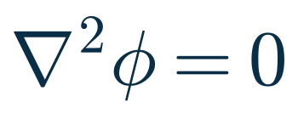

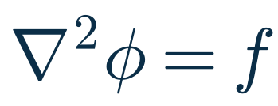

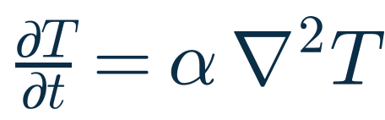
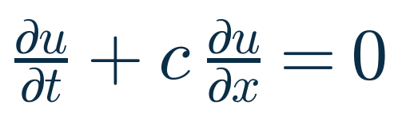

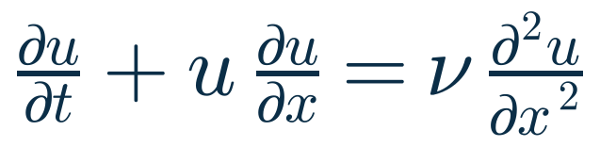
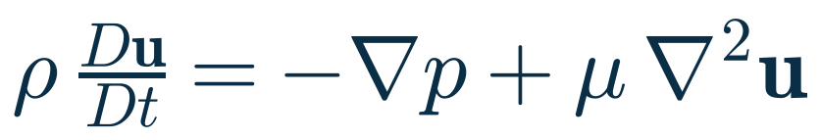
Physics: choose the governing equations
PILLAR 3 · PRE-PROCESSING
Ask yourself
MODEL EQUATION
FORM
TYPE
Steady or unsteady?
Laplace
elliptic
steady conduction, ideal flow
Compressible or incompressible?
Poisson
elliptic
heat sources, pressure equation
Viscous? Laminar or turbulent?
Heat / diffusion
parabolic
unsteady conduction, diffusion
Does heat transfer matter?
Linear advection
hyperbolic
a quantity carried by a flow
Buoyancy, reactions, phases?
Burgers
mixed
a 1D “toy” Navier–Stokes
Navier–Stokes
mixed
Every “yes” adds terms or equations; every justified “no” makes the problem simpler.
general viscous fluid flow
Elliptic: every point influences every other · Parabolic: marches in time while smoothing · Hyperbolic: carried along directions at finite speed
Notes:
Pillar 3: physics. Decide which physics matters and write down its equations. Ask: steady or unsteady? compressible? viscous, laminar or turbulent? does heat transfer matter? any buoyancy, reactions or several phases? Every yes adds terms; every justified no simplifies.
The table shows the classic model equations of CFD. Their type tells us how information travels and therefore which numerical method fits. Elliptic problems (Laplace, Poisson): every point influences every other point, so the whole domain is solved at once. Parabolic (heat equation): march forward in time while smoothing out. Hyperbolic (advection): information travels along particular directions at finite speed.
Today's problems: the fin and the plate are elliptic, phosphorus diffusion is parabolic.

Slide 16


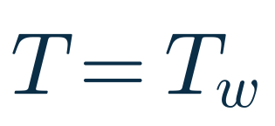
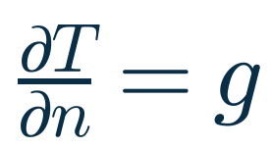
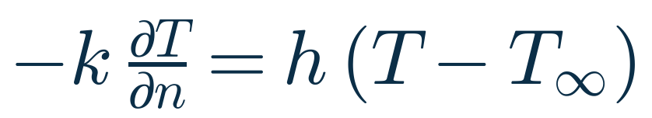
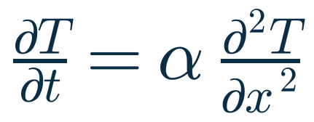
Boundary & initial conditions
PILLAR 3 · PRE-PROCESSING
A PDE alone has infinitely many solutions. Boundary conditions (and, if unsteady, initial conditions) pick the one that matches your problem.
Dirichlet
Neumann
Robin (mixed)
prescribes the value
prescribes the gradient
a combination of both
e.g. a wall held at a fixed temperature, a known inlet velocity
e.g. an insulated wall (∂T/∂n = 0), a symmetry plane
e.g. a surface cooled by the surrounding air
Rod: the 1D heat equation
α = k/(ρc_{p}): thermal diffusivity
Notes:
A PDE alone has infinitely many solutions; the boundary conditions, and for unsteady problems the initial conditions, select the one that matches the physical problem.
Dirichlet prescribes the value, for example a wall at fixed temperature. Neumann prescribes the gradient, for example an insulated wall where the heat flux and so dT/dn is zero, or a symmetry plane. Robin mixes both: the heat conducted to the surface equals the heat convected away, h (T − T∞).
Rod: pure conduction with constant properties gives the 1D heat equation, with two Dirichlet conditions (100 °C left, 20 °C right) and the initial condition 20 °C everywhere.

Slide 17
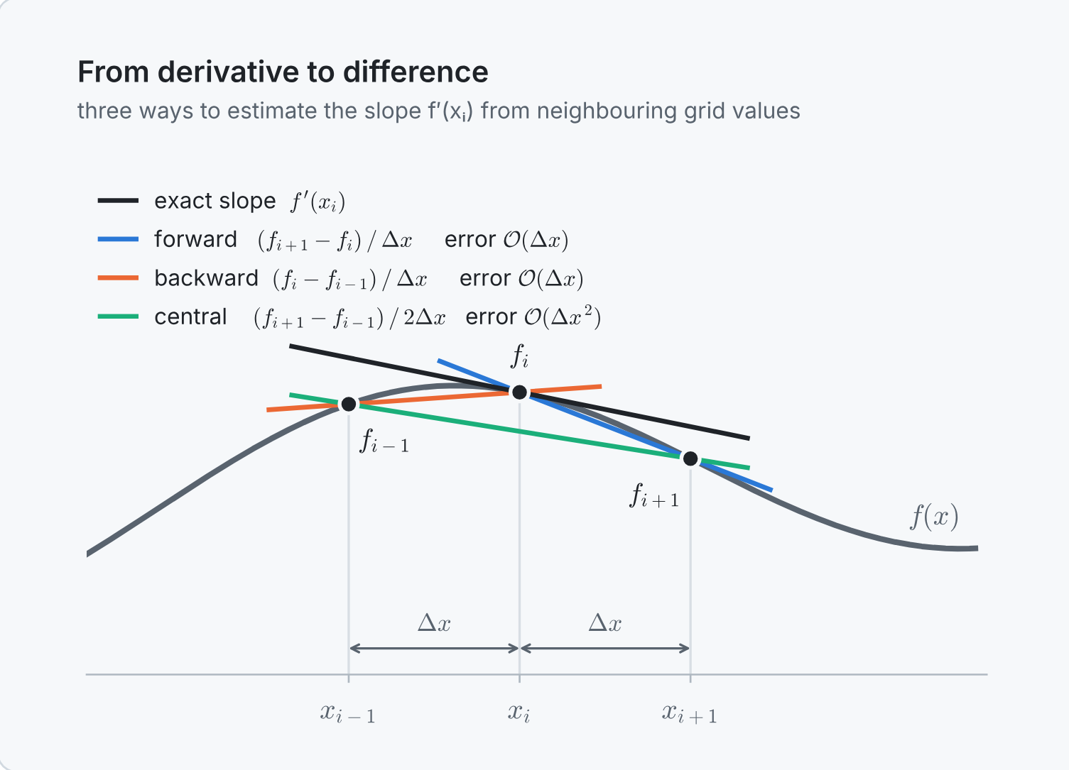
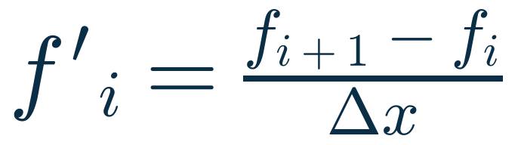
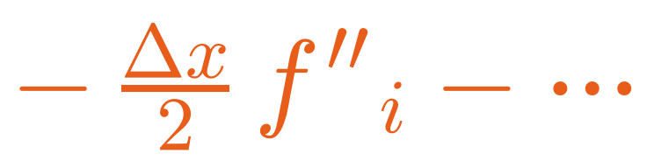
Numerical scheme: derivatives → differences
PILLAR 4 · SOLVING
1 · TAYLOR SERIES AROUND x_{i}
2 · SOLVE FOR f′_{i}: THE FORWARD DIFFERENCE
truncation error, O(Δx)
The terms we throw away are the truncation error. The power of Δx in its leading term is the order of accuracy p.
Three ways to estimate the slope from neighbouring grid values. The central difference is closest to the exact tangent.
Notes:
Pillar 4 is the heart of the finite difference method. A derivative is the limit of a difference quotient as the spacing goes to zero. On a grid the spacing cannot go to zero, so we simply keep the difference.
The Taylor series tells us exactly how good that approximation is. Solve it for the first derivative: we get the forward difference plus the terms we throw away, the truncation error. Its leading term is proportional to Δx, so this formula is first-order accurate.
On the right: the exact tangent (black) and the three difference estimates. The central difference (green) is almost parallel to the exact tangent: it is second order.

Slide 18
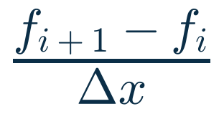
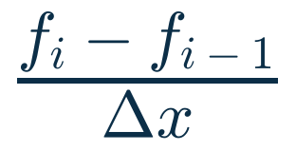
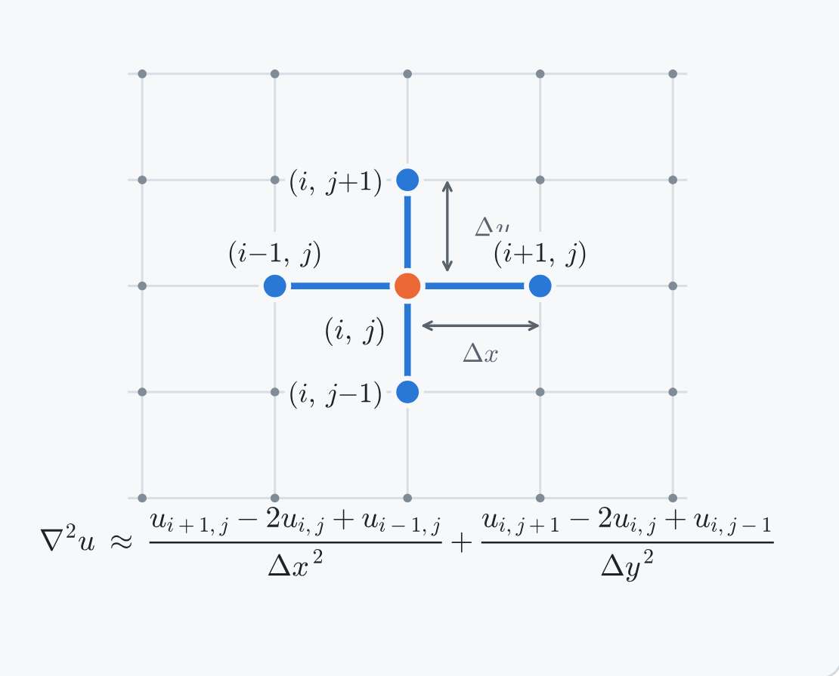
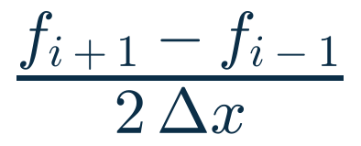
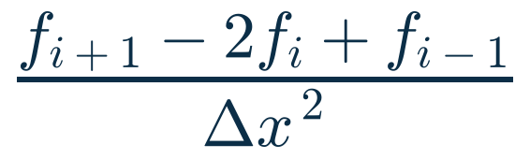

The finite difference toolbox
PILLAR 4 · SOLVING
÷4
Halve Δx and a 2nd-order error falls 4×; a 1st-order error only 2×. In general, error ∝ Δx^{p}.
f′_{i} · forward
1st order
f′_{i} · backward
1st order
In 2D, the five-point stencil links node (i, j) to its four neighbours.
f′_{i} · central
2nd order
f″_{i} · central
2nd order
Write one formula at every node → the PDE becomes a set of algebraic equations, each linking a node to its neighbours.
Notes:
The finite difference toolbox. Forward and backward differences for the first derivative are first order. The central difference uses both neighbours and is second order. The second derivative, the one we need for diffusion and conduction, also has a second-order central formula: (f(i+1) − 2 f(i) + f(i−1)) / Δx².
Order p means the error behaves like Δx^p: halving the grid spacing divides the error of a 2nd-order scheme by 4. Remember this factor 4: we will see it by hand in Problem 1.
In 2D, the Laplacian uses the five-point stencil, which we will meet in Problem 3. Writing such a formula at every node replaces the PDE with a set of algebraic equations.

Slide 19
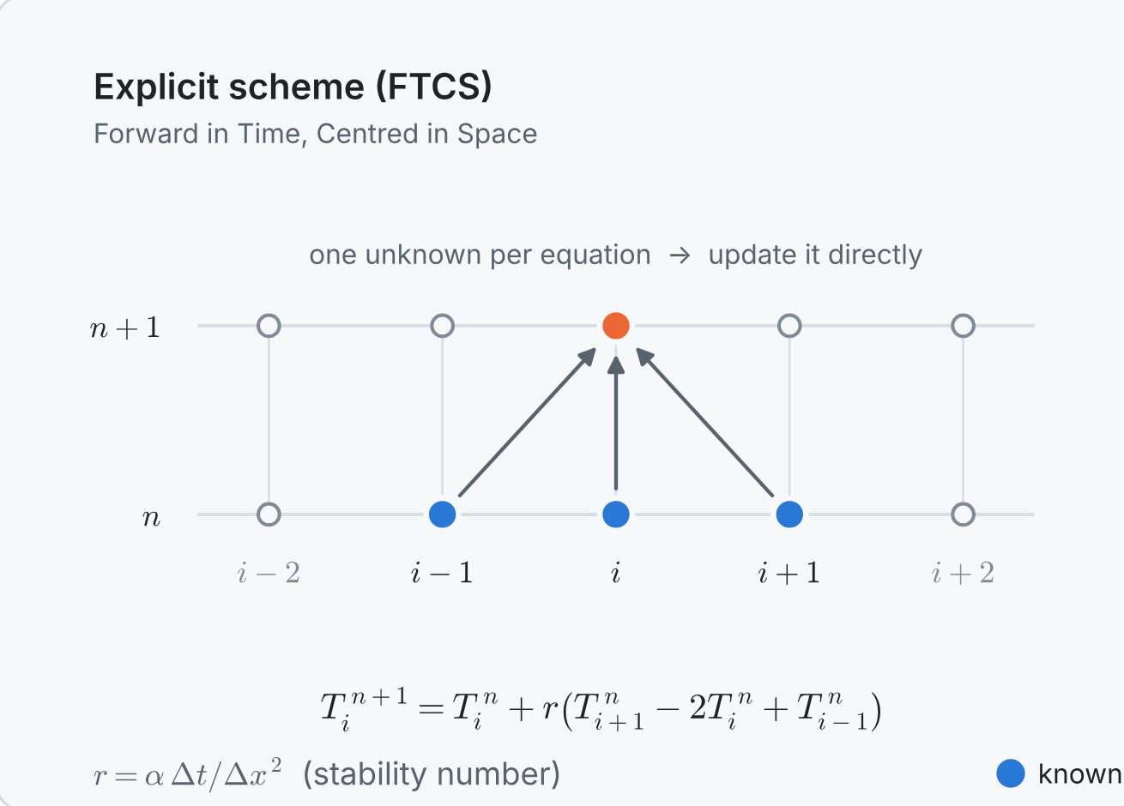
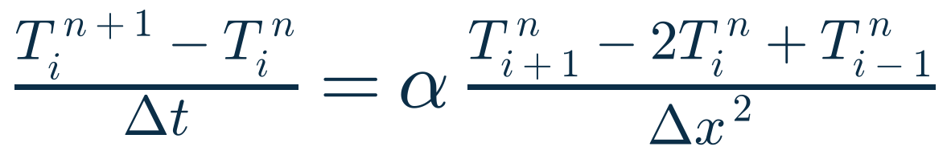
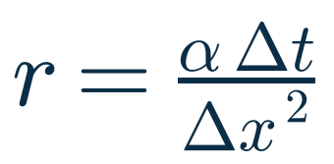

The rod becomes plain arithmetic
PILLAR 4 · RUNNING EXAMPLE
FORWARD IN TIME + CENTRED IN SPACE = FTCS
the stability number (Pillar 5)
No calculus left: each new temperature = old value + r × (sum of neighbour differences).
3 known values at time level n → 1 new value at n + 1: every node is updated directly.
Notes:
Back to the rod. Use a forward difference in time, with time step Δt and time level n, and a central difference in space. This is the FTCS scheme: Forward in Time, Centred in Space.
Rearranged, the new temperature at node i is the old one plus r times the difference of its neighbours, with r = α Δt / Δx². The PDE has become plain arithmetic: three known values at time n give one new value at n+1.
Keep r in mind: it controls the stability of the scheme, which is the topic of the next pillar.

Slide 20
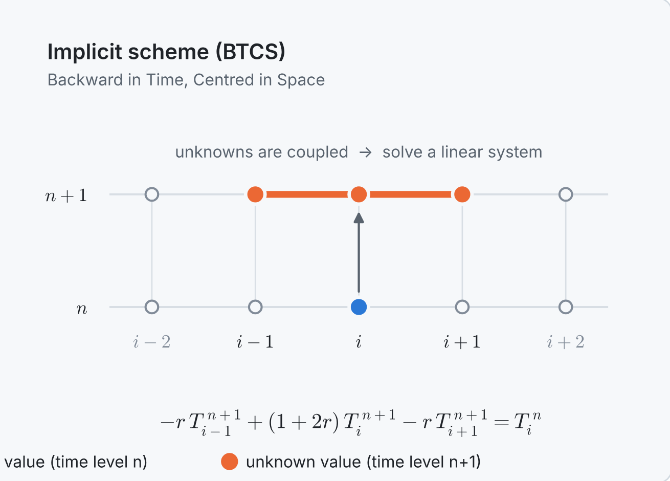




Solution setup ①: explicit or implicit?
PILLAR 5 · SOLVING
new values from old values only
new values from old values and each other
tiny work per step: just arithmetic
solve a linear system every step
a few lines of code
needs a matrix solver
Δt limited by stability (r ≤ ½)
any Δt is stable: choose it for accuracy
Notes:
Once you have the algebraic equations, there are many ways to solve them. Three decisions come up in almost every problem; the first one is explicit or implicit.
Explicit (FTCS): the new values come directly from old values. Tiny work per step, a few lines of code, but the time step is limited by stability: r ≤ 1/2 for FTCS.
Implicit (BTCS, Crank–Nicolson): the unknowns at the new time level are coupled, so every step needs the solution of a linear system. More work per step, but any Δt is stable, so you choose it for accuracy only.
COMSOL uses implicit time stepping, as we will see in Problem 2.

Slide 21
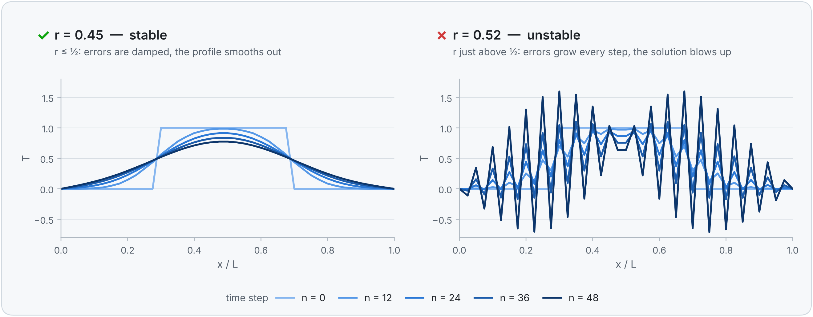
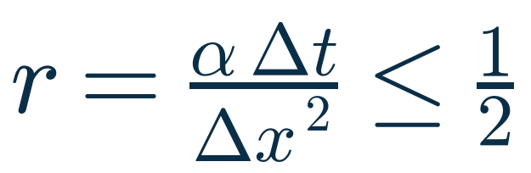
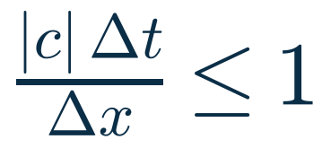
Solution setup ②: is the scheme stable?
PILLAR 5 · SOLVING
FTCS · DIFFUSION
EXPLICIT CONVECTION · CFL
Consistency
+
Stability
=
Convergence
Lax equivalence theorem: a scheme approaches the true solution as Δx, Δt → 0 only if it is consistent and stable. Exceed the stability limit by a few percent and the solution explodes (right plot).
Notes:
Second decision: is the scheme stable? A scheme is stable if small errors (round-off, sharp jumps in the initial data) die out instead of growing.
Left plot: FTCS with r = 0.45 smooths a top-hat profile, as diffusion should. Right plot: r = 0.52, just 4 % above the limit, and a saw-tooth oscillation grows with every step until the solution explodes.
The stability conditions: r ≤ 1/2 for FTCS, and for explicit convection schemes the CFL condition, |c| Δt / Δx ≤ 1.
The Lax equivalence theorem: consistency plus stability equals convergence. Always check your scheme's stability condition.

Slide 22
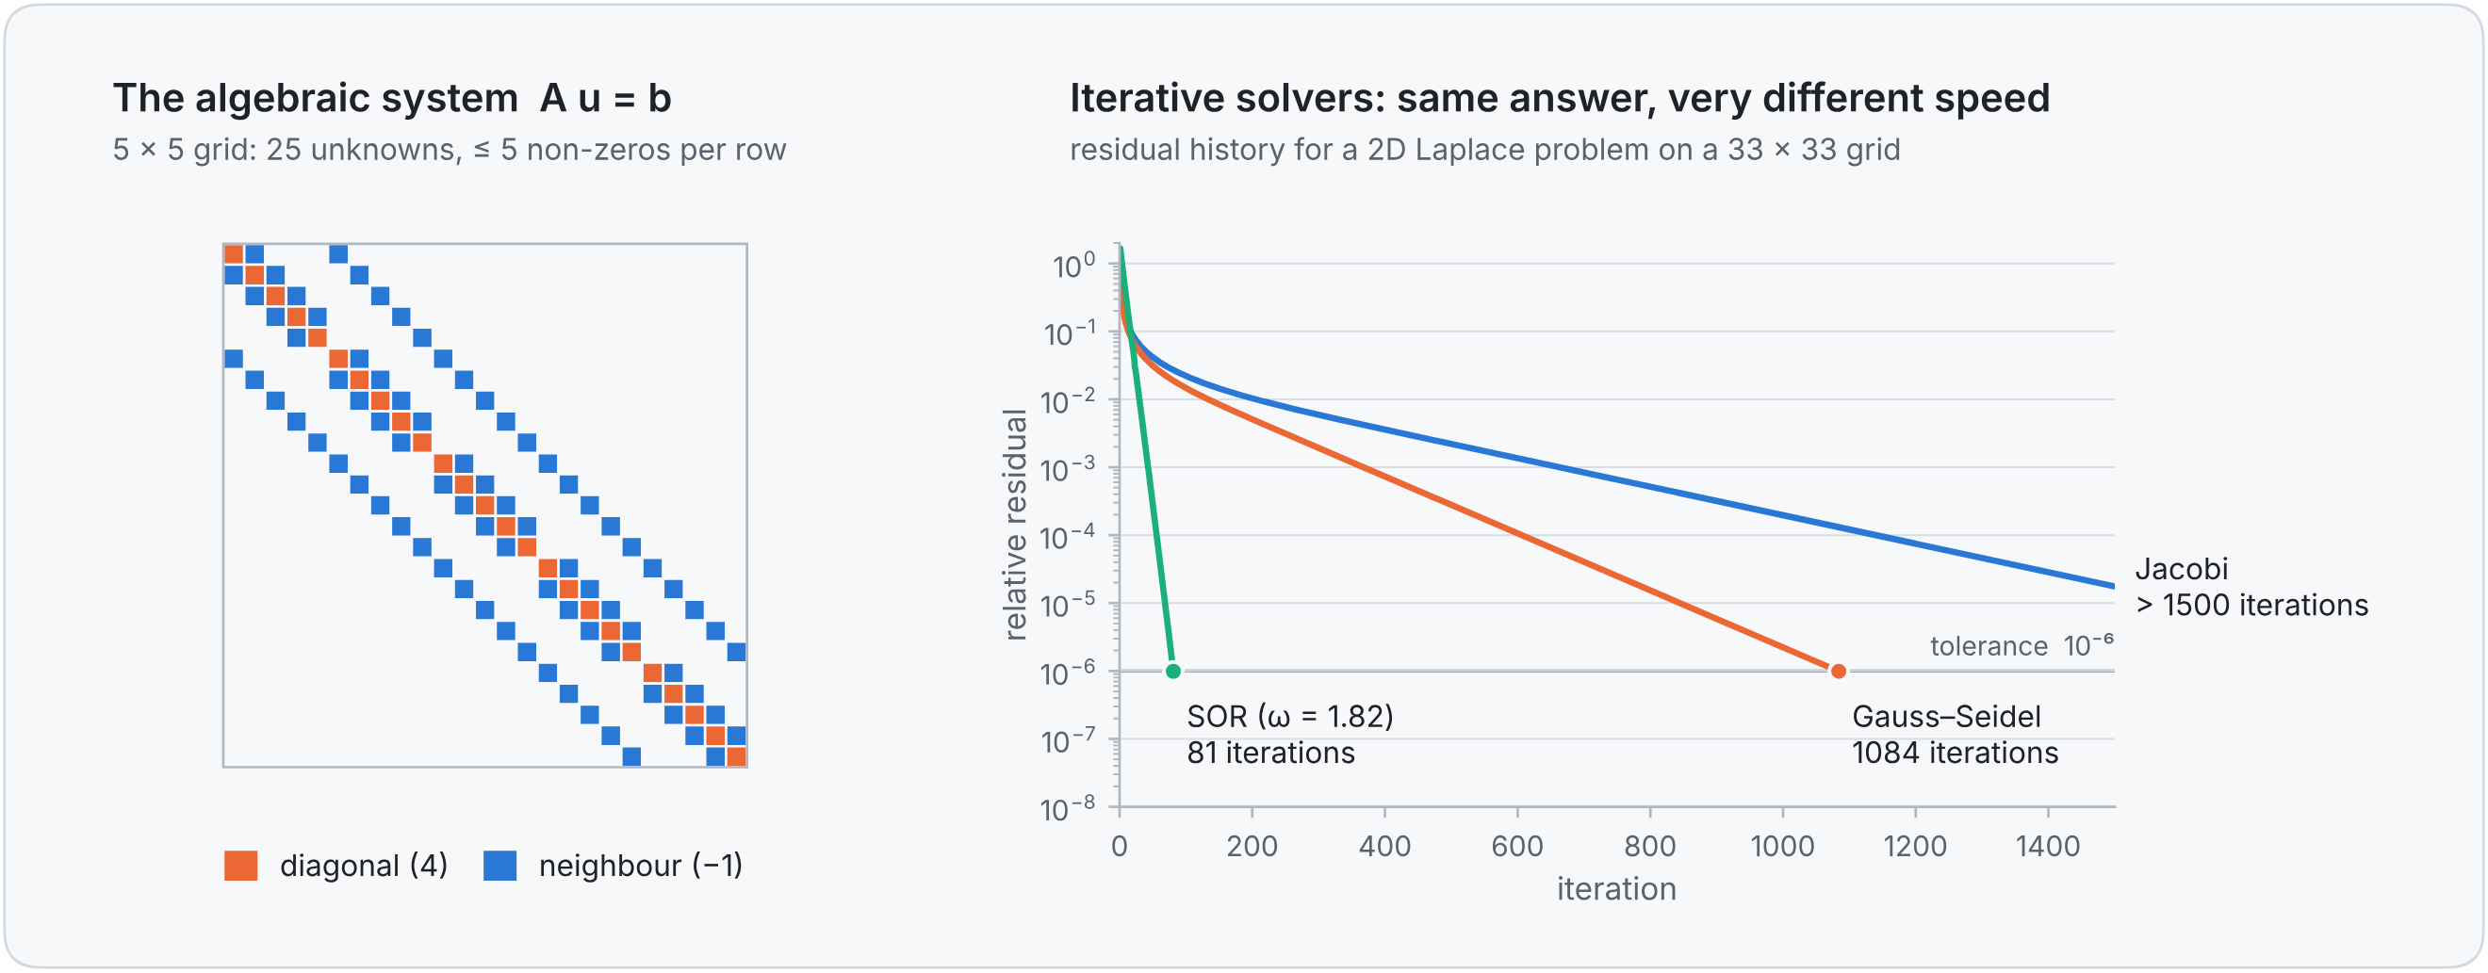
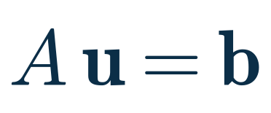


Solution setup ③: direct or iterative?
PILLAR 5 · SOLVING
Implicit schemes and steady problems give a linear system. A is huge but sparse: each equation involves only a node and its neighbours.
Direct
Jacobi
Gauss–Seidel
SOR
Gauss, LU, Thomas: exact in one pass; Thomas costs only O(N)
neighbours' old values: simple, but very slow
uses new values at once: ~2× faster than Jacobi
over-corrects with 1 < ω < 2: often 10–100× faster
Rod: explicit FTCS with r = 0.4 ≤ ½: simple and stable. (Implicit BTCS would need the Thomas algorithm every step, but allows a larger Δt.)
Notes:
Third decision: direct or iterative solver. Implicit schemes and steady problems give a linear system A u = b. The matrix is huge but sparse, almost all zeros, because each equation involves only a node and its neighbours (left: the banded matrix of a 5 x 5 Laplace grid).
Direct solvers eliminate unknowns exactly; for tridiagonal systems the Thomas algorithm costs only O(N). Iterative solvers improve a guess: Jacobi uses old values, Gauss–Seidel uses new values as soon as they are available, SOR over-corrects. The plot shows the same problem: SOR reaches the tolerance in 81 iterations, Gauss–Seidel in 1084, Jacobi needs more than 1500.
Iterative solvers need a convergence criterion: stop when the residual falls below a tolerance. We will use both Thomas and Gauss–Seidel by hand in Problem 1.

Slide 23




Compute: run the program
PILLAR 6 · SOLVING
Python
Excel / Calc
ROD SOLVER: ABOUT A DOZEN LINES OF PYTHON
import numpy as np
import matplotlib.pyplot as plt
L, N, alpha = 1.0, 20, 1e-4 # rod, intervals, α
dx = L / N # pillar 2: grid
r = 0.4 # pillar 5: r ≤ 0.5
dt = r * dx**2 / alpha
x = np.linspace(0, L, N + 1) # 21 nodes
T = np.full(N + 1, 20.0) # pillar 3: 20 °C
T[0] = 100.0 # hot left end
for n in range(600): # pillars 4 + 6
T[1:-1] += r*(T[2:] - 2*T[1:-1] + T[:-2])
plt.plot(x, T, "o-") # pillar 7
learning, prototyping: this course
one cell = one node
MATLAB / Octave
C++ / Fortran / Julia
matrix-friendly teaching & research
large, fast production codes
Part 2
OpenFOAM · SU2
Fluent · COMSOL
open-source CFD packages
commercial, graphical workflow
Same algorithm, many environments.
Notes:
Pillar 6: compute. With everything set up, the computer does the arithmetic. The same algorithm can be written in many environments: Python for learning (this course), a spreadsheet where every cell is a node, MATLAB, compiled languages for large production codes, open-source CFD packages like OpenFOAM, and commercial software like Fluent or COMSOL, which we use in Part 2.
On the right is the complete rod solver: about a dozen lines of Python. Point out where each pillar appears in the code. The single line inside the loop is the FTCS update from Pillar 4.

Slide 24
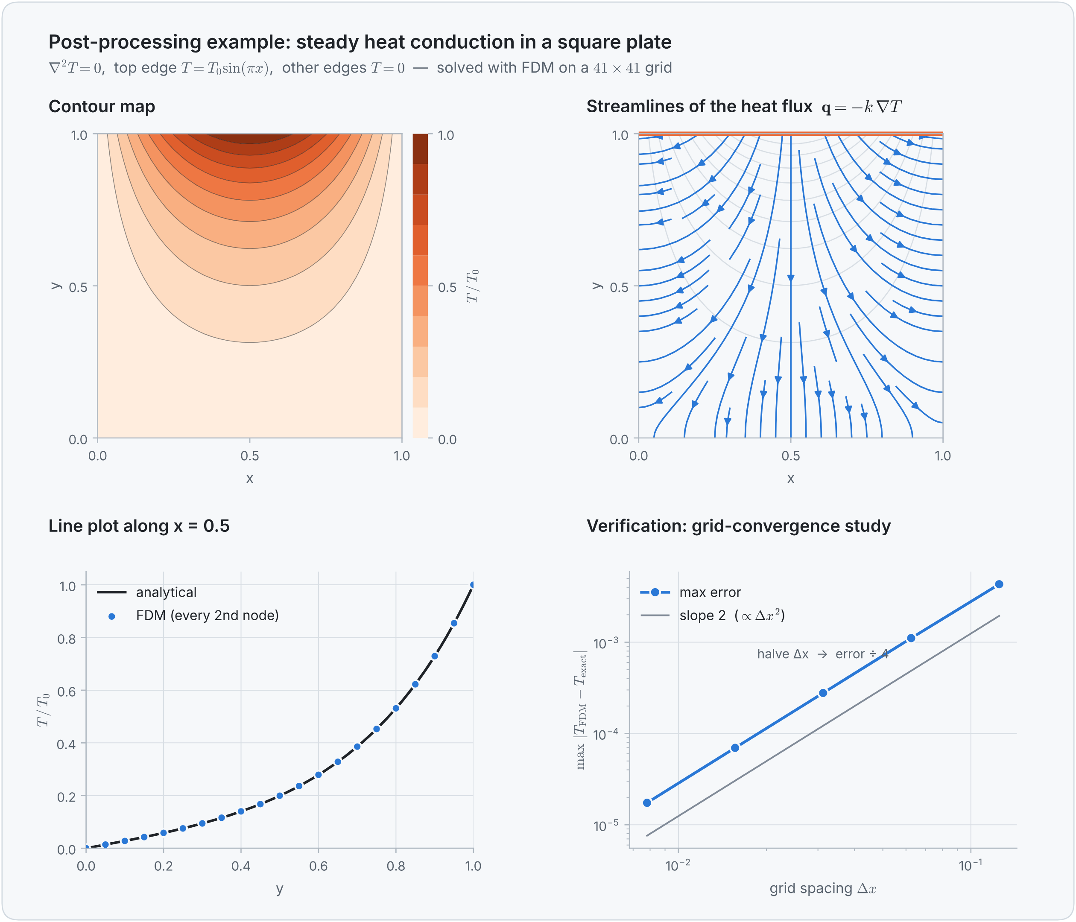




Visualize: turn numbers into insight
PILLAR 7 · POST-PROCESSING
Contour / colour map
a scalar field: hot spots, pressure regions
Vectors / streamlines
flow patterns, recirculation, heat paths
Line plot (profile)
compare with theory, experiments, other grids
Animation
how an unsteady solution evolves
Convergence plot
show that the solution can be trusted
Tools: Matplotlib (this course) · ParaView · VisIt · Tecplot · built-in post-processors
Notes:
Pillar 7: post-processing. The raw output is just a long list of numbers; post-processing turns it into understanding and into the quantities of interest: a maximum temperature, a heat flux, a drag force.
The figure shows steady heat conduction in a square plate: a contour map, streamlines of the heat flux, a line plot where the FDM points lie on the analytical curve, and a grid-convergence plot where the error falls with slope 2, exactly as a second-order scheme should.

Slide 25
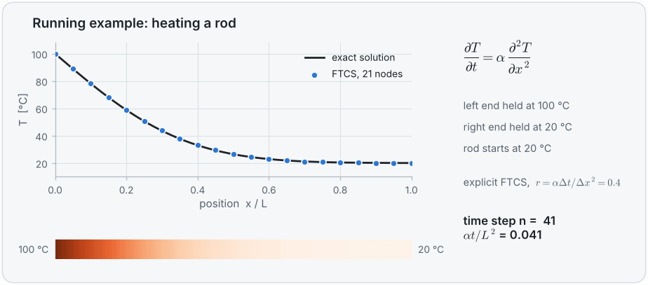
Never trust a colourful picture blindly
PILLAR 7 · POST-PROCESSING
Verification
Are we solving the equations right?
Compare with exact solutions; refine the grid and check the order of accuracy.
Validation
Rod: 21-node FTCS (dots) on top of the exact solution (line). The rod settles to a straight line from 100 °C to 20 °C.
Are we solving the right equations?
Compare with experiments and measurements.
Verify with:
exact solutions
grid refinement
benchmarks
Notes:
The animation is the rod's post-processing: the 21-node FTCS solution (dots) sits right on the exact solution (line), and the rod settles to a straight-line profile between 100 and 20 °C. (The GIF plays in slide-show mode.)
Never trust a colourful picture blindly. Verification asks: are we solving the equations right? Compare with exact solutions and refine the grid. Validation asks: are we solving the right equations? Compare with experiments.
That completes the 7 pillars. Now let us apply all of them to a real problem, by hand.

Slide 26
Problem 1: the aluminium pin fin, solved by hand
WORKED EXAMPLE · ABOUT 20 MINUTES
4 intervals, 4 unknowns and a pocket calculator: every step of the finite difference method
Notes:
Worked example, about 20 minutes, following the whiteboard guide of Problem 1 (04_whiteboard_guide.pdf). We solve the fin completely by hand with 4 intervals, so you see every step before meeting the notebook, which does the same with 10 or more intervals, and before COMSOL, which does it with finite elements.

Slide 27
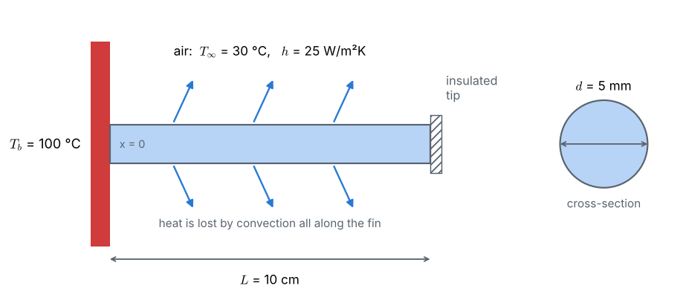

A pin fin cooled by air
PROBLEM 1 · THE PHYSICAL PROBLEM
FIND
the steady temperature T(x)
the tip temperature
the heat lost by the fin
ASK THE CLASS
L = 10 cm
d = 5 mm
k = 237 W/(m·K)
h = 25 W/(m²·K)
Where is the fin hottest? Where is it coldest?
Why does the tip not reach 30 °C?
T∞ = 30 °C
T_{b} = 100 °C
insulated tip
steady state
Notes:
Problem 1: determine the steady-state temperature distribution in an aluminium pin fin. The base is at 100 °C, the tip is insulated, the fin is cooled by air at 30 °C. The fin dimensions, conductivity and h were not given in the original statement; typical values are used.
Ask the class before calculating: the fin is hottest at the base, coldest at the tip, and the tip stays well above 30 °C because aluminium conducts heat very well and the fin is short.

Slide 28
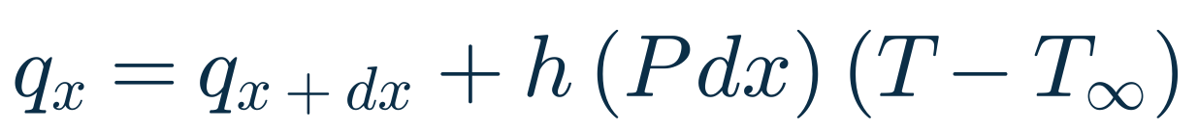
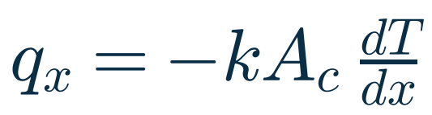
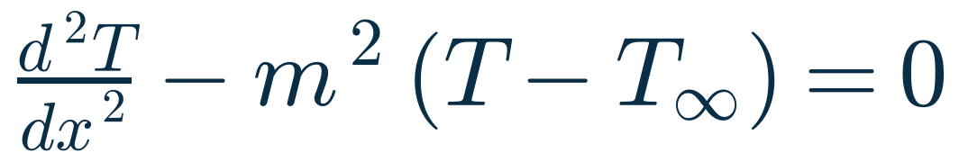
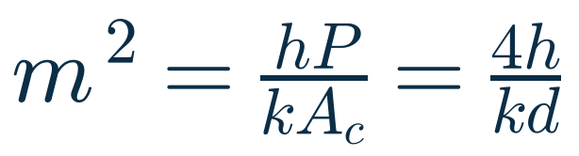
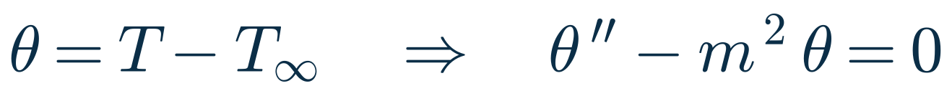
Energy balance → the fin equation
PROBLEM 1 · STEP 1: PHYSICS
h (P dx)(T − T∞)
ENERGY BALANCE ON THE SLICE
FOURIER'S LAW
q_{x}
q_{x+dx}
⇒ THE FIN EQUATION
dx
x = 0
x = L
Steady state: heat in = heat out + heat convected to the air
TRICK: EXCESS TEMPERATURE θ
θ(0) = 100 − 30 = 70 K (base)
dθ/dx = 0 at x = L (insulated tip)
m² = 4 × 25 / (237 × 0.005) = 84.388 m⁻²
Notes:
Board 2 of the whiteboard guide. Draw a thin slice dx of the fin. In steady state, heat conducted in equals heat conducted out plus heat convected to the air from the slice's side surface, h times (P dx) times (T − T∞). With Fourier's law q = −k A dT/dx this gives the fin equation T'' − m² (T − T∞) = 0, with m² = hP/(kA) = 4h/(kd) for a circular pin.
Simplification for the board: use the excess temperature θ = T − T∞; the equation becomes θ'' − m² θ = 0 with no constant term.
Boundary conditions: θ(0) = 70 K at the base, dθ/dx = 0 at the insulated tip. Calculator: m² = 84.388 m⁻².

Slide 29
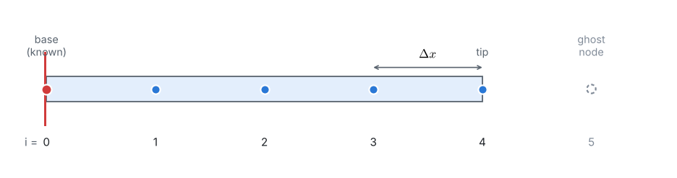
4 intervals, 5 nodes and a ghost node
PROBLEM 1 · STEP 2: GRID
Node 5 is a ghost node beyond the tip: a helper we use to apply the insulated-tip condition.
N = 4
Δx = 0.025 m
θ₀ = 70 K
θ₁ … θ₄
intervals
= L / N
base node: known
the 4 unknowns
Notes:
Board 3: the grid. N = 4 intervals, Δx = L/N = 0.025 m, nodes at x = 0, 2.5, 5, 7.5 and 10 cm.
Node 0 is known (θ₀ = 70 K). Nodes 1 to 4 are the four unknowns. Node 5 is a ghost node beyond the tip: it does not exist physically, but it lets us write the insulated-tip condition with a central difference.

Slide 30
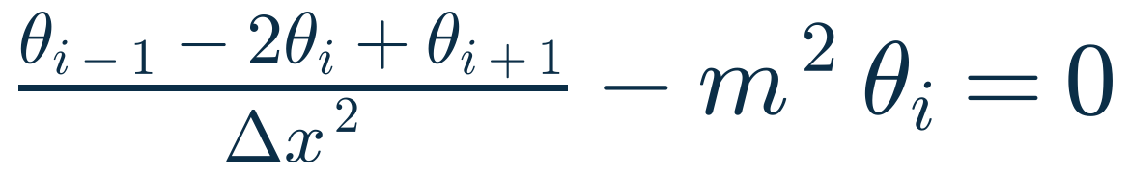
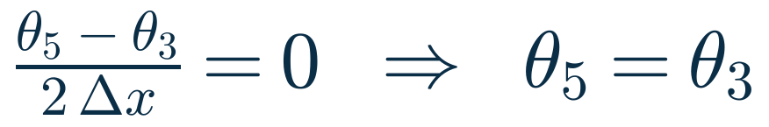
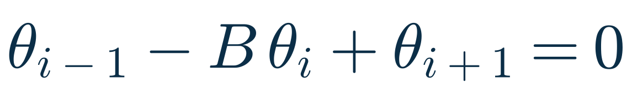
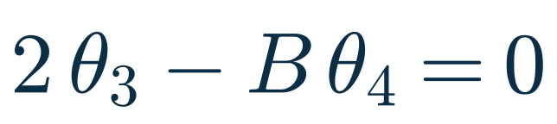
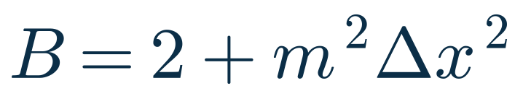
Central difference → one equation per node
PROBLEM 1 · STEP 3: DISCRETIZATION
INTERIOR NODES i = 1, 2, 3
TIP NODE i = 4 (INSULATED)
The tip equation needs θ₅: use the ghost node.
= 2 + 84.388 × 0.025² = 2.052743
θ₅ replaces θ₃, so θ₃ appears twice: the factor 2.
Calculator tip: keep at least 4 decimals. Rounding B = 2.052743 to 2.05 already shifts the tip temperature by almost 1 °C.
Notes:
Board 4: at an interior node replace the second derivative by the central difference. Multiplying by Δx² gives θ(i−1) − B θ(i) + θ(i+1) = 0, with B = 2 + m²Δx² = 2.052743.
The tip node needs θ₅. The insulated tip gives (θ₅ − θ₃)/(2Δx) = 0, so θ₅ = θ₃, and the tip equation becomes 2θ₃ − Bθ₄ = 0.
Ask the class: why is there a 2 in the tip equation? Calculator advice: keep at least 4 decimals in B.

Slide 31



Four equations, one tridiagonal system
PROBLEM 1 · STEP 3: DISCRETIZATION
Each equation links a node only to its neighbours: only 3 diagonals are non-zero, a tridiagonal system.
B
−1
0
0
θ₁
70
−1
B
−1
0
θ₂
0
=
0
−1
B
−1
θ₃
0
The −2 comes from the ghost node θ₅ = θ₃.
0
0
−2
B
θ₄
0
The known base value θ₀ = 70 moves to the right-hand side.
with B = 2.052743
Ask the class: why does each equation contain only neighbouring nodes?
Notes:
Write the four equations with the known θ₀ = 70 moved to the right-hand side. In matrix form only three diagonals are non-zero: the system is tridiagonal, because each node talks only to its neighbours through the central difference. That is exactly the sparse structure we saw in Pillar 5.
Note the −2 in the last row: it comes from the ghost node.
(1) 2.052743 θ1 − θ2 = 70; (2) −θ1 + 2.052743 θ2 − θ3 = 0; (3) −θ2 + 2.052743 θ3 − θ4 = 0; (4) −2 θ3 + 2.052743 θ4 = 0.

Slide 32
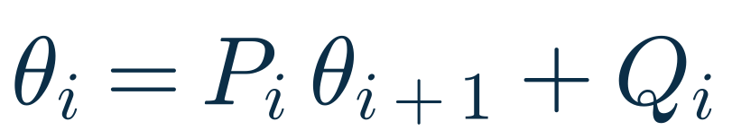
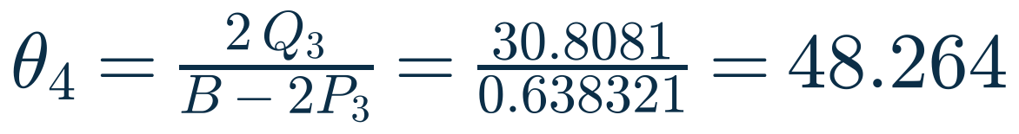

Elimination by hand: the Thomas algorithm
PROBLEM 1 · STEP 4: SOLVE
IDEA
write every unknown in terms of the next one: sweep base → tip, then come back tip → base
① Forward sweep: base → tip
② Back substitution: tip → base
i | P_{i} | Q_{i}
1 | 0.487153 | 34.1007
2 | 0.638737 | 21.7814
3 | 0.707211 | 15.4040
TIP: PUT θ₃ INTO EQ. (4)
node | θ_{i} [K] | T_{i} [°C]
4 | 48.264 | 78.26
3 | 49.537 | 79.54
2 | 53.422 | 83.42
1 | 60.126 | 90.13
Check one equation, e.g. (2): −60.126 + 2.052743 × 53.422 − 49.537 ≈ 0
Notes:
Board 5: solve by elimination, the Thomas algorithm by hand. Idea: write every unknown in terms of the next one, θi = Pi θ(i+1) + Qi, going from the base to the tip; then come back.
Forward sweep. From (1): P1 = 1/B = 0.487153, Q1 = 70/B = 34.1007. Put into (2): B − P1 = 1.565590, so P2 = 0.638737, Q2 = 21.7814. Put into (3): B − P2 = 1.414006, so P3 = 0.707211, Q3 = 15.4040.
Tip: substitute θ3 = P3 θ4 + Q3 into the tip equation: θ4 = 2 Q3 / (B − 2 P3) = 48.264.
Back substitution: θ3 = 49.537, θ2 = 53.422, θ1 = 60.126. Add 30 to get °C. Check equation (2) together with the class.

Slide 33
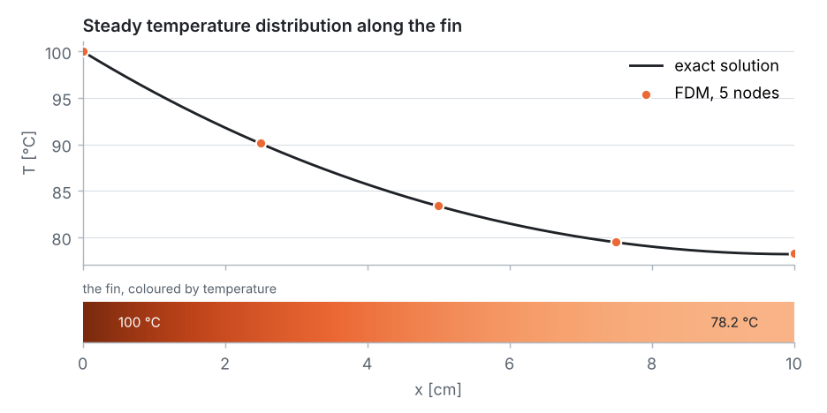
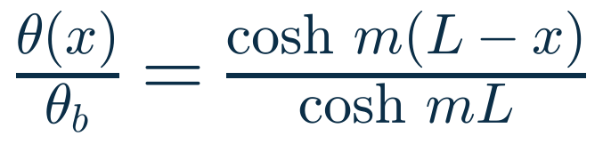
By hand, within 0.07 °C of the exact answer
PROBLEM 1 · STEP 5: RESULTS
node | x [cm] | by hand [°C] | exact [°C] | error [°C]
0 | 0 | 100.00 | 100.00 | 0
1 | 2.5 | 90.13 | 90.09 | +0.03
2 | 5.0 | 83.42 | 83.37 | +0.05
3 | 7.5 | 79.54 | 79.47 | +0.07
4 | 10.0 | 78.26 | 78.19 | +0.07
EXACT SOLUTION
m = 9.1863 m⁻¹, mL = 0.9186
0.07 °C
2.18 W
≈ 0.5 %
largest error, with only 4 unknowns
heat lost by the fin (exact 2.17 W)
error of the heat loss
Notes:
Board 6: results. The exact solution is θ/θb = cosh(m(L − x))/cosh(mL), with m = 9.1863 1/m.
With only 4 unknowns and a calculator, every temperature is within 0.07 °C of the exact solution. The heat lost by the fin, summing h P Δx θ over the nodes (half weight at the ends), is 2.18 W against the exact 2.17 W, about 0.5 %.
The central difference is a very good approximation for this smooth profile.

Slide 34

Second-order accuracy, seen by hand
PROBLEM 1 · VERIFICATION
0.28 °C
0.07 °C
halve Δx
tip error, 2 intervals
tip error, 4 intervals
÷4
Halving Δx divides the error by 4: second-order accuracy, exactly as the Taylor series predicted.
2 intervals: B = 2.210970 → T₁ = 83.58 °C, T_{tip} = 78.47 °C (exact 83.37 and 78.19 °C)
The notebook keeps halving Δx: the error falls 4× every time (slope 2 on log axes).
Notes:
Even quicker, in 5 minutes on the board: 2 intervals. With Δx = 0.05 m, B = 2.210970, the two equations give T1 = 83.58 °C and T_tip = 78.47 °C, against the exact 83.37 and 78.19 °C.
Halving Δx from 2 to 4 intervals reduces the tip error from 0.28 to 0.07 °C: a factor of 4. Second-order accuracy, seen by hand.
The notebook does the same with many grids: on log axes the error falls on a line of slope 2.

Slide 35





Why we need computers: Gauss–Seidel
PROBLEM 1 · STEP 4B: ITERATE
SOLVE EACH EQUATION FOR ITS OWN NODE, SWEEP BASE → TIP
sweep | T₁ | T₂ | T₃ | T₄ [°C]
0 | 30.00 | 30.00 | 30.00 | 30.00
1 | 64.10 | 46.61 | 38.09 | 37.88
2 | 72.19 | 54.50 | 45.77 | 45.37
3 | 76.03 | 60.11 | 52.16 | 51.59
10 | 86.92 | 78.08 | 73.26 | 72.15
20 | 89.73 | 82.77 | 78.77 | 77.52
40 | 90.12 | 83.41 | 79.53 | 78.25
60 | 90.13 | 83.42 | 79.54 | 78.26
≈ 60
sweeps to match the elimination result. An easy rule, painful by hand, and perfect for a computer: milliseconds.
Notes:
Board 7 (optional): why we need computers. Solve each equation for its own node and sweep from the base to the tip, starting from the initial fin temperature, 30 °C (θ = 0). Do the first sweep together with the class.
The iteration is easy, but it needs about 60 sweeps to agree with the elimination result. Perfect for a computer, painful by hand. In the notebook the same algorithm runs hundreds of sweeps in a fraction of a second (437 sweeps for 10 intervals and a 1e-6 tolerance).

Slide 36


Common mistakes, and from board to notebook
PROBLEM 1 · WRAP-UP
Common mistakes
From board to notebook
Forgetting the factor 2 in the tip equation
03_fdm_solver.ipynb
Board 4
build_system
Using Δx in centimetres in m²Δx²
Board 5
thomas
Board 7
gauss_seidel
Forgetting T∞: work with θ = T − T∞
Set N = 10 (11 nodes):
Rounding B too early
78.205 °C
tip (exact 78.194)
2.1721 W
heat loss (exact 2.1702)
Writing an equation for the base node (it is known!)
Notes:
Common mistakes to watch for on the board: forgetting the factor 2 in the tip equation; using Δx in centimetres in m²Δx² (Δx must be in metres, like m); forgetting the T∞ term when working with T instead of θ; rounding B too early; and writing an equation for the base node, whose temperature is known.
Every board step has a matching function in the notebook: build_system is Board 4, thomas is Board 5, gauss_seidel is Board 7. Set N = 4 and the computer reproduces the numbers on the board; set N = 10 and the tip temperature is 78.205 °C against the exact 78.194 °C.

Slide 37
What we have learned
PART 1 · RECAP
1 · Geometry
2 · Grid
3 · Physics
4 · Scheme
5 · Setup
6 · Compute
7 · Visualize
CFD = PDEs solved on a grid
FDM: derivatives → differences
Trust needs checks
Geometry, physics and a math model, solved approximately with numerical methods, at a finite set of points.
The Taylor series gives the formulas and their order: halve Δx and a 2nd-order error falls by 4.
Stability limits, grid refinement, exact solutions and benchmarks, before any colourful plot.
Next: the same fin in COMSOL, with finite elements →
Notes:
Recap of Part 1. CFD means solving the governing PDEs approximately, with numerical methods, on a grid. FDM turns derivatives into differences; the Taylor series tells us the order of accuracy, and we saw the factor 4 by hand. And before trusting any result: check stability, refine the grid, compare with exact solutions or benchmarks.
Next: the same fin in COMSOL, with the finite element method. Ask everyone to open COMSOL now.

Slide 38
Hands-on COMSOL Multiphysics
PART 2 · 2:00 – 3:00 PM
Build, solve and verify the repo's problems step by step, starting with Problem 1
Notes:
Part 2: hands-on COMSOL Multiphysics. Everyone should have COMSOL open. We build Problem 1 together, step by step, following the COMSOL guide in the repo, then continue with Problems 2 and 3 as far as time allows.

Slide 39


The 7 pillars inside COMSOL
COMSOL BASICS
Model Wizard
space dimension · physics · study type
1 · Geometry
3 · Physics
5 · Setup
Global Definitions
parameters: all problem data in one place
problem data
Geometry
interval, square …: the domain
1 · Geometry
Materials
k, ρ, c_{p}
3 · Physics
Physics nodes
the equation + boundary conditions
3 · Physics
4 · Scheme (FEM, auto)
Mesh
the elements: our grid
2 · Grid
Study › Compute
stationary or time-dependent solver
5 · Setup
6 · Compute
Results
plots, point evaluations, integrals
7 · Visualize
Notes:
Before clicking anything: the COMSOL Model Builder tree is the 7 pillars in disguise.
The Model Wizard asks for the space dimension (pillar 1), the physics interface (pillar 3) and the study type (pillar 5). Global Definitions holds parameters. Geometry is pillar 1, Materials and the physics nodes with their boundary conditions are pillar 3. COMSOL picks the discretization itself: finite elements, pillar 4. The Mesh is pillar 2, our grid. Study and Compute are pillars 5 and 6. Results are pillar 7.
So everything from Part 1 applies; COMSOL just automates the arithmetic.

Slide 40


From Problem 1, as far as time allows
HANDS-ON PLAN
Problem 1 · Pin fin
Problem 2 · Diffusion
Problem 3 · Square plate
1D · steady · Heat Transfer in Solids
1D · time-dependent · Transport of Diluted Species
2D · steady · Heat Transfer in Solids
New: 1D model, heat source, point evaluation
New: parameters, transient study, exact-curve overlay
New: 2D geometry, parametric mesh sweep
~25 min
~15 min
~15 min
IF TIME ALLOWS · TAKE-HOME
4 · Brick column (Robin BC)
5 · Convection–diffusion
6 · Lid-driven cavity
Notes:
The plan for the hour. Problem 1, the pin fin, about 25 minutes: 1D steady heat transfer, the same problem we solved by hand. Problem 2, phosphorus diffusion, about 15 minutes: time dependent, with parameters and a comparison against the exact error-function solution. Problem 3, the square plate, about 15 minutes: 2D, with a parametric sweep over the mesh size.
Problems 4 to 6 also have COMSOL guides in the repo; do them at home or if we are fast.

Slide 41





Before you start
HANDS-ON · SET-UP
Get the files
Menus
Select points & edges
problems/01_aluminium_fin/
comsol_solution/
Left-click a tree node first, then right-click it.
Hover until it turns red → click → press +.
COMSOL_PinFin_Guide.pdf
12 annotated steps with screenshots
fin1d_pin_fin.mph
Units in [brackets]
Kelvin & metres
the finished model, to compare
373.15[K]
0.1[um]
6.5e-13[cm^2/s]
100 °C = 373.15 K. Type 0.1 (m), not 10 (cm).
COMSOL 4.3a or newer
Licence: university network or VPN
Save often: File › Save As, and compare with the supplied .mph if you get stuck.
Notes:
Practical set-up. The files are in each problem's comsol_solution folder: a PDF guide with annotated screenshots and the finished .mph model to compare with. You need COMSOL 4.3a or newer (the guides use 4.3a; newer versions look slightly different but the tree is the same), and a licence connection.
Four golden rules that save most of the questions: left-click a node before right-clicking; to select a point or edge, hover until it turns red, click, then press +; write units in square brackets; COMSOL works in kelvin and metres.

Slide 42
Translating the fin into a COMSOL model
PROBLEM 1 IN COMSOL
PROBLEM
COMSOL FEATURE
The fin, 10 cm long
Interval 0 → 0.1 m (1D)
Base at 100 °C
Temperature 373.15 K at Point 1
Insulated tip
Thermal Insulation at Point 2 (default!)
TARGET: THE EXACT SOLUTION
Convection from the side
Heat Source Q = −h (4/d)(T − T∞)
78.194 °C
tip temperature
2.1702 W
heat lost by the fin
Steady state
Stationary study
Notes:
Before clicking, translate the problem. The fin becomes a 1D line from 0 to 0.1 m. The base at 100 °C becomes a Temperature condition of 373.15 K at Point 1. The insulated tip is the default Thermal Insulation at Point 2, so we do nothing. The convection from the side surface, which a 1D model cannot see, becomes a volumetric heat sink Q = −h(4/d)(T − T∞). Steady state means a Stationary study.
Target: the exact solution gives a tip temperature of 78.194 °C and a heat loss of 2.1702 W.

Slide 43



Model Wizard: 1D → physics → study
PROBLEM 1 IN COMSOL · STEPS 1–3
1
Select 1D, then Next
2
Heat Transfer › Heat Transfer in Solids › + › Next
3
Stationary › Finish
Why? The pin is long and thin: one temperature per cross-section, T(x) only.
Why? Solves −d/dx(k dT/dx) = Q. We will use Q for the convective loss.
Why? Steady state: the initial 30 °C has no influence, so it is not needed.
Notes:
Steps 1 to 3, the Model Wizard. Step 1: select 1D and click the Next arrow. Step 2: expand Heat Transfer, select Heat Transfer in Solids, click the blue + (Add Selected), then Next. Step 3: select Stationary under Preset Studies and click Finish (the chequered flag).
Why 1D: the pin is thin, so each cross-section has a single temperature, exactly like our FDM model. Why stationary: the initial 30 °C only matters in a time-dependent simulation.

Slide 44

A tour of the Model Builder tree
PROBLEM 1 IN COMSOL · STEP 4
1
Geometry 1
the fin's shape (Step 5)
2
Materials
aluminium (Step 6)
3
Heat Transfer in Solids
equation & BCs (Steps 7–8)
4
Thermal Insulation 1
default on every boundary = our insulated tip
5
Length unit: m
enter all lengths in metres
In 1D the domain is a line; its boundaries are its two end points.
Domain 1: the fin
Point 1 · base, x = 0
Point 2 · tip, x = L
Notes:
Step 4: after Finish, the Model Builder on the left contains the complete outline of the model, and we work through it from top to bottom: Geometry (Step 5), Materials (Step 6), Heat Transfer in Solids (Steps 7 and 8).
Thermal Insulation 1 is added by default on every boundary: that is exactly our insulated-tip condition, so we keep it. The length unit is metre.
In a 1D model the domain is the line (the fin) and the boundaries are the two end points: Point 1 at x = 0 (base) and Point 2 at x = L (tip).

Slide 45


Geometry and material
PROBLEM 1 IN COMSOL · STEPS 5–6
5
Geometry: a 10 cm line
6
Material: aluminium
Right-click Geometry 1 › Interval · Left endpoint 0 · Right endpoint 0.1 · Build Selected (F8)
Right-click Materials › Material (blank) · Selection: All domains
k = 237 W/(m·K)
ρ = 2700 kg/m³
C_{p} = 900 J/(kg·K)
Only k matters for the steady state. COMSOL needs ρ and C_{p} for a complete material.
Type 0.1, not 10: the length unit is metres.
Notes:
Step 5: right-click Geometry 1 and choose Interval. Left endpoint 0, right endpoint 0.1 (metres!), then Build Selected (F8). The line from 0 to 0.1 appears in the Graphics window.
Step 6: right-click Materials and choose Material (a blank material). Selection: all domains. Enter k = 237, rho = 2700, Cp = 900: double-click each Value cell, type, press Enter. Density and heat capacity do not affect the steady state, but COMSOL requires a complete material before it will solve.

Slide 46

Boundary condition: the base at 100 °C
PROBLEM 1 IN COMSOL · STEP 7
1
Right-click Heat Transfer in Solids › Temperature
2
Select Point 1: hover until red → click → +
3
T₀ = 373.15[K]
100 °C = 373.15 K
Why? A Dirichlet condition T(0) = T_{b}. Thermal Insulation stays on Point 2: the insulated tip.
Notes:
Step 7: the wall holds the base of the fin at 100 °C = 373.15 K, a Dirichlet condition at Point 1. Right-click Heat Transfer in Solids and choose Temperature. In the selection list, add Point 1: move the mouse over the left end point until it turns red, click it, press +. Type T0 = 373.15[K]; writing the unit in brackets keeps the entry unambiguous.
COMSOL works internally in kelvin. The default Thermal Insulation remains on Point 2.

Slide 47


Convection as a heat sink
PROBLEM 1 IN COMSOL · STEP 8
A 1D model has no side surface, so we add the convective loss as a volumetric heat sink along the fin.
WHAT COMSOL SOLVES
THE SOURCE: LOSS PER UNIT VOLUME (P/A = 4/d)
TYPE IN THE Q FIELD (UNIT W/m³)
-25*4/0.005*(T-303.15)
The minus sign makes it a sink: heat leaves the fin. 303.15 K = T∞ = 30 °C.
Notes:
Step 8, the key modelling step. A 1D fin model has no side surface, so the convective loss from the lateral surface is added as a volumetric heat sink. Right-click Heat Transfer in Solids, choose Heat Source, selection All domains, General source: -25*4/0.005*(T-303.15).
Where does it come from? The same energy balance on a slice as on the board: the loss h P dx (T − T∞) divided by the slice volume A dx gives h (P/A)(T − T∞) = h (4/d)(T − T∞). The minus sign makes it a sink. It is the same physics as the m² term in our fin equation.

Slide 48


Mesh: 100 elements along the fin
PROBLEM 1 IN COMSOL · STEP 9
Mesh 1 › Element size: Extremely fine › Build All (F8)
Messages: Complete mesh consists of 100 elements (Δx = 1 mm)
The FEM mesh plays the role of our FDM grid. Later, try Normal (15) and Extremely coarse (3 elements).
Notes:
Step 9: the finite element mesh divides the line into small elements, just like the grid of nodes in the finite difference method. Click Mesh 1, open the Element size list, choose Extremely fine and Build All. The Messages window reports 100 elements, Δx = 1 mm, so the result is mesh-independent.
Later, for the mesh study, try Normal (15 elements) and Extremely coarse (3 elements).

Slide 49

Compute: the temperature profile
PROBLEM 1 IN COMSOL · STEP 10
10
Right-click Study 1 › Compute (F8)
373.15 K
= 100 °C at the base
351.3 K
= 78.2 °C at the tip
Steepest slope at the base, where heat enters; zero slope at the tip = insulated. The classic fin profile cosh m(L − x) / cosh mL.
Notes:
Step 10: right-click Study 1 and Compute (F8). The default plot shows temperature against x: 373.15 K at the base, and at the tip the curve flattens at about 351.3 K, 78.2 °C. Zero slope at the tip: the insulated condition.
The slope is largest at the base, where the heat enters the fin. Compare with our hand result: 78.26 °C at the tip with only 4 intervals.

Slide 50


Read the numbers: tip temperature and heat loss
PROBLEM 1 IN COMSOL · STEPS 11–12
11
Tip temperature
12
Heat lost by the fin
Derived Values › Point Evaluation · select Point 2 (the tip) · Evaluate (=)
Second Point Evaluation · select Point 1 (the base) · clear the Unit field
EXPRESSION
EXPRESSION
T
-237*pi*0.005^2/4*Tx
the temperature, in K
Q = −kA dT/dx at the base; Tx is COMSOL's dT/dx
RESULT
RESULT
351.34408 K
= 78.194 °C
Q = 2.17021 W
(exact 2.17022 W)
Notes:
To get exact numbers, not just a plot, evaluate the solution at points.
Step 11: right-click Derived Values, Point Evaluation, select Point 2 (the tip), expression T, Evaluate (=). The table shows 351.34408 K = 78.194 °C, exactly the analytical value.
Step 12: in steady state all heat entering the fin at the base is lost by convection, so evaluate Fourier's law at the base: a second Point Evaluation at Point 1 with expression -237*pi*0.005^2/4*Tx, where Tx is COMSOL's name for dT/dx. Clear the Unit field. Result: 2.17021 W.

Slide 51
COMSOL vs FDM vs exact
PROBLEM 1 · VERIFICATION
 | FDM by hand 4 intervals | FDM notebook 10 intervals | COMSOL 100 elements | Exact
Tip temperature [°C] | 78.26 | 78.205 | 78.194 | 78.194
Heat lost [W] | 2.18 | 2.1721 | 2.1702 | 2.1702
Reading the mesh study
T_{tip} is already exact on the Normal mesh: COMSOL uses quadratic elements. Q needs a derivative, so its error falls more slowly, roughly with the element size squared.
TRY IT
Change h to 100 W/(m²·K) (a fan). Predict first: hotter or colder tip? Then check with COMSOL.
Notes:
Verification. With 100 elements COMSOL reproduces the exact solution: 78.194 °C and 2.1702 W. Our notebook with 10 intervals gives 78.205 °C and 2.1721 W, and our hand calculation with 4 intervals 78.26 °C and 2.18 W.
Mesh study (change Element size, Compute, Evaluate All): the tip temperature is already exact on the Normal mesh because COMSOL uses quadratic, second-order elements. The heat flow Q needs a derivative of the solution, and its error falls roughly with the square of the element size: 0.66 % with 3 elements, 0.03 % with 15, 0.0005 % with 100.
Exercise: change h to 100 W/(m²K). Predict first: the tip gets colder, because the fan removes heat faster.

Slide 52


Doping a silicon wafer: 1D and unsteady
PROBLEM 2 · PHOSPHORUS DIFFUSION
GOVERNING EQUATION (FICK'S LAW)
EXACT SOLUTION (SEMI-INFINITE WAFER)
c_{s} = 2.5×10²⁰ atoms/cm³
D = 6.5×10⁻¹³ cm²/s
TARGET
z_{film} = 1.762 µm
1 h at 1100 °C
film edge: c = 1 % of c_{s}
depth where c = 1 % of c_{s}, after 1 h (exact)
NEW IN COMSOL
time-dependent
parameters
Diluted Species
Notes:
Problem 2. In a CVD reactor a P-rich SiO2 coating supplies phosphorus, which diffuses into a silicon wafer that starts free of phosphorus. The coating keeps the surface concentration constant; the wafer is effectively semi-infinite. Predict the depth of the Si-P film after 1 h, where the film edge is 1 % of the surface concentration.
This is the 1D diffusion (heat) equation: parabolic, unsteady. Its exact solution is an error function, giving z_film = 1.762 µm. New in COMSOL: a time-dependent study, parameters, and the Transport of Diluted Species interface.

Slide 53


Model Wizard and parameters
PROBLEM 2 · STEPS 1–5
1
1D (COMSOL's x is the depth z)
5
Parameters: all data in one place
2
Chemical Species Transport › Transport of Diluted Species
Name | Expression | Meaning
D | 6.5e-13[cm^2/s] | diffusivity of P in Si
cs | 2.5e20[1/cm^3]/ 6.02214e23[1/mol] | surface conc., 415.13 mol/m³
c_edge | 0.01*cs | film edge (1 %)
t_end | 3600[s] | doping time, 1 h
zmax | 5[um] | depth of the model
3
Time Dependent › Finish
COMSOL's concentration c is in mol/m³: atoms/cm³ must be converted with Avogadro's number.
Units in [brackets]: COMSOL converts everything to SI. Change a value and re-run.
Notes:
Steps 1–3: Model Wizard. 1D (COMSOL calls the coordinate x; here it means the depth z). Add Chemical Species Transport › Transport of Diluted Species: it solves dc/dt + div(−D grad c + u c) = R; with u = 0 and R = 0 it is exactly our diffusion equation. Then Time Dependent and Finish.
Step 5: right-click Global Definitions › Parameters. Type each Name, Tab, Expression. D = 6.5e-13[cm^2/s]; cs = 2.5e20[1/cm^3]/6.02214e23[1/mol], the surface concentration in mol/m³ (415.13); c_edge = 0.01*cs; t_end = 3600[s]; zmax = 5[um]. Parameters keep all numbers in one place, so you can change them and re-run.

Slide 54
Domain, boundary conditions and mesh
PROBLEM 2 · STEPS 6–10
Point 1 · z = 0
c = c_{s}
coating: source
Initial value: c = 0 everywhere (the wafer starts free of P)
Point 2 · z = 5 µm
c = 0
deep wafer: sink
D = 6.5×10⁻¹³ cm²/s, velocity u = 0: diffusion only
mesh: 50 elements of 0.1 µm
6
Geometry
7
Diffusion
8
Surface
9
Deep end, start
10
Mesh
Interval 0 → zmax
D_{c} = D, u = 0
Concentration at Point 1: c = cs
c = 0 at Point 2; initial c = 0
User-controlled, max 0.1[um] → 50 elements
Why cut at 5 µm? There c/c_{s} = erfc(5.17) ≈ 4×10⁻¹³: the semi-infinite wafer is effectively infinite.
Notes:
Steps 6 to 10 build the domain and conditions shown in the diagram.
Step 6: Geometry › Interval from 0 to zmax (5 µm). Why 5 µm? The diffusion length after 1 h is about 0.5 µm; at 5 µm the exact profile is erfc(5.17) ≈ 4e-13, zero for practical purposes, so the cut-off does not matter.
Step 7: Convection and Diffusion 1: velocity 0, diffusion coefficient = D.
Step 8: right-click Transport of Diluted Species › Concentration, Point 1, tick species c, c0 = cs: the Dirichlet condition at the surface.
Step 9: a second Concentration at Point 2 with c0 = 0, and check Initial Values: c = 0.
Step 10: Mesh 1 › User-controlled mesh › Size: Custom, maximum element size 0.1[um], growth rate 1, Build All: 50 elements.

Slide 55



Solve in time, then compare with the exact curve
PROBLEM 2 · STEPS 11–13
11
Output times, then Compute
12
Plot every 10 minutes
13
Overlay the exact curve
range(0,60,3600)
range(600,600,3600)
cs*(1-erf(x/(2*sqrt(D*t))))
COMSOL's time stepper is implicit: no stability limit on Δt (51 unknowns, solved in about 3 s).
Notes:
Step 11: click Step 1: Time Dependent. Times: range(0,60,3600), from 0 to 3600 s every 60 s. These are output times; COMSOL chooses its own internal time steps. Compute.
Step 12: the default plot has 61 curves. In the plot group set Time selection: Interpolated, times range(600,600,3600): six curves, every 10 minutes. The phosphorus penetrates deeper with time; depth grows like the square root of t.
Step 13: add a second Line Graph with expression cs*(1-erf(x/(2*sqrt(D*t)))), dashed, black. COMSOL 4.3a has no erfc, so we write 1 − erf. The dashed exact curves lie on the COMSOL curves.
Note: COMSOL's implicit time stepper is unconditionally stable, unlike our explicit FTCS scheme.

Slide 56


Film depth after 1 hour
PROBLEM 2 · STEP 14 & VERIFICATION
14
Film depth by line integration
Derived Values › Integration › Line Integration · Time: Last · Unit: um
(c>c_edge)
= 1 where c > 1 % of c_{s}, so the integral is the film depth
Method | Depth [µm] | Error
Exact (erf solution) | 1.7621 | –
COMSOL, line integral | 1.7722 | +0.6 %
COMSOL, exported profile | 1.7624 | +0.015 %
FTCS, Δz = 0.1 µm, Δt = 50 s | 1.7643 | +0.12 %
LINK TO PART 1: FTCS STABILITY
Δt = 50 s (Fo = 0.33): stable, depth 1.764 µm
Δt = 100 s (Fo = 0.65): blows up, 10⁵ × the surface value!
COMSOL's implicit time stepper has no such limit.
Notes:
Step 14: the film depth is where the concentration drops to 1 % of the surface value. Right-click Derived Values › Integration › Line Integration, time Last, expression (c>c_edge), which is 1 where the concentration is above the film edge and 0 elsewhere, so the integral is the length of that region. Unit um. Result 1.772 µm, against the exact 1.762 µm: the 0.6 % difference comes from integrating a logical expression on a 0.1 µm grid. Reading the crossing from the exported profile gives 1.7624 µm, within 0.02 %.
Link to Part 1: the explicit FTCS scheme for this problem is stable only for Δt ≤ Δz²/(2D) = 76.9 s. With 50 s it works; with 100 s the solution blows up to 10^5 times the surface value. COMSOL's implicit stepper has no such limit.

Slide 57

A plate with four interior nodes (2D)
PROBLEM 3 · SQUARE PLATE
LAPLACE EQUATION (STEADY 2D CONDUCTION)
FDM, Δx = Δy: THE FIVE-POINT STENCIL
HAND ANSWER (4 UNKNOWNS)
T₁ = 487.5 °C
T₂ = 362.5 °C
T₃ = 437.5 °C
T₄ = 412.5 °C
Plate size and k are not given: they are not needed!
NEW
2D geometry
mesh sweep
heat-balance check
Notes:
Problem 3: a square plate divided into 3 x 3 equal squares, with edges held at 700 °C (top), 100 °C (left), 400 °C (right) and 500 °C (bottom). Find the temperatures at the four interior points with FDM.
Steady 2D conduction without sources is the Laplace equation; with Δx = Δy the five-point stencil says every interior node is the average of its four neighbours. Four equations, four unknowns: T1 = 487.5, T2 = 362.5, T3 = 437.5, T4 = 412.5 °C. Ask: why are the plate size and k not needed? Laplace's equation has no material constant and is scale-free.
In COMSOL we check how close this coarse answer is to the converged solution.

Slide 58
Build the plate: 2D, a square, four edge temperatures
PROBLEM 3 · STEPS 1–8
Model Wizard
700 °C · boundary 3
1–3
2D › Heat Transfer in Solids › Stationary
Geometry
5
Right-click Geometry 1 › Square, side 1 m › Build
4
1
100 °C
bdry 1
400 °C
bdry 4
Material
6
k = 1, ρ = 1, C_{p} = 1: size and k drop out of the Laplace equation
2
3
Top edge
7
Temperature on boundary 3: T₀ = 700[degC]
500 °C · boundary 2
Other edges
8
unit square, side 1 m, corner at (0, 0)
boundary 1 → 100[degC] · 4 → 400[degC] · 2 → 500[degC]
Notes:
Steps 1 to 8 build the plate. Model Wizard: 2D, Heat Transfer in Solids, Stationary. Step 4 is the same tree tour as before. Step 5: right-click Geometry 1 › Square, side 1 m, corner at the origin, Build. Step 6: a blank material with k = 1, rho = 1, Cp = 1: the plate size and conductivity drop out of the Laplace equation.
Steps 7 and 8: four Temperature nodes. Top edge is boundary 3: 700[degC] (typing degC saves the conversion to kelvin). Left edge, boundary 1: 100[degC]. Right edge, boundary 4: 400[degC]. Bottom edge, boundary 2: 500[degC]. Hover until the edge turns red, click, +.

Slide 59



Mesh size as a parameter: a grid study in one click
PROBLEM 3 · STEPS 9–11
9
Parameter hm = 1/3
10
Mesh size = hm
11
Parametric sweep over hm
hm = 1/3
Maximum element size: hm
1/3 1/6 1/12 1/24 1/48 1/96
One Compute solves 6 meshes, from 26 elements upwards: a grid-convergence study, exactly the verification of Pillar 7.
Notes:
Steps 9 to 11 turn the mesh into a grid-convergence study.
Step 9: Global Definitions › Parameters: hm = 1/3, the maximum mesh element size.
Step 10: Mesh 1 › User-controlled mesh › Size: Custom, maximum element size = hm. Build All: 3 elements along every edge, 26 triangles in total.
Step 11: right-click Study 1 › Parametric Sweep, parameter hm, values 1/3 1/6 1/12 1/24 1/48 1/96.
One click on Compute now solves six meshes.

Slide 60



Results: field, points and heat balance
PROBLEM 3 · STEPS 12–16
Step 15: total heat flow through all four edges, per mesh. It shrinks towards 0 as the mesh is refined, apart from the singular corners: heat in = heat out.
Cut Point 2D
Point Evaluation
13
14
the 4 points (1/3, 1/3), (2/3, 2/3), (2/3, 1/3), (1/3, 2/3)
expression T, unit degC, all hm: one row per mesh
Heat balance
Isotherms
15
16
Line Integration of ht.ntflux over all edges
crowd into the corners where very different edge temperatures meet
Notes:
Step 12: Compute. The temperature surface plot: hot top, cold left, sharp corners. The title shows the parameter value, hm = 1/96 for the last mesh. The legend is in kelvin.
Step 13: Results › Data Sets › Cut Point 2D on Solution 2 (the parametric solutions), with x = 1/3 2/3 2/3 1/3 and y = 1/3 2/3 1/3 2/3.
Step 14: Derived Values › Point Evaluation on the cut points, expression T, unit degC, all values of hm: a table with one row per mesh.
Step 15: Line Integration of ht.ntflux, the normal total heat flux, over all boundaries: the net heat flow, which should go to zero as the mesh is refined (except for the corner singularities).
Step 16: isotherms crowd into the two corners where very different edge temperatures meet.

Slide 61

Four unknowns, already within 3 °C
PROBLEM 3 · VERIFICATION
 | T₁ | T₂ | T₃ | T₄ [°C]
FDM, 4 unknowns | 487.5 | 362.5 | 437.5 | 412.5
COMSOL, coarse (hm = 1/3) | 490.92 | 358.81 | 438.45 | 411.20
COMSOL, fine (hm = 1/96) | 490.36 | 359.64 | 438.07 | 411.93
Exact series solution | 490.36 | 359.64 | 438.07 | 411.93
2.9 °C
largest error of the 4-unknown FDM
0.0001 °C
COMSOL fine mesh vs the exact series
slope 2
refining the FDM grid: second-order convergence
Notes:
Verification. The finite difference answer with only four unknowns is already within 2.9 °C of the exact series solution. COMSOL on the coarse mesh (element size 1/3, like our grid) is similar; on the finest mesh it reproduces the exact solution to 0.0001 °C.
Refining the finite difference grid converges to the same values at second order: slope 2 in the left plot, the same factor 4 we saw by hand in Problem 1.

Slide 62




More problems in the repository
IF TIME ALLOWS · TAKE-HOME
4 · Brick column
5 · Convection–diffusion
6 · Lid-driven cavity
7 · Natural convection
2D · Robin BC · symmetry
1D · Péclet number
2D · Navier–Stokes (ψ–ω)
2D · buoyancy · Nusselt
A coarse 0.25 m grid gets the temperatures right but over-predicts the heat loss to the air by 41 %.
Cell Péclet > 2: central differences wiggle. COMSOL's stabilisation acts like upwinding.
The classic benchmark: the FDM solution converges to Ghia et al. (1982).
Heat drives the flow and the flow carries the heat. Richardson extrapolation.
COMSOL guide
COMSOL guide
COMSOL guide
notebook + whiteboard
Notes:
If time allows, or as homework: Problems 4 to 7. Problem 4 adds a convective (Robin) boundary and symmetry: the coarse grid over-predicts the heat loss by 41 %, a lesson in grid independence. Problem 5 introduces convection and the Péclet number: central differences wiggle when the cell Péclet number exceeds 2, and COMSOL's default stabilisation adds artificial diffusion much like upwinding. Problem 6 is the Navier–Stokes equations at last, the lid-driven cavity, validated against the Ghia et al. benchmark. Problem 7, natural convection, has a notebook and a whiteboard guide.

Slide 63

Key takeaways
WRAP-UP
Every CFD analysis rests on 7 pillars
Pre-processing (geometry, grid, physics) → solving (scheme, setup, compute) → post-processing (visualize & verify).
FDM turns derivatives into differences
The Taylor series sets the order of accuracy: halve Δx and a 2nd-order error falls by 4.
Check before you trust
Stability limits (r ≤ ½, CFL), grid refinement, exact solutions and benchmarks.
COMSOL automates the pillars, not the thinking
You still choose the physics, boundary conditions and mesh, and you verify the answer.
Notes:
Four things to take home. Every CFD analysis rests on the same 7 pillars, whatever the software. The finite difference method turns derivatives into differences, and the Taylor series tells you how accurate that is. Before trusting a result, check stability, refine the grid and compare with exact solutions or benchmarks. And COMSOL automates the arithmetic of the pillars, but not the thinking: the physics, the boundary conditions, the mesh and the verification are still your job.

Slide 64

Thank you!
Questions? Let's discuss.
FURTHER READING
simple_CFD repository
Anderson: CFD, The Basics with Applications (1995)
github.com/maryamomer2004/simple_CFD
Versteeg & Malalasekera: An Introduction to CFD, the FVM (2007)
Patankar: Numerical Heat Transfer and Fluid Flow (1980)
Barba & Forsyth: CFD Python, 12 steps to Navier–Stokes (free)
Notes:
Thank you. Questions?
Everything from today is in the simple_CFD repository: problem statements, solutions, notebooks, whiteboard guides and COMSOL models with step-by-step guides. For further reading, Anderson is the classic gentle first book on CFD; Versteeg & Malalasekera for the finite volume method; Patankar for numerical heat transfer; and Barba's CFD Python notebooks are free and interactive.

