Slide 1
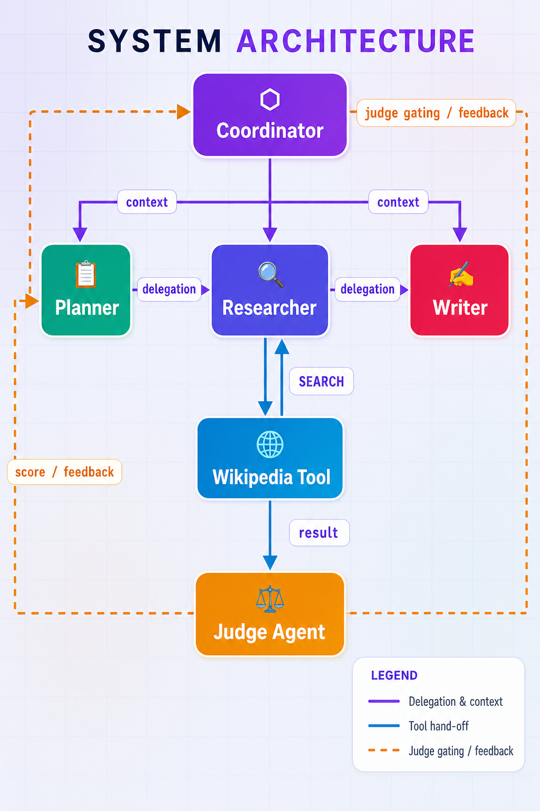
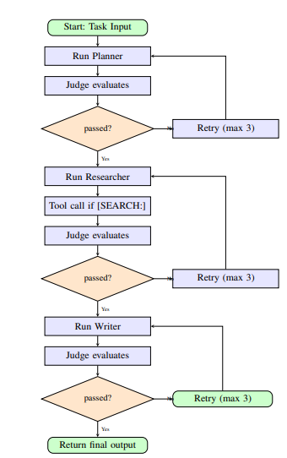
Divide and Conquer: Role Assignment and Coordination Strategies
in LLM-Powered Multi-Agent Systems
Maryam Khalid · Laiba Zubair
Dept. of Data Science & AI | National University of Computer & Emerging Sciences, Islamabad, Pakistan
ABSTRACT
SYSTEM ARCHITECTURE
ORCHESTRATION & FAULT TOLERANCE
SCORE ANALYSIS
Large language models (LLMs) enable a new design space: teams of specialized agents that divide complex tasks and collaborate. This work presents a custom multi-agent orchestration system with three fixed-role agents—Planner, Researcher, and Writer—coordinated by a Judge agent that gates progression via a scored quality threshold. An external Wikipedia tool gives the Researcher optional grounded retrieval. A fault-tolerant retry loop with judge-feedback injection handles agent failures autonomously. Experiments across five open-domain knowledge tasks show a mean judge score of 8.87/10, 100% pipeline completion, and self-correcting behaviour from feedback-augmented retries.
Coordinator
Retry
(max 3)
Retry
(max 3)
MOTIVATION & PROBLEM
ETHICAL CONSIDERATIONS
Single-agent LLMs fail on complex synthesis tasks — planning, research, and writing conflict in one context window.
Role rigidity vs. role confusion: fixed pipelines break under novelty; loose systems duplicate or miss sub-tasks.
No existing framework resolves the triple challenge of flexibility, coherence, and fault tolerance simultaneously.
Core question: How can an LLM system decompose a knowledge task, execute sub-tasks reliably, verify quality, and recover from failures — without human intervention?
Agentic solution is necessary: multi-step reasoning, role-specific execution, quality judgment under uncertainty, autonomous retry.
Hallucination: Judge scores coherence, not factuality — outputs need human verification for high-stakes use.
API reliability: Rate limits (HTTP 429) can corrupt Judge JSON, forcing retries unrelated to output quality.
Bias: Agents inherit LLM training biases — Western-centric viewpoints may appear in politically sensitive tasks.
AGENT ROLES
CONCLUSION & FUTURE WORK
🗂 Planner
Proposed a Judge-gated Planner→Researcher→Writer pipeline with Wikipedia tool hooks and retry logic.
Results: 8.87/10 mean judge score, 100% completion, 1 retry, 1/3 tool success across 5 tasks.
Future (1): Robust Wikipedia title resolution via search-then-fetch.
Future (2): Adaptive role management — Coordinator adjusts system prompts based on agent performance.
Future (3): Human evaluation + multi-seed runs to calibrate Judge and establish reproducible baselines.
Receives raw task → structured step-by-step plan with sub-tasks, research directions, and writing strategy.
🔍 Researcher
Synthesizes information from plan context. Emits [SEARCH: keyword] to invoke Wikipedia tool; Coordinator intercepts, appends observation, re-runs agent.
PER-TASK EVALUATION RESULTS
✍ Writer
Task | Planner | Researcher | Writer | Retries | Tool | Time (s)
T1: Climate Change | 9 | 9 | 9 | 0 | Yes | 151.6
T2: Nuclear Energy | 9 | 9 | 8 | 0 | No | 94.5
T3: COVID-19 Econ. | 9 | 9 | 9 | 0 | Yes | 110.9
T4: AI History | 9 | 8 | 9 | 1 | Yes | 164.6
T5: World War I | 9 | 9 | 9 | 0 | No | 102.0
Mean | 9.0 | 8.8 | 8.8 | 0.2 | 3/5 | 124.7
Consumes full accumulated context (plan + research) → final synthesized document. Strips internal tool markup from output.
KEY RESULTS AT A GLANCE
⚖️ Judge Agent
8.87
100%
1
Outputs JSON only: {score 1–10, feedback, passed (score≥7)}. Coordinator reads 'passed' to gate or retry. Regex fallback if JSON malformed.
Mean Judge Score /10
Pipeline Completion
Retry (of 15 stages)
References: [1] Wang et al. Frontiers 2024 | [2] Deng et al. IEEE TNNLS 2024 | [3] Chen et al. ICLR 2024 | [4] Wu et al. NeurIPS 2024 | [5] Qian et al. ICLR 2024 | [6] Li et al. NeurIPS 2023 | [7] Gronauer & Diepold, AI Rev. 2022 | [8] Liu et al. ICLR 2024
FAST-NUCES Islamabad · Department of Data Science and Artificial Intelligence · Agentic AI

