Slide 1
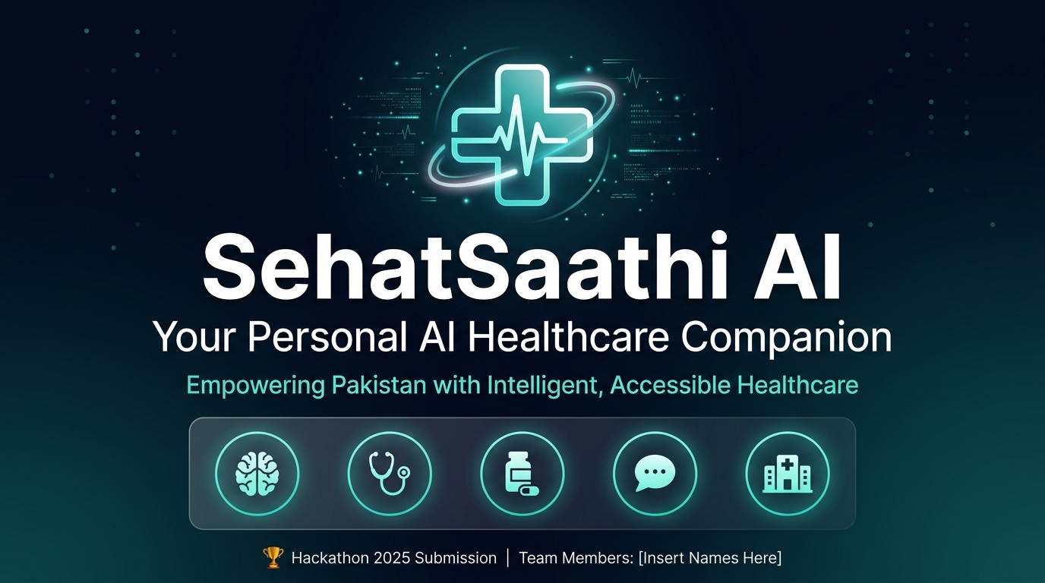
1 / 12

Slide 2
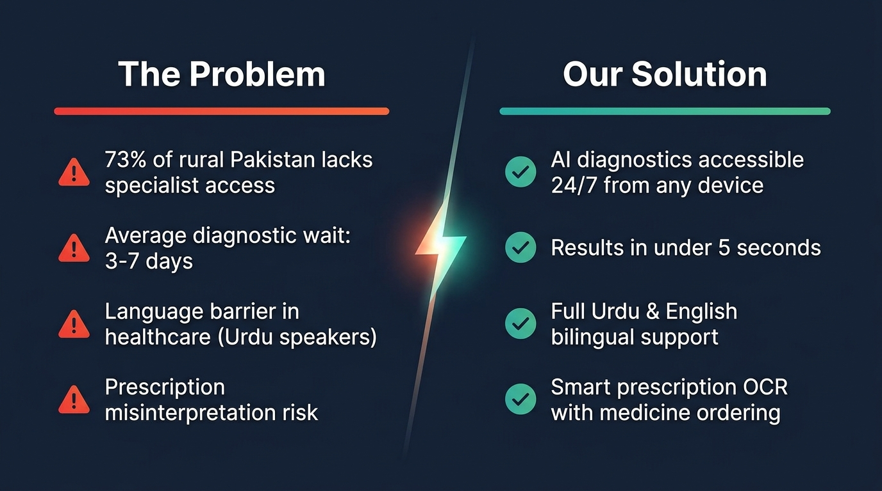
2 / 12

Slide 3
SehatSaathi AI — 8 Healthcare Modules
🔬 AI Diagnostics
🩺 Symptom Checker
🤖 AI Chat (EN/UR)
📜 Prescription OCR
MRI, X-Ray & Skin Analysis ONNX CNN Models • ~99% accuracy
132 symptoms → 41 diseases ONNX SVC ML Model
Groq LLaMA 3.3-70b Bilingual Urdu + English
Tesseract.js — offline Photo → Medicine table → Cart
💊 Pharmacy Store
🏥 Hospital Locator
🥗 Diet Planner
📊 Admin Dashboard
15,000+ real medicines COD checkout, search & filter
OpenStreetMap via Leaflet Filter by city & specialty
Disease-specific meal plans Calorie & BMR calculation
Revenue, orders, AI stats Role-gated via Appwrite
"One platform. Every healthcare need."
3 / 12

Slide 4
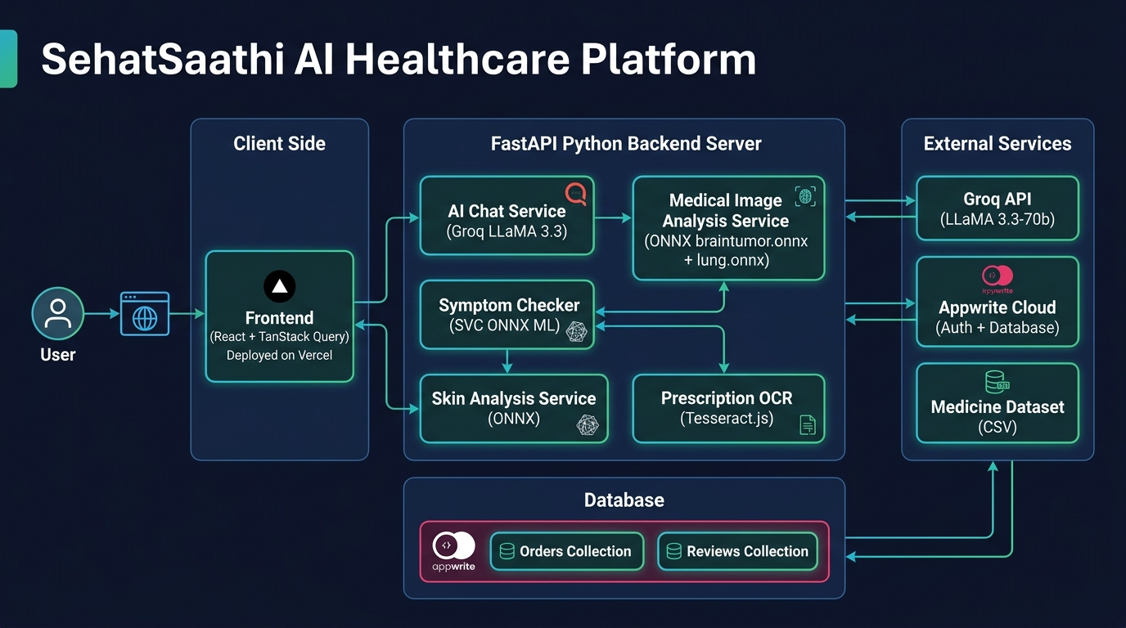
System Architecture
4 / 12

Slide 5
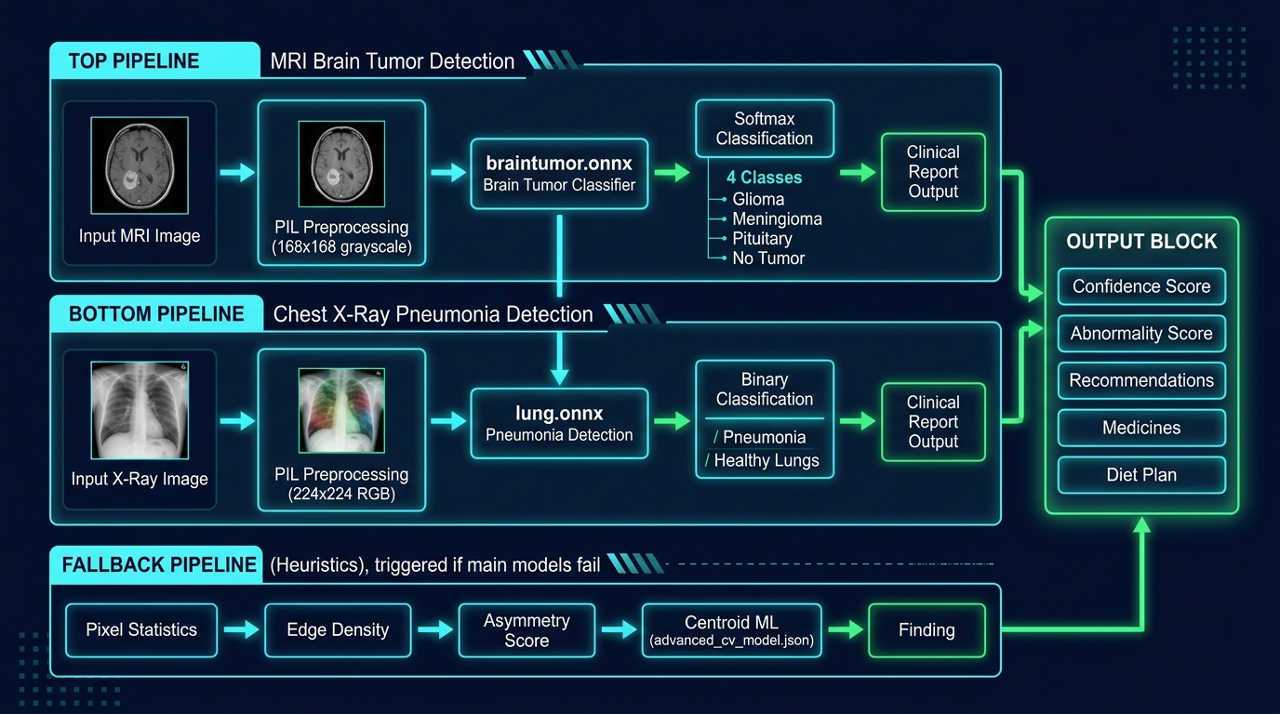
AI / ML Pipeline
5 / 12

Slide 6
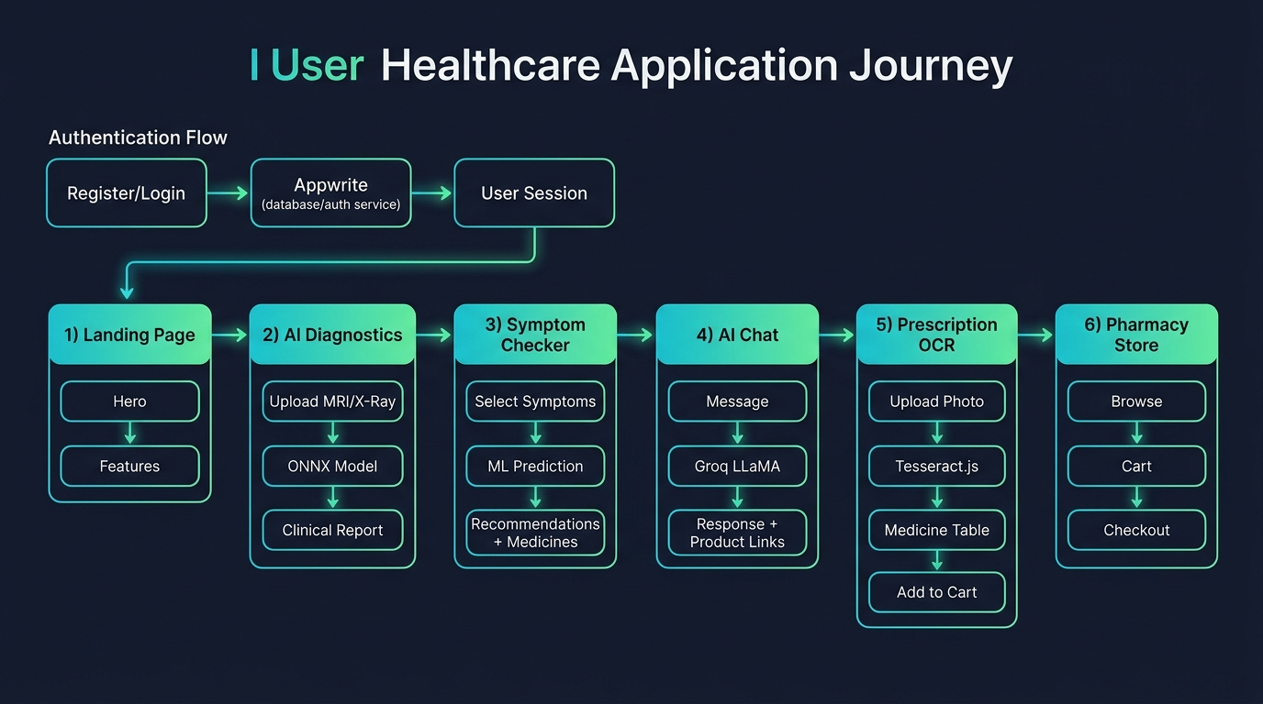
User Journey Flow
6 / 12

Slide 7
AI Chat Assistant — Bilingual (EN / اردو)
🇬🇧 English Mode
🇵🇰 اردو موڈ
User: "I have chest pain for 2 days"
SehatBot: "Chest pain lasting more than a few
minutes can indicate cardiac issues. If the
pain is severe or spreading to your arm,
please seek emergency care immediately.
Please consult a qualified healthcare
professional for accurate diagnosis."
صارف: "مجھے 2 دن سے سینے میں درد ہے"
سیہت ساتھی: "سینے میں درد سنجیدہ
ہو سکتا ہے۔ اگر درد شدید ہو یا
بازو تک پھیلے تو فوری طور پر
ایمرجنسی سے رابطہ کریں۔"
Powered by: Groq LLaMA 3.3-70b
Speed: ~500 tokens/second
7 / 12

Slide 8
Prescription OCR Scanner
INPUT
PROCESSING
OUTPUT
📷 Photo of handwritten
or printed prescription
Drag & drop or click to
upload on any device
Image compressed to
max 1200px for WASM
⚙ Tesseract.js WASM
(100% offline, in browser)
⚙ Image → raw text
⚙ Heuristic parser:
tab / cap / syp / inj
mg / od / bd / tds
⚙ Fallback: OCR.space API
✅ Structured medicine table
Amoxicillin 500 Capsule
Paracetamol 500 Tablet
Brufen 400 Tablet
[ + Cart ] per medicine
[ Add ALL to Cart ]
→ Checkout → COD Delivery
8 / 12

Slide 9
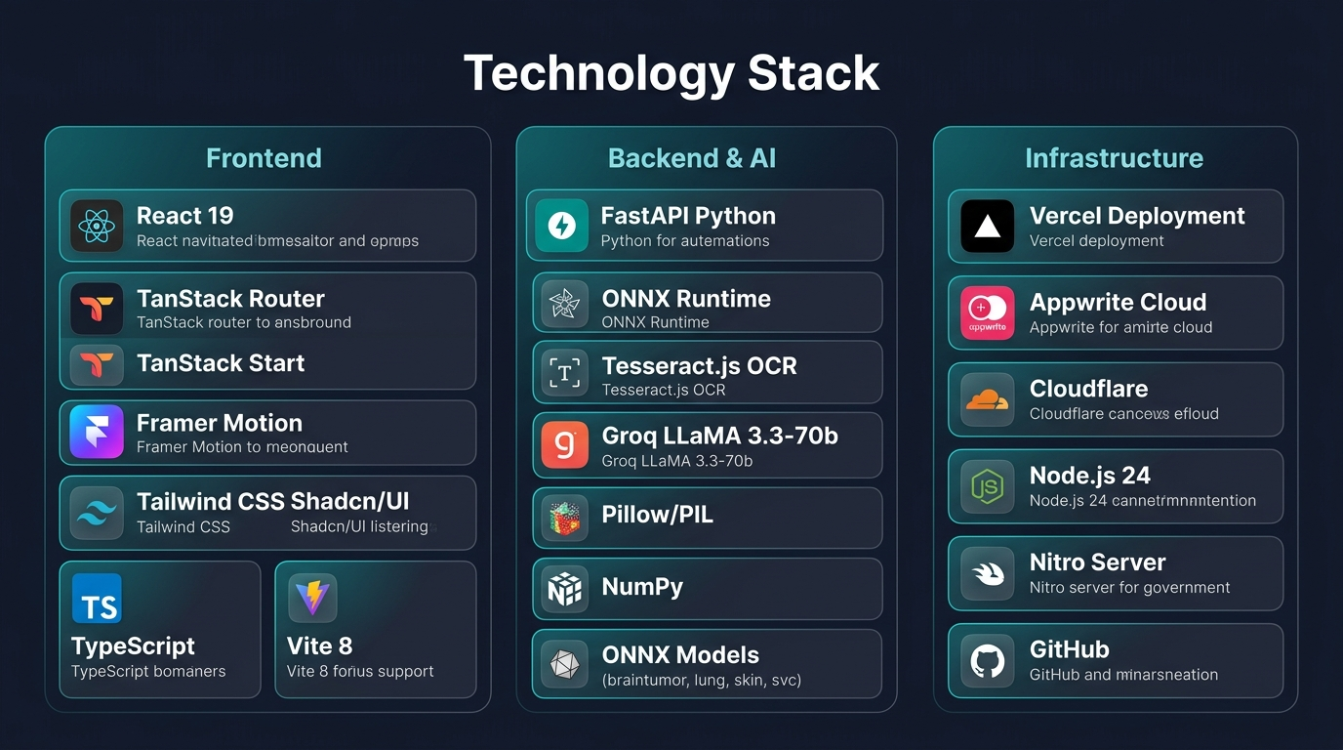
Technology Stack
9 / 12

Slide 10
🌐 Live Demo
https://sehat-saathi-ai.vercel.app
STEP 1 → /diagnostics — Upload a brain MRI or chest X-Ray image
STEP 2 → /symptoms — Select: fever, headache, nausea → predict disease
STEP 3 → /chat — Ask a health question in Urdu
STEP 4 → /prescription — Upload a prescription photo → OCR → Cart
STEP 5 → /pharmacy — Browse medicines → Checkout → COD
GitHub: github.com/maryamtahir7/SehatSaathi-AI
10 / 12

Slide 11
Impact & Metrics
~99%
132
15,000+
Brain Tumor Model Accuracy
Symptoms Supported
Medicines in Pharmacy
< 5 sec
41
2 langs
Full AI Diagnosis Time
Diseases Predicted
English & Urdu
11 / 12

Slide 12
What We Built & What's Next
✅ DELIVERED
🚀 ROADMAP
✅ 8 AI Healthcare Modules
✅ 4 ONNX ML Models (trained)
✅ Bilingual EN / Urdu (RTL)
✅ 15,000+ Medicine Database
✅ Live on Vercel — production
✅ Full E-Commerce Cart + COD
✅ Appwrite Auth & Database
✅ Admin Dashboard
v1.1 → Voice input (Web Speech API)
v1.1 → WhatsApp Bot for rural users
v1.2 → Telemedicine video calls
v1.2 → Retinal & blood report OCR
v2.0 → React Native mobile app
v2.0 → Wearables integration
v2.0 → Pakistan Govt. hospital API
"SehatSaathi AI — Making healthcare intelligent, accessible, and human."
12 / 12

