Slide 1
SehatSaathi AI
Alibaba Cloud Hackathon Presentation
Intelligent Healthcare Ecosystem

Slide 2
The Healthcare Gap
Lack of accessible, immediate diagnostic tools.
Solution: A unified portal for CV diagnostics, OCR, and Pharmacy.
Architecture: Vercel Serverless (Next.js + FastAPI).

Slide 3
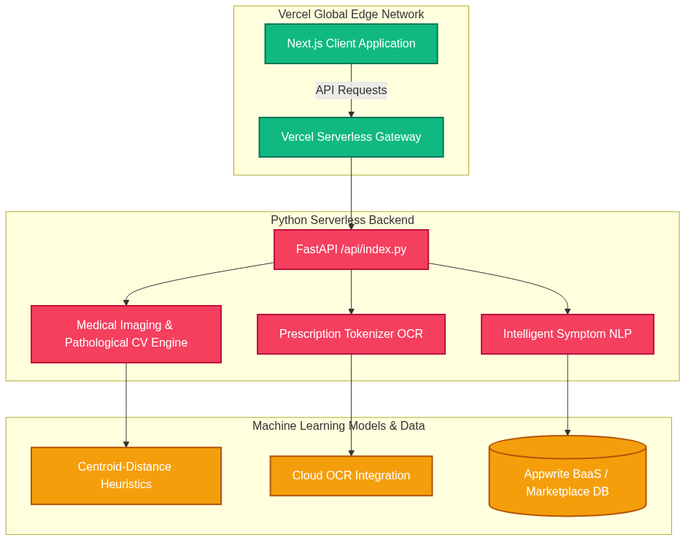
System Architecture

Slide 4
Core Intelligence Modules
1. Medical Image Analysis (Multi-Modal CV & Heuristics)
2. Optical Prescription Parser (Cloud OCR + NLP Matching)
3. Predictive Symptom Analysis (Statistical ML)
4. Integrated Pharmacy Ecosystem

