Slide 1
Predicting Customer Bookings: A Random Forest Approach
Turning 50,000 customer searches into a model that flags who's likely to book
Dataset
Conversion Rate
50,000 flight-booking searches, 14 features, zero missing values
Only 14.96% of searches result in a completed booking
Model
Key Result
Random Forest with 500 trees, tuned for high recall
ROC-AUC 0.79 — flags 68% of true bookers on held-out data
Purpose
Approach at a Glance
The business challenge: most customers who search do not book. This project builds a predictive model to identify high-propensity customers so marketing and operations teams can prioritize outreach, offers, and capacity planning more effectively.
Exploratory analysis of 14 raw features plus engineered signals
Stratified 80/20 train/test split to preserve class balance
5-fold cross-validation for robust evaluation
Feature importance analysis to surface actionable drivers

Slide 2
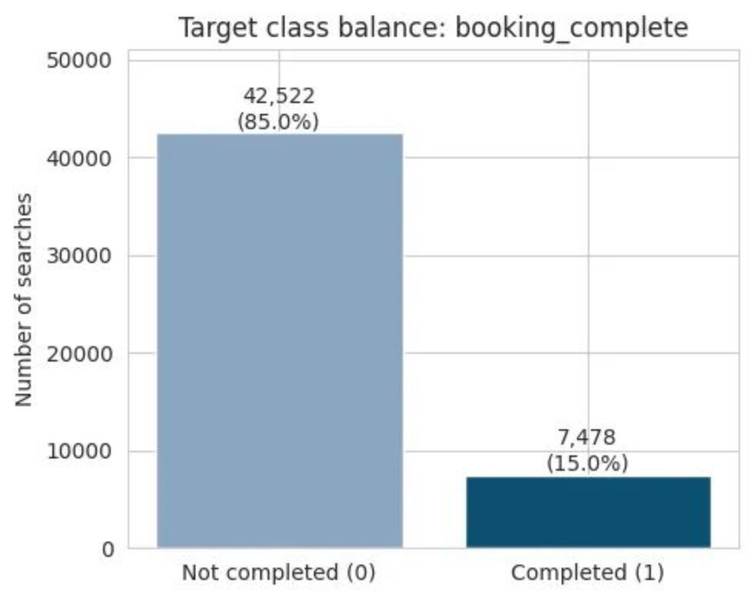
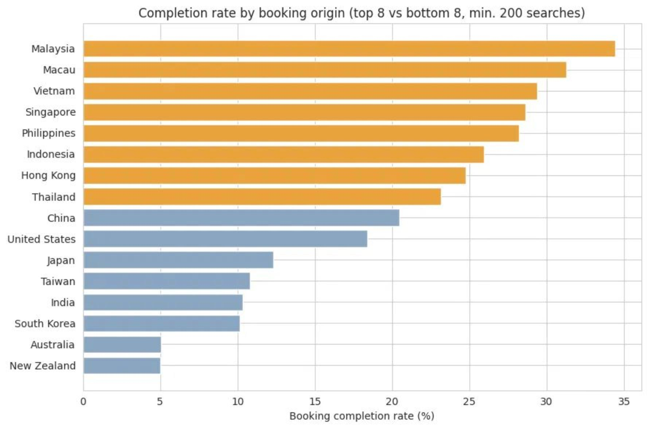
The Data & The Prediction Challenge
Dataset Overview
Raw accuracy is a misleading metric here. A model that predicts "no booking" every time would still be correct 85% of the time.
50,000 customer flight-booking searches with 14 original features: passengers, sales channel, trip type, purchase lead time, length of stay, flight timing, route, booking origin, requested extras, and flight duration. No missing values were found — the dataset is clean and complete.
Only 14.96% of searches convert into a completed booking. This severe class imbalance means standard accuracy metrics are uninformative. The model must be evaluated on precision, recall, and ROC-AUC instead.
Geographic Variation in Conversion Rate
Completion rate ranges from ~5% (Australia, New Zealand) to ~34% (Malaysia). Critically, Australia is the single largest source of searches
at 36% of all data — meaning the market with the lowest conversion dominates the dataset.

Slide 3
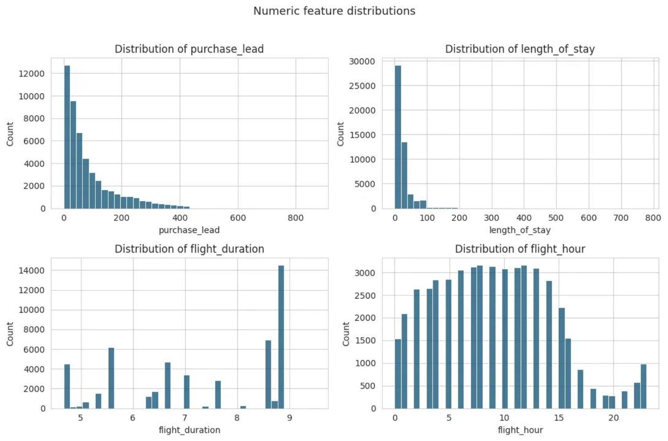
Preparing the Data: Feature Engineering
Engineered Features
Handling Skewed Distributions
flight_day_numeric & is_weekend_flight
purchase_lead and length_of_stay are right-skewed with extreme outliers — up to 867 and 778 days respectively. However, no scaling or transformations were applied: tree-based models like Random Forest are invariant to monotonic feature transforms and handle skewed data natively.
Derived from flight day of the week to capture timing patterns and weekend travel behavior.
route_origin_airport / route_destination_airport
Decomposed from 799 unique route values to expose airport-level signal more cleanly.
total_extras_requested
Aggregate sum of baggage, seat, and meal requests — a single composite engagement signal.
Encoding Strategy & Leakage Prevention
High-cardinality categoricals — route, booking origin, and airport codes — are frequency-encoded rather than one-hot encoded, keeping the feature space manageable. Critically, all encoders are fit only on training data inside a pipeline, preventing any information from the test set from leaking into model training.

Slide 4
Training a Random Forest Model
Why Random Forest?
Non-linear Relationships
Robust to Skew
Interpretability
Captures complex interactions between variables automatically — no manual feature crosses required.
Handles skewed, unscaled features without preprocessing — ideal for purchase_lead and length_of_stay.
Outputs feature_importances_ directly, giving clean insight into which signals drive predictions.
Data Split
Final Hyperparameters
80/20 stratified train/test split
40,000 searches for training — 10,000 held out for final evaluation. Stratification ensures the 85/15 class ratio is preserved in both sets.
Parameter
Value
Rationale
n_estimators
500 trees
Stable variance reduction
max_depth
12
Selected via cross-validation
class_weight
"balanced"
Corrects 85/15 imbalance
Balanced vs. unweighted models and multiple tree depths were compared via cross-validation before settling on these values.

Slide 5
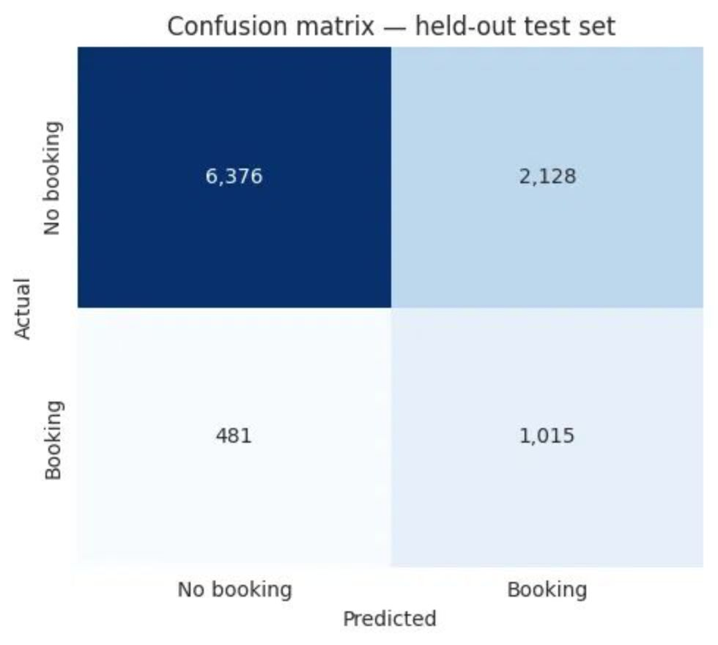
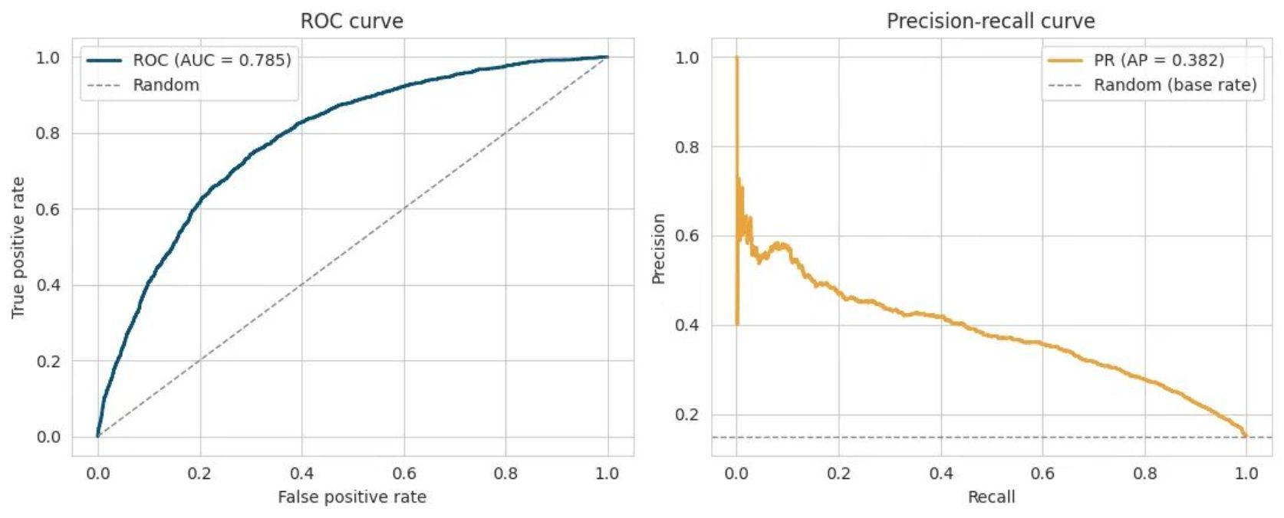

Evaluating the Model
0.79
68%
ROC-AUC
Recall
Held-out test set (10,000 unseen searches)
Correctly flags 68% of customers who go on to book
32%
0.78
Precision
CV ROC-AUC
Of flagged searches, 32% result in actual bookings
5-fold stratified cross-validation mean (std < 0.015)
Confusion Matrix
ROC & Precision-Recall Curves
Design choice: The model is deliberately tuned to favor recall over precision — better suited to broadly prioritizing likely bookers than guaranteeing any individual prediction. The classification threshold can be adjusted once a concrete downstream use case is defined.

Slide 6
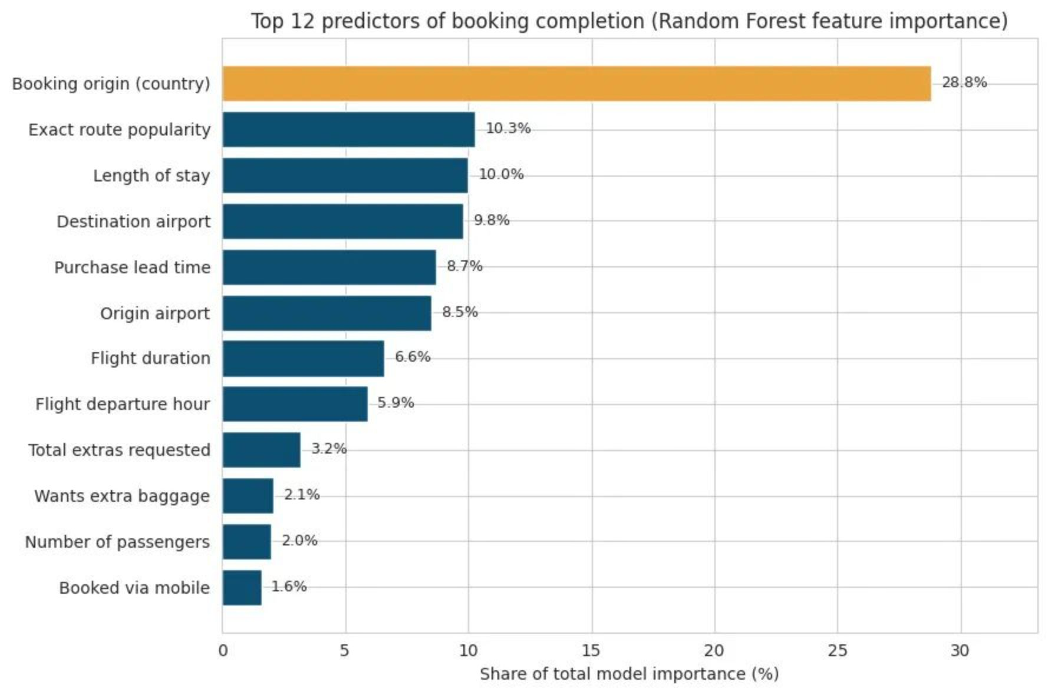
What Drives Booking Completion?
Feature Importance Breakdown
~29% — Booking Origin (Country)
~27% — Route & Airport Popularity
The dominant predictor, accounting for nearly 3× the importance of the next-highest feature. Where a customer is booking from is the strongest signal in the model.
Combined contribution of route frequency-encoding and decomposed origin/destination airport signals.
Trip Logistics Over Extras
<0.2% — Trip Type
Carries almost no importance. Because 99% of bookings are round trips, there is too little variation for the model to learn a meaningful signal.
Length of stay and purchase lead time outweigh specific add-ons like baggage, seat selection, and meal requests.

Slide 7

Executive Summary & Recommendations
Model Performance
Recommended Actions
ROC-AUC 0.79 on 10,000 unseen searches. The model correctly flags 68% of customers who go on to book — well above the 15% baseline conversion rate. Cross-validation scores (ROC-AUC 0.78, recall 0.65, avg. precision 0.37) are consistent across folds with standard deviation under 0.015, confirming the model generalizes reliably.
1
Prioritize High-Propensity Searches
Use model scores to rank searches by booking likelihood — by market and route — and direct targeted follow-up or promotional offers to the highest-scoring segments first.
Top Driver
2
Investigate the Australia Gap
The country a customer is booking from accounts for ~29% of total model importance — by a wide margin the single most predictive feature in the dataset.
Australia is the largest single source of searches at 36% of all data, yet converts at just 5% — compared to 34% in Malaysia. Understanding this gap is the highest-leverage business question surfaced by the model.
Caveat on threshold tuning: The model currently favors recall over precision. The classification decision threshold should be revisited once a concrete downstream use case (e.g. email campaign, seat hold, dynamic pricing) is defined — the optimal trade-off depends entirely on the cost of a false positive versus a missed booker in that context.

