Slide 1
Retail Analysis Capstone
Mary Anna Garifo

Slide 2

Hello! I’m Mary Anna
Started career as an Earth Science Geographic Information System (GIS) Teacher
Current Booz Allen consultant with the Air Force’s Operational Energy – as a result of this class ☺
.1% of Spotify listener of Taylor Swift

Slide 3
Agenda
01
Objective
What is the goal?
02
Methodology
How was it done?
03
Analysis
What work was done?
04
Conclusion
Are there recommendations?
05
Q&A
What thoughts did this provoke?

Slide 4
Objective
01
Take retail transaction data and turn it into insights to drive a strategic decision-making marketing campaign
Optimizing promotional strategies to maximize their effectiveness and return on investment

Slide 5
62,748
… numbers in my dataset and its my job is to reveal their meaning.

Slide 6
Methodology
ID
Birth_Year
Age
Education
Marital_Status
Income
Kids
Teens
Date
Recency
MntWines
MntFruits
MntMeatProducts
MntFishProducts
MntSweetProducts
MntGoldProds
NumDealsPurchases
NumWebPurchases
NumCatalogPurchases
NumStorePurchases
NumWebVisitsMonth
AcceptedCmp3
AcceptedCmp4
AcceptedCmp5
AcceptedCmp1
AcceptedCmp2
Complain
Response
02
Marketing Campaign dataset
Rows 2,241, Columns 28
Tools: Excel, SQL, Tableau, Python

Slide 7
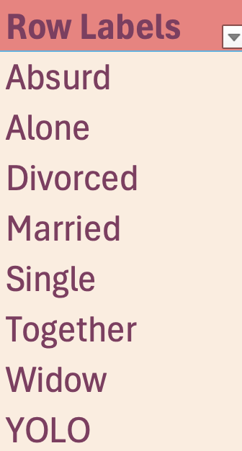
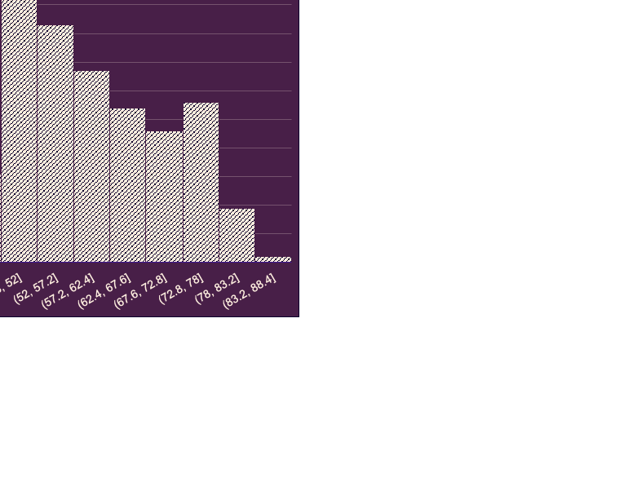
Cleaning & Statistical Tests
01
Missing Data
04
Statistical Tests
Mix tool use
Missing data for ‘income’
02
Quality
Martial Status
Education (2n Cycle & Basic)
03
Time
Dash vs Slash
European style vs American

Slide 8
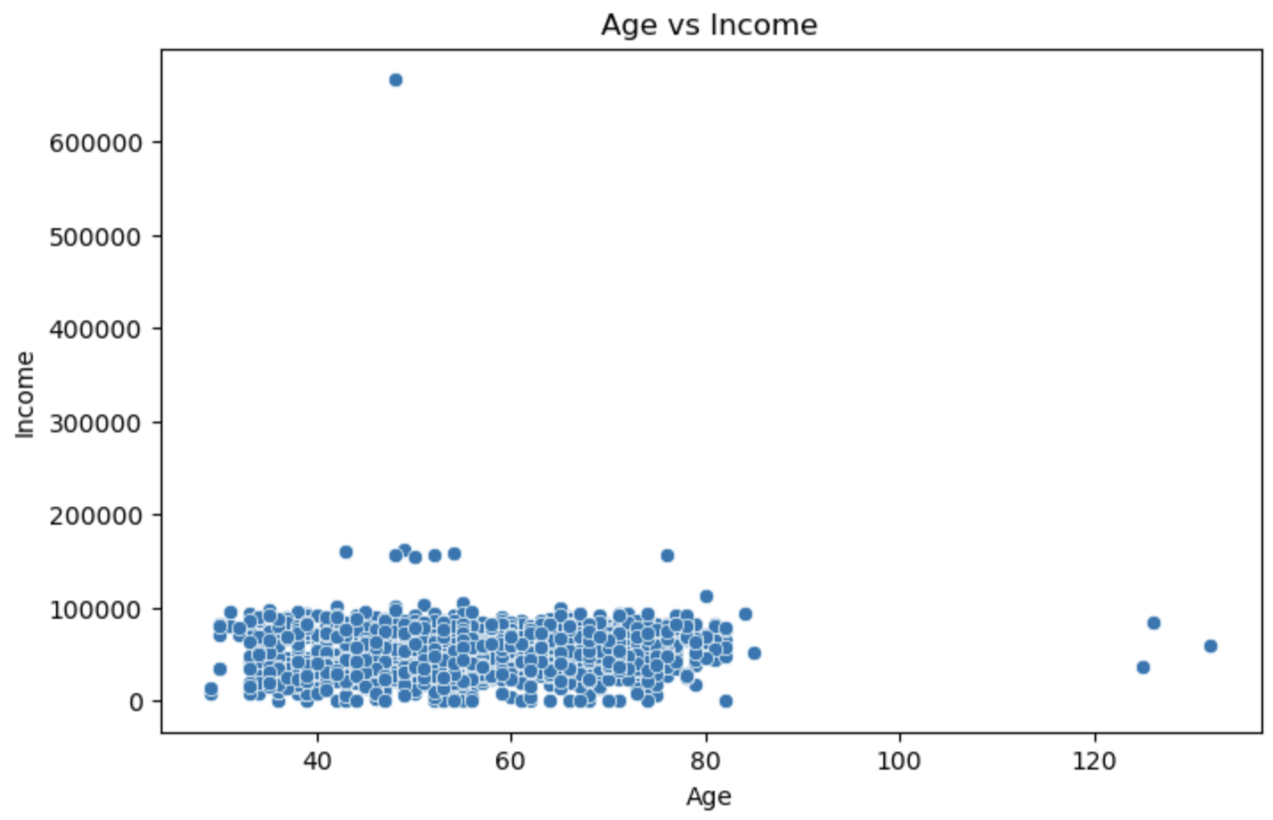
Age VS Income
Changed income of $666,666 to $66,666
Instead of being born in 1893, with a teen child, more likely born in 1993

Slide 9
Analysis
03

Slide 10
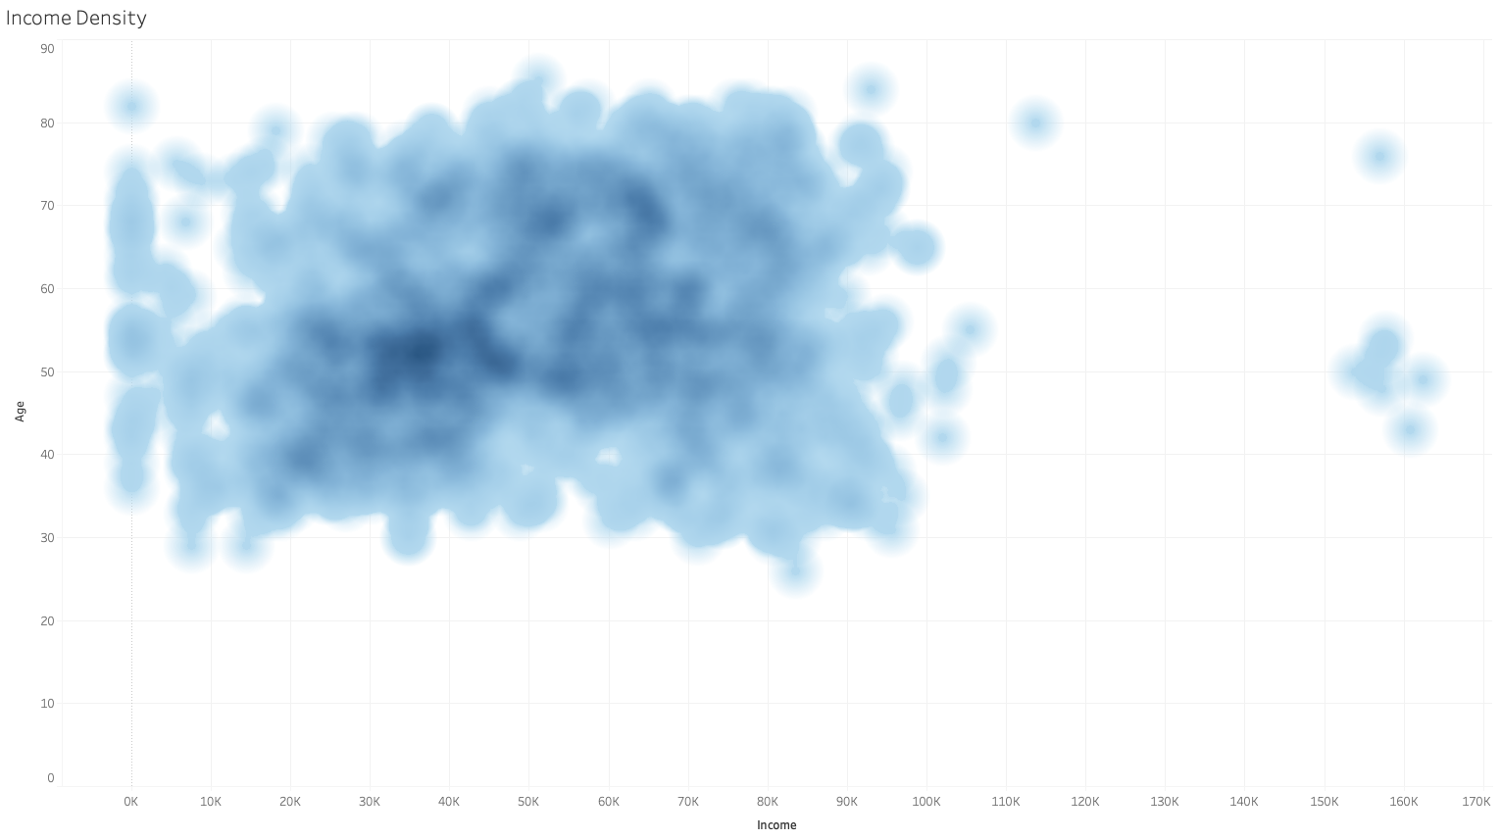
Age VS Income
Most people’s income in below 100,000 so marketing should target incomes below that level. The largest cluster is people between 45 and 75 with an income between $40,000 and $80,000.

Slide 11
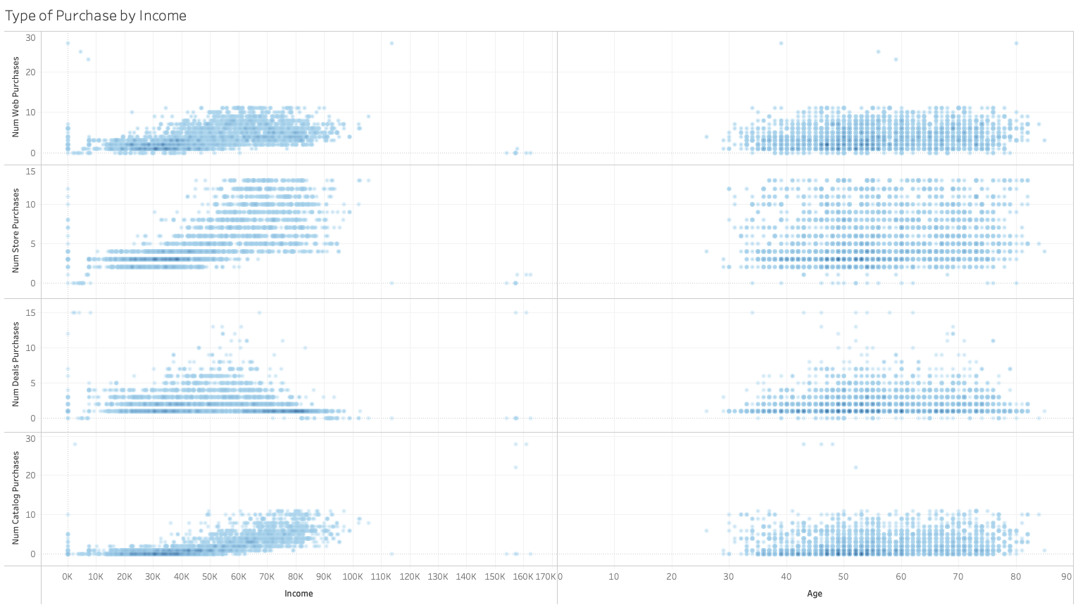
Income, Age, and Type of Purchases
Strongest Relationship
Weakest relationships

Slide 12
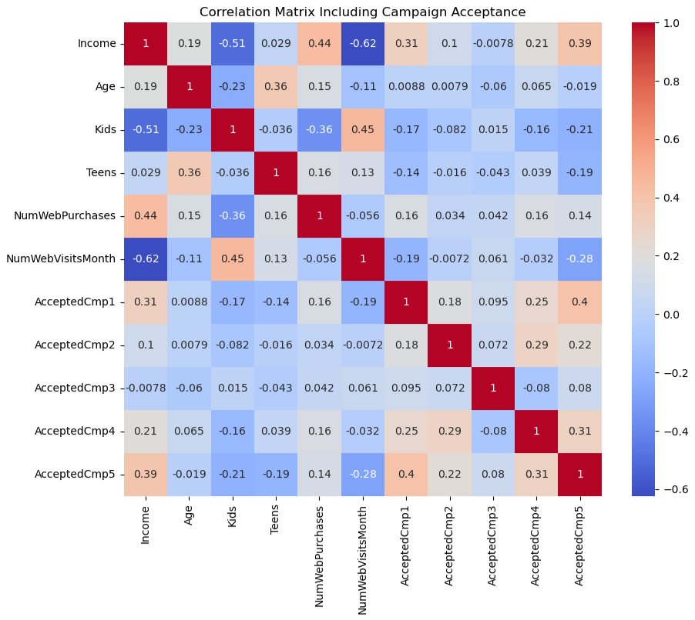
Matrix Heat Map
Higher income correlates to more web purchases
High income correlates to lower web visits

Slide 13
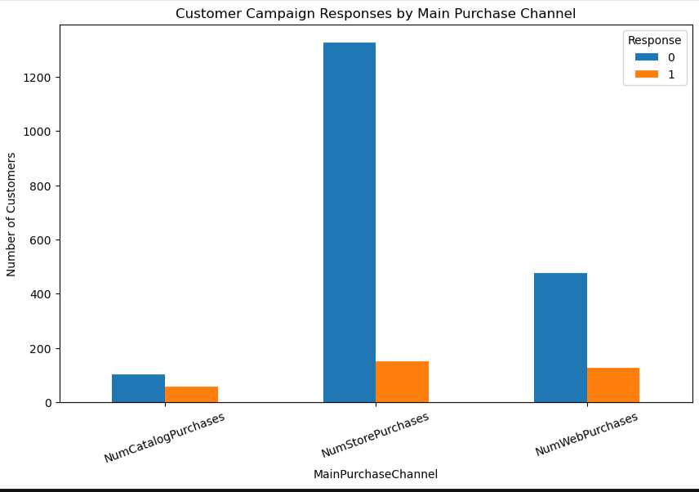
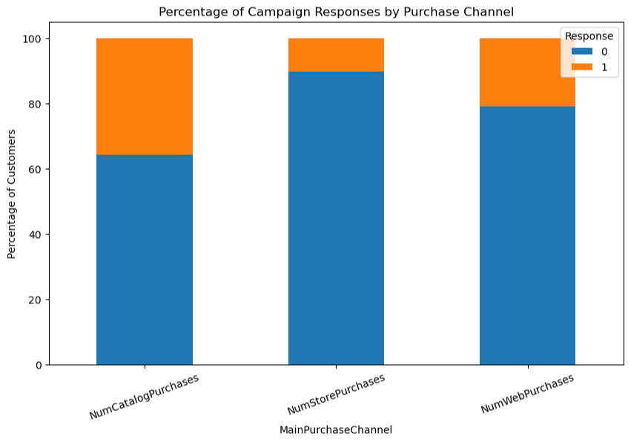
Web VS Catalog Shopping
312
334
333

Slide 14
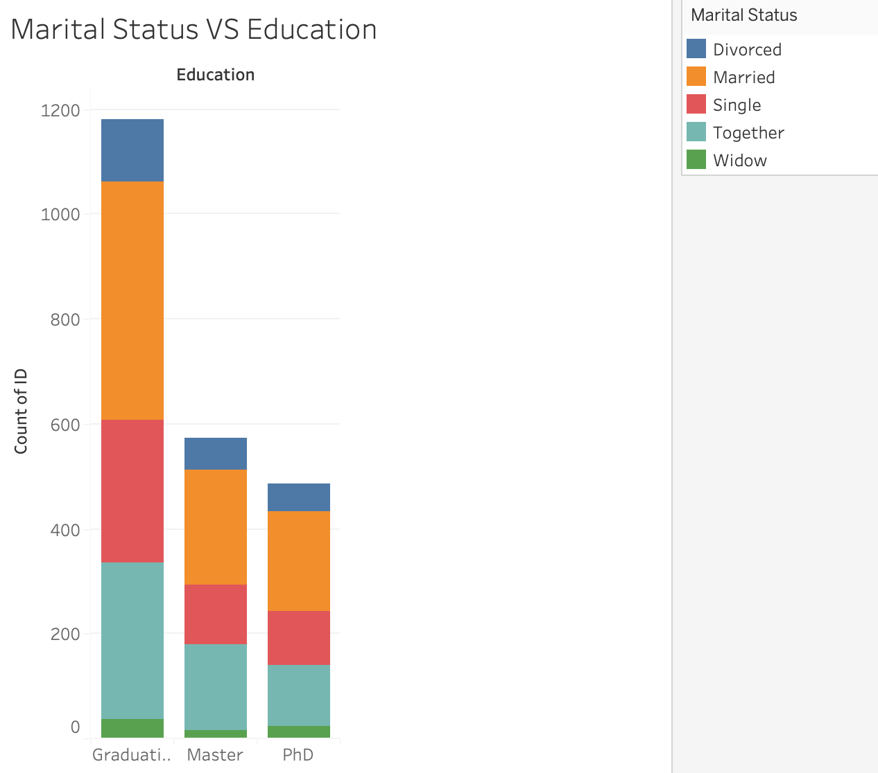
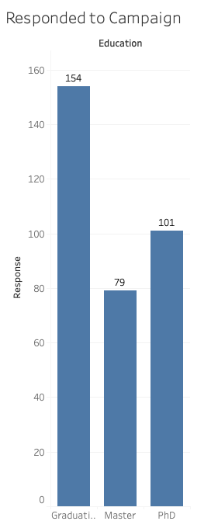
Marital Status VS Education VS Response

Slide 15
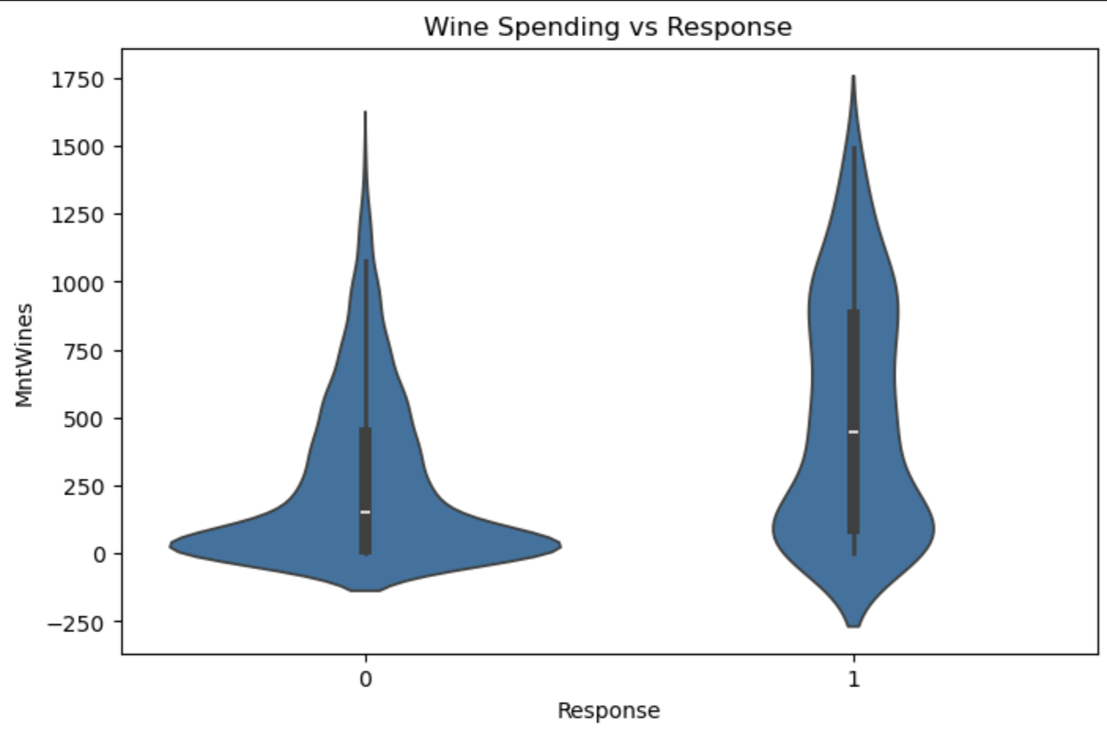
Wine Spending
Higher median & interquartile range
People who buy wine are more likely to response to campaigns

Slide 16
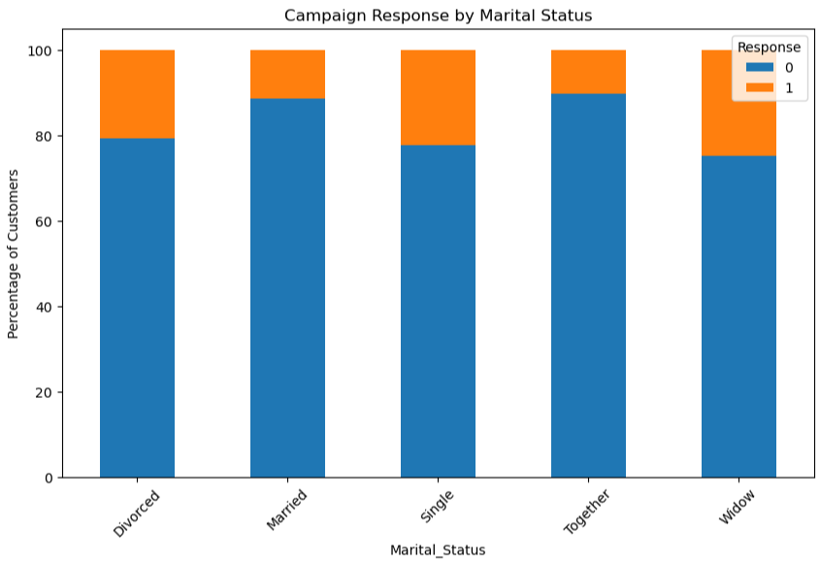
Alone Individuals
Divorced, Single, and Widows have a higher percent of responding to marketing campaigns.

Slide 17
Conclusion
04

Slide 18
Recommendations
01
02
03
Online
People Alone
PhD
Online has more people shopping than catalog and a higher success rate than in-person.
Focus on single serving food products as alone people are 7% more likely to response to campaigns
101 out of 486 PhD educated shoppers participated in the campaign

Slide 19
Thank you!
Do you have any questions?
maryannagarifo@gmail.com

