Slide 1

INTERNAL GUIDE
Client Meeting Etiquette
Presence, preparation, and professionalism — in the room and on the call.
ArkDev · People & Culture
2026 Edition
Notes:
Welcome — set the tone: this refreshes our client-meeting etiquette for how we actually meet clients today, in person and on screen.

Slide 2
WHY IT MATTERS
Etiquette isn't formality. It's clarity.
“Dress gives the outward sign from which people judge the inward state of mind. One they can see, the other they cannot.”
A code of conduct — written and unwritten — for the behavior clients expect from anyone representing us. It's how we signal that we're organized, attentive, and worth trusting with real work.
Attributed advice to the Prince of Wales, HM Queen Elizabeth II
Notes:
Reframe etiquette as clarity of intent, not formality for its own sake. Read the quote.

Slide 3
01
Caring About Details
What you wear says a lot about you. People assume the quality of your work matches the quality of your appearance.
Notes:
Transition into the details act.

Slide 4
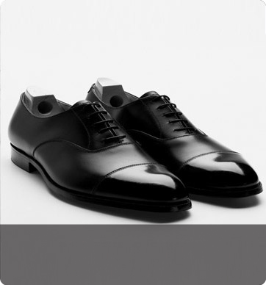
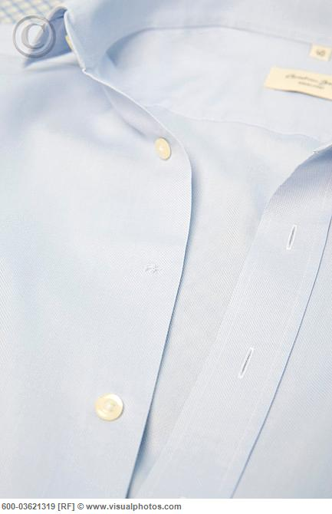

Grooming & Polish Checklist
The details clients notice before you say a word.
FOOTWEAR
GARMENT CARE
TIMING
Polished shoes,
belt matching shoe color,
briefcase kept to the same standard.
Buttons secure,
no loose threads,
no visible spots or wrinkles.
Wear a watch.
Business runs on schedules — promptness counts, visibly.
Notes:
Walk through the small things that get noticed: shoes, belt, briefcase, buttons, watch.

Slide 5
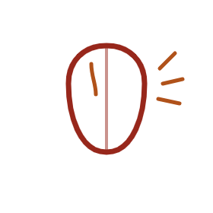
Mouth Also Counts
Small hygiene details clients notice up close.
Mind your breath — watch coffee, garlic, smoking.
Trim your nails.
Shave, or keep facial hair neatly groomed.
Go light on makeup and perfume or cologne.
Notes:
Personal grooming basics from the original deck: breath, teeth, shave, nails, makeup, perfume.

Slide 6
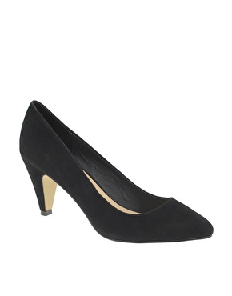
Clothes
Suits, pantsuits, blazers with shirts or blouses. Knee-length skirts, shirts tucked in.
Hair
Neat, combed, simple and natural.
Client Dress Code — In Person
Accessories
Small earrings, minimal jewelry, only a watch and essential rings. Socks match trousers.
At least semi-formal, every time.
Colors & Fabric
Neutral tones — no bright or fluorescent colors. Structured fabrics; skip cotton and denim.
Notes:
Condensed in-person client dress code: clothes, hair, accessories, colors and fabrics.

Slide 7
Meeting Prep — Before You Walk In
Remember to, every time:
01
Prepare and share the agenda in advance.
02
Assign a moderator to run the room.
03
Confirm dress code: formal or smart casual.
04
First time meeting? Introduce yourself and your team.
05
No side conversations while someone else is talking.
06
Concentrate — it's not your phone's time.
Notes:
Cover the before-you-walk-in checklist: agenda, moderator, dress code, first-timer intros.

Slide 8
02
Presence, In Person and On Screen
Most client meetings today happen over video, not across a table. The courtesies have to travel with us.
Notes:
Transition into presence: in person and on screen.

Slide 9
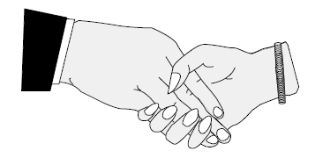
Meeting-Room Courtesies
01
02
Arriving
In Their Space
The Handshake
Never be late. If you are, apologize and explain.
Present your business card if you have one.
Keep your jacket on.
Bag on the floor or your lap.
Never touch things on someone else's desk.
Firm but painless,
eye contact, about three seconds —
two or three pumps, no more.
Notes:
In-person basics: office visits, doors, handshake.

Slide 10

Doors
First to reach it? Open, go through, hold it — regardless of gender.
With a senior executive? Let them go through first.
Someone's arms full? Hold it, regardless of role.
Notes:
Restored from the original deck's two door-etiquette slides.

Slide 11

Elevators
Nearest the door? Board first, hold it till everyone's in.
Nearest the panel? Ask floors, press them for others.
Nearest the door on exit? Step out, let others off, then reboard.
Notes:
Restored from the original deck's elevator-etiquette slide.

Slide 12

A Few Words on Complimenting
Graceful in, graceful out.
Never ask what something cost, or where they got it.
Don't brag about your own price tags or labels.
Complimented? A simple thank-you is enough.
Notes:
Old deck's etiquette on compliments — don't ask cost, don't brag, don't feel obligated to return.

Slide 13
Miscellaneous Courtesies
Keep bathroom habits out of the conversation.
Skip put-on-the-spot questions ("Why do you ask?").
Cover a sneeze.
Say please, thank you, and excuse me — always.
Notes:
Restored from the original deck's miscellaneous-etiquette slide.

Slide 14
Buffet Etiquette
Be patient — queue, don't cut the line.
Use the serving spoon, not your hands.
Take a small portion first — go back for more.
Fresh plate per course; dessert and seafood separate.
Notes:
Restored from the original deck's two buffet-etiquette slides.

Slide 15

Smoking
No ashtray, no smoking. Don't ask a client if they mind — request a table in the smoking section if one exists.
Notes:
Restored from the original deck's smoking-etiquette slide.

Slide 16
Video Call Presence
The same standards — reframed for a camera.
Camera on, at eye level. Frame yourself from chest up, camera roughly eye height.
Light your face, not your back. Face a window or lamp; never sit in front of one.
Keep backgrounds neutral. Tidy real room or a plain blurred background — no clutter, no distractions.
Mute when not speaking. Unmute a beat before you talk so the first word isn't lost.
Dress as you would in the room. Clients see waist-up — dress like it, in case you stand.
Join two minutes early. Test audio and video before the client is waiting on you.
Notes:
New section: camera, lighting, background, mute discipline, dress.

Slide 17
Hybrid Meeting-Room Courtesies
When some of the room is remote, the room owes them attention too.
Frame the room
Position the camera to show everyone present, not just whoever sits closest.
One conversation
No side talk in the room that remote attendees can't hear or join.
Say who's talking
State your name before speaking so remote attendees can follow without seeing faces.
Actively invite them in
Pause for remote questions — don't let the in-room energy carry the whole meeting.
Notes:
New section: hybrid room courtesies — camera framing, mic discipline, including remote attendees.

Slide 18
03
Working With Clients
Our clients span the US, the Gulf, and Europe. Respect and security travel across every one of those meetings.
Notes:
Transition into working-with-clients act.

Slide 19
Cross-Cultural Client Etiquette
Same core respect — different norms to read the room on.
United States
Egypt & Middle East
Europe
Direct communication, first names common once invited, punctuality is strict, small talk brief before business.
Greet the most senior person first, expect relationship-building before business, right hand for exchanges, modest dress.
Formal titles until told otherwise, precise scheduling, understated dress — avoid over-familiarity early on.
When in doubt: default to the more formal option, and let the client set the pace toward casual.
Notes:
New section: cross-cultural etiquette across US, Gulf, Europe.

Slide 20
Confidentiality & Screen Discipline
Trust is part of the etiquette too.
Close what you don't need open. Before screen sharing, quit unrelated tabs, chats, and notifications.
Know the NDA status. Confirm what's covered before sharing another client's work as an example.
Lock your device. Never leave a laptop open and unattended in a client's office.
Record only with consent. Ask before recording or transcribing any client call.
Notes:
New section: cybersecurity and confidentiality basics for client meetings.

Slide 21
Finally, Take Care NOT To
Express negative attitudes or criticize others in public.
Wear inappropriate clothing for the setting.
Fail to make introductions or disregard social courtesies.
Make people wait without explanation.
Mispronounce or forget a client's name.
Use vulgar or inappropriate language.
Notes:
Refresh of the finally-take-care-of slide.

Slide 22
IN SHORT
Prepare. Present. Protect.
Prepare — agenda, moderator, and dress code set before anyone joins.
Present — the same standard in the room and on camera.
Protect — client trust, confidentiality, and their time.
Thank you!
Notes:
Close on three pillars: prepare, present, protect. Thank you.

