Slide 1

AResume: A Web-based Resume Generator with Augmented Reality Features
Mary Chew Jia Yi
B02170010

Slide 2

Chapter 1:
Introduction

Slide 3
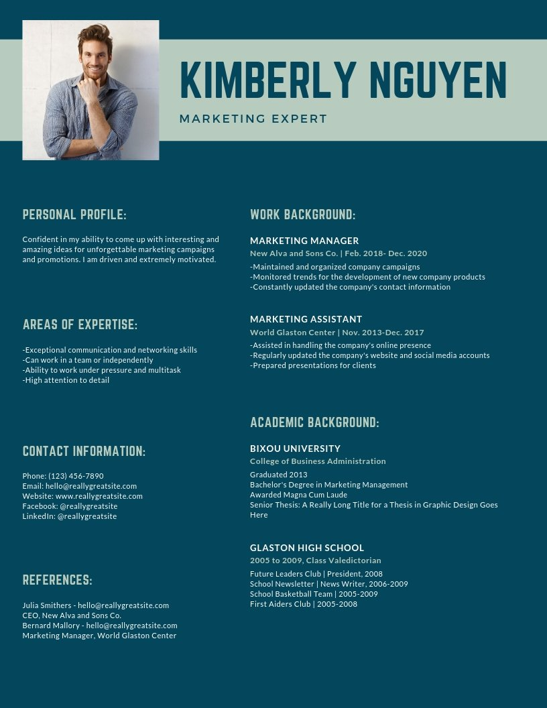
What is resume?
A document of several pages about a job applicant’s profile
To apply for posted jobs of any fields
As a marketing tool to an employer

Slide 4
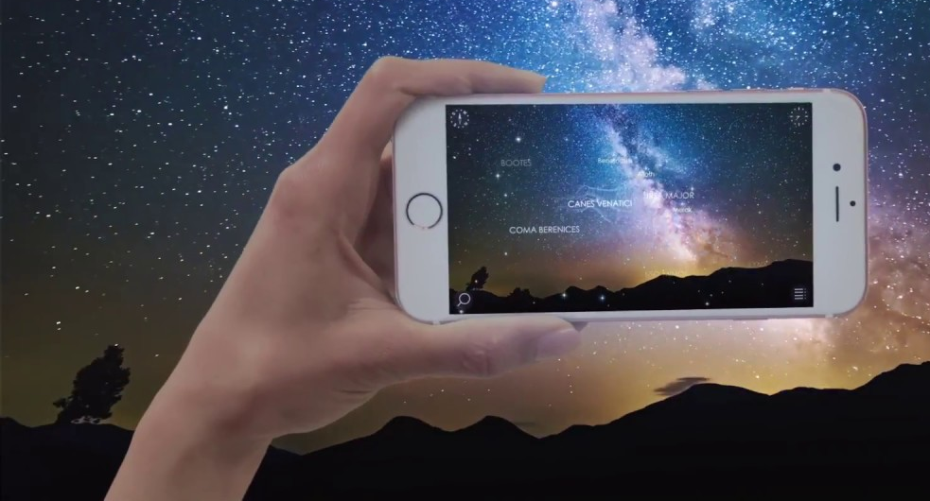

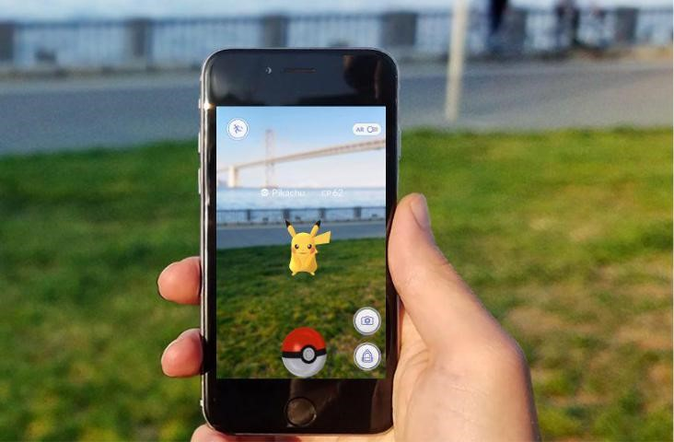
What is AR?
Expands physical world by adding layers of digital information
Education, tourism, furniture, healthcare, manufacturing

Slide 5
Problem Statement
Lack of experience of fresh graduates in building a resume
Attempt “one-size-fit-all” approach
Processes of drafting, formatting and writing are tedious

Slide 6

Aim
To develop a resume generator for job applicants to create resume online with AR technology

Slide 7

Objectives
To study the comparison analysis of the existing similar applications
To develop a web-based application that generates an AR resume
To test the usability of the application with user acceptance testing

Slide 8





Scope

Slide 9

Chapter 2:
Literature
Review

Slide 10
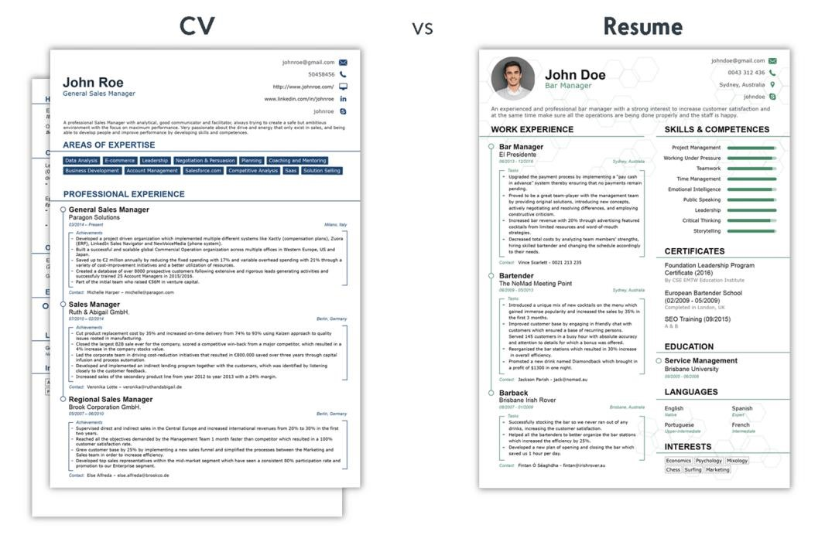
Resume
Curriculum vitae

Slide 11

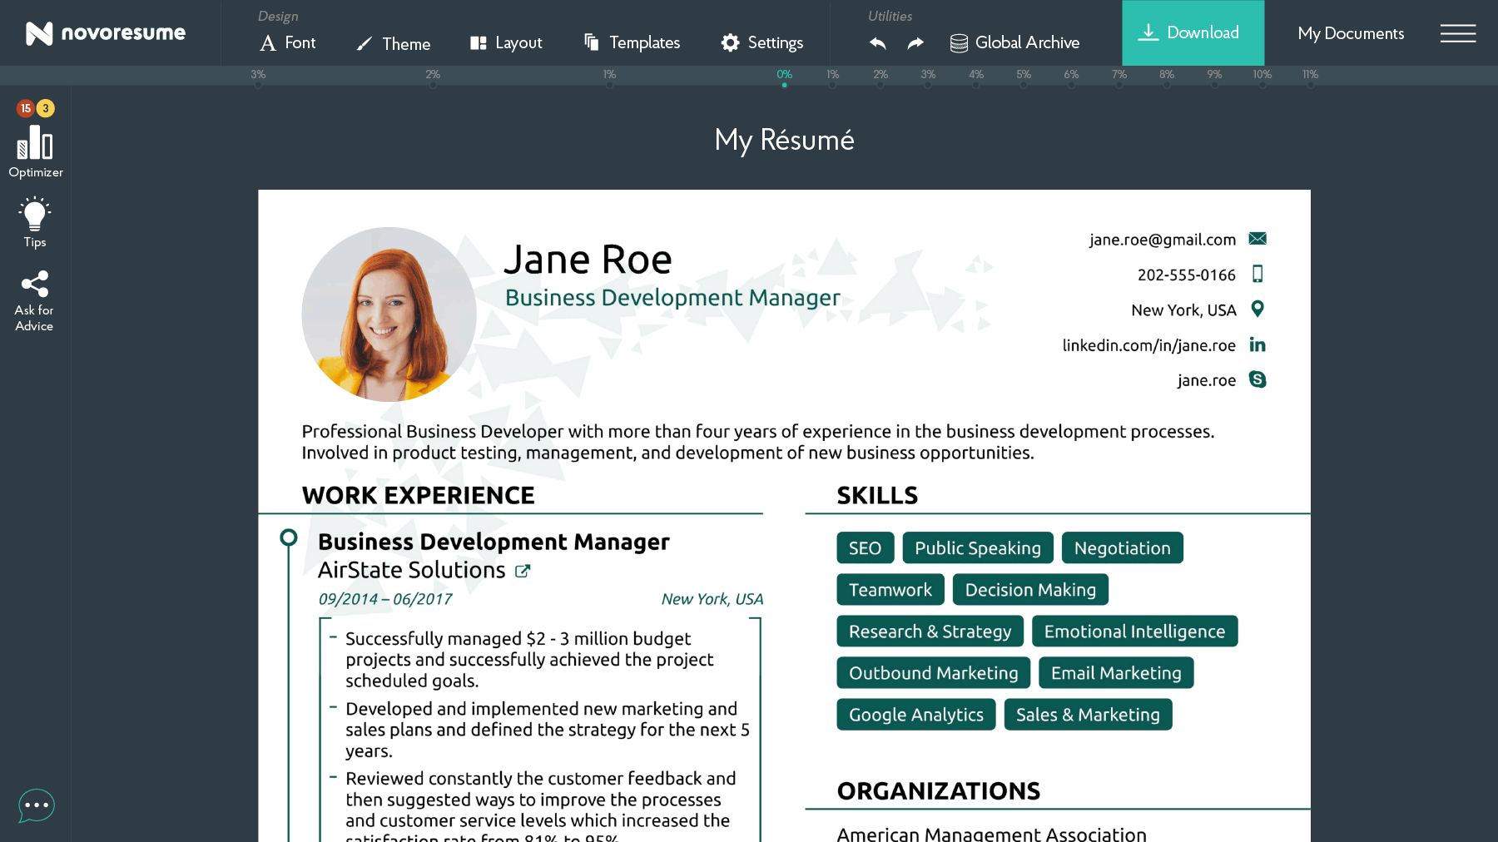
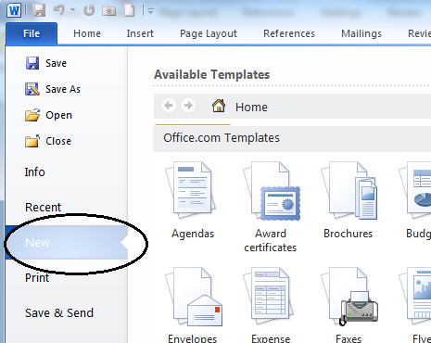
Ways to build a resume
Buy a resume writing service and hire a professional resume writer
Use an online resume builder on the web
Use an offline resume builder

Slide 12

Augmented Reality

Slide 13
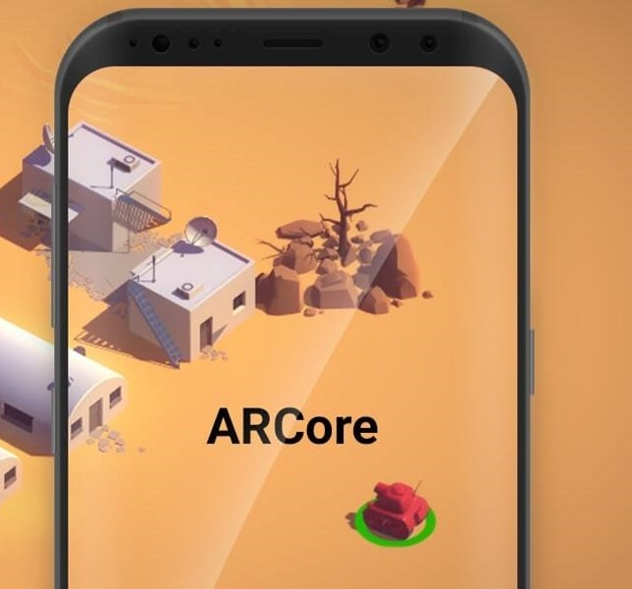
Mobile AR
Hardware-based and app-based
Sensor-based, vision-based, hybrid-tracking methods
Supports marker-based and markerless-based
Computational, storage and networking

Slide 14
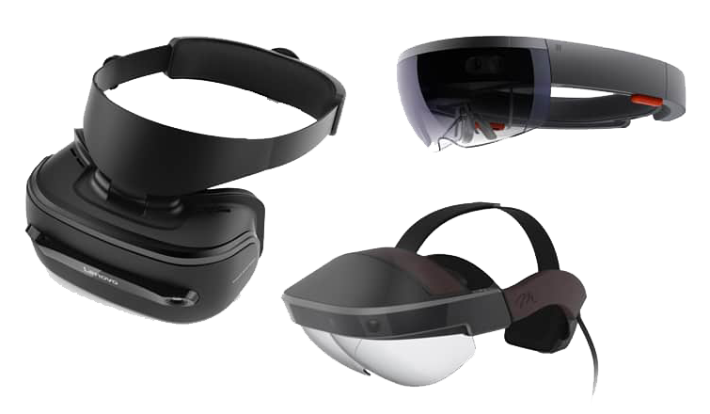
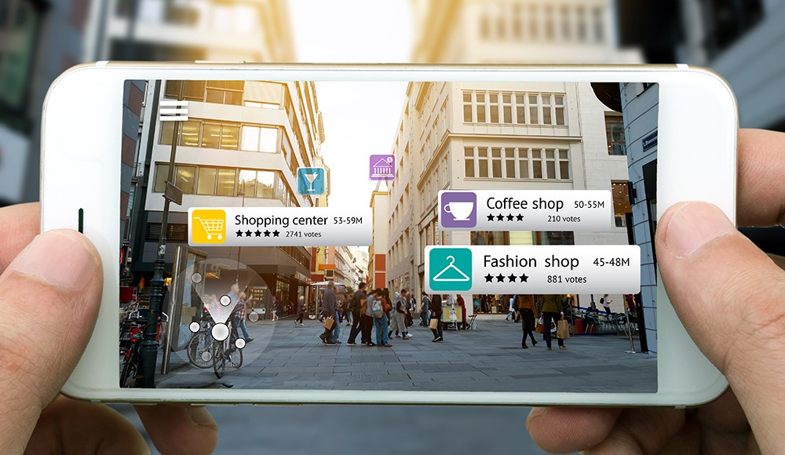
Disadvantages of mobile AR
Costly, lack of flexibility
Additional downloading and installation
Lack of cross-platform support

Slide 15
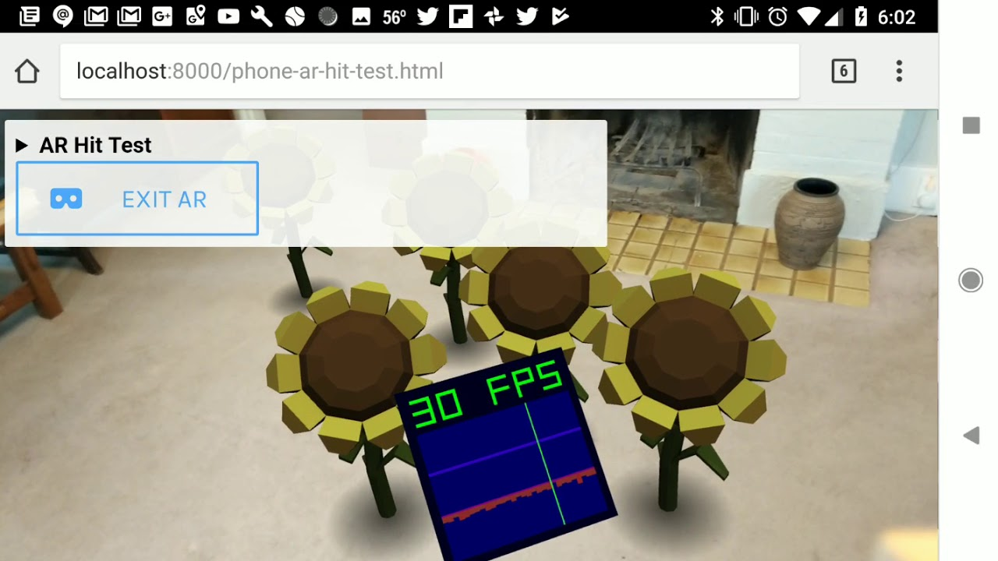
Web AR
The future promising direction for mobile AR
Lightweight, native cross-platform, pervasive service provisioning of mobile AR
Facebook, Snapchat

Slide 16




Challenges of web AR
Limited computing, rendering
Performance degraded
Network delay
Limited data rate
Real-time operations affected
Limited battery capability
Tremendous pressure on battery
Compatibility issue
Display platform, OS, data, sensor

Slide 17


Solutions for web AR
Offloading computation-intensive tasks to the remote cloud
Solve issues of limited computing, battery capability
5G network
Provides higher bandwidth, lower network delay

Slide 18







Comparison between similar applications
Features
Free account signup | √ | √ | √ | √ | √ | √ | √
File export | x | √ | x | x | x | x | √
Free subscription | x | √ | x | √ | x | x | √
Free resume download | x | √ | x | x | x | x | √
Free customization | √ | √ | √ | √ | √ | √ | √
Cross-platform support | x | x | x | √ | √ | √ | √
Web AR support | x | x | x | √ | √ | √ | √

Slide 19
Comparison between similar applications
Features
Digital media upload | √ | x | √ | √ | √ | √ | √
Produce augmented contents | x | x | √ | √ | √ | √ | √
Free hosting | x | x | x | √ | √ | √ | √
Free publication | x | x | √ | √ | x | √ | √
Marker-based support | x | x | x | √ | x | √ | √
Generate sharable URL | √ | x | √ | √ | √ | √ | √
Create augmented resume | x | x | x | x | x | x | √

Slide 20

Chapter 3: Methodology

Slide 21
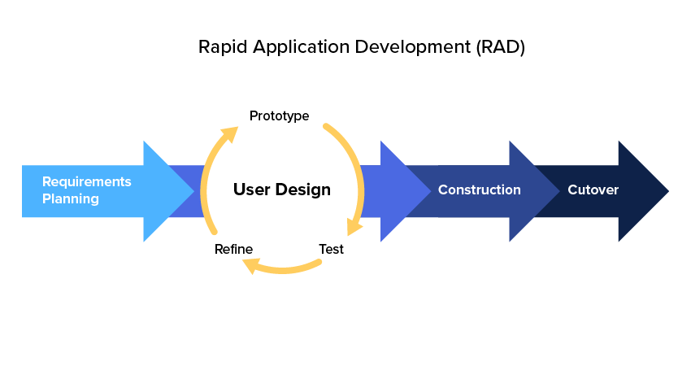
Rapid Application Development

Slide 22







Technologies

Slide 23

Chapter 4:
Analysis and Design

Slide 24
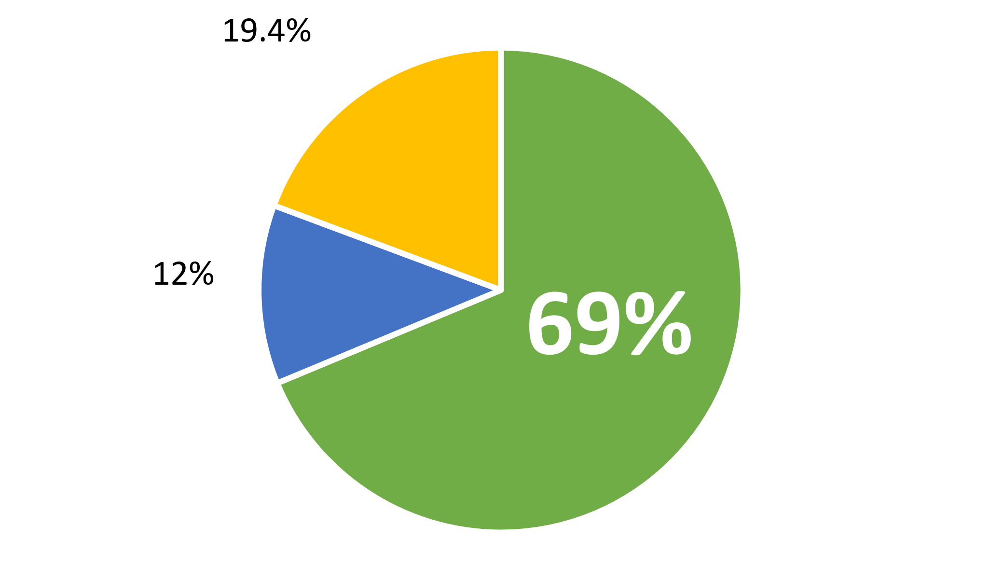

Survey Analysis
69% do not know how to present portfolio in a resume to impress hiring managers

Slide 25
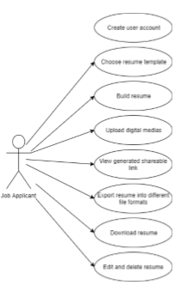


Functional
Non-functional
Performance
Network optimization

Slide 26
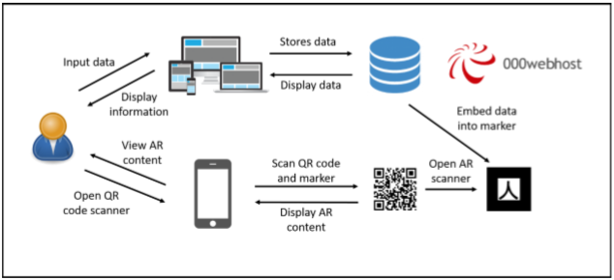
System Architecture

Slide 27

Chapter 5: Implementation and Discussion

Slide 28

DEMO

Slide 29



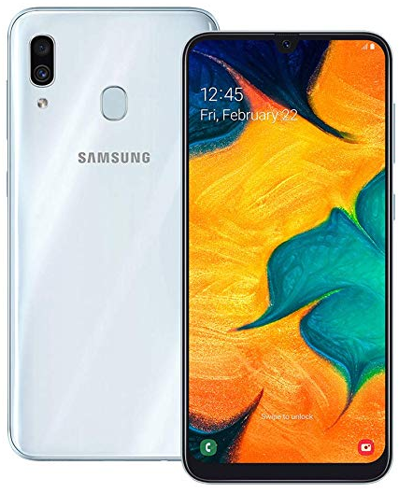
User Acceptance Testing
iPhone SE
(iOS 13.3)
Google Pixel 3 (Android 10)
Vivo V5 (Android 6)
Samsung Galaxy A30 (Android 9)

Slide 30
Observations
Create resume successfully
Scan markers
Size of markers
Camera permission is blocked unknowingly

Slide 31

Chapter 6:
Conclusion and Recommendation

Slide 32
Allow job seekers to create resume
Can enrich experience with AR for job seekers and hiring managers
User acceptance testing

Slide 33
Recommendation
5G network
Markerless-based resume
Integration with LinkedIn and Github
AResume as middle platform between job applicants and hiring managers

Slide 34

Thank you
Q & A

