Slide 1
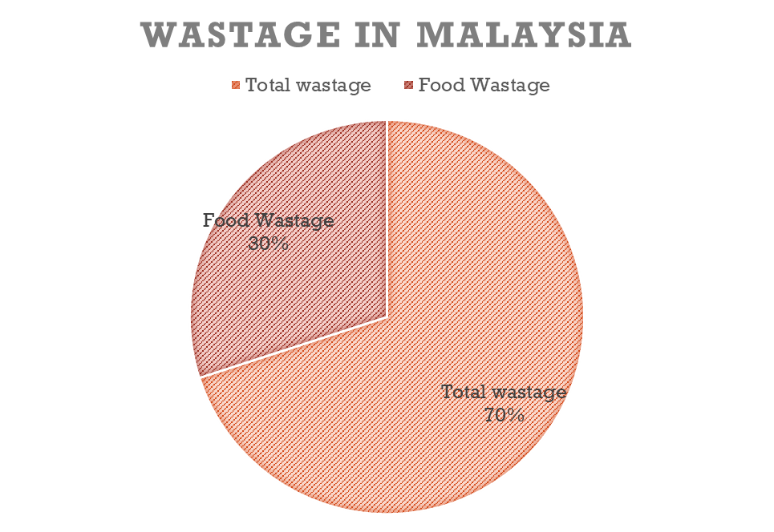
A.I 4 GOOD bot is created with the intention of understanding. The bot is designed in a way to give response that will gather more information from the people in need, through open ended questions.
WHAT CLEAN PLATE USE FOR?
Can HELP poor people to get free food
LESS wastage of food
HELP restaurant, company, hotel, shopping center for free advertising

