Slide 1



US Covid-19 Dashboard Vaccinations
Project 3
Created By
MaryClare C. Colombo,
Gus Thanasuwandithee, Mary Thisssen &
Victor Diaz

Slide 2

Introduction

Slide 3
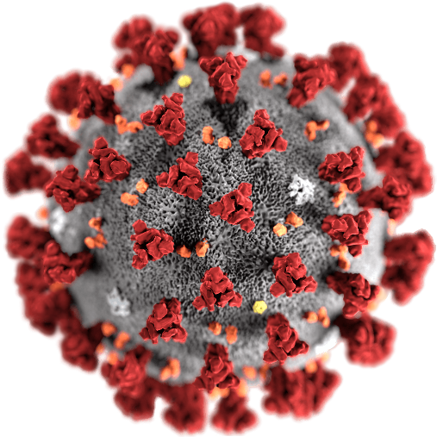
Introduction
Why we chose this project?
What are we hoping to discover?
Results we expect?
What hypothesis(such as alternate) can we assume?

Slide 4
Dataset, Server, & Data Cleanup

Slide 5
Placeholder to explain our data

Slide 6
Visualizations

Slide 7
Insert graphs here

Slide 8
Placeholder for more graphs

Slide 9
Show Our Dashboard & talk about our coding process

Slide 10
Placeholder show our dashboard

Slide 11
Conclusion

Slide 12


Placeholder for conclusion
What did we learn ?
Did our hypothesis came true?
Anyway to do this differently? Improvements…..

Slide 13

Thanks!!!
Questions???

