Slide 1

MAKERERE UNIVERSITY
DEVELOPING A MODULAR AND ADAPTIVE POWER ELECTRONICS SYSTEM FOR ENERGY CONSTRAINED AUTOMATIC WEATHER STATIONS
By
Tobias Newman Muhanguzi
(BTE., KyU)
Supervisors
Dr. Roseline Akol Dr. Mary Nsabagwa
A research proposal submitted to the Directorate of Research and Graduate Training in partial fulfilment for requirements of the award of Masters of Science in Power Systems Engineering of Makerere University
7th OCTOBER, 2025
Kampala, Uganda

Slide 2
Contents
Background
Problem statement
Study Objectives
Research Questions
Justification
Significance
Scope
Conceptual Framework
Methodology
References
Appendix

Slide 3
Background
Automatic weather stations (AWS) use advanced sensors, communication protocols, and power electronic systems to measure various weather parameters.
Proposed design strategies for AWS include:
    Modularity
Modularity is where a complex system is broken down into manageable subsystems.
This improves scalability, fault tolerance, and maintainability.
Example is. Modular multilevel converters (MMCs) that reduce harmonics, simplify thermal management, and improve reliability (Perez, Rodriguez, & Bernet, 2022; Ma, Wang, & Chen, 2023).
Sensor Subsystem
Power Subsystem
Communication Subsystem
Sensor Nodes
Converters
GSM, LoRa, WiFi, & BLE
Battery
Battery Charger

Slide 4
Background
    Adaptability
Adaptability in power electronics refers to automatic adjustment of control parameters and operational modes in response to changing conditions (e.g. input variation, load shift, component aging).
Adaptive controllers such as Gain-Scheduled, Robust Adaptive laws (Pallo, Bonfiglio, & Procopio, 2020; Savadkoohi, Karami, & Shojaci, 2024).
And, Model-free adaptive control (MFAC) which are event-triggered reduce computational burden and switching losses. Have been suggested (Fang et al., 2024)
    Micro Energy Harvesting, Storage & Adaptive Management
In IoT or micro-power applications, power management circuits must dynamically switch modes (e.g. sleep, active, boost) and adapt to harvested energy availability (Sarker et al., 2024).

Slide 5
Background
    Modularity & Adaptability
Adaptive control ensures stable and efficient operation under varying loads, fault conditions and environmental changes.
Modular, adaptive converters simplify deployment, support interoperability, and enhance resilience against supply intermittency (Kramer & Chakraborty, 2009).
  Hybrid communication and Protocol switching
The system will be able to dynamically switch among the programmed communication modes such as, LoRa, GSM, and WiFi depending on signal strength, power availability, data urgency, or data type/formats.
This proposal will integrate modularity, adaptability to design an AWS system with hybrid communication and fault tolerance mechanisms.

Slide 6
Background
  Research Gaps and Opportunities
Limited research in Lightweight, event triggered, model free adaptive algorithm controllers optimized for low power embedded hardware and resource constrained systems(Fang et al., 2024).
While modular architectures support fault isolation in high power and more complex systems, their translation to micro scale AWS hardware (with cost, size, energy constraints) is underexplored.
An AWS System with hybrid communication protocols, and multiple energy sources remains understudied this research aims at providing insights in this design approach.

Slide 7
Problem statement
AWS operation is mostly in off-grid and energy constrained locations, making intermittent renewable energy resources (RER) the primary source of power. The current Monolithic AWS system design is unsuitable for incorporating the multiple energy resources, and lack hybrid communication for network stability. Therefore, AWS systems have low energy efficiency, limited reliability (due to frequent downtime), and high maintenance requirements.
By designing modular and adaptive power electronics system that can dynamically manage energy flow, support scalable integration of multiple energy sources, this will ensure robust operation for autonomous weather monitoring applications AWS current design challenges will be reduced, by increasing power availability and system uptime.

Slide 8
Study Objectives
Main Objective
To develop a modular and adaptive power electronics system architecture for off-grid and energy constrained AWS with hybrid communication protocols to subsequently optimize power usage.
Specific Objectives
To simulate and design a modular AWS system that will consist of power supply, communication subsystem, and sensor nodes as subsystems.
To develop an algorithm that will adaptively optimize power efficiency by adjusting input power levels and duty cycle of the system.
To evaluate the performance of the developed AWS system in energy-constrained applications.

Slide 9
Research Questions
1. What are the design requirements for simulating and designing a modular, adaptive and hybrid communication AWS system?
2. What are the necessary parameters required to develop an algorithm that will adaptively optimize power efficiency of the AWS system?
3. What is the performance of the AWS system in energy-constrained applications?
Justification
Developing a modular and adaptive power electronics system architecture with hybrid communication is essential because existing solutions fail to meet the operational demands of off-grid remote environments and energy constrained applications.

Slide 10
Significance
The outcome of the design will improve the reliability, efficiency, and operational autonomy for remote weather monitoring systems, thereby enhancing the quality and continuity of meteorological data essential for applications in agriculture, public safety, infrastructure planning, and climatic research.
Scope
Design Scope; Requirement identification for the AWS system, development of two Prototypes, adaptive control strategy/algorithm development , and firmware development, system simulation and modelling, deployment and evaluation to assess system performance of four AWS, will not include development of Web Application.
Geographical Scope; The four AWS will be deployed in all regions of Uganda to collect relevant weather data

Slide 11
Conceptual Framework
INPUTS
PROCESSES
OUTPUTS
PSU (PI)
Solar Panel Sizing & Wattage (W)
Maximum Power conversion efficiency (%)
Battery Charger rating (Ah)
Logic Level Shifter thresholds (5 V & 3.3 V)
Daily Load profiles (Wh/day)
Energy conversion and regulation
Battery SoC Stability
Logic Level Shifter Performance
Thermal Management
Load prioritization
Panel voltage output (V)
Converter efficiency (%)
Battery life (hours/day)
Daily energy usage (Wh)
System uptime (hours/day)
Idle & active modes scheduling
Adaptive protocol Switching (LoRa Primary, GSM/WiFi/BLE Fallback)
Transmission optimization (RSSI, & energy tradeoff)
Data type & size Transmitted
Transmit power used (dBm)
Module Mode/State.
Transmission Success Rate (RSSI)
Network switching Success.
Communication Subsystem (PI)
Protocol Data size (bits)
Protocol Data Type (A/D)
Transmission power (dBm)
Preferred protocol (LoRa,GSM,WiFi,BLE)
Sensor Subsystem (PI)
Sensor voltage input (V)
Sensor Power Consumption (mW)
Sensor sensitivity Level
Automatic sensor mode (idle & active)
Calibration & Sensor sensitivity adjustment
Bus/interface selection (I2C, SPI, UART)
Sensor Sensitivity & resolution
Sensor SoC contribution
Accuracy of Sensor Measurements
Sensor Uptime (Tactive )(h)
Firmware (PI)
Sensor mode selection (idle & active)
Transmit scheduling based on data type & packet Size (A/D, Bits)
Adaptive Protocol Switching (dBm)
SoC Adaptation algorithm
Sensor Sensitivity Adjustment
Network protocol Adaptation
Dynamic adjustment of SoC Thresholds

Slide 12
Methodology
Research Design
To develop the proposed AWS system, this study will adopt mixed methods of scientific research including, case studies, comparative, simulation-based, analytical, experimental research design and quantitative approach.
Methodology processes and Research Methods
System requirements and specifications identification, (Analytical, Exploratory, case study)
Prototype development, (Design, Prototyping, Simulations, HIL analysis-simulator/actuator)
Firmware development, (Parameter modelling, iterative approach)
System modelling and simulation, (Predictive and Simulations, behavioural complexity, comparative studies)
Field deployment and evaluation. (Observation, benchmarking, Mitigation strategies, KPIs analysis)

Slide 13
Methodology Cont.
Table 1. List of development tools and requirements
S/N | Category | Tools/Software | Purpose
1 | Simulation | Altium Power Analyzer (PDN), ngSpice (Circuit Simulator) | Power electronics simulation
2 | Design | KiCAD (intermediate) and Altium (Advanced) | PCB design
3 | Programming | ESP-IDF, Arduino IDE | Firmware development
4 | Adaptive controller | MATLAB | Adaptability Algorithm
5 | Hardware assembling | ESP32-S3 (MCU), BSS138 (Logic Level Shifter), SIM900L, INA219, GSM, LoRa modules, Environmental Sensors, 12 V/100W Solar panel, Power converters, Lithium batteries | PSU, Sensor and communication subsystem development
6 | Storage & Logging | SD card modules, RTC | Data logging and timestamping

Slide 14
Methodology
This study adopts an experimental research design and quantitative approach. Combining System requirements and specifications identification, Prototype development, Firmware development, System modelling and simulation and finally, Field deployment and evaluation.
Sensor Nodes
Repository
    Sensor and communication subsystem
Internet
Gateway Board
GSM + LoRa
Modules
Logic Level
Shifter
RTC
SD
Power subsystem (Converter and Storage)
Microcontroller
LDO
DC – DC
Converter
Solar Panel
Battery
Charger
Figure 2. AWS Subsystems
Battery

Slide 15
Methodology Cont.
  Adaptive control algorithm
Control strategy will include Gain scheduled adaptive control, Model Reference Adaptive Control MRAC, or GS to be developed using MATLAB
Firmware will be developed using ESP-IDF, Arduino IDE
Simulation tasks will include; evaluating algorithm response to fluctuating solar input, implementing duty cycle adjustments based on SoC and load variation, and finally, modelling power management modes (active, sleep, and harvest).
Sample Logic
------------------------------
If SoC ˃ SoC_{high}: implies all sensors & frequent transmissions
------------------------------
If SoC_{low} ≤ SoC ≤ SoC_{high}: implies less frequent transmissions
------------------------------
If SoC ˂ SoC_{low}: implies minimal safe mode, essential sensors, local data storage no or minimal transmission
------------------------------
Thresholds
SoC_high = 0.6, SoC_low = 0.2

Slide 16

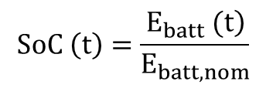

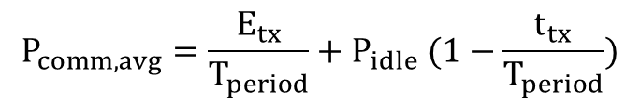

Methodology Cont.
  Field Testing and Performance Evaluation
Power subsystem (KPI)
Sensor and Comm. Subsystem (KPI)
    Converter efficiency and losses
Evaluate system uptime (%)
Energy efficiency in (mWh/day).
Communication reliability (%).
Fault tolerance (MTBF, MTTR, RPO).
Environmental resilience.
    Battery/ SoC update
$$SoC \left(t\right)=\frac{\left.E_{batt} (t\right)}{E_{batt,nom}}$$
Solar energy and PV Sizing
$$E_{daily}≈η_{panel }{×A}_{panel }{×G}_{day }{×T}_{sun }$$
    Energy budget for communication
$$P_{comm,avg}=\frac{E_{tx}}{T_{period}}{+ P}_{idle}(1−\frac{t_{tx}}{T_{period}})$$
    System average power
$$P_{avg}=P_{active}(\frac{t_{active}}{T}){ + P}_{sleep}(1−\frac{t_{active}}{T})$$
$Battery lifetime (hours) ≈\frac{E_{batt,nom}}{P_{avg}}$

Slide 17
Methodology Cont.
  Prototype development
Fabrication
Integration
Testing
Data Collection and Analysis.
Data sources; Energy monitors like INA219, SD card logs, & communication logs.
Data analysis tools; SSP, Python (NumPy, Pandas, Matplotlib) and MATLAB.
Data quality control: Ensure the reliability and validity of instruments used.

Slide 18
Methodology Cont.
  Validation of research outcomes
Benchmarking the designed AWS with WIMEA-ICT AWS system,
Verification to ensure the objectives of improved energy efficiency, reliability, and fault tolerance are met. And other KPIs like Converter efficiency, sensor Sensitivity, SoC, and System Uptime (Availability)
Documentation of data to identify limitations & recommendations for improvement.
  Expected outcomes and limitations
Modular and Adaptive AWS system, that if is small
Integration of MMCs, multi energy sources, and hybrid communication
The computation power is expected to be high, and component count, The goal to achieve miniaturisation might not be realised.

Slide 19
Methodology Cont.
  Ethical considerations
Protection of participants (Confidentiality), Data integrity,
Respect intellectual property rights
Ensure proper citation of sources.
Environmental considerations
Responsible disposal of electronic waste
Less noisy electronics

Slide 20
References
Selvam, A. P., & Al-Humairi, S. N. S. (2024). Environmental impact evaluation using smart real-time weather monitoring systems: a systematic review. Innovative Infrastructure Solutions, 10(1), 13. https://doi.org/10.1007/s41062-024-01817-7
2. Kramer, B., & Chakraborty, S. (2009). A review of power electronics interfaces for distributed energy systems towards achieving low-cost modular design. Renewable and Sustainable Energy Reviews, 13(9), 2323-2335. https://doi.org/10.1016/j.rser.2009.05.005.
3. Jaber, M. M., Ali, M. H., Abd, S. K., Jassim, M. M., Alkhayyat, A., Aziz, H. W., & Alkhuwaylidee, A. R. (2022). Predicting climate factors based on big data analytics based agricultural disaster management. Physics and Chemistry of the Earth, Parts A/B/C, 128, 103243. https://doi.org/10.1016/J.PCE.2022.103243
4. Nsabagwa, M., Byamukama, M., & Otim, J. S. (2019). Towards a robust and affordable Automatic Weather Station. Development Engineering, 4, 100040. https://doi.org/10.1016/j.deveng.2018.100040
5. Pérez, M. A., Rodríguez, J., & Bernet, S. (2022). A comprehensive review on modular multilevel converters. Energies, 15(10), 3701. https://doi.org/10.3390/en15103701
6. Ma, Z., Wang, X., & Chen, L. (2023). Advances and perspectives in multilevel converters. Electronics, 13(18), 4736.
7. Fang, Y.; Liu, Y.; Fu, A.; Shi, S.; Zhang, Z. A Data-Driven Control for Modular Multilevel Converters Based on Model-Free Adaptive Control with an Event-Triggered Scheme. Electronics, 2024, 13(15), 2899. https://doi.org/10.3390/electronics13152899
8. Pallo, S., Bonfiglio, A., & Procopio, R. (2020). Adaptive control of four-quadrant DC–DC converters. Energies, 13(21), 5619.

Slide 21
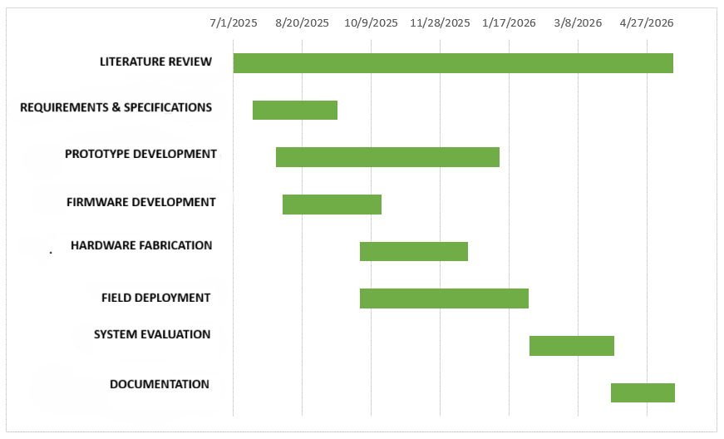
Appendix
Gantt chart showing proposed work plan

Slide 22
Appendix
Table 2. Proposed Budget
S/N | Item | Cost (USD)
1 | PCB Fabrication | 400
2 | Components & Materials | 600
3 | Simulation and Design Software | 600
4 | Field Installation & Testing | 1,000
5 | Travel and Data Collection | 400
6 | Report Production & Dissemination | 400
 | Total | 3,400

