Slide 1

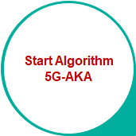
Kyambogo University
5G Architecture | 5G-AKA
© Muhanguzi Tobias, 15/U/7774/ETE/PE, https://github.com/marydovika

Slide 2
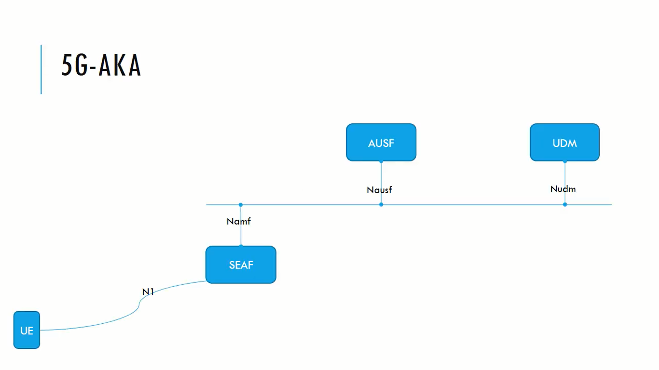
Kyambogo University
5G Architecture | 5G-AKA
© Muhanguzi Tobias, 15/U/7774/ETE/PE, https://github.com/marydovika

Slide 3
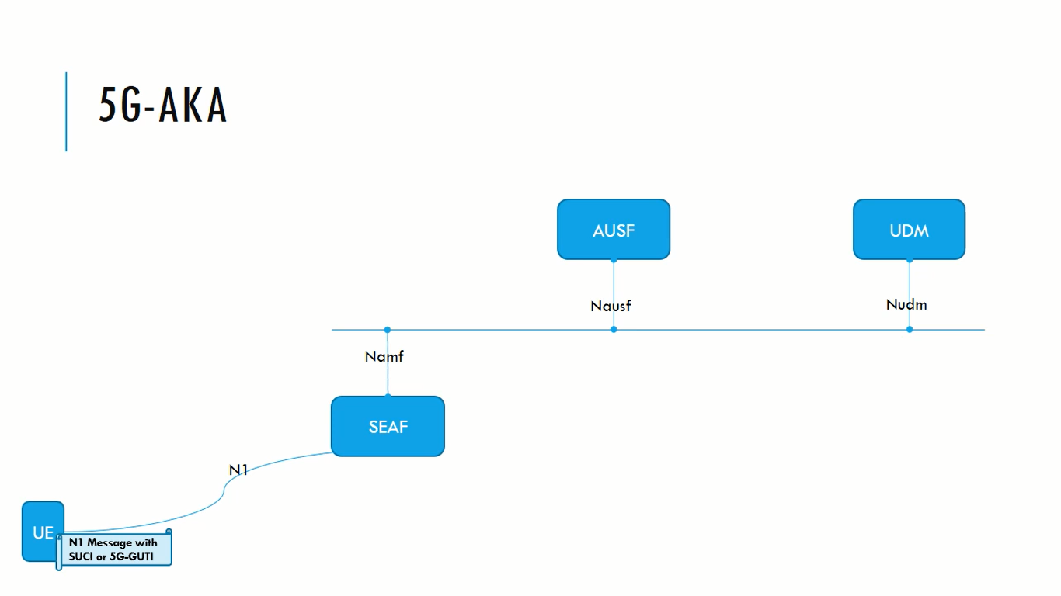
Kyambogo University
5G Architecture | 5G-AKA
© Muhanguzi Tobias, 15/U/7774/ETE/PE, https://github.com/marydovika

Slide 4
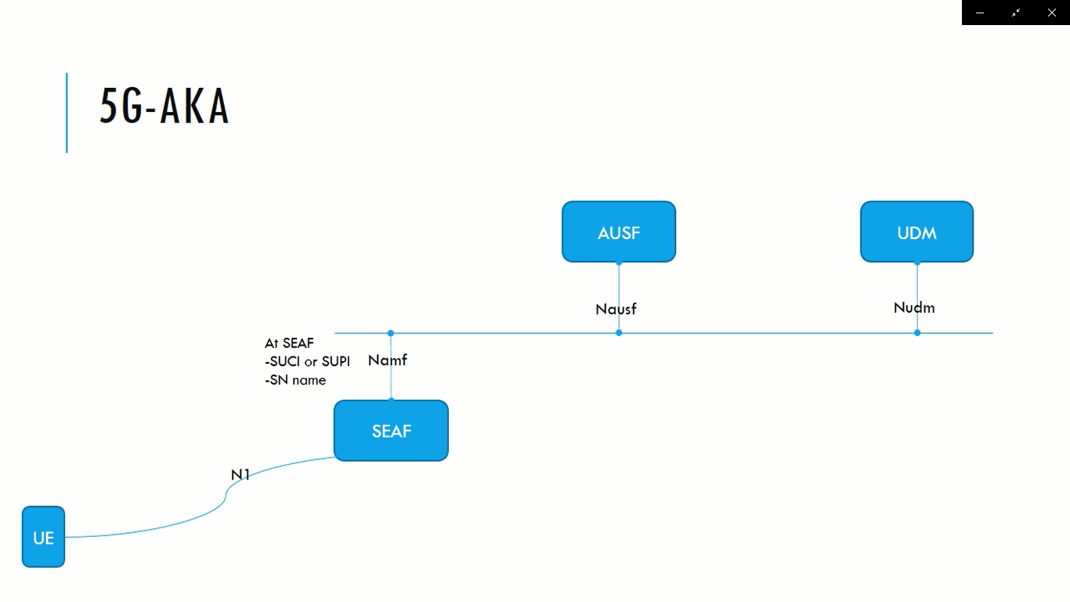
Kyambogo University
5G Architecture | 5G-AKA
© Muhanguzi Tobias, 15/U/7774/ETE/PE, https://github.com/marydovika

Slide 5
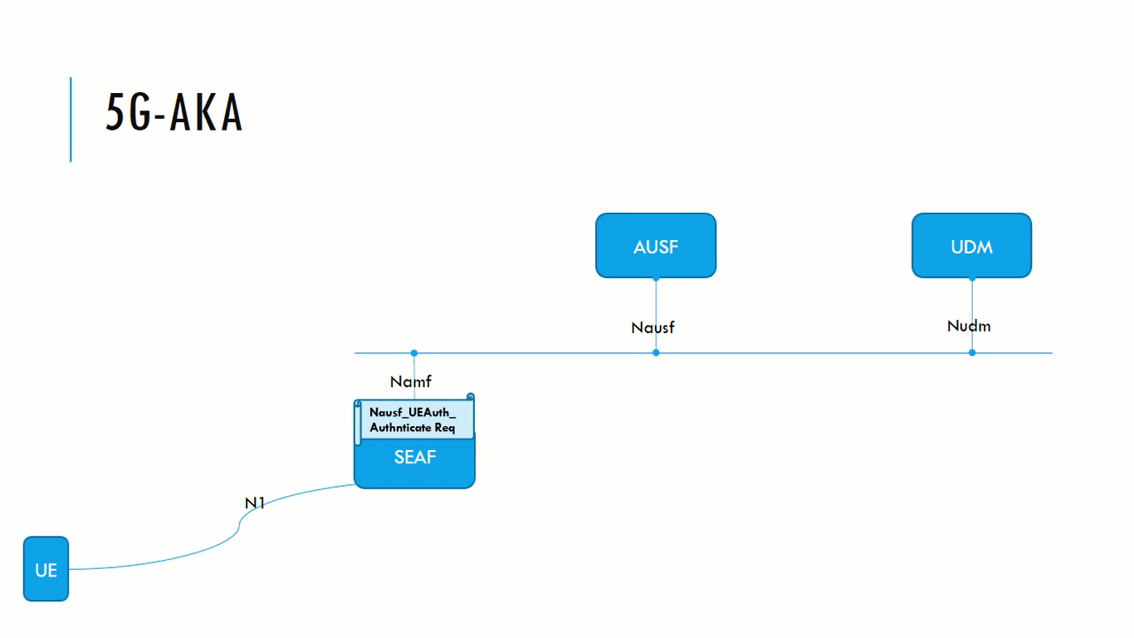
Kyambogo University
5G Architecture | 5G-AKA
© Muhanguzi Tobias, 15/U/7774/ETE/PE, https://github.com/marydovika

Slide 6
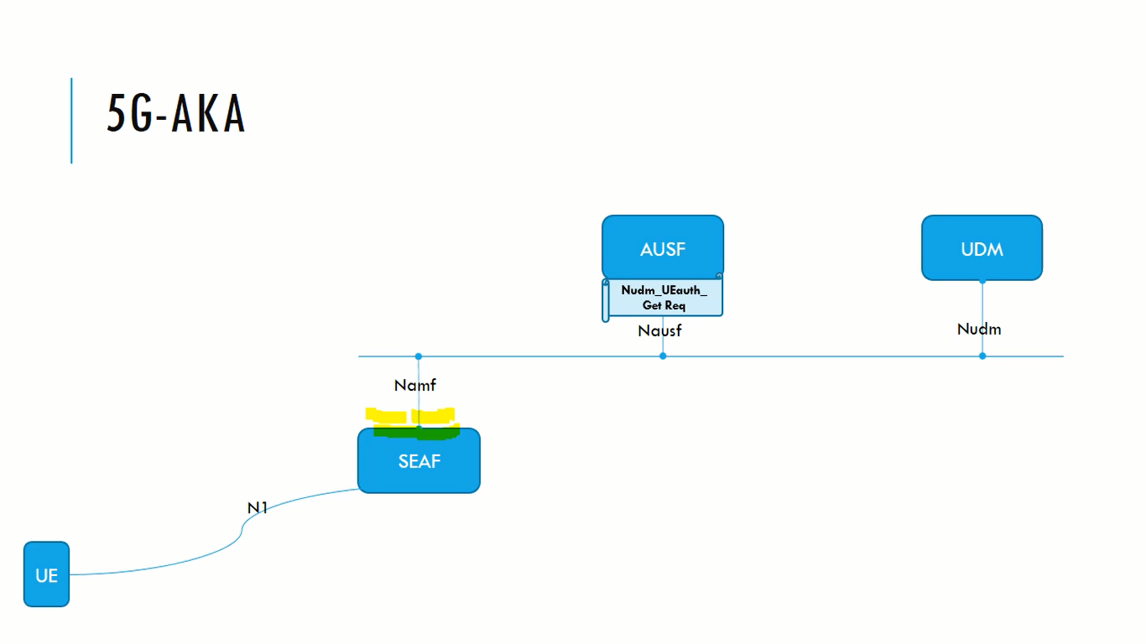
Kyambogo University
5G Architecture | 5G-AKA
© Muhanguzi Tobias, 15/U/7774/ETE/PE, https://github.com/marydovika

Slide 7
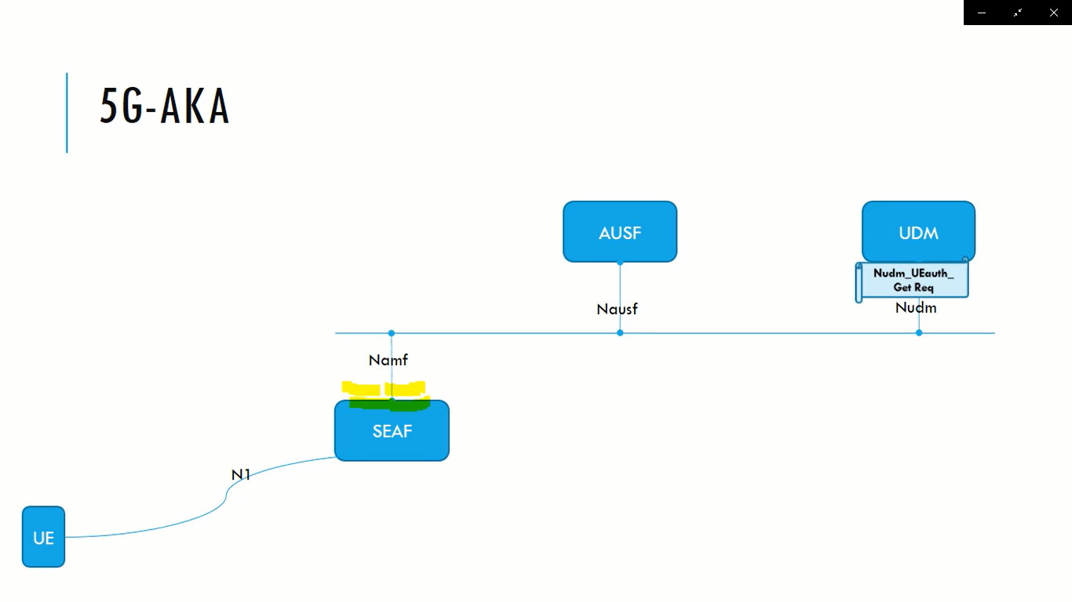
Kyambogo University
5G Architecture | 5G-AKA
© Muhanguzi Tobias, 15/U/7774/ETE/PE, https://github.com/marydovika

Slide 8
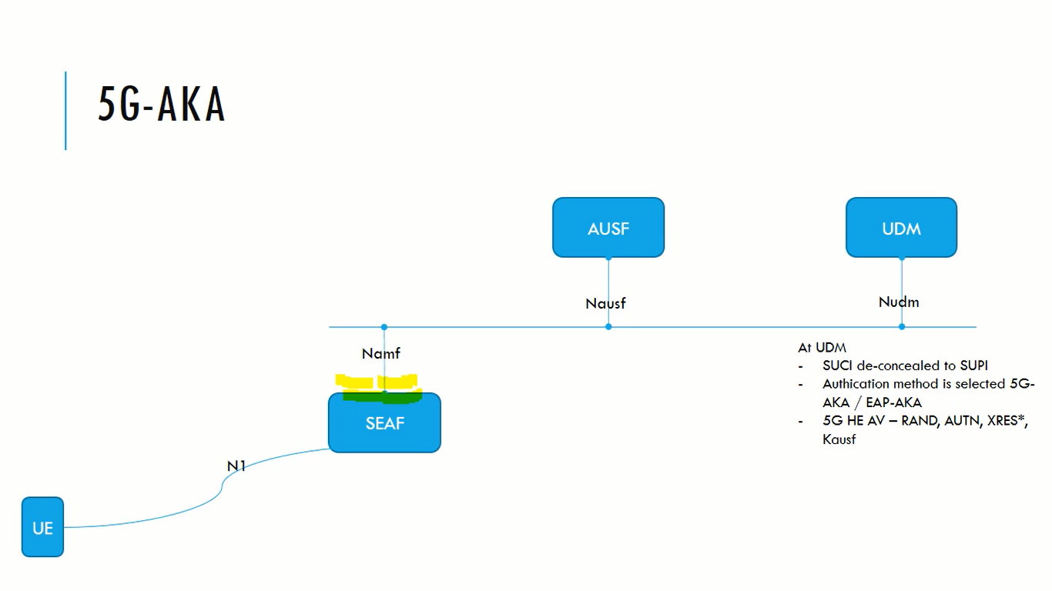
Kyambogo University
5G Architecture | 5G-AKA
© Muhanguzi Tobias, 15/U/7774/ETE/PE, https://github.com/marydovika

Slide 9
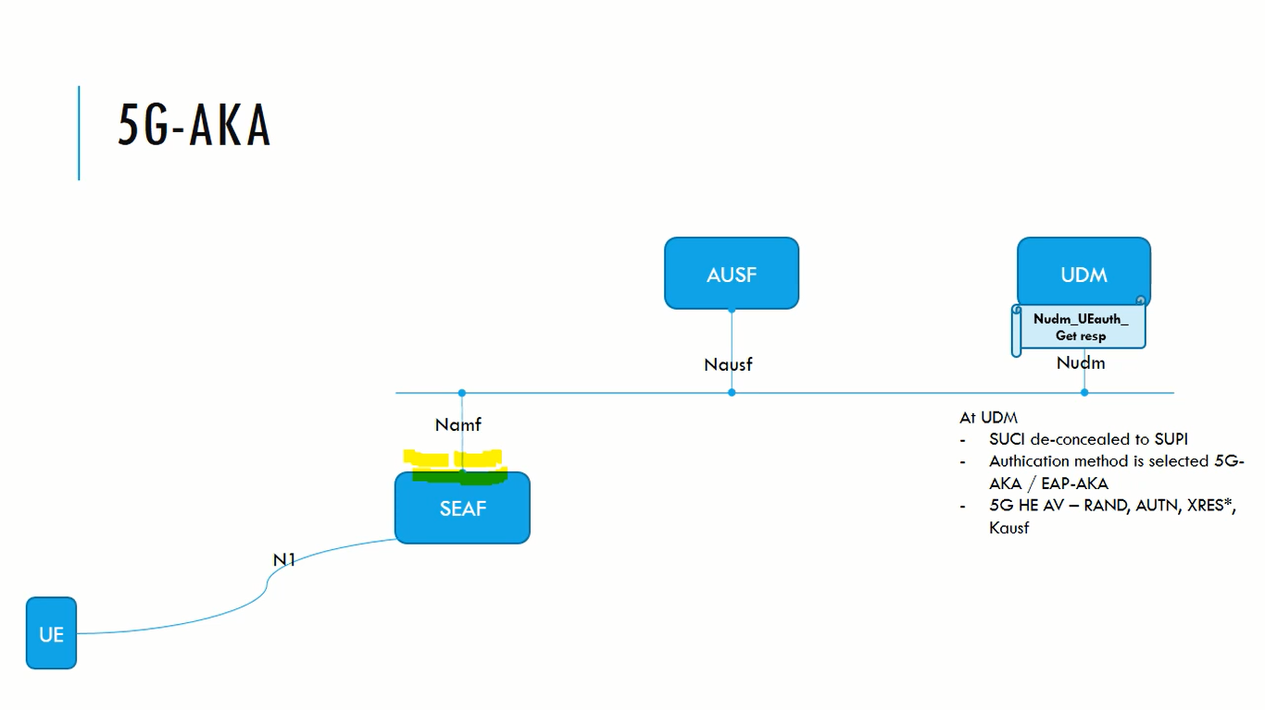
Kyambogo University
5G Architecture | 5G-AKA
© Muhanguzi Tobias, 15/U/7774/ETE/PE, https://github.com/marydovika

Slide 10
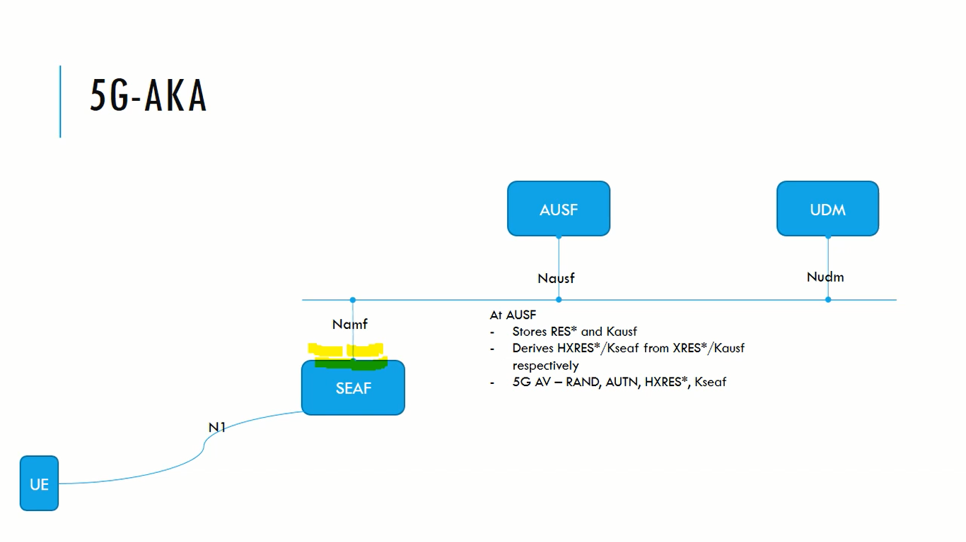
Kyambogo University
5G Architecture | 5G-AKA
© Muhanguzi Tobias, 15/U/7774/ETE/PE, https://github.com/marydovika

Slide 11
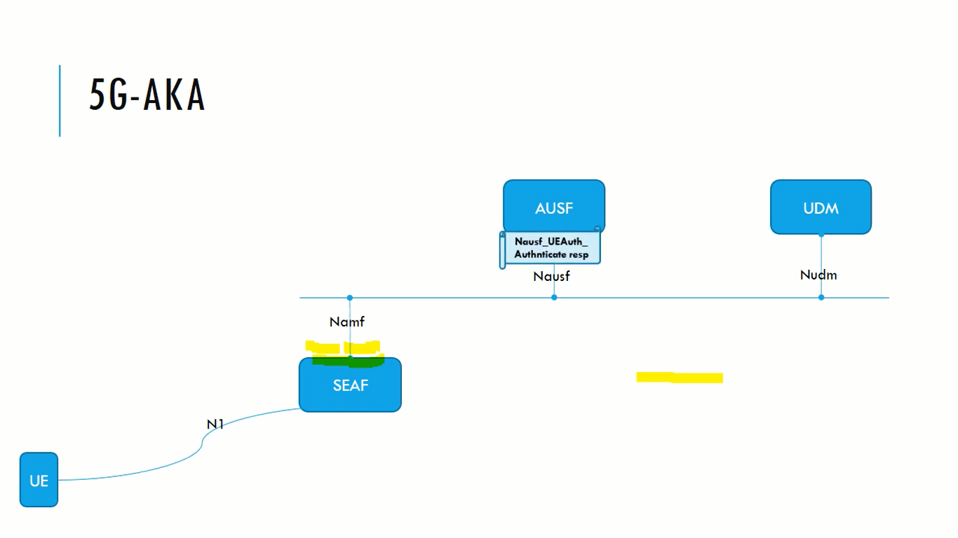
Kyambogo University
5G Architecture | 5G-AKA
© Muhanguzi Tobias, 15/U/7774/ETE/PE, https://github.com/marydovika

Slide 12
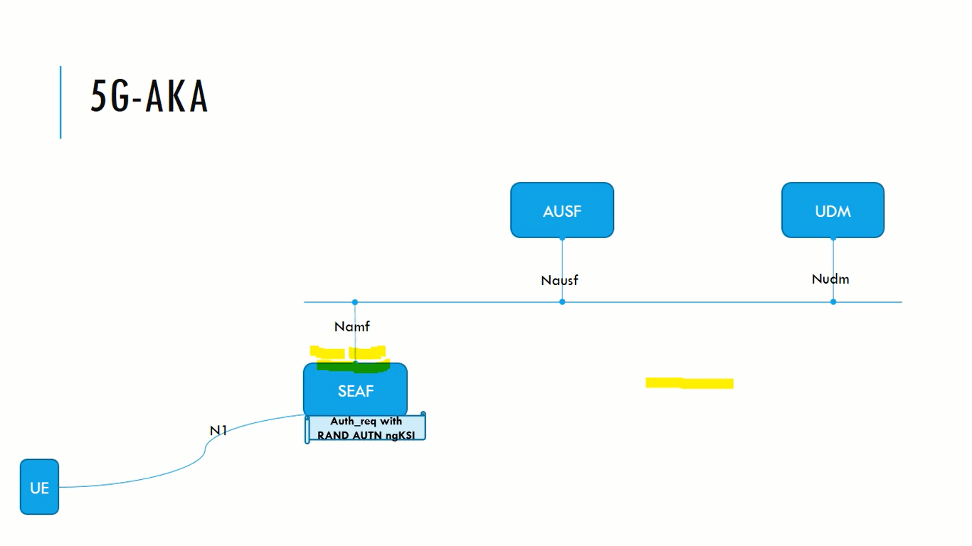
Kyambogo University
5G Architecture | 5G-AKA
© Muhanguzi Tobias, 15/U/7774/ETE/PE, https://github.com/marydovika

Slide 13
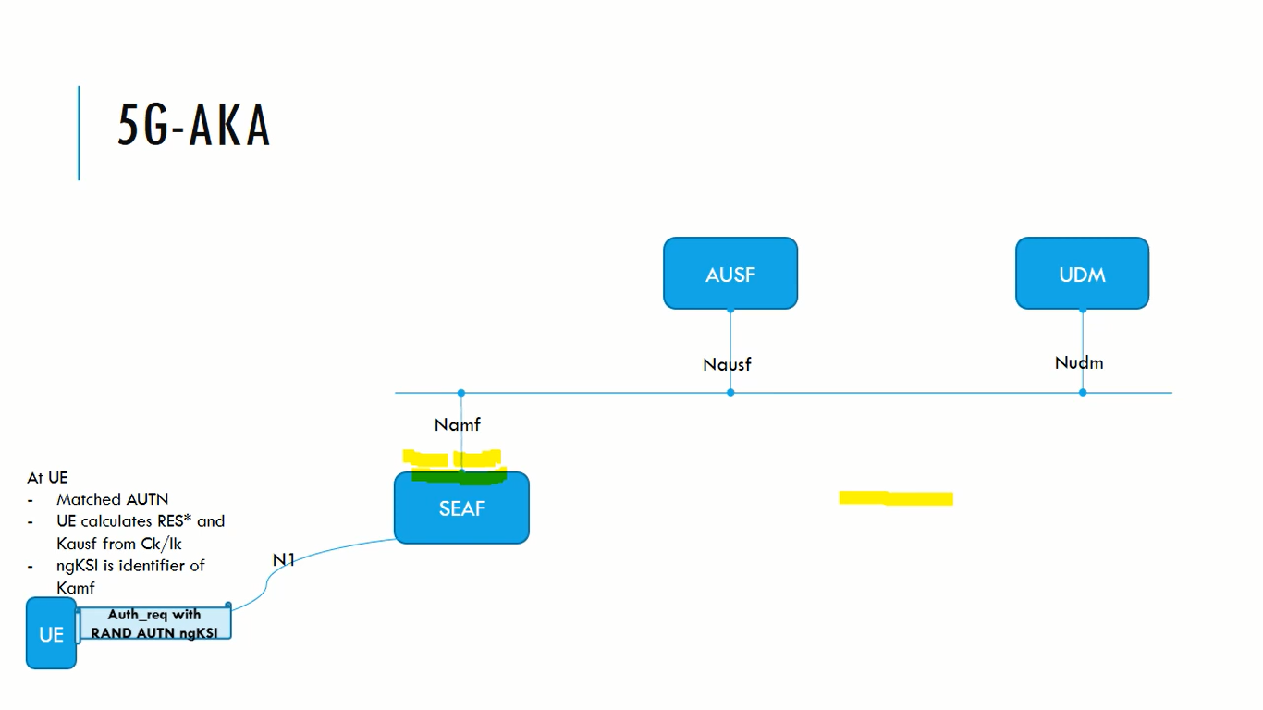
Kyambogo University
5G Architecture | 5G-AKA
© Muhanguzi Tobias, 15/U/7774/ETE/PE, https://github.com/marydovika

Slide 14
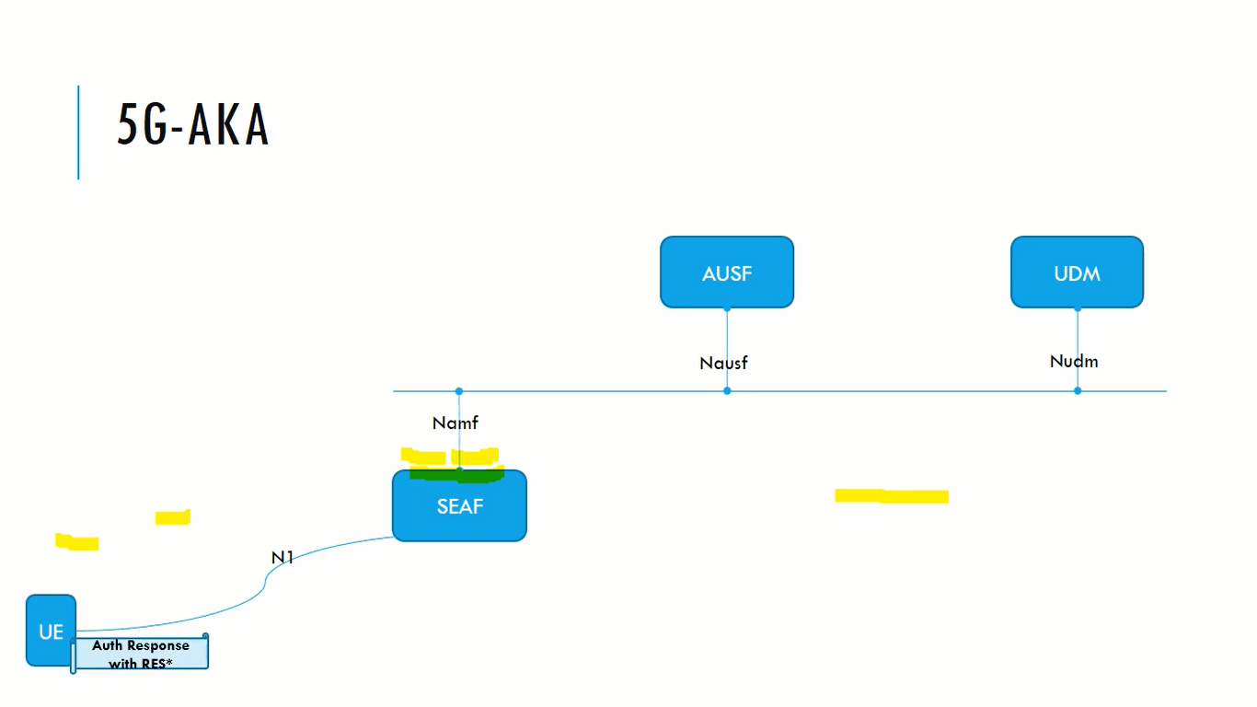
Kyambogo University
5G Architecture | 5G-AKA
© Muhanguzi Tobias, 15/U/7774/ETE/PE, https://github.com/marydovika

Slide 15
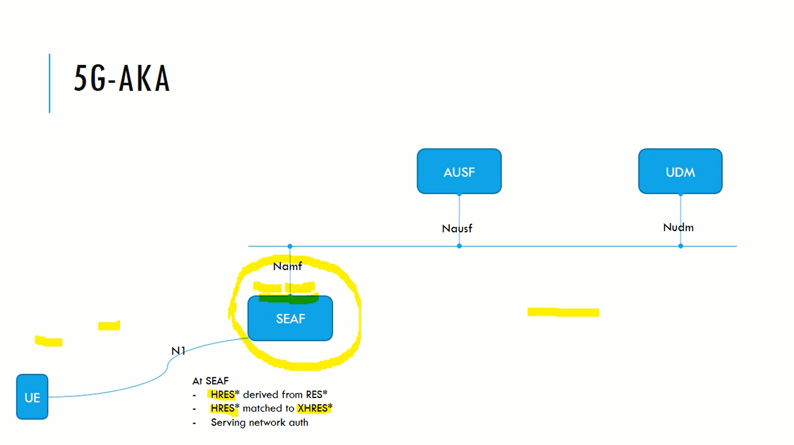
Kyambogo University
5G Architecture | 5G-AKA
© Muhanguzi Tobias, 15/U/7774/ETE/PE, https://github.com/marydovika

Slide 16
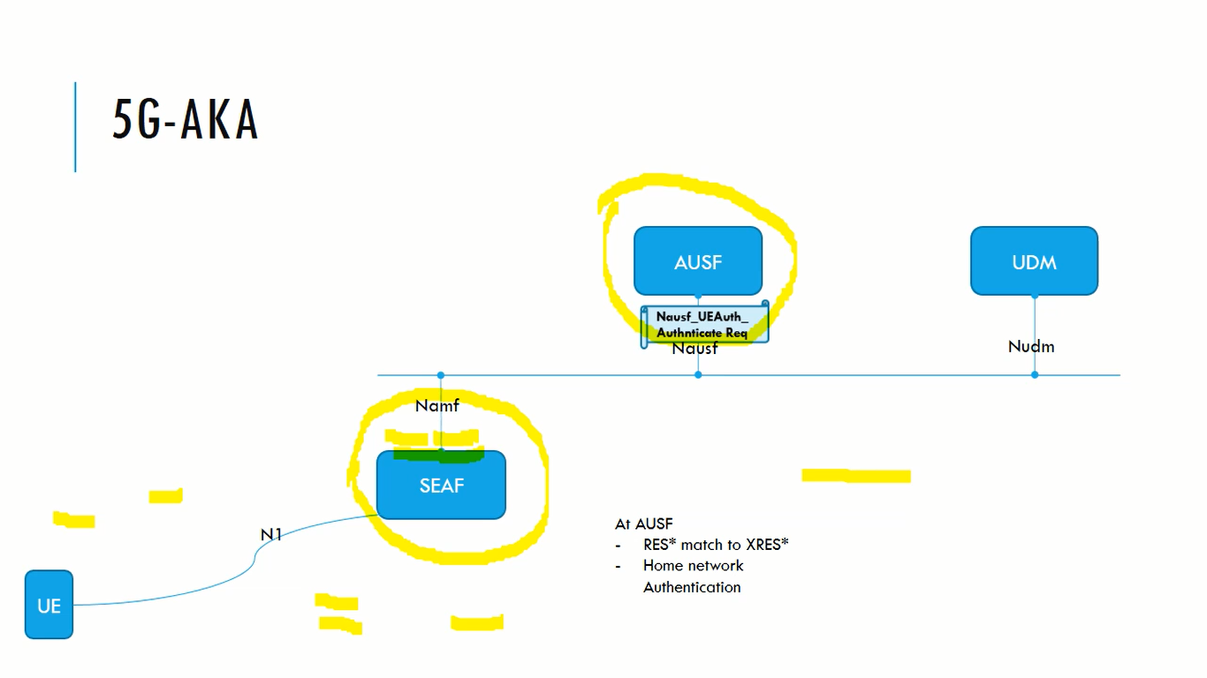
Kyambogo University
5G Architecture | 5G-AKA
© Muhanguzi Tobias, 15/U/7774/ETE/PE, https://github.com/marydovika

Slide 17
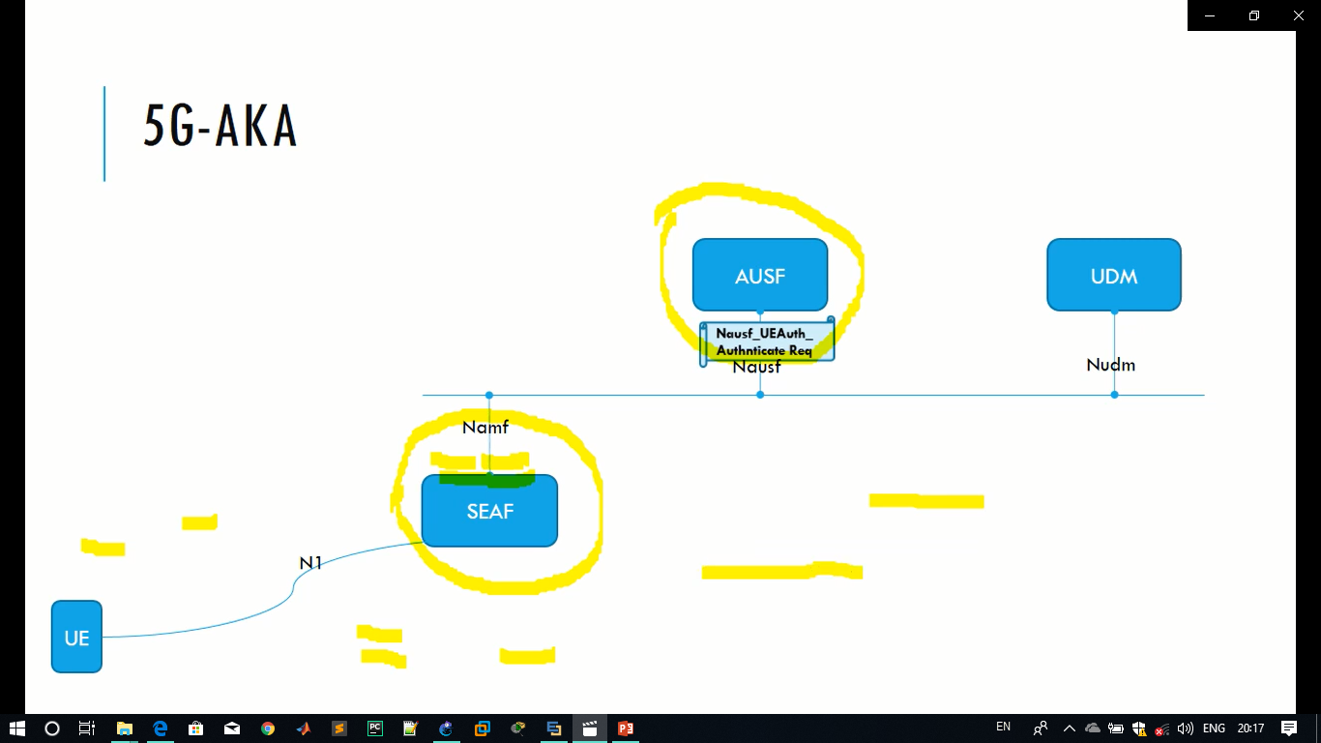
Kyambogo University
5G Architecture | 5G-AKA
© Muhanguzi Tobias, 15/U/7774/ETE/PE, https://github.com/marydovika

Slide 18
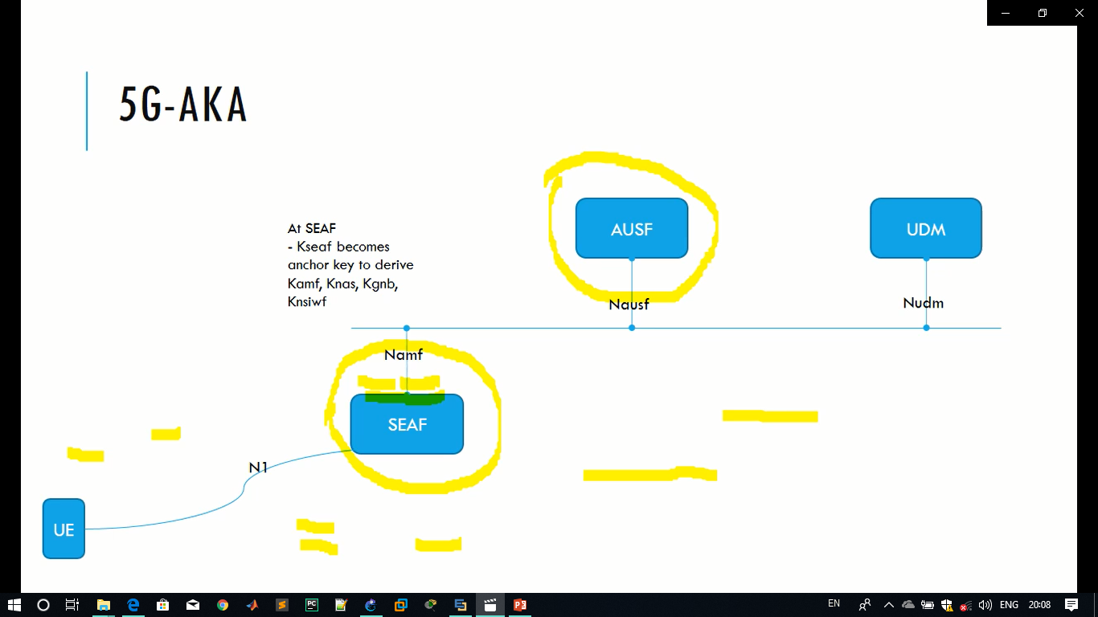
Kyambogo University
5G Architecture | 5G-AKA
© Muhanguzi Tobias, 15/U/7774/ETE/PE, https://github.com/marydovika

Slide 19
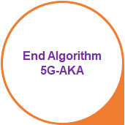
Kyambogo University
5G Architecture | 5G-AKA
© Muhanguzi Tobias, 15/U/7774/ETE/PE, https://github.com/marydovika

