Slide 1
Selection process
of the internship subject

Slide 2
It is crucial to establish my objectives for the internship in order to make the appropriate choice for the subject of my project. Therefore, I have extracted here what I precisely expect from this experience.

Slide 3
My goals :
Learn as much as possible from the team, the instructor, and other interns about the workflow in the company, as well as professional concepts and techniques.
Be exposed as much as possible to new subjects I have never encountered before (NLP, reinforcement learning, RNN, GAN, big data, cloud computing, ...), as well as technical concepts and challenges in data science (especially during the modeling phase).
Have a positive impact on the workplace where I will do my internship and, hopefully, enrich their work with what I am capable of contributing through my project.
In the case of using neural networks, learn to reason effectively to improve the model (determining, for example, when and how to modify parameters during each optimization attempt)

Slide 4
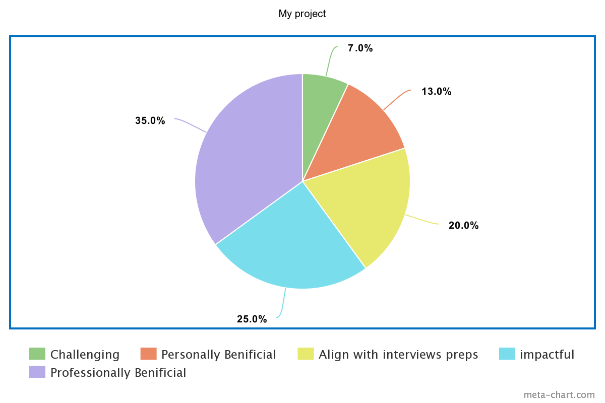
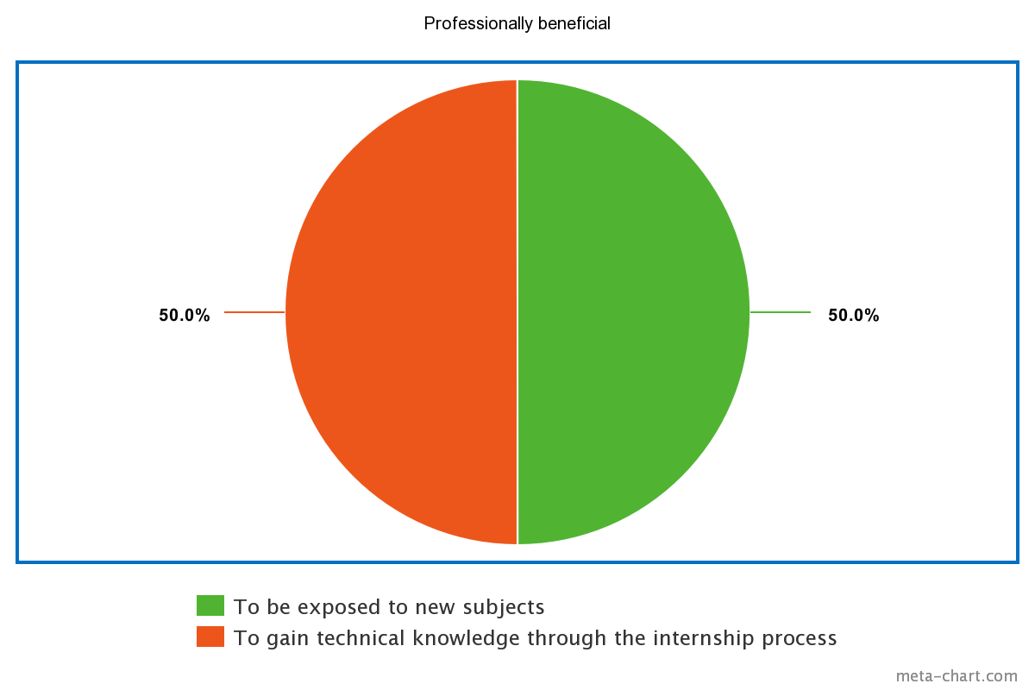
I expect my project to be enriching and beneficial for my learning process, rather than being too challenging, as it is only a summer project and not a final year project.
My project could align with preparations for next year's interviews, as I will be applying for a final year project as an AI engineer.
Beneficial
Beneficial

Slide 5
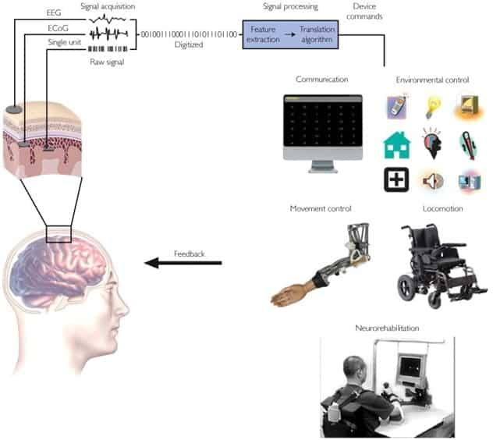
Topics that interested me after sharing our visions during the last meeting:
BCI: Brain Interface Components : Performance management solutions using brain-computer interface technology
https://how2electronics.com/brain-computer-interface-system-overview-applications/

Slide 6
Sustainable dev with APM
Environment friendly: energy consumption , cloud consumption. . . .
Ethics: user friendly
. . . .

Slide 7
Other relevant themes that could be useful:
- AR/VR apms
- emotinally intelligent apps apms
Mlops
Auto-recovery Apms

Slide 8
Possible ideas
To inspire us during the final selection of the internship subject

Slide 9
Brain-computer interface applications in APM RUM:
Explore the integration of brain-computer interface technology with the APM RUM solution. Study how brain signals can be used as input to monitor and analyze user experiences, thus providing valuable insights for APM.
Emotion recognition and analysis in APM:
Explore the integration of emotion recognition and analysis in APM. Develop techniques to monitor and analyze user emotions during application usage, enabling organizations to understand emotional responses and enhance the user experience.

Slide 10
Intelligent alert prioritization:
Implement intelligent algorithms within the APM RUM solution to prioritize and classify alerts based on their severity and impact on the user experience. This would concentrate attention on critical issues and facilitate efficient incident resolution and management.
Personalized recommendations:
Customize the APM RUM solution to provide personalized recommendations to individual users based on their preferences and usage habits. The system can leverage machine learning algorithms to understand user behavior, application features, and performance data, offering tailored suggestions for feature usage or configuration optimization.

Slide 11
Project ideas related to sustainable development: ethics.
Monitoring ethical compliance in intercultural contexts:
Develop an APM RUM solution equipped with integrated capabilities to monitor and identify potential violations of ethics, cultural norms, or religious beliefs specific to different countries, social groups, sects, or religions. This includes features such as an ethical rules engine, contextual analysis, detection of ethical violations, real-time alerts, customizable ethical guidelines, reports, and analyses.
Monitoring child-friendly content:
Implement mechanisms within the APM RUM solution to monitor and ensure that content and applications intended for children adhere to appropriate standards and guidelines. This may include age-appropriate content filtering, performance optimization for child-focused applications, and compliance with regulations for children's privacy protection.

Slide 12
Project ideas related to sustainable development: environment-friendly
Wise Energy Consumption:
Develop a rating system that evaluates the energy efficiency and sustainable practices of different applications. This can be based on factors such as resource usage, optimization efforts, and adherence to sustainable development principles. The system provides insights and recommendations to improve sustainability performance
Sustainable Cloud Resource Allocation:
Integrate the APM RUM solution with Cloud infrastructure providers and develop algorithms to optimize the allocation of Cloud resources based on sustainability criteria. The system could dynamically allocate resources to applications according to their performance requirements while considering energy efficiency and the availability of renewable energies in data centers.
Real-time Carbon Emissions Dashboard:
Develop a dashboard that presents real-time data on carbon emissions alongside application performance indicators. This enables organizations to understand the environmental impact of their applications and make informed decisions to reduce carbon emissions, such as code optimization, adopting eco-friendly infrastructure, or choosing more environmentally friendly hosting options.

Slide 13
Top 3

Slide 14
Emotion recognition and analysis in APM:
Explore the integration of emotion recognition and analysis in APM. Develop techniques to monitor and analyze user emotions during application usage, enabling organizations to understand emotional responses and enhance the user experience.
Monitoring ethical compliance in intercultural contexts:
Develop an APM RUM solution equipped with integrated capabilities to monitor and identify potential violations of ethics, cultural norms, or religious beliefs specific to different countries, social groups, sects, or religions. This includes features such as an ethical rules engine, contextual analysis, detection of ethical violations, real-time alerts, customizable ethical guidelines, reports, and analyses.
Wise Energy Consumption:
Develop a rating system that evaluates the energy efficiency and sustainable practices of different applications. This can be based on factors such as resource usage, optimization efforts, and adherence to sustainable development principles. The system provides insights and recommendations to improve sustainability performance

Slide 15
This was our final choice before altering it to company needs and ressources:
Emotion recognition and analysis in APM:
Explore the integration of emotion recognition and analysis in APM. Develop techniques to monitor and analyze user emotions during application usage, enabling organizations to understand emotional responses and enhance the user experience.

