Slide 1
Process for choosing classification algorithms
Part 1

Slide 2
Algorithms/techniques used in common recommendation systems
Usual recommendation systems are implemented through:
Collaborative filtering algorithm: User-based: searching for similar users to recommend products product-based: searches for similar products to recommend to the user Content-based filtering algorithm: uses the characteristics or attributes of the products themselves to make recommendations Factorization matrix: consists of decomposing a data matrix into two factor matrices, one for users and one for elements, in order to represent the interactions between them (Acceleration of calculations/Elimination of noise or redundant data) RNN (Recursive Neural Network) Real-time data processing Hybrid approaches: combining several algorithms

Slide 3
2 . Example
Amazon
YouTube
Collaborative user-based filtering Collaborative product-based filtering Content-based filtering algorithm: Factorization matrix Recurrent neural networks (RNNs) for sequential recommendations Association Rule Mining Deep neural networks for click-through rate prediction (CTR) Near real-time recommendation generation A/B testing and experimentation Contextual factors Feedback loop A9/A10 (reference to specific algorithms used in recommender systems) Source https://www.baeldung.com/cs/amazon-recommendation-system#hybrid-approaches
consists of two neural networks: Candidate generation network: provide extensive customization with high accuracy (collaborative filtering - factorization techniques - softmax classifier) Ranking network: distinguishes relative importance among candidates with high coverage (deep neural network with logistic regression) The efficiency of the algorithm or model is determined through A/B testing The architecture of the model is inspired by "bag of words" language models Article published by google: https://static.googleusercontent.com/media/research.google.com/fr//pubs/archive/45530.pdf

Slide 4
3 . Research aligned with our interests and requirements.
Our approach is to extract patterns that allow us to extract the user classes that are useful in the recommendation.
Focus in research on pattern mining algorithms – knowledge discovery – emotion mining
Knowledge mining is the process of extracting interesting patterns and applying those patterns to specific areas of interest. => broader process that encompasses pattern mining Pattern mining is a process of discovering recurring patterns and meaningful relationships in data. Pattern mining algorithms identify hidden structures and patterns, allowing useful insights and trends to be deduced. Emotion Mining: This is an area of research that aims to extract and analyze emotions expressed by users in a given context.

Slide 5
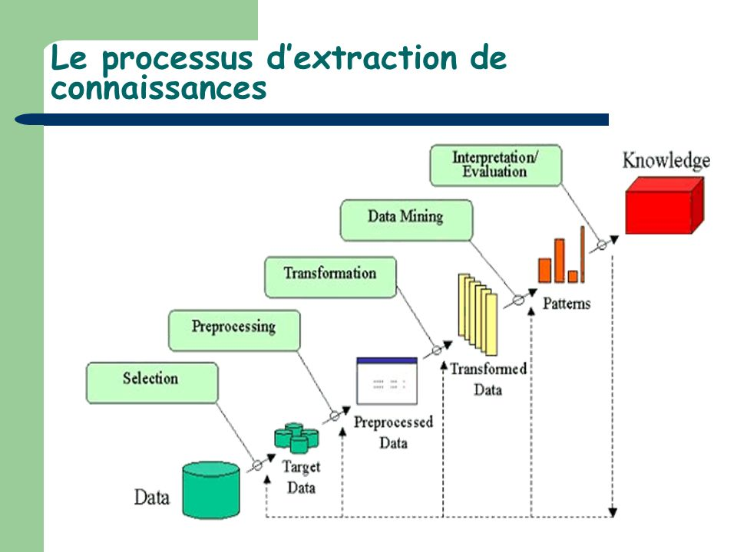
Pattern mining
Emotion mining
Our center of interest
Knowledge mining

Slide 6
In the initial stage of my research, I found that these algorithms are relevant in our case:
Sequential Pattern mining algorithms : GSP (Generalized Sequential Pattern Mining) SPADE (Sequential Pattern Discovery using Equivalence Class) Non-Apriori Based Algorithms PrefixSpan (Prefix-projected Sequential Pattern Mining) https://hevodata.com/learn/sequence-pattern-mining/ Hidden Markov Models
NN : RNN ~ LSTM Autoencoders Transformers Association Rule Mining algorithms : les plus utilisé : Apriori Algorithm P-Growth Algorithm Eclat Algorithm
=> the choice among them still requires further discussion and research.

Slide 7
Ability to extract relevant patterns:
GSP (Generalized Sequential Pattern Mining): GSP is a well-established algorithm for extracting frequent sequential patterns from sequential data. SPADE (Sequential Pattern Discovery using Equivalence Class): SPADE is another algorithm commonly used to discover frequent sequential patterns. Non-Apriori Based Algorithms: These algorithms, such as PrefixSpan, are designed to extract frequent sequential patterns without using the Apriori approach. Hidden Markov Models (HMMs): HMMs can also be used to extract sequential patterns by modeling transitions between hidden states.

Slide 8
Ability to capture long-term dependencies:(involves understanding patterns, relationships, or dependencies that occur over an extended period of time, rather than individual events) RNN~LSTM: Recurrent neural networks, especially LSTMs, are designed to capture long-term dependencies in data sequences. Hidden Markov Models (HMMs): HMMs can model long-term dependencies between hidden states using the transition structure. Transformers: Transformers, while initially designed for natural language processing, can also capture long-term dependencies in sequences.

Slide 9
Scalability: GSP, SPADE, Non-Apriori Based Algorithms, Hidden Markov Models: These algorithms can typically scale to process large amounts of sequential data. RNN ~ LSTM, Autoencoders, Transformers: The scalability of these algorithms depends on various factors such as data size, model complexity, and available computing resources.

Slide 10
Interpretability: GSP, SPADE, Non-Apriori Based Algorithms, Hidden Markov Models: These algorithms can generate sequential patterns or hidden patterns that are often interpretable for human analysts. RNN ~ LSTM, Autoencoders, Transformers: These algorithms are often thought of as black box patterns and may be less interpretable due to their complexity.

Slide 11
After analyzing the different algorithms mentioned, it is important to conduct extensive research and experiment with these algorithms to determine which one offers the best efficiency in your specific case. It is also interesting to explore the possibilities of combining several algorithms to obtain better results ( this article highlights the improvement of results after using the combination between LSTM and GRU (https://webpages.charlotte.edu/aatzache/Papers/2021_EmotionClassificationUsingRecurrentNeuralNetworkandScalablePatternMining.pdf ) the use of reinforcement algorithms such as RL (Reinforcement Learning) may offer promising prospects, as these newer algorithms have not yet been widely used in many fields. Since your project is a research initiative, it may be beneficial to explore these new approaches to discover improved results. Experimentation is essential to evaluate the effectiveness of algorithms with the database of valid data, it is necessary to try several algorithms to make the final choice,
Remains to be done: read articles that compare sequential pattern mining algorithms , Association Rule Mining algorithms

Slide 12
Algorithmes | Interprétabilité | Évolutivité | capturer des dépendances à long terme | Extraire des motifs pertinents | Allocation des ressources | Rapidité | Précision | Nbre de paramètres de réglage | Domaine d'utilisation
GSP | Élevée | Élevée | Moyenne | Élevée | Moyenne | Élevée | Élevée | Faible | Divers domaines
SPADE | Élevée | Élevée | Moyenne | Élevée | Moyenne | Élevée | Élevée | Faible | Divers domaines
Non-Apriori | Élevée | Élevée | Moyenne | Élevée | Moyenne | Élevée | Élevée | Faible | Divers domaines
PrefixSpan | Élevée | Élevée | Moyenne | Élevée | Moyenne | Élevée | Élevée | Faible | Divers domaines
Hidden Markov | Moyenne | Élevée | Élevée | Moyenne | Moyenne | Moyenne | Moyenne | Moyenne | Divers domaines
LSTM | Faible | Moyenne | Élevée | Moyenne | Moyenne | Moyenne | Élevée | Élevée | Divers domaines
Autoencoders | Faible | Moyenne | Moyenne | Élevée | Moyenne | Élevée | Moyenne | Élevée | Divers domaines
Transformers | Faible | Moyenne | Élevée | Moyenne | Moyenne | Élevée | Élevée | Élevée | Traitement du langage naturel
Apriori | Élevée | Élevée | Faible | Élevée | Élevée | Élevée | Élevée | Élevée | Divers domaines
P-Growth | Élevée | Élevée | Faible | Élevée | Élevée | Élevée | Élevée | Élevée | Divers domaines
Eclat | Élevée | Élevée | Faible | Élevée | Élevée | Élevée | Élevée | Élevée | Divers domaines

