Slide 1
P
POCUS-Emergency
Intelligent Multimodal Assistant for Clinical Ultrasound
and Decision Support in Emergencies
A multimodal decision-support system combining patient information, three ultrasound modules and a clinical reasoning layer — with an explicit account of what it does not know.
4
339
37
perception models
automated tests
safety properties
Mariem Brik · ESPRIT / Esprit Tech · Clinical partner: STMU · Supervisor: Ms. Wiem Trabelsi
Notes:
Open on what it is: decision support, not diagnosis. The three numbers signal that the talk carries evidence.

Slide 2
The problem
Emergency assessment is multimodal, and the modalities arrive apart
1
Time pressure
Decisions are made before all the information is available.
The gap
No system combines
imaging with the rest
of the emergency record
while keeping an honest
account of its own
reliability.
2
Scattered evidence
Vitals, complaint, laboratory values and imaging arrive separately.
3
Operator dependence
POCUS adds real information at the bedside — its interpretation varies with the operator.
That gap is the subject of this work.
4
Integration
Combining these under time pressure, while tracking what is still unknown, is where error enters.
The objective is assistance, not replacement. The physician remains responsible for the clinical decision.

Slide 3
The proposed solution
One workflow, several sources of evidence, one decision
Centralised evidence
Explicit uncertainty
Triage, three POCUS modules and the clinical record on one screen.
Every finding carries its reliability, and absent evidence is labelled absent — never normal.
Structured reasoning
Persistent record
The assessment is assembled from enumerated evidence, not narrated freely.
Each physician keeps their own patients, examinations and images.
Delivered as a working web platform with accounts, a stored patient history, containerised deployment and an automated test suite.

Slide 4
Technical architecture
CRISP-DM · Modeling
PATIENT
TRIAGE AGENT
gradient-boosted trees
ULTRASOUND AGENTS
convolutional models
Lung
multi-label
Heart
segmentation
Gallbladder
classification
CLINICAL REASONING AGENT
Models produce evidence
Escalation is computed
BEFORE the language
model runs.
If the model fails, the alerts are still correct.
No module emits a diagnosis. The assessment is assembled from enumerated findings, each carrying its own reliability.
DETERMINISTIC SAFETY LAYER
CLINICAL DECISION SUPPORT → PHYSICIAN

Slide 5
Data sources and preparation
CRISP-DM · Phases 2–3
Four independent public sources, prepared under one rule
Triage
Lung
Heart
Gallbladder
16,180 encounters
(held-out test)
187 clips
165 cases
100 patients
(validation)
199 cases
Pooled emergency-department registries
Point-of-care lung ultrasound
CAMUS, plus an independent external set
Abdominal teaching atlas
Quality control
Cleaning and harmonisation
Case-level splitting
Training / evaluation sets
Data is split by patient, never by image — so no model is ever tested on a patient it has already seen. Every reported figure depends on this.
Case counts are small for the imaging modules. That is the principal limitation of this work, and it is stated wherever a figure is reported.

Slide 6
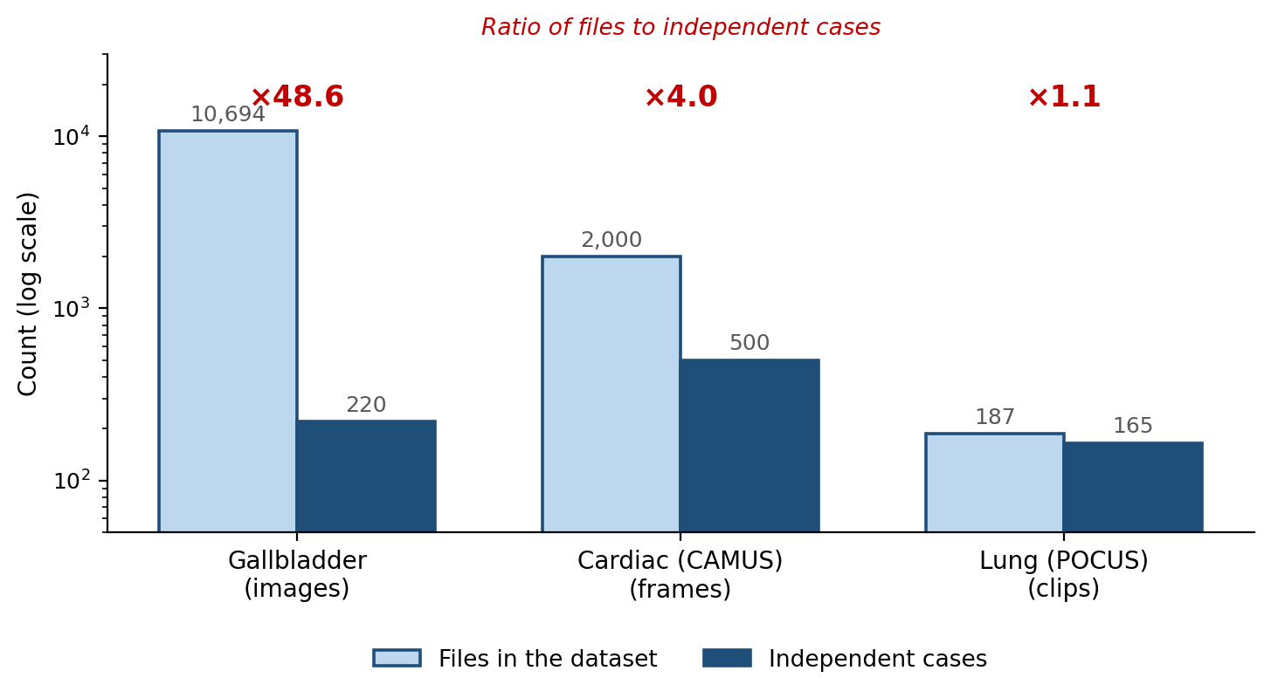
Why the split is by case, not by image
The same patient appears many times over — counting files would count them as many patients
What the ratio means
The gallbladder set holds 10,694 images from 220 patients — on average 48 images of the same person.
Split those files at random and the same patient lands in both training and test. The model recognises the patient, the score rises, and nothing has been learned about a new one.
Every figure in this presentation is computed on splits made by case.
Notes:
If a jury member asks why the numbers are not higher, this is the slide to return to: the honest split costs accuracy and buys meaning.

Slide 7
Module 1 — Triage
Modeling
Clinical task
Data
Approach
Grade the urgency of a patient from information available at the bedside.
Pooled emergency-department registries. Disposition fields removed after they were found to leak the outcome into the input.
Gradient-boosted trees on 21 prepared inputs — 10 entered by the clinician, 11 derived (shock index, pulse pressure, red-flag indicators). Probabilities calibrated.
Output
A suggested urgency tier with its probability — presented to the clinician, who confirms or changes it. The suggestion is never applied on its own.
The deployed model was retrained on exactly the fields the interface collects, so its reported accuracy is accuracy a bedside prediction can actually reach.

Slide 8
Results — Triage
CRISP-DM · Evaluation
Held-out test set, 16,180 encounters
63.0%
56.7%
77.3%
1.36%
Accuracy
Macro F1
High-urgency recall
Dangerous miss rate
Two models, and why the weaker one is deployed
The reference model also sees hospital registration fields and reaches 68.0% accuracy. The deployed model uses only what a clinician types at the bedside: 63.0% accuracy, and a LOWER dangerous-miss rate — 1.36% against 1.55%. On the error that matters, the deployable model is the better one.
A dangerous miss is a genuinely high-acuity patient graded low. These are retrospective figures on registry data: a decision-support suggestion, not a validated triage instrument.
Model selection: gradient-boosted trees were compared against logistic regression, random forest, a multilayer perceptron and CatBoost on identical features and splits. None beat them — the ceiling is a property of the data.

Slide 9
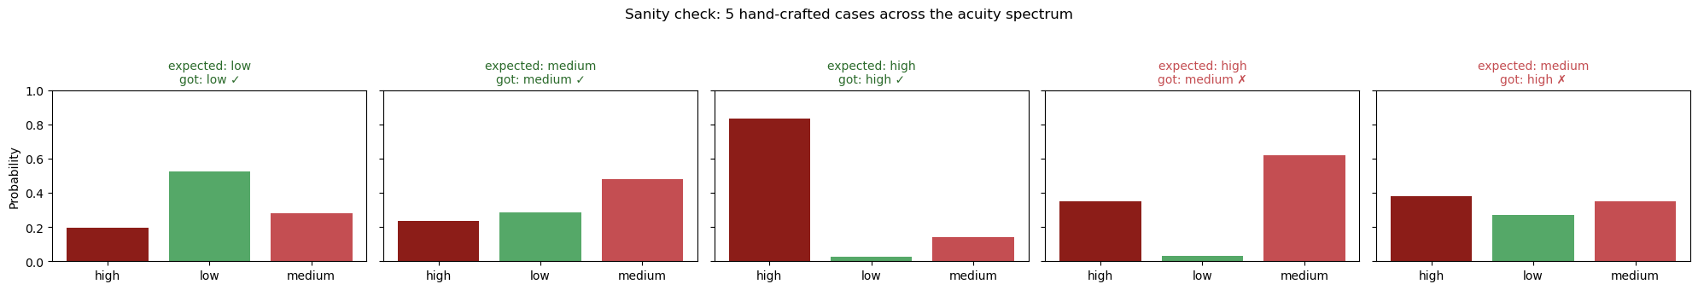
Triage: a behavioural check on constructed cases
Five cases written by hand to span the acuity spectrum
Constructed case
Expected
Predicted
Conf.
Healthy young adult, minor ankle sprain, walk-in
low
low
52.2%
✓
Middle-aged, moderate abdominal pain, stable vitals
medium
medium
47.8%
✓
Elderly, tachycardic, hypotensive, hypoxic, ambulance
high
high
83.2%
✓
Elderly, ambulance, severe chest pain, tachycardic
high
medium
61.9%
✗
Young adult, high fever and tachycardic, walk-in
medium
high
37.9%
✗
Five constructed cases support no statistical claim. The purpose is to see whether the model moves in the direction a clinician would expect — which an aggregate accuracy cannot show.
Notes:
Both failures confuse ADJACENT tiers, and neither confuses low with high. The febrile young adult is over-triaged at 37.9% — the harmless direction, without conviction. The elderly patient under-triaged at 61.9% is the one that matters, and it is why the dangerous-miss rate is reported separately.

Slide 10
Module 2 — Lung
Modeling
Clinical task
Data
Approach
Detect four findings on point-of-care lung ultrasound: B-lines, consolidation, pleural effusion, pleural thickening.
187 clips from 165 cases. Frames sampled per clip; clips of one case never split across folds.
EfficientNet-B0 backbone with a multi-label head — findings co-occur, so they must not compete for probability mass. Three-fold grouped cross-validation, per-finding thresholds.
Output
Per-finding detection with a confidence, reduced across frames by median so one blurred frame cannot carry the result.
Pneumothorax is deliberately NOT modelled: it is a motion sign, invisible in a single static frame, and the dataset contains no positive cases.

Slide 11
Results — Lung
CRISP-DM · Evaluation
Pooled out-of-fold, 187 clips from 165 cases
Finding
AUROC
Sensitivity
Positive cases
B-lines
0.830
84.1%
63
Consolidation
0.832
60.0%
60
Pleural effusion
0.718
75.0%
24
Pleural thickening
0.773
65.2%
46
Macro AUROC 0.788
Pleural effusion rests on 24 positive cases, and per-fold AUROC for B-lines ranges from 0.536 to 0.830. A pooled figure conceals that spread, which is why the spread is reported.
Pneumothorax is not modelled and therefore cannot be excluded by this system. It is reported as not assessed — never as absent.
Calibration was not applied to this module: a held-out calibration split would leave about three positive effusion cases, and a curve fitted on three points is not a calibration. The interface states that the confidence is uncalibrated.

Slide 12
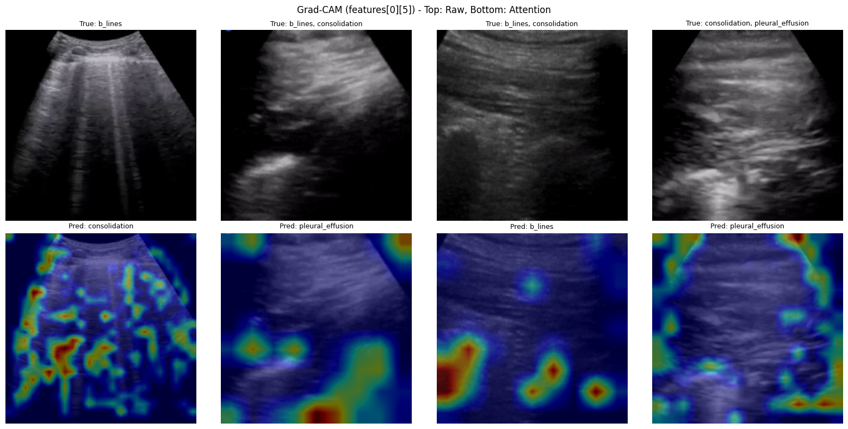
What the lung model attends to
Grad-CAM on cases the model got WRONG — a selection of successes would prove nothing
Why the failures
A viewer who already knows where the pathology lies will read any attention map as pointing at it. Maps of correct predictions are therefore not evidence.
Shown here are cases the model misclassified, so attention on a correct and an incorrect prediction can be compared. That comparison is the only one from which anything follows without expert annotation.
Aggregate statistics — centroid spread, area above half-maximum, centre-bias — were computed over the full sets.
Notes:
The selection principle matters more than the pictures. Say that the maps shown are failures, on purpose.

Slide 13
Module 3 — Heart
Modeling
Clinical task
Data
Approach
Segment the left ventricle and derive an ejection-fraction band from the segmentation.
CAMUS, 100 validation patients, plus an independent external collection used for validation only and never for training.
U-Net with an EfficientNet-B0 encoder, four output classes. Ejection fraction computed from end-diastolic and end-systolic areas, with a geometric volume correction.
Output
Left-ventricle segmentation and an ejection-fraction band — severe, reduced or normal — with the value flagged when it falls close to a cutoff.
Segmentation quality and clinical output are reported separately. The band is what a clinician acts on, so the band is the module’s result.

Slide 14
Results — Heart
CRISP-DM · Evaluation
Segmentation is strong; the derived clinical band is weaker, and that is the figure reported
0.928
0.534
63.4%
6.9 pp
LV Dice, in-domain
(nnU-Net: 0.93)
LV Dice, external
EF-band balanced acc.
(chance 33.3%)
EF mean absolute error
(was 12.2 pp)
Ejection fraction here is a geometric estimate derived from segmentation — a proxy, not a definitive echocardiographic measurement. Volume correction halved its error.
Values near a band boundary are flagged
A 6.9-point error is enough to move a patient across a cutoff. Where an estimate falls within that margin of a threshold, the system states the value could lie on either side. The margin is the module’s own measured error, not a round number chosen for convenience.
The external drop was first attributed to a labelling-convention mismatch. Connected-component analysis over the full external set disproved that hypothesis, and the reversal is reported rather than dropped.

Slide 15
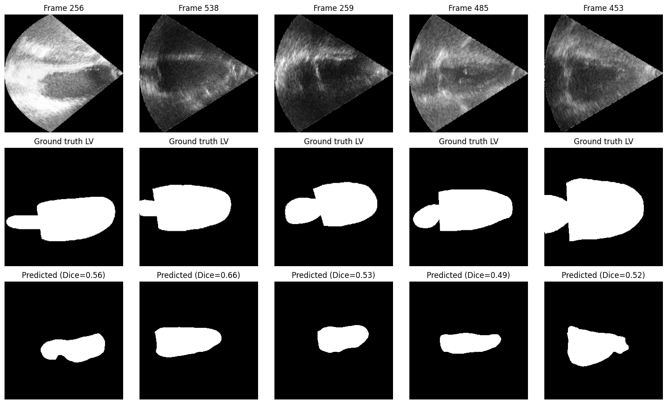
Where the cardiac model fails
Five frames from the external collection: the image, the reference contour, and what the model produced
A consistent failure, not a random one
The predicted region is systematically SMALLER than the reference, and loses the apex. It is not noise: the model finds the ventricle and under-segments it.
Dice on these frames runs 0.49 to 0.66, against 0.928 in-domain. Under-segmenting the ventricle biases the derived ejection fraction, which is why the band and not the Dice is reported as the module’s clinical result.
Showing the failure is the point: an external gap named but never displayed is a gap a reader cannot judge.
Notes:
Expect a question about domain shift here: different scanner, different acquisition convention. The labelling-convention hypothesis was tested and disproved by connected-component analysis.

Slide 16
Module 4 — Gallbladder
Modeling
Clinical task
Data
Approach
Identify the principal abnormality in a gallbladder study, among five reported groups.
199 cases from an abdominal teaching atlas. One class was excluded after per-case inspection showed its contents did not match its label.
EfficientNet-B0 trained on eight fine-grained classes, reported as five by summing group probabilities. Temperature scaling for calibration.
Output
One reported finding with a calibrated confidence. Groups are mutually exclusive: classes considered and rejected are not passed on as evidence.
The atlas contains no healthy class. This module can say which abnormality is most consistent with the image — it cannot say a gallbladder is normal.

Slide 17
Results — Gallbladder
CRISP-DM · Evaluation
Five reported groups, held-out evaluation
59.7%
0.024
199
Balanced accuracy
(chance 20.0%)
Calibration error
after temperature scaling
Cases
Why the taxonomy matters more than the accuracy
82% of the model’s confusions cross a reported group boundary. A coarser three-category grouping was tested and rejected on that evidence: if the groups captured a distinction the model could see, its confusions would concentrate within them. They do not.
No healthy class. The model reports which abnormality is most consistent with the image; it cannot report the absence of disease, and the interface says so beside every result.
A ninth folder present in the original release was excluded after sampling one frame per case across the whole set. A first inspection of a handful of frames had judged it consistent — frames from one case are not a sample of a class.

Slide 18
The Clinical Reasoning Agent
Modeling
How the branches are combined
Triage evidence
Ultrasound evidence
Clinical context
What the physician receives
CLINICAL REASONING
A possible interpretation
Before interpreting anything, it establishes:
Alerts and limitations
?
Are important findings missing?
?
Do the assessments agree with one another?
What evidence is missing
?
Is the evidence sufficient to support a conclusion?
?
What are the declared limits of what was measured?
What would clarify the case
?
Is further assessment needed before deciding?
Evidence is enumerated and cited by identifier, so the reasoning layer cannot assert a finding that no module produced.

Slide 19
Safety architecture
AI evidence
Four states a finding can occupy
detected
Deterministic safety checks
Computed before any
model runs:
Missing evidence
Disagreement
Severity
Uncertainty
a positive finding
unreliable
Language-model explanation
detected, weak evidence
screened, not detected
Validation of the output
looked for, not found
not assessed
Physician
no model covers this
Absence of evidence is never recorded as evidence of absence. This is enforced by the data structure, not by a convention someone must remember.

Slide 20
Global validation
CRISP-DM · Evaluation
What was verified, and how
339
37
150
6 / 6
Automated tests
all passing
Safety properties
each reported separately
Regression checks
over 10 full cases
Automated checks
tests, lint, security
Grouped by property, not by count
Beyond model metrics
Conflict detection — 14 / 14
Absent is not normal — 24 / 24
Hallucination rejection — 25 / 25
Access control — 17 / 17
Generalisation tested on an independent set where one existed
Calibration measured per module, and refused where data was insufficient
Whole encounters run end to end, intake through report
Individual real studies inspected by hand
"339 passed" is not evidence. "Conflict detection 14/14" is.
Seven well-motivated changes were tested and rejected on measurement rather than preference — each reported with its outcome.

Slide 21
Technical deployment
CRISP-DM · Deployment
A running application, not a notebook
1
Application
2
Containerised
FastAPI and uvicorn serving a generated clinician interface in English and French
Docker image running as a non-root user, with a health check that reports whether each model actually loaded
3
Accounts and storage
4
Automated pipeline
Per-physician accounts, hashed passwords, server-side sessions, and a stored patient record
Every check runs on each push: tests, regression, lint, code and dependency security
Technical deployment and clinical deployment are different claims. The first is demonstrated here; the second — installation in a hospital and prospective validation — has not been attempted.

Slide 22
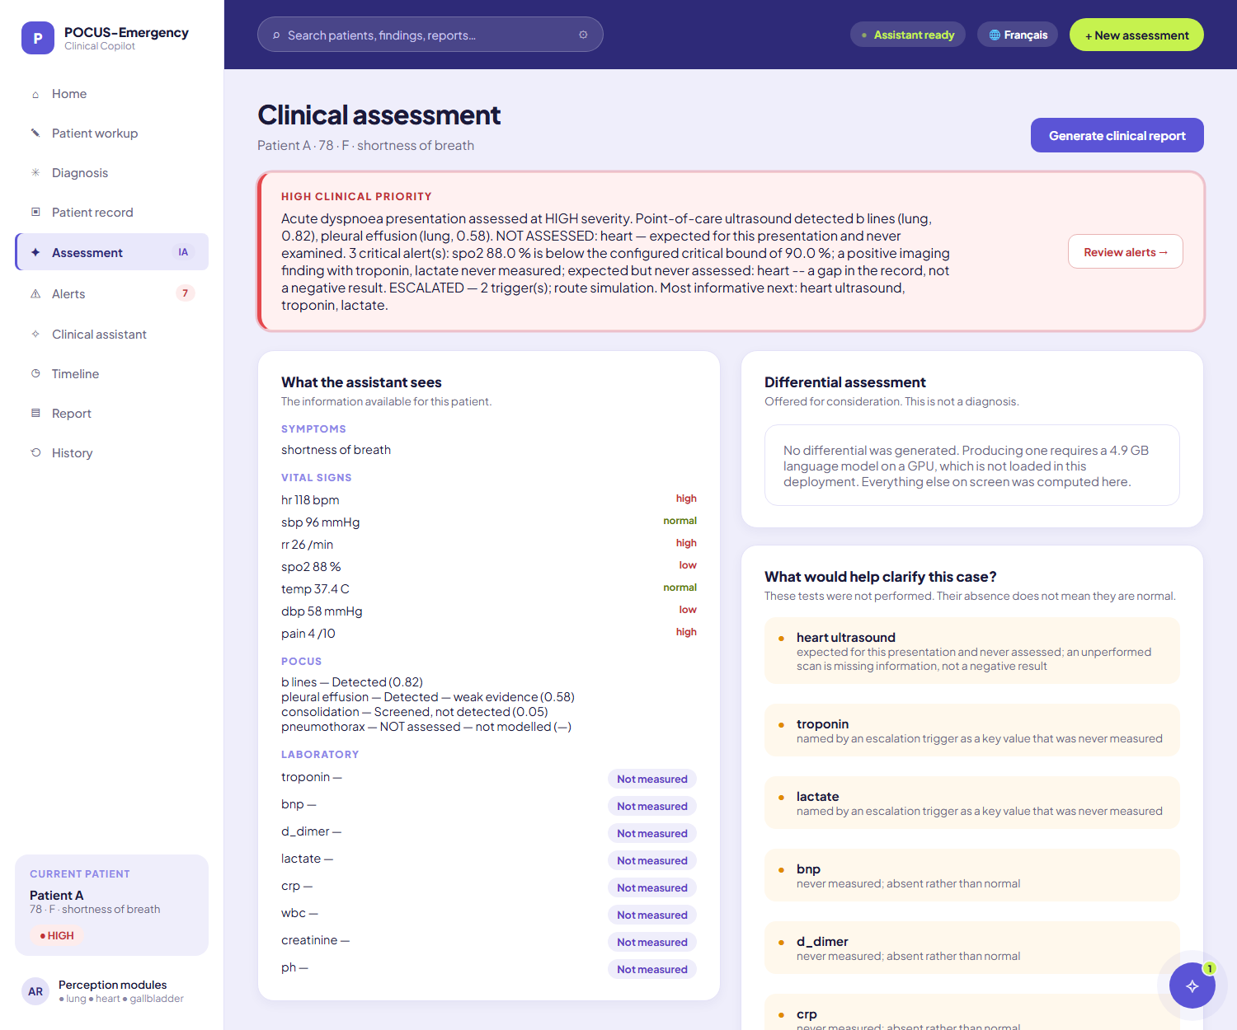
The clinician interface
On one screen
Patient information
Triage suggestion
Ultrasound findings
What was not measured
Alerts and limitations
What would clarify the case
Every value on the screen is computed by the pipeline. Where the system has nothing real to put in a slot, the slot says so.
Served in English and in French — the French text is composed from the same computed fields, so a French screen cannot state something the English record does not.

Slide 23
What this could bring to an emergency department
Centralised evidence
Faster access to findings
Triage, imaging and laboratory values assembled in one place rather than read separately.
A POCUS study is read and filed against the patient as it is acquired.
Explicit uncertainty
Structured reasoning support
Every finding carries its reliability, and what was not measured is named.
A written assessment with its alerts, its gaps and what would clarify the case.
Persistent history
Extensible
Each physician’s patients, examinations and images kept across visits.
Further organs and findings slot into the same contract and the same safety layer.
The value proposition is the workflow, not any single model. No individual module reaches the accuracy a standalone diagnostic tool would require.

Slide 24
Limitations and roadmap
Stated plainly — a system that hides these is not usable clinically
Current limitations
Roadmap
Small datasets for several ultrasound findings
External generalisation remains difficult (LV Dice 0.928 → 0.534)
Ejection fraction is a geometric proxy
Pneumothorax is not assessed at all
The gallbladder model has no healthy class
No prospective clinical validation
Larger and more diverse clinical datasets
External and prospective validation
Improved robustness of the ultrasound modules
Evaluation with emergency physicians
Additional organs within the same safety contract
Integration into a real clinical workflow
The system is built to accept validated data later: versioned by content hash, retrained, evaluated against fixed criteria, and approved by a named person before any model reaches a patient.

Slide 25
What it can tell you — and what it cannot
It can
assemble the available evidence, grade urgency, read three organ systems, and state what is missing.
It cannot
exclude a pneumothorax, confirm a normal gallbladder, or replace an echocardiographic measurement.
It never
makes the clinical decision. That remains yours.
339 automated tests · 37 safety properties · 150 regression checks · 4 perception models · a working platform
Thank you · Questions

