Slide 1
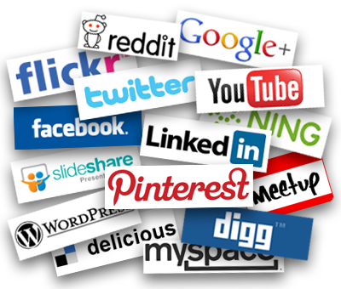
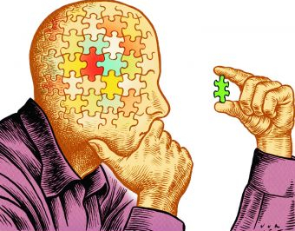
To think about…
Who owns the data in Social Media?
Do you think that currently there is enough protection for world citizens to avoid censorship on Social Media?
What are the advantages of using social media versus the disadvantages to expose our data to everyone?

Slide 2
To think about…
How Social media content can influence our thoughts and behaviours?
Social media has desensitized us from privacy issues?
Do you expect privacy anywhere?
Would you pay to protect your privacy?

Slide 3
To think about…
Do you know what of your photos, tweets or posts are shared to an open public?
How would you feel if those photos, tweets or posts were used for another purposes? (e.g., commercials, politics, research)

Slide 4
To think about…
Which hurdles are social media sites facing in copyright-protecting our posts?
Is there a relationship between the types of work you can publish on a certain social media and the extent of copyright support that media can provide?

