Slide 1

The Facebook Study: A Personal Account of Data Science, Ethics and Change
Guest speaker: Prof. Jeff Hancock

Slide 2


Facebook emotion study

Slide 3


Guest speaker: Prof. Jeff Hancock
Professor in the Departments of Communication and Information Science at Cornell University.

Slide 4
Experimental evidence of massive-scale emotional contagion through social networks
Presented by Maryi Arciniegas

Slide 5
Purpose & Participants
Researchers wanted to test whether emotional contagion occurs outside of in-person interaction between individuals by reducing the amount of personal content in the News Feed.
Participants: people who viewed Facebook in English

Slide 6
Methodology
1 week January 11th - 18th 2012 ~155.000 participants were randomly selected.
Parallel experiments:
Positive emotions: exposure to friends’ positive emotional content in their News feed was reduced.
Negative emotions: exposure to friends’ negative emotional content in their News feed was reduced

Slide 7
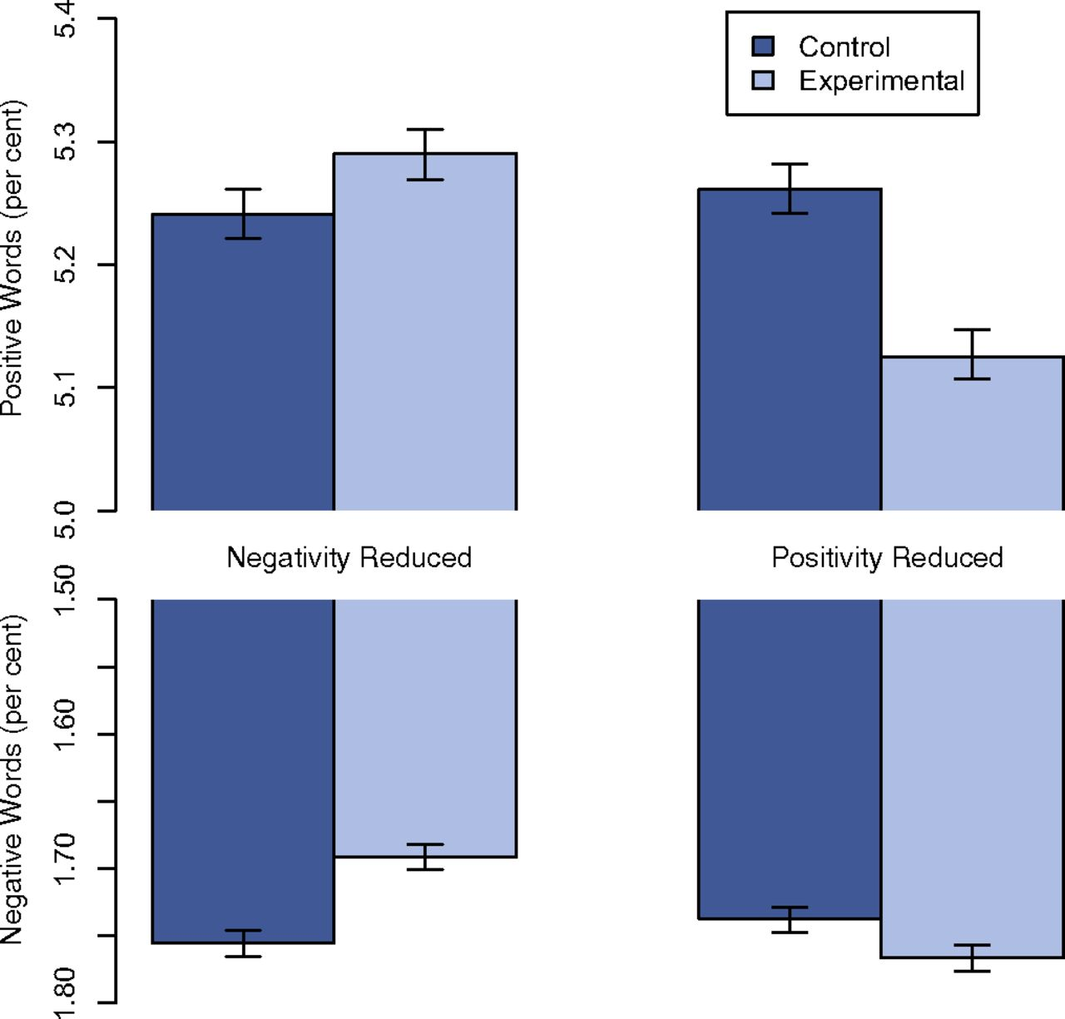
Results
Mean number of positive (Upper) and negative (Lower) emotion words (percent) generated people, by condition.

Slide 8
Conclusion
“Emotions expressed by friends, via online social networks, influence our own moods, constituting, to our knowledge, the first experimental evidence for massive is scale emotional contagion via social networks.”

Slide 9


What happened after the study was published?
Public concern about the approach, was that Ethical?

Slide 10
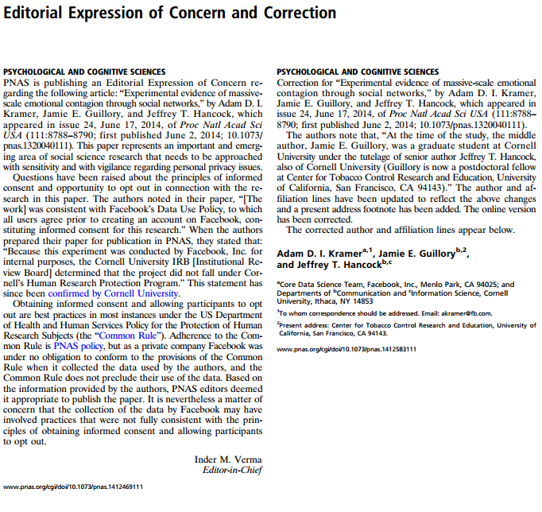
What happened after the study was published?
By the time I downloaded the paper:

Slide 12

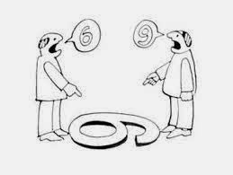
What is next?
Facebook presentation:
Another way to see it:

Slide 13

What does Facebook says?

Slide 14
To think about..
Do you know what of your photos, tweets or posts are shared to an open public?
How would you feel if those photos, tweets or posts were used for another purposes? (e.g., commercials, politics, research)

Slide 15

Comments or questions?

