Slide 1


“Narco” Emotions: Affect and Desensitization in Social Media during the Mexican Drug War
Authors: Munmun De Choudhury, Andrés Monroy-Hernández, Gloria Mark
Presented by: Arturo Reyes López

Slide 2
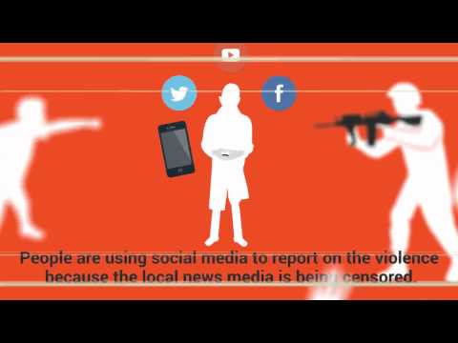

Slide 3
Outline
Social context: Mexican Drug War
Research: Affective responses in social media and how they might indicate desensitization to violence experienced.
Results: People using Twitter in the studied regions of Mexico lose sensitivity to the violence over the time.
Conclusions: Positive & Negative aspects.

Slide 4
Social Context in México
Since 2010, Mexico is living a Drug War:
In 2011,INEGI:The war has taken 60,000 lives, displaced 2 million people.
Citizens have created alert networks in Social Media to inform about violence.
Exposure to violence may cause desensitization.
How social media can be used to gauge the well-being of a society experiencing violence?

Slide 5
Terminology
Metrics to be studied the impact of desensitization on Social Media:
Negative Affect: Exposure to violence may produce aversive responses: increased heart rate, fear, discomfort, disgust.
Activation:Measures the intensity of an emotion.

Slide 6
Research Questions
How does the expression of Negative Affect in social media change over the time, subject to prolonged violence exposure?
How does the expression of activation in social media change over time, subject to prolonged violence exposure?
How does the level of social media use change over time, subject to prolonged violence exposure?

Slide 7
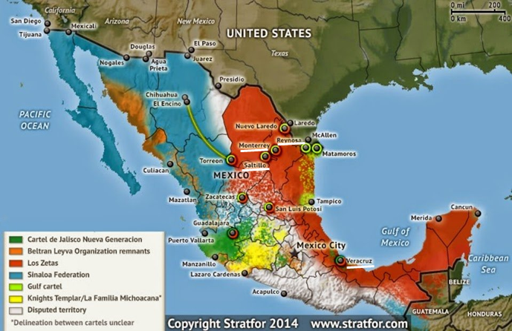

Data and Methods
4 major cities: Monterrey, Reynosa, Saltillo, Veracruz.
(August 2010- December 2012)

Slide 8
Postings Classification Method
LIWC (Spanish Linguistic Inquiry and Word Count): Negative affect.
Negative affect categories: negative emotion, sadness, anger, anxiety, inhibition.
ANEW (Affective Norms for English Words) lexicon: Activation - sentiment analysis.
Regular expression match to classify the words

Slide 9
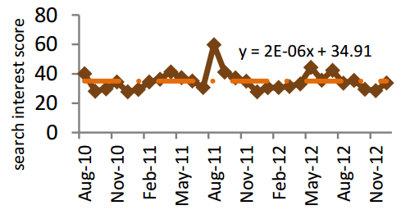
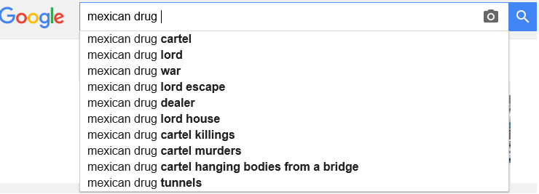
Statistics on Drug War
Web search interest on violence-related phrases:

Slide 10
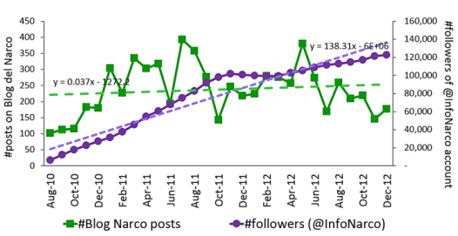
Statistics on Drug War
“Narco” blog (highly popular anonymously curated).
25 million hits by month
100 most-visited websites in Mexico

Slide 11
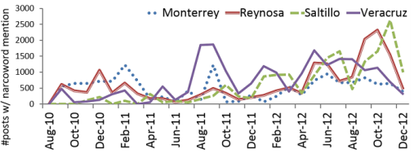
Twitter Postings Analysis
Social media data from Twitter (Twitter’s Firehose stream):
Use of LIWC to classify posts with “narco” words by emotions
City | 2010-2011 | 2012
Monterrey | 14% | 18%
Reynosa | 22% | 29%
Saltillo | 15% | 32%
Veracruz | 28% | 30%
Table 1.- Increase of Narco Posts by city.
Notes:
Linguistic Inquiry and Word Count (LIWC)is the gold standard in computerized text analysis.
Learn how the words we use in everyday language reveal our thoughts, feelings, personality, and motivations.
2015 is the gold standard in computerized text analysis. Learn how the words we use in everyday language reveal our thoughts, feelings, personality, and motivations.

Slide 12
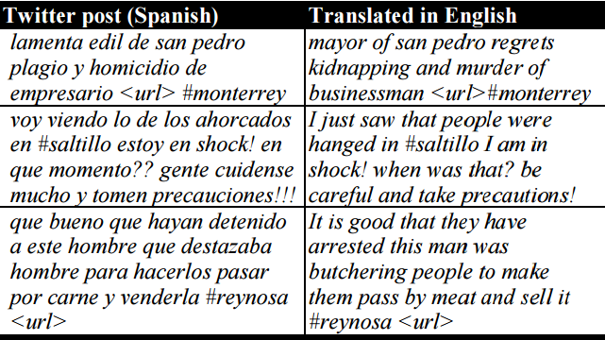
Postings on Twitter

Slide 13
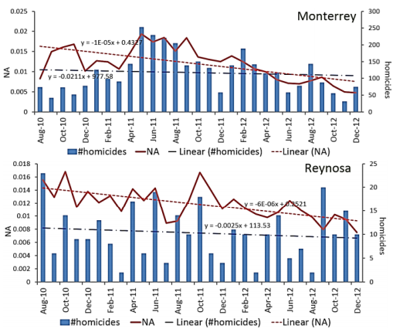
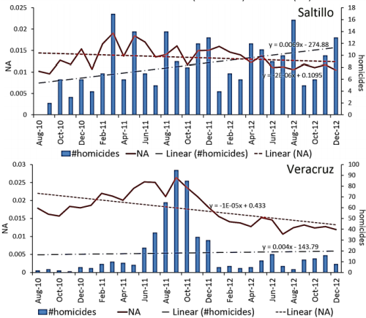
Results in Negative Affect

Slide 14
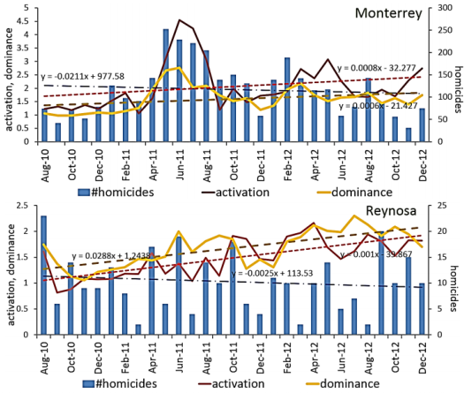
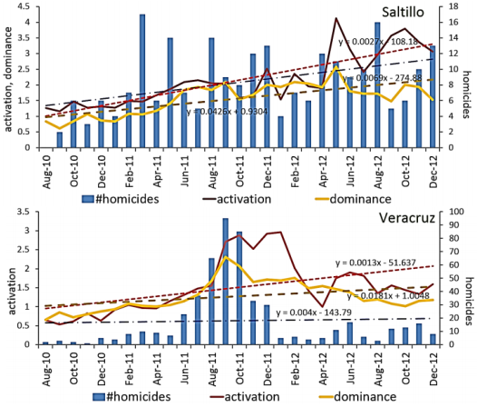
Results in Activation

Slide 15
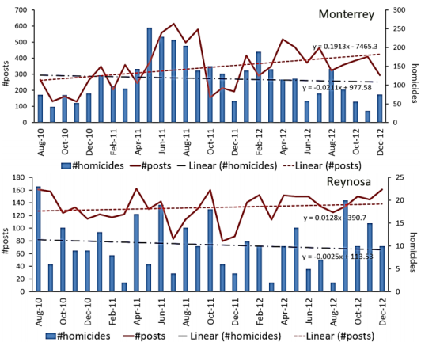
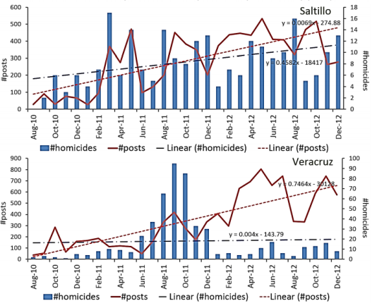
Results in Social Media Use

Slide 16
Conclusions
Negative aspect:
Results: Excessive exposure to violence is associated with desensitization on social media postings.
Positive aspects:
Mexicans created citizen alert network to be informed.
Well-being can be measured on Social Media to create prevention strategies and humanitarian aid.

Slide 17
Questions?
Who owns the data in Social Media? Do you think that currently there is enough protection for world citizens to avoid censorship on Social Media?
What are the advantages of using social media versus the disadvantages to expose our data to everyone?
How Social media content can influence our thoughts and behaviours?

Slide 18
Thank you

