Slide 1

Karime Salomon Z.

Slide 2
Ruby gems installation
Gems commands
From Ruby’s installation folder:
gem install <gem_name>
gem list
gem_name --version
gem search –l <gem_name_pattern>
gem uninstall <gem_name>
Practice :
Install cucumber gem.
List all gems installed
List cucumber version installed
Perform any search in your gems installed
Uninstall the gem

Slide 3
Recursive uninstall
Create a ruby file that read the resulti of all gems listed and execute the uninstall command :
`gem list`.split(/$/).each { |line|
puts `gem uninstall -Iax #{line.split(' ')[0]}` unless line.empty?
}

Slide 4
Gems installation using bundler
What is bundler?
Bundler provides a consistent environment for Ruby projects by tracking and installing the exact gems and versions that are needed.
Why it is useful?
Bundle let you share your gem installation snapshot, so that anybody could have your exact configuration, including version you need in development, testing, and production environment.
GemFile and GemFile lock are files that will be read by bundle
How to use is?
In ruby folder : gem install bundler
In GemFile location : bundle install

Slide 5
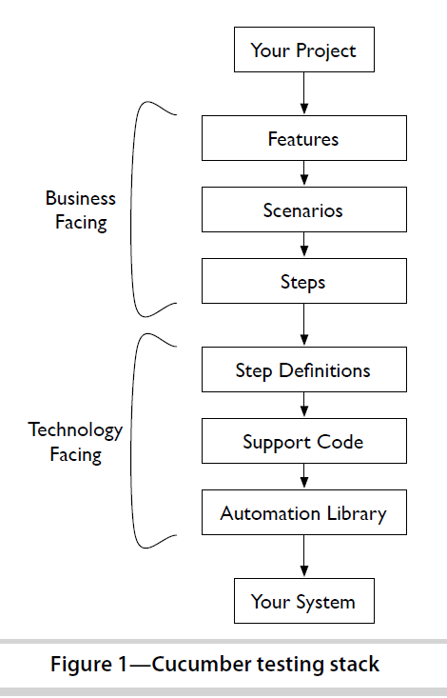
What is cucumber
Cucumber is a command-line tool. When you run it, it reads in your specifications
from plain-language text files called features, examines them for
scenarios to test, and runs the scenarios against your system.
Each scenario is a list of steps for Cucumber to work through.

Slide 6
Framework desing
Feature files
Gherkin
Step definitions
ruby
Methods, helpers, hooks
ruby

Slide 7

Cucumber structure
Lets start with it :
cucumber --init
How cucumber understand plain text?
Cucumber can understand the feature files following some basic syntax rules. The name
for this set of rules is Gherkin.

Slide 8
Gherkin?
Gherkin is the language that Cucumber understands. It is a Business Readable, Domain Specific Language that lets you describe software’s behaviour without detailing how that behaviour is implemented.
Gherkin serves two purposes — documentation and automated tests. The third is a bonus feature — when it yells in red it’s talking to you, telling you what code you should write.
Gherkin’s grammar exists in different flavours for many spoken languages (around 37), so that your team can use the keywords in your own language.

Slide 9
Gherkin
Dry Run
In order to know if our gherkins is valid or not, cucumber provides dry run option.
Into your feature folder add an empty file “test.feature”
Open CMD and go to your cucumber folder
Execute the command :
$ cucumber test.feature --dry-run
The --dry-run switch tells Cucumber to parse the file without executing it. It
will tell you if your Gherkin isn’t valid.

Slide 10
Gherkin Keywords
A Gherkin file is given its structure and meaning using a set of special keywords:
Feature
Background
Scenario
Given
When
Then
And
But
*
Scenario Outline
Examples

Slide 11
Gherkin Feature
Each Gherkin file begins with the Feature keyword.
This keyword doesn’t really affect the behavior of your Cucumber tests at all; it just gives you a convenient
place to put some summary documentation about the group of tests that follow.
Here’s an example:
Feature: This is the feature title
This is the description of the feature, which can span multiple lines.
You can even include empty lines, like this one:
In fact, everything until the next Gherkin keyword is included in the description.
The text immediately following on the same line as the Feature keyword is the
name of the feature, and the remaining lines are its description.
You can include any text you like in the description except a line beginning with one
of the words Scenario, Background, or Scenario Outline
Practice
Run the example described with a similar feature description, and dry-run to review if the correct gherkin is displayed.

Slide 12
Practice
Create one feature file with the name of an specific feature (e.g. search_customer.feature)
Into the file you should create the first 3 lines with a comment to simulate a copyright – author
Add some title for your feature file and some description
Run the feature file using –dry-run option (push the result into a txt file)
Run the feature file without dry-run option (push the result into a txt file)
Which one is the difference between both executions?

Slide 13
Gherkin Scenario
In valid Gherkin, a Feature must be followed by one of the following:
• Scenario
• Background
• Scenario Outline
Scenario :
To actually express the behavior we want, each feature contains several scenarios.
Each scenario is a single concrete example of how the system should
behave in a particular situation. If you add together the behavior defined by
all of the scenarios, that’s the expected behavior of the feature itself.

Slide 14
Gherkin Scenario
When Cucumber runs a scenario, if the system behaves as described in the scenario, then the scenario will pass; if not, it will fail
Each scenario tells a little story describing something that the system should be able to do.
Every scenario starts with the :
Scenario: keyword followed by an optional scenario title.
Each feature can have one or more scenarios, and every scenario consists of one or more steps.

Slide 15
Gherkin Scenario
Scenario structure
Start with a context
finally check
that the outcome was what we expected
go on to describe an action

Slide 16
Gherkin Scenario
Given, When, Then
In Gherkin, we use the keywords Given, When, and Then to identify the three
different parts of the scenario:
Scenario: Successful withdrawal from an account in credit
Given I have $100 in my account # the context
When I request $20 # the event(s)
Then $20 should be dispensed # the outcome(s)
So, we use Given to set up the context where the scenario happens, When to
interact with the system somehow, and Then to check that the outcome of that
interaction was what we expected.

Slide 17
Gherkin Scenario
Given, When, Then
When we have more than 1 precondition, or more than one action or result :
Scenario: Successful withdrawal from an account in credit
Given I insert my PIN
Given I have $100 in my account
When I select withdrawal
When I request $20
Then $20 should be dispensed
Then the balance is 80$

Slide 18
Gherkin Scenario
And,But
Use and to concatenate :
Scenario: Successful withdrawal from an account in credit
Given I insert my PIN
And I have $100 in my account
When I select withdrawal
And I request $20
Then $20 should be dispensed
And the balance is 80$

Slide 19
Gherkin Scenario
But
Use but to give a better sense of the scenario described for negative steps:
Scenario: Attempt withdrawal using stolen card
Given I have $100 in my account
But my card is invalid
When I request $50
Then my card should not be returned
And I should be told to contact the bank

Slide 20
Gherkin Scenario
Cucumber doesn’t actually care which of these keywords you use; the choice
is simply there to help you create the most readable scenario. If you don’t
want to use And or But, you could write the previous scenario like this, and it
would still work exactly the same way:
Scenario: Attempt withdrawal using stolen card
Given I have $100 in my account
Given my card is invalid
When I request $50
Then my card should not be returned
Then I should be told to contact the bank
But that doesn’t read as nicely, does it?

Slide 21
Gherkin Scenario
Replacing Given/When/Then with Bullets
Some people find Given, When, Then, And, and But a little verbose. There is an additional keyword you can use to start a step: * (an asterisk). We could have written the previous scenario like this:
Scenario: Attempt withdrawal using stolen card
* I have $100 in my account
* my card is invalid
* I request $50
* my card should not be returned
I should be told to contact the bank
To Cucumber, this is exactly the same scenario.
Do you find this version easier to read
Did some of the meaning get lost?
It’s up to you and your team how you want to word things. The only thing that matters is that everybody understands what’s communicated.

Slide 22
Gherkin Scenario
Stateless
When writing scenarios, here’s a really important concept you need to grasp:
“Each scenario must make sense and be able to be executed independently of any other scenario”
That means you can’t put some money into the account in one scenario and
then expect that money to be there in the next scenario.
Cucumber won’t stop you from doing this, but it’s extremely bad practice: you’ll end up with scenarios that fail unexpectedly and are harder to understand.

Slide 23
Gherkin Scenarios
Comments
As well as the description fields that follow Feat ure and Scenario keywords, Cucumber allows you to precede these keywords with comments.
Like in Ruby, comments start with a # character.
Unlike in Ruby, comments have to be the first and only thing on a line (well, apart from whitespace).
# This feature covers the account transaction and hardware-driver modules
Feature: Withdraw Cash
In order to buy beer
As an account holder
I want to withdraw cash from the ATM
# Can't figure out how to integrate with magic wand interface
Scenario: Withdraw too much from an account in credit
Given I have $50 in my account
# When I wave my magic wand
And I withdraw $100
Then I should receive $100

Slide 24
Practice
1. In the .feature file created before:
- Write 2 scenarios from your own projects
2. Create a new daily.feature file
include 2 scenarios describing your daily activities, e.g. cooking breakfast, go to work, etc,etc
Define steps of each one using Given, Then, When and also sing And /But or *.
Also add comment lines to add any extra information.

Slide 25
Practice
Consider you will be in charge of testing google main page.
Create a feature file describing your feature, and adding all the scenarios that you consider that need to be add to be sure that page is working as expected
Add the validation steps using Given, Then, When and also sing And /But or *.

Slide 26

Questions?

Slide 27
Thanks!

