Slide 1
EdgeSafe
An Edge-Based Weapon Detection and Secure Event Logging System
Group F: Andrea Seda, Jessy Andújar, Jorge Marín, Marymar Maldonado

Slide 2

Motivation

Slide 3
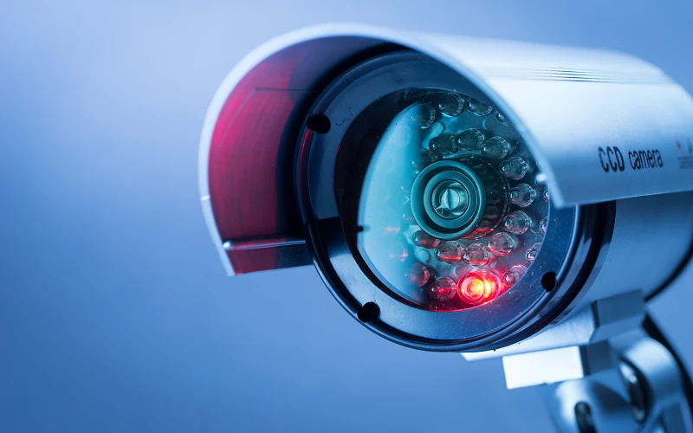
Current Problems
Traditional surveillance is reactive
Human monitoring is unreliable and slow
Cloud-based AI detection:
introduce latency,
connectivity issues,
and privacy concerns.

Slide 4
Why It Matters
Firearms are now a leading cause of death among youth in the U.S.
Faster detection can improve situational awareness and response time
EdgeSafe explores local detection as a faster and a more controlled alternative.

Slide 5
Objectives

Slide 6
Specific Objectives:
Detection
≥80% detection accuracy
≤1 second inference latency
Automation
Autonomous detection pipeline
Real-time result publishing
Security
HTTPS communication
Authenticated dashboard access
Auditability
Structured event logging
Historical event retrieval

Slide 7
Solution Approach

Slide 8
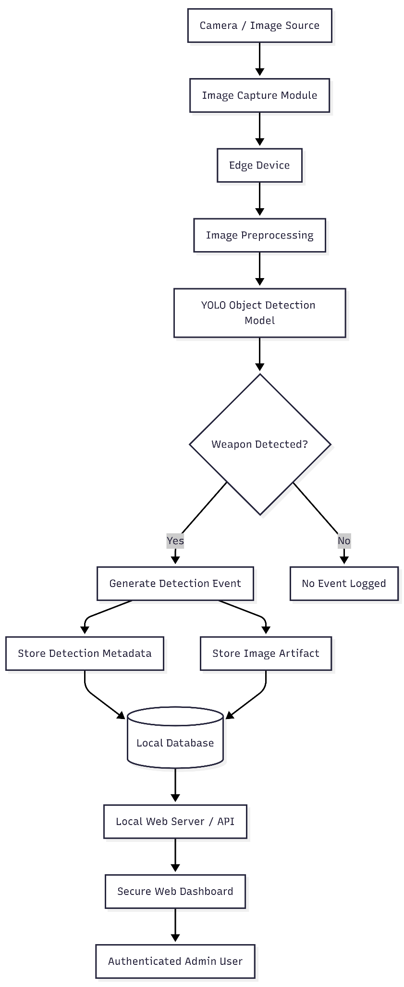
System Overview
Image input
Edge inference
Weapon detection
Event generation
Database logging
Dashboard visualization

Slide 9
System Architecture
Layout:
Presentation Layer
React/Vite dashboard
Application Layer
FastAPI backend
YOLO inference
Authentication
Data Layer
SQLite event logging
Image references
NVIDIA Jetson Nano

Slide 10
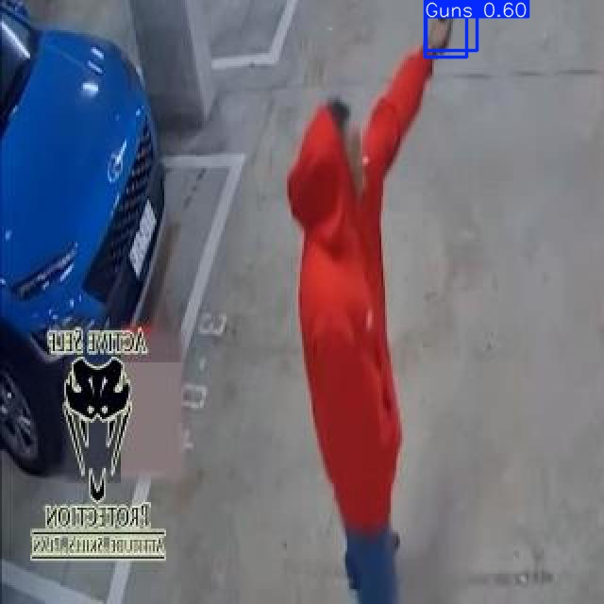
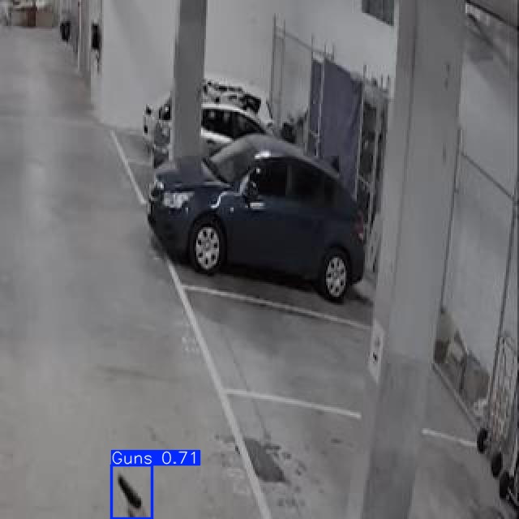
Detection Model
YOLOv11 object-detection architecture (Ultralytics), chosen for its balance of speed and accuracy on edge devices
Transfer learning applied: pretrained weights fine-tuned on a firearm-specific dataset rather than training from scratch
Two candidate variants evaluated for deployment: YOLOv11n (nano) and YOLOv11s (small)
Models evaluated with standard object-detection metrics: precision, recall, F1-score, and mAP
Confidence-threshold tuning applied under a ≥90% precision constraint to minimize false alarms
Dataset used:
Kaggle Gun Dataset YOLO v8

Slide 11
Event Logging
Backend
SQLite local database
Detection metadata storage:
timestamp
source
confidence
latency
image reference
Secure local storage
Traceability and auditability
FastAPI-based REST API
Structured JSON responses
Event retrieval endpoints
Error handling and validation

Slide 12
Dashboard
Authentication
React (Vite) dashboard displays system status and detection of events.
Event metadata display
Empty-state handling prevents dashboard from breaking even when no events are logged.
Dashboard retrieves event data directly from backend API endpoints.
JWT tokens are used to protect backend routes.
Passwords are stored using bcrypt hashing.
Login page restricts access to authorized users only.
Authenticated sessions allow access to protected dashboard pages.

Slide 13
Results

Slide 14
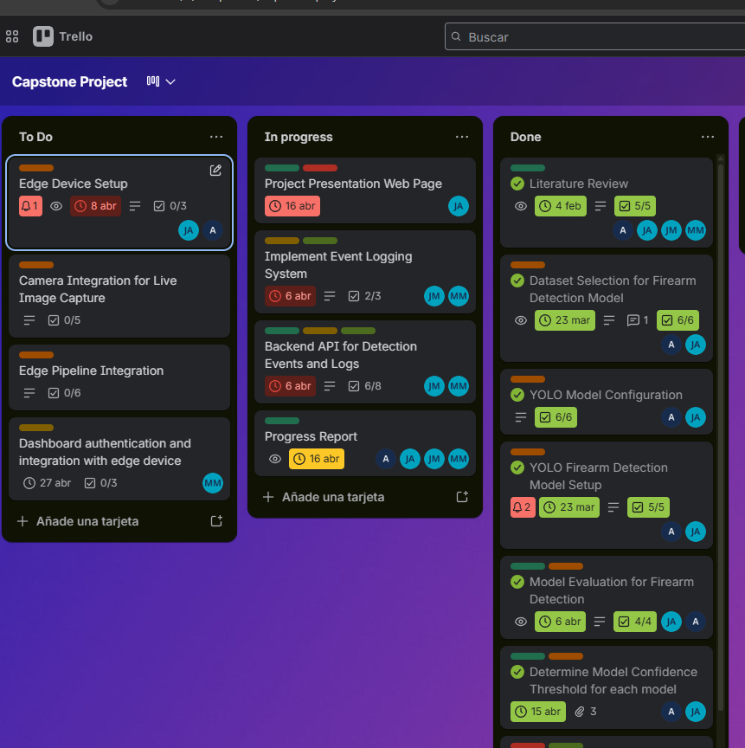

Project Management and Documentation
Trello Task Board was used to itemize issues and tasks.
Git/GitHub was used to host repository and handle all source code.
Feature branches and Pull Requests supported team collaboration and code review.
Documentation was maintained throughout the project. Including: API documentation and project website containing project and member’s information.

Slide 15
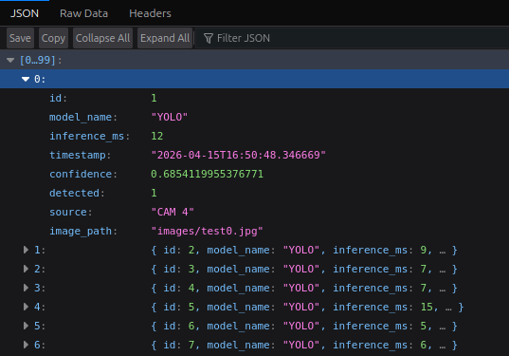
Backend, Database and API
Implemented Features:
FastAPI REST API
JSON event responses
Detection event retrieval
Error handling validation

Slide 16
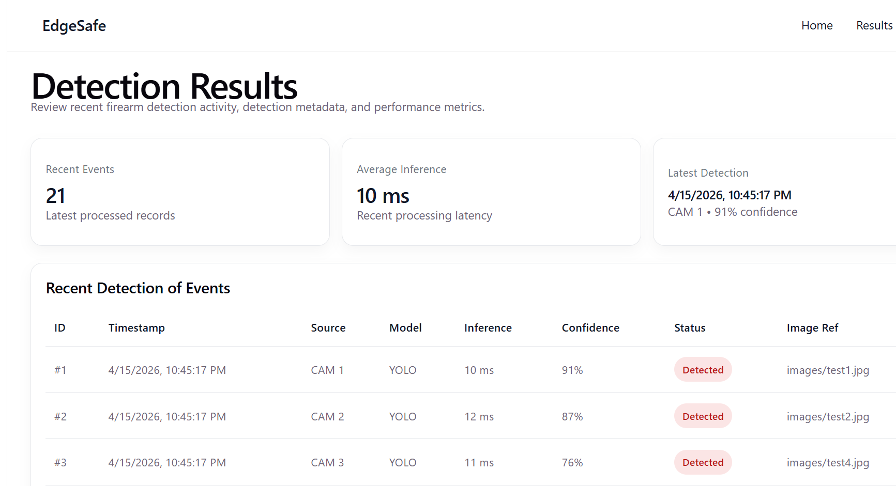
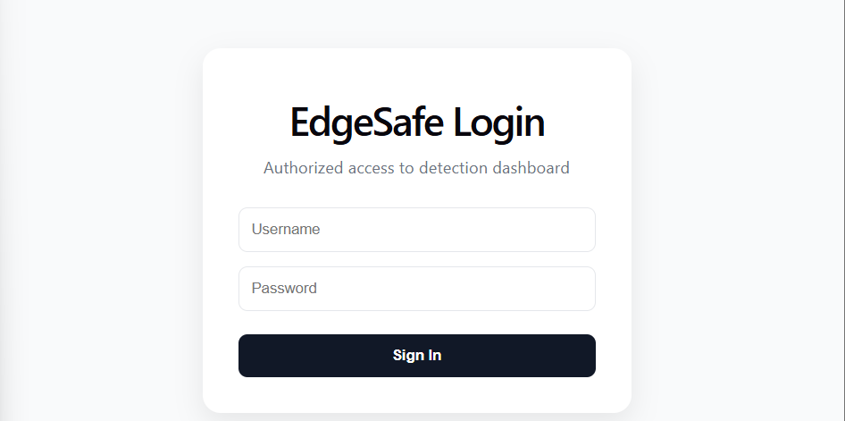
Dashboard and Authentication
The dashboard displays logged detection of events clearly.
The login page controls access to restricted dashboard areas.
After login, the backend generates a JWT token for authenticated access to protected routes.
This ensures only authorized users can access detection results and event logs.

Slide 17
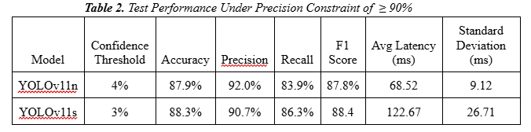
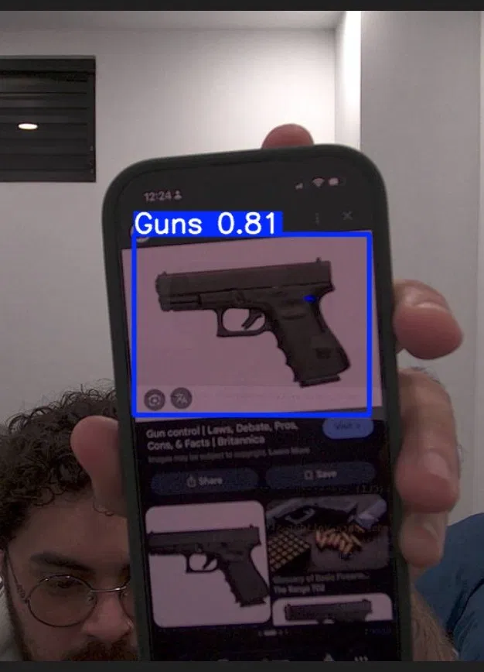
Model Detection Performance
Both exceeded the 80% target
High precision yields a low false-positive rate, critical for maintaining operator trust
YOLOv11s achieved slightly higher recall and F1; YOLOv11n achieved higher precision
Both successfully detected and localized firearms in representative test imagery
Results confirm transfer learning produced a reliable detector under project constraints

Slide 18
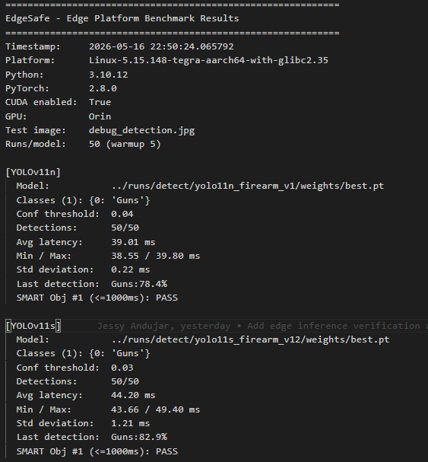
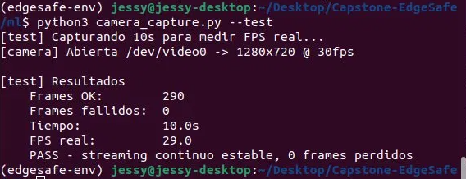
Testing Results
On-device benchmark (Jetson Orin Nano):
YOLOv11n averaged 39.28 ms latency
~25× faster than the 1 s requirement
30/30 successful detections on the edge device with stable runtime
Live camera integration validated:
29 fps effective throughput, 0 dropped frames
End-to-end pipeline verified:
capture → inference → event → secure logging → dashboard
YOLOv11n selected as final deployment model
lowest latency, lowest variability, smallest footprint
Hardware constraint identified and mitigated:
memory limit addressed via swap provisioning

Slide 19
Conclusion

Slide 20
Conclusions
EdgeSafe demonstrates that responsible, real-time firearm detection is feasible on low-cost edge hardware
All core SMART objectives met: accuracy ≥80%, precision ≥90%, latency ≤1 s, secure auditable logging
Edge-first design delivers privacy, low latency, and offline resilience: addressing the key gap in cloud-based solutions
Live-camera stretch goal was achieved, exceeding the original proof-of-concept scope
Limitation: single-semester proof-of-concept;
Future work: extended reliability testing, multi-camera support, and full production deployment

Slide 21
Demo

Slide 22

Demo

Slide 23
Q&A: 5 mins

