Slide 1

DUAL AXIS PHOTON TRACKER WITH RASPBERRY PI PICO

Slide 2

What is Dual axis Photon Tracker?
Overview: Dual axis solar tracker which we can rotate the solar panel horizontally or vertically according to Sun’s direction.
Key Elements Used: Raspberry Pi Pico is the heart of the system.
Existing Solar tracker technology

Slide 3
Basic Working Diagram
LDR1
POWER SUPPLY
SERVO MOTOR 1
LDR2
RASPBERRY PI PICO
LDR3
LDR4
SERVO MOTOR 2
SOLAR PANEL
DISPLAY

Slide 4
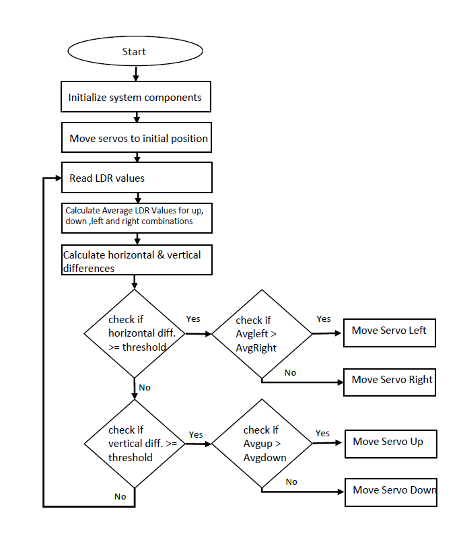
FLOWCHART

Slide 5
APPLICATIONS
Rural Electrification
Educational and Research Projects
Agricultural Use
Public Infrastructure

Slide 6
CONCLUSION
Enhanced efficiency
Cost-Effective
Simplicity and Accessibility

Slide 7

Thank you!

