Slide 1
Trends and Treasures of Egypt’s Hotels
Mary Morkos
Thursday, October 31st, 2024
DS5610: Exploratory Data Analysis

Slide 2
How do hotel ratings and amenities vary across different regions of Egypt?
This is a dataset about hotels in Egypt. Each row represents a unique hotel listing with information about its location, rating, price per night, and available amenities. The columns represent various attributes of each hotel, including its name, geographical coordinates, customer rating, price range, and a list of amenities. And the takeaway represents insights into the spatial distribution of hotel ratings and amenities across different regions in Egypt, helping identify popular and highly-rated areas for travelers.
https://www.kaggle.com/datasets/ziadashraf3010/egypt-hotels-dataset

Slide 3
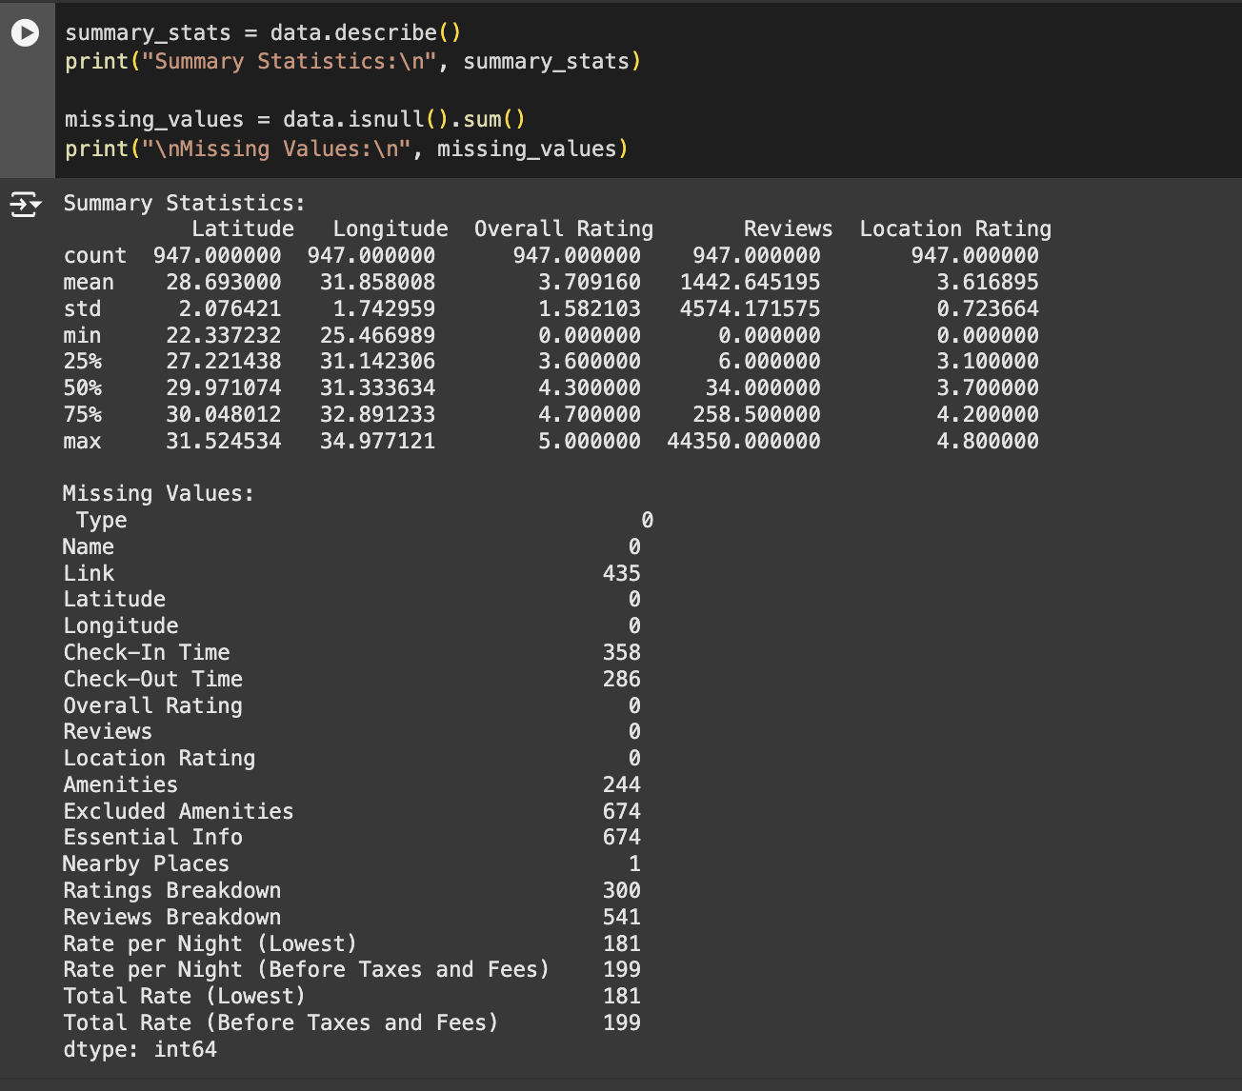

Slide 4
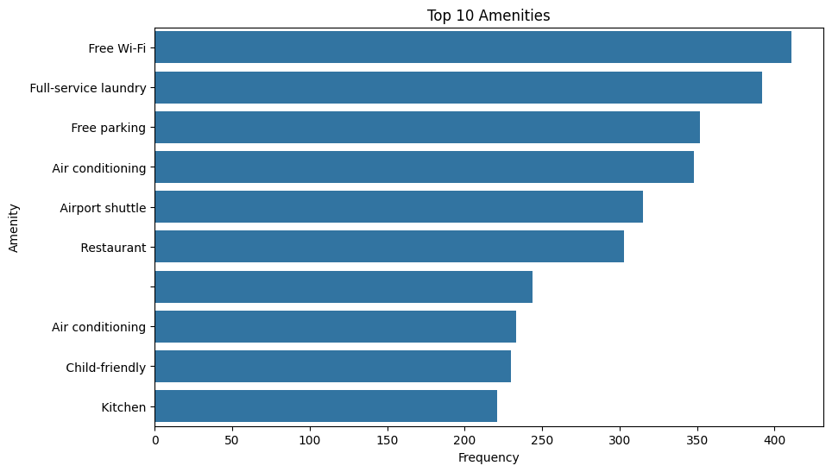

Slide 5
1
How do hotel ratings and amenities vary across different regions of Egypt?

Slide 7
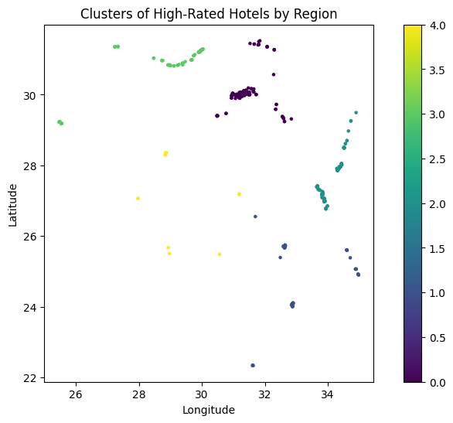

Slide 8
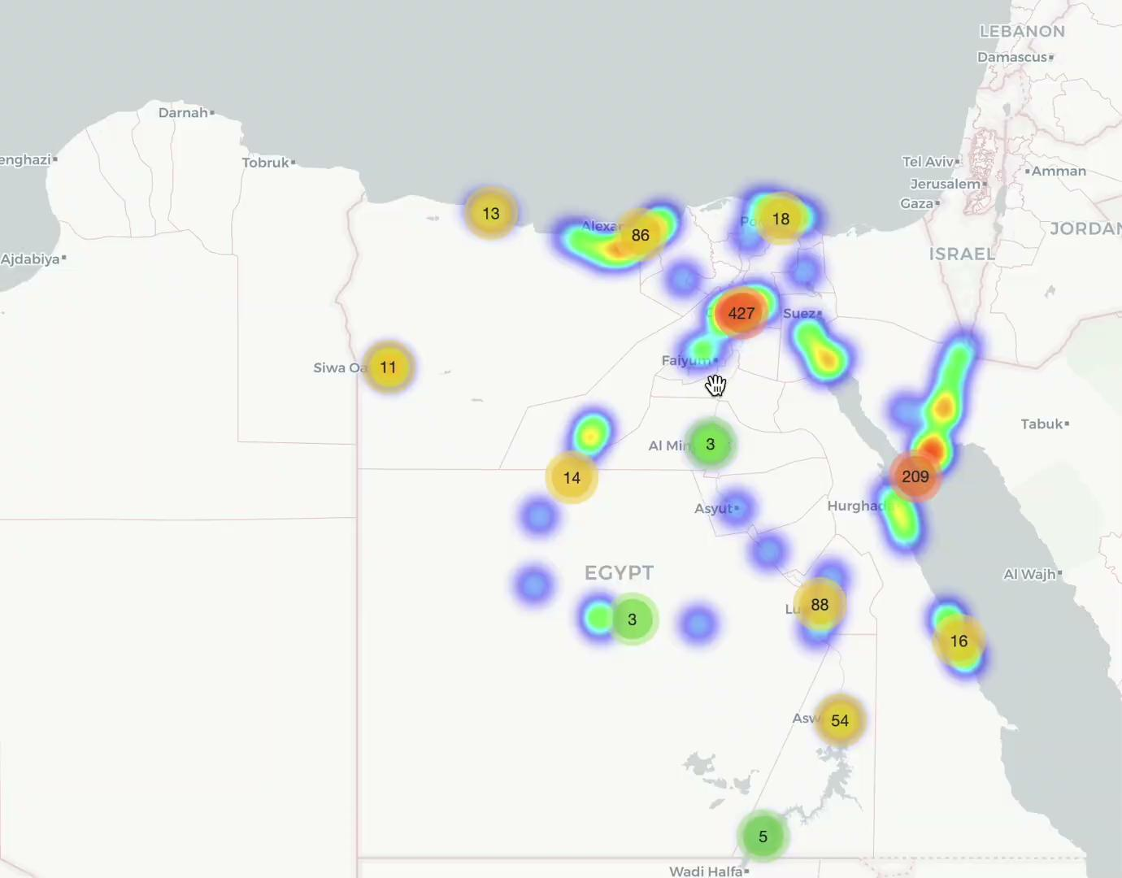

Slide 9
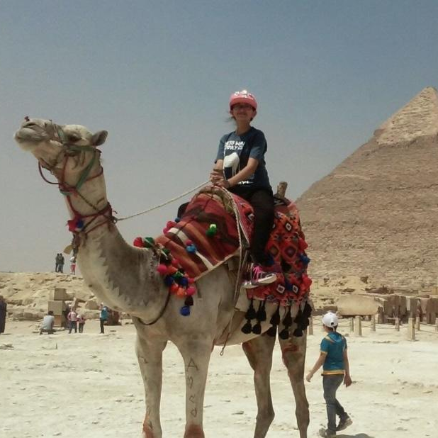
Key Takeaways
Trends:
Higher-rated hotels cluster in popular tourist areas.
Free Wi-Fi and laundry are the most common amenities.
Speculations:
Tourist areas likely attract better-reviewed hotels.
Popular amenities reflect traveler expectations for convenience.

