Slide 1
AI-Powered Logistics Operations Automation Rate Confirmation Processing • UiPath • Document Understanding • AI Workflow Automation
Maryna Khlynina

Slide 2
Business Context
Carrier operations teams process large volumes of broker rate confirmations daily. These documents contain critical shipment, rate, pickup, delivery, and reporting information needed for operational tracking and profitability analysis.
Manual handling of rate confirmations creates repetitive workflow bottlenecks across document review, shipment data extraction, mileage lookup, spreadsheet reporting, and RPM calculations.
Operational Challenges
• Manual review of broker rate confirmation PDFs
• Repetitive extraction of shipment details from inconsistent document formats
• Separate mileage lookup process using external tools
• Manual spreadsheet entry for reporting and RPM calculations
• Limited visibility into shipment profitability and operational performance
• Difficult to scale reporting workflows as document volume increases
Business Impact
• ~5 hours/week spent on repetitive document processing and reporting tasks
• Increased risk of manual data entry errors
• Delayed RPM and profitability reporting
• Reduced operational visibility across shipment workflows
• Limited scalability of manual carrier operations processes

Slide 3
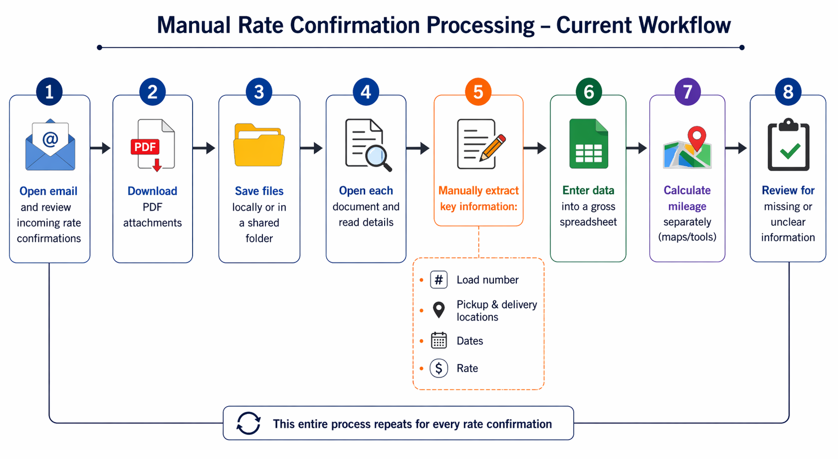
Manual Rate Confirmation Workflow
The original workflow required manual handling of each rate confirmation, including downloading documents, reviewing shipment details, calculating mileage separately, and entering data into a reporting spreadsheet.
This created a repetitive, time-consuming process that slowed reporting and made operational performance analysis harder to scale.

Slide 4
Automation Solution
An AI-powered logistics operations workflow was developed in UiPath to streamline rate confirmation processing through automated document extraction, mileage enrichment, validation workflows, and structured operational reporting.
The solution transforms unstructured shipment documents into structured operational data, improving reporting efficiency, workflow scalability, and operational visibility across carrier operations.
Core Capabilities:
• Automatically retrieves rate confirmations from operational email workflows
• Stores and organizes documents in Google Drive
• Extracts shipment data from unstructured PDF documents using Document Understanding
• Calculates mileage using AI-based enrichment
• Writes structured reporting outputs into Google Sheets
• Flags incomplete or missing data for manual review
• Sends automated validation alerts when issues are detected
• Improves reporting visibility and reduces repetitive manual processing

Slide 5
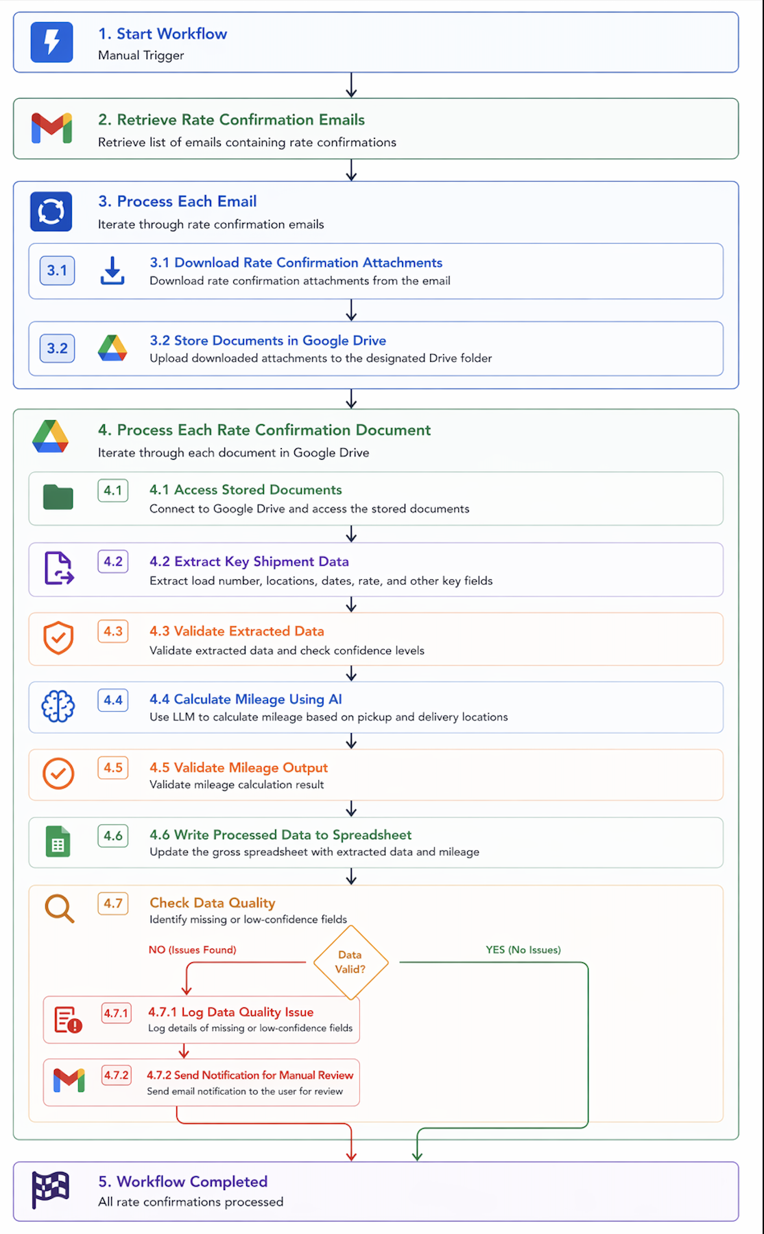
Automation Workflow Architecture
This workflow automates the end-to-end processing of logistics rate confirmations, from email intake and document extraction to mileage calculation, validation, and structured reporting.
The automation connects multiple operational steps into a single workflow, reducing repetitive manual processing and improving reporting efficiency.

Slide 6
Automation Architecture Components
The automation was implemented in UiPath by combining multiple components, including email integration, file handling, document understanding, AI-based enrichment, and validation logic.
Key Components:
Email integration to retrieve rate confirmations
Google Drive integration for document storage and organization
Document Understanding pipeline for data extraction
AI integration for mileage calculation
Validation logic for data quality control
Google Sheets integration for structured reporting output

Slide 7
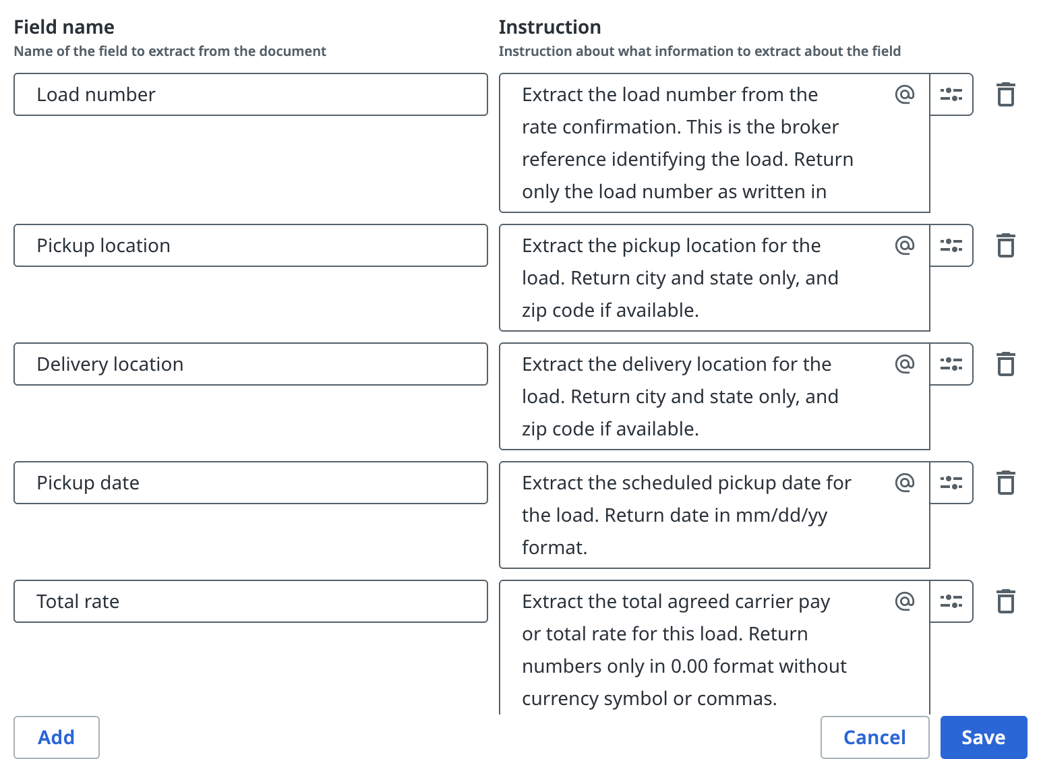
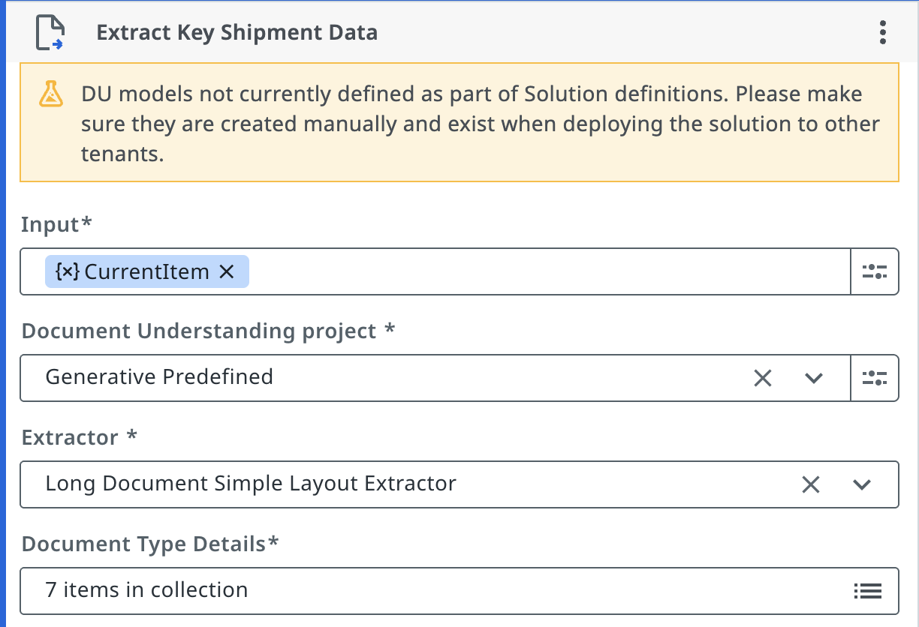
Document Understanding & Custom Extractor
A custom generative extractor was configured to extract shipment data from broker rate confirmations, which often vary in structure and formatting.
The workflow was designed to process unstructured logistics documents and convert them into structured operational data for reporting and analysis.

Slide 8
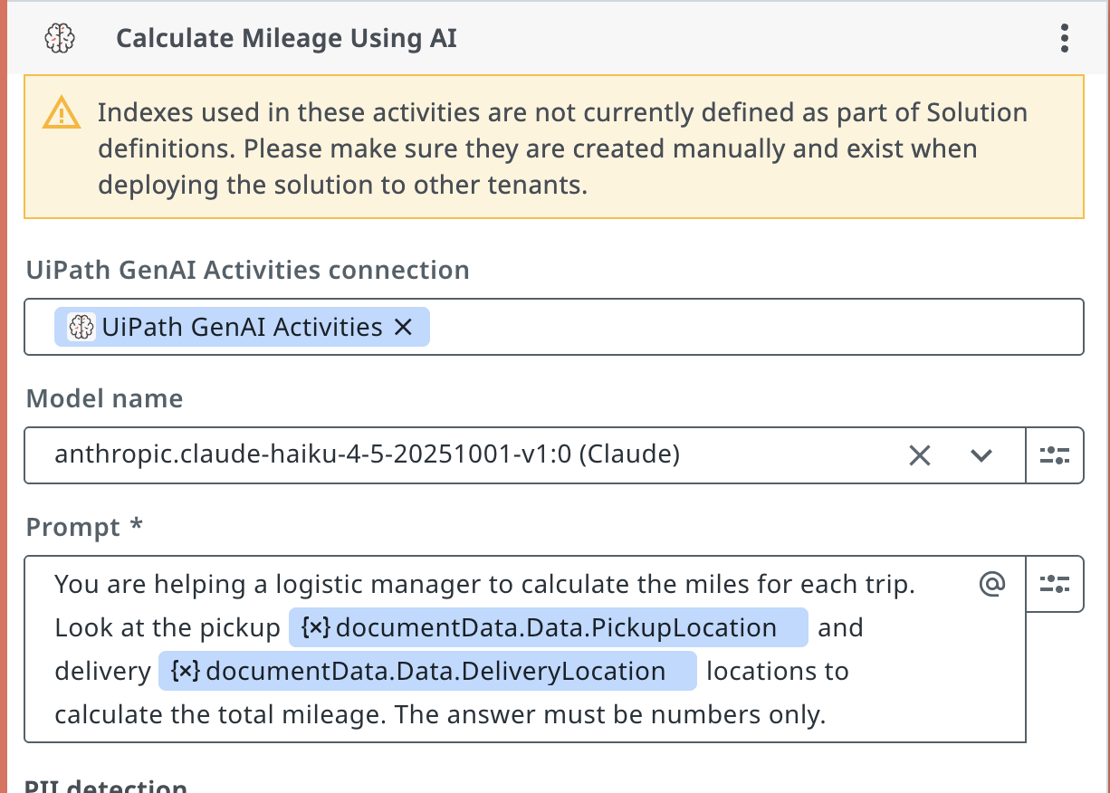
AI-Powered Mileage Calculation
LLM-based mileage estimation was implemented as a lightweight AI enrichment approach during initial workflow prototyping.
Key Points:
Uses pickup and delivery locations extracted from documents
Sends structured prompt to LLM
Returns estimated mileage for each trip
Eliminates manual lookup in tools like Google Maps
Ensures consistent and fast calculation
The workflow automatically calculates mileage without manual lookup, helping simplify reporting and reduce repetitive operational tasks.

Slide 9
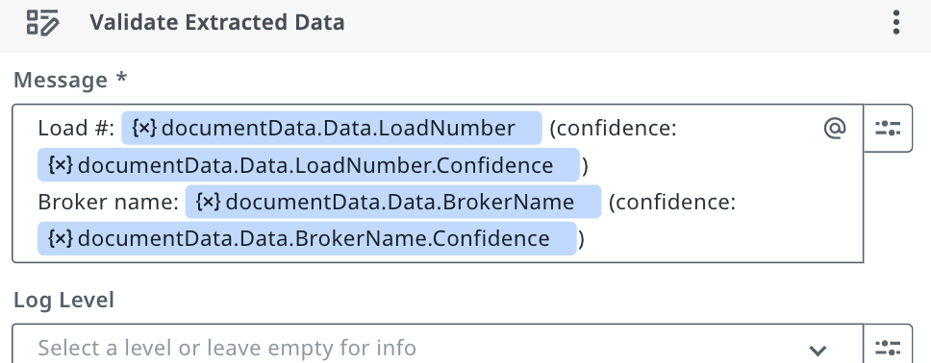
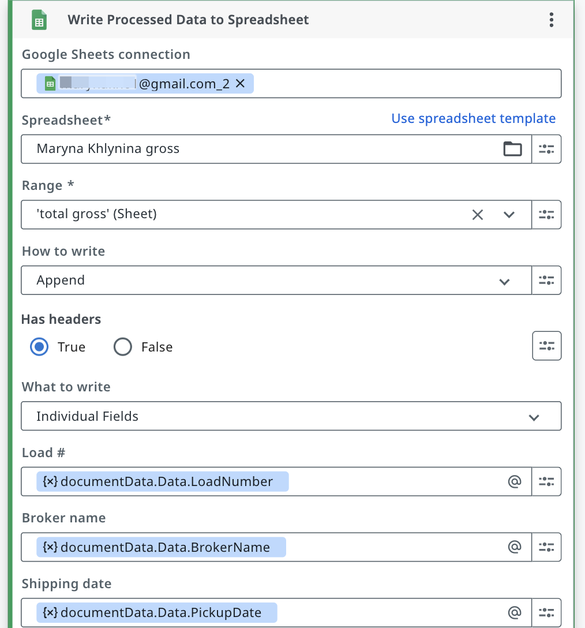
Data Mapping & Debugging
Extracted shipment data is mapped into a structured output format, with logging used to validate extracted values and support debugging during workflow development.
The workflow helps improve reporting consistency and makes troubleshooting easier when processing different document formats.
Key Points:
• Extracted fields are mapped into structured output columns in Google Sheets
• Log messages are used to validate extracted values before writing output
• Helps identify missing or incorrect data during workflow testing
• Simplifies debugging and improves workflow reliability

Slide 10
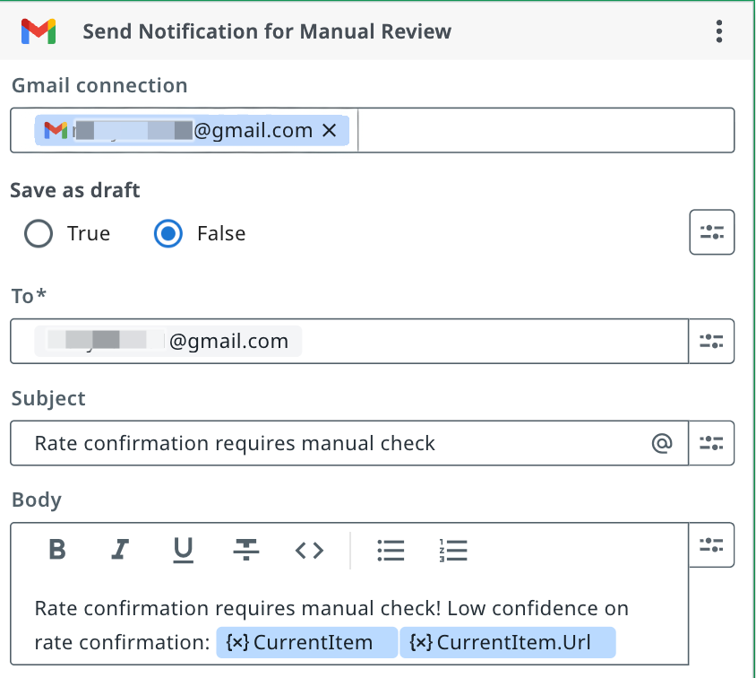
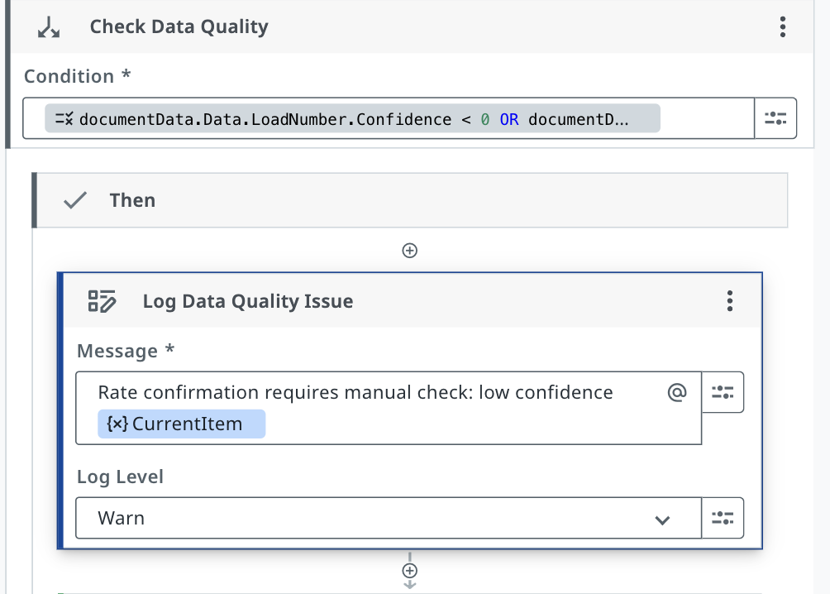
Validation Logic
Validation logic is used to identify incomplete or low-confidence data before it is written into the final reporting output.
The workflow automatically flags potential issues and sends notifications for manual review when needed.
Key Points:
• Identifies missing or incomplete extracted fields
• Flags low-confidence or suspicious data based on validation rules
• Sends email notifications for manual review
• Prevents incorrect or incomplete data from entering the reporting workflow
• Uses logging and validation checks to improve workflow reliability

Slide 11
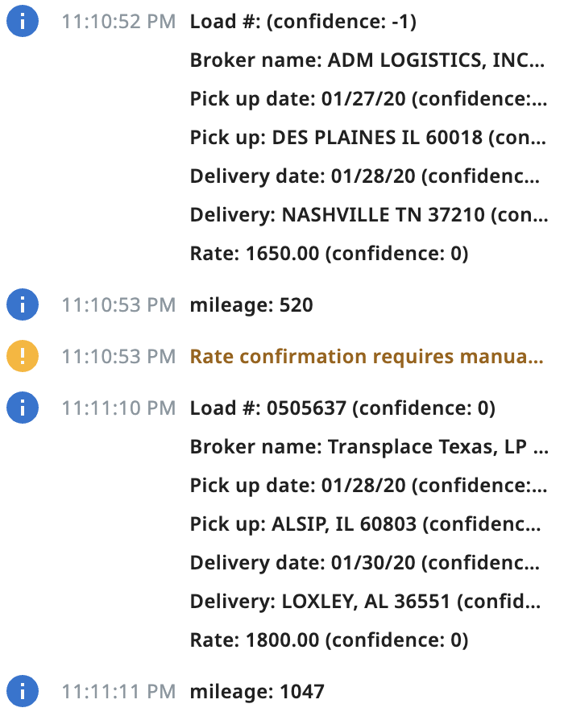
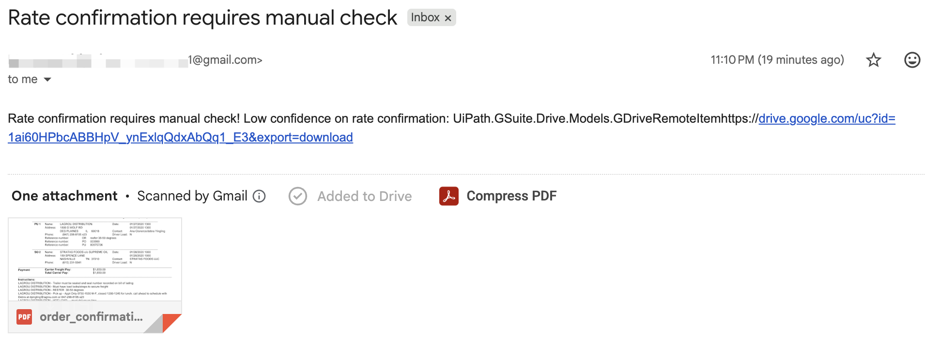
Workflow Monitoring & Alerts
Workflow logs and automated notifications provide visibility into processing results and help identify records that require manual review.
The monitoring flow highlights incomplete or low-confidence extractions, allowing issues to be reviewed before final reporting output is generated.
Key Points:
• Workflow logs display extracted shipment data and validation results
• Low-confidence records are automatically flagged for review
• Email notifications are triggered when potential issues are detected
• Monitoring output improves visibility into workflow processing
• Helps identify extraction issues before data is written into reports

Slide 12
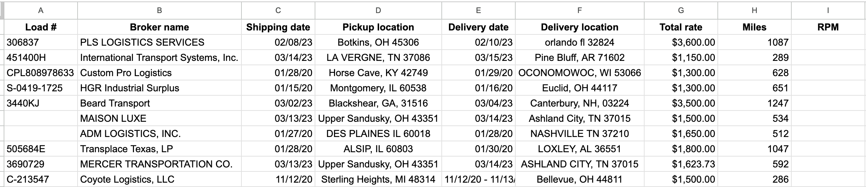
Structured Reporting Output
Processed shipment data is organized into a structured spreadsheet format, making it easier to review shipment information, identify missing values, and support reporting workflows.
With mileage already calculated, RPM can be generated automatically across all records, reducing manual calculations and improving reporting efficiency.

Slide 13
Key Outcomes
The workflow automates the end-to-end processing of rate confirmations, transforming unstructured shipment documents into structured operational data.
Key Outcomes:
• ~70–80% reduction in repetitive manual processing
• Automated processing of shipment confirmations
• AI-based mileage calculation using extracted location data
• Reduced repetitive data entry and manual lookup
• Faster and more structured RPM reporting
• Automatic flagging of incomplete or low-confidence data

Slide 14
Business Impact
Operational Improvements:
• Reduced repetitive manual work
• Improved reporting efficiency
• Increased data consistency
• Supports scalable document processing
Automation Capabilities:
• AI-powered document extraction
• Automated mileage enrichment
• Validation and monitoring workflow
• Structured spreadsheet reporting output

Slide 15
Production Readiness & Future Enhancements
How AI improved it:
• Automated extraction of shipment data from unstructured documents
• AI-based mileage calculation reduces manual lookup work
• Supports processing larger volumes of shipment documents
Future Enhancements:
• Replace LLM mileage estimation with Google Maps API for higher accuracy
• Use a custom-trained extraction model to improve extraction accuracy across different broker formats

