Slide 1
Recitation Section 9
10/21/2016 and 10/24/2016

Slide 2
Problem 1
Given the fourier transform of x(t),
Compute the fourier transform of the following signals:
a) b) c)

Slide 3
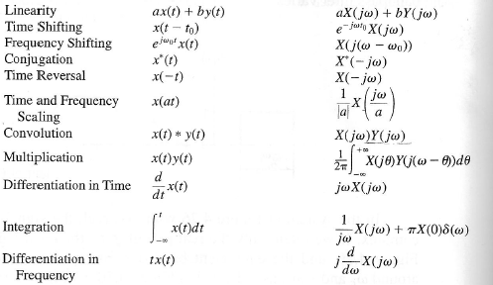
Using Properties of FT

Slide 4
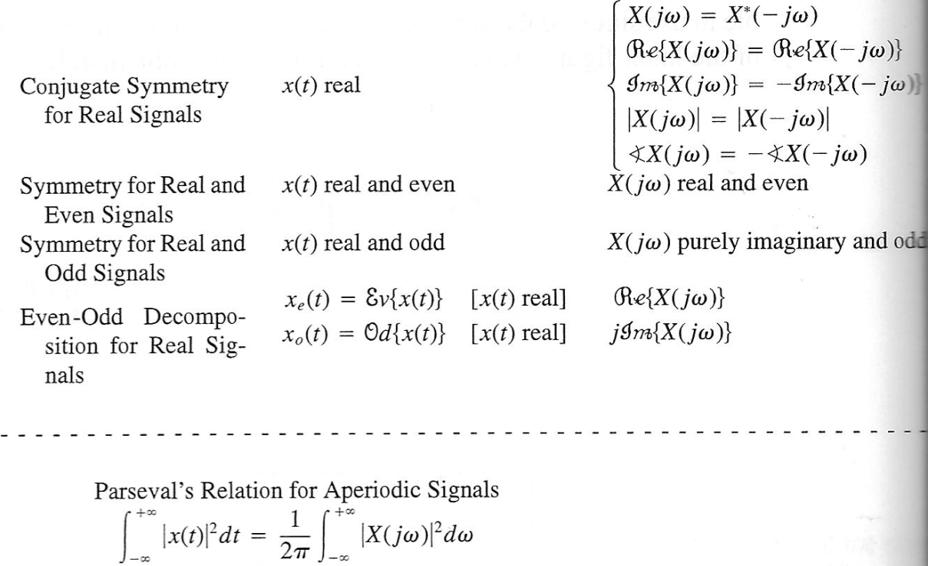
Using Properties of FT

Slide 5
Problem 2
A causal LTI system has a frequency response, given in the figure.
Compute the output y(t) for each of the input signals:
a)
b)

Slide 6
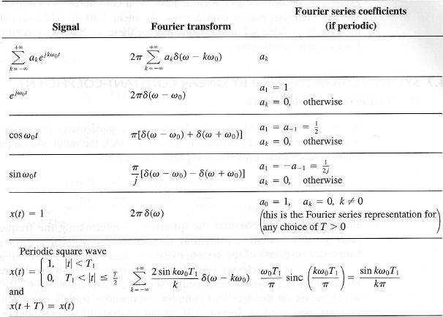
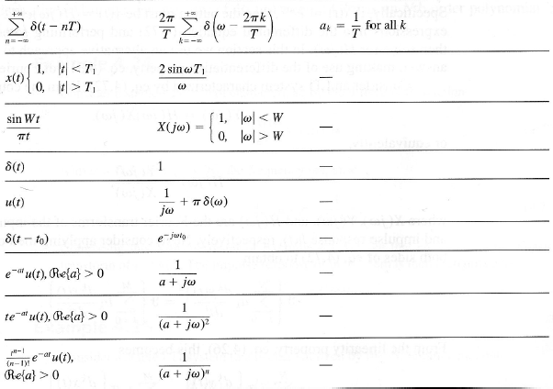
Fourier Transform Pairs

Slide 7
Problem 3
The input and output of a stable LTI system are related by the differential equation
Determine the impulse response of the system
Determine the response of the system for

