Slide 1
Recitation Section 10
10/28/2016 and 10/31/2016

Slide 2
Problem 1
Given a signal x(t) whose fourier transform is , determine the
fourier transform of the following signals
a)
b)
c)

Slide 3
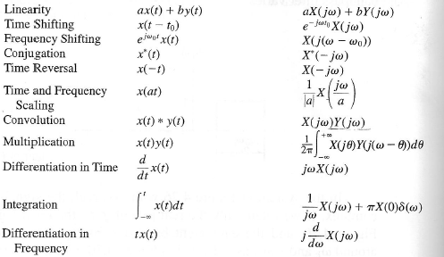
Using Properties of FT

Slide 4
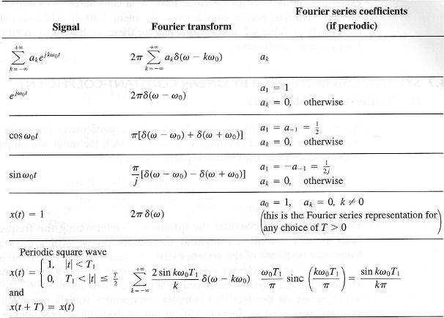
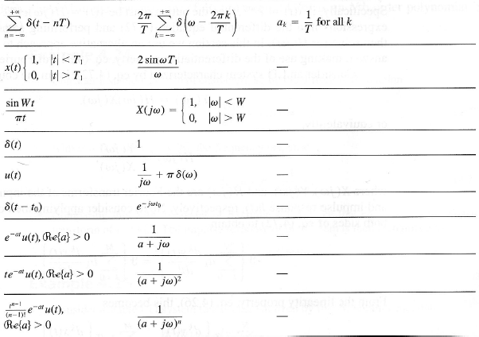
Fourier Transform Pairs

Slide 5
Problem 2
A causal LTI filter has the frequency response H(jw), shown here.
For the following input signals, find y(t)
a)
b)
Hint:

Slide 6
Problem 3
The following frequency response belongs to a high pass filter implemented using an RC circuit:
a) Given that the resistor used in the circuit is R = 20Kohms, what is the value of the capacitor? What is the cut-off frequency in hertz?
b) For the same resistance value and capacitor, C = 0.2μF, what would be the transfer function of a low pass filter?

