Slide 1
Recitation Section 7
9/30/2016 and 10/3/2016

Slide 2
Problem 1
Given a periodic signal, x(t) defined below, plot the signal over two periods and calculate the fourier coefficients using the analysis equation
Use :

Slide 3
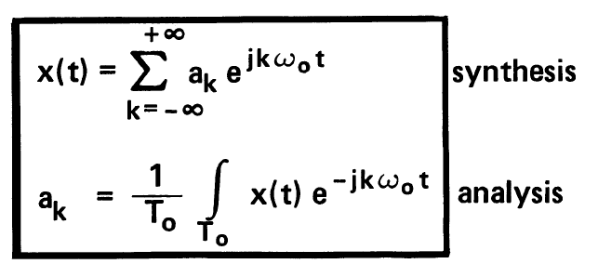
Fourier series: continuous
What do these equations mean?
Synthesis: Any periodic signal with frequency ω₀ (corresponding to period T₀) can
be represented as a linear combination of sines and cosines (together referred to as
complex exponentials) of frequency ω₀ and its integer multiples .
Analysis: The coefficients or “weights “ of each complex exponential (for a given multiple
of frequency ω₀ )can be computed
Note: a₀ represents the “dc level” of the signal , i.e the average signal amplitude over
a cycle

Slide 4
Problem 2
x(t) is a periodic signal with fundamental period, T = 4 and fourier
coefficients as given below:
Using fourier series properties, calculate the new coefficients for
a) ; b) ; c) ; d)
for k = -6, -2, 0, 2

Slide 5
Fourier series properties
Intensity shifting y(t)= x(t) + A b₀= a₀+A
b_{k} = b_{k} for k ≠ 0

Slide 6
Fourier series properties cont.

Slide 7
Problem 3
A periodic signal x(t) has a fundamental period of ¼ and the following fourier coefficients:
Rest of the coefficients are zero. Construct the signal x(t) using the synthesis equation.

