Slide 1
Recitation Section 8
10/14/2016 and 10/17/2016

Slide 2


Problem 1
Compute the fourier transform of the following signals:
a) $x1\left(t\right)=\left\{\begin{aligned}1, −2<t<−1 \\ 0, −1<t<1 \\ 1, 1<t<2 \\ 0, otherwise\end{aligned}\right.$
a) $x2\left(t\right)=\left\{\begin{aligned}−1, −2<t<−1 \\ 0, −1<t<1 \\ 1, 1<t<2 \\ 0, otherwise\end{aligned}\right.$

Slide 3
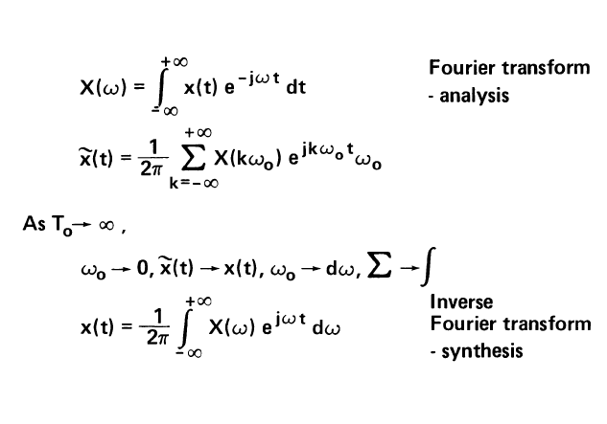
Fourier Transform
Allows us to look at the frequency content of a signal (x(t)
Allows us to look at the time-dependence of a signal (x(t) whose
frequency content is known

Slide 4
Problem 2
Compute the fourier transform of the following signals:

Slide 5
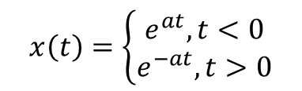
Problem 3
Compute the fourier transform of the following signals:
$$x\left(t\right)=\left\{\begin{aligned}e^{at},t<0 \\ e^{−at},t>0\end{aligned}\right.$$
a)
b)

Slide 6
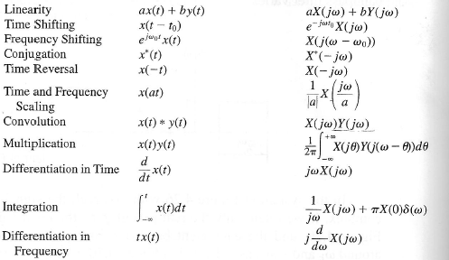
Using Properties of FT

Slide 7
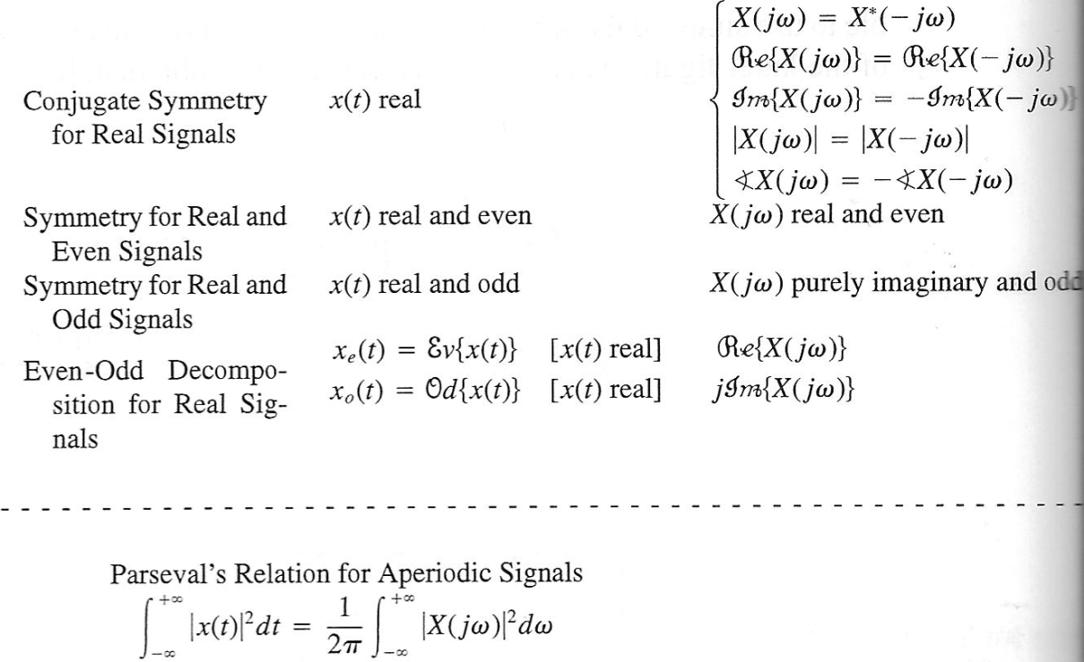
Using Properties of FT

