Slide 1

How much would you pay for a cake?
Price prediction

Slide 2
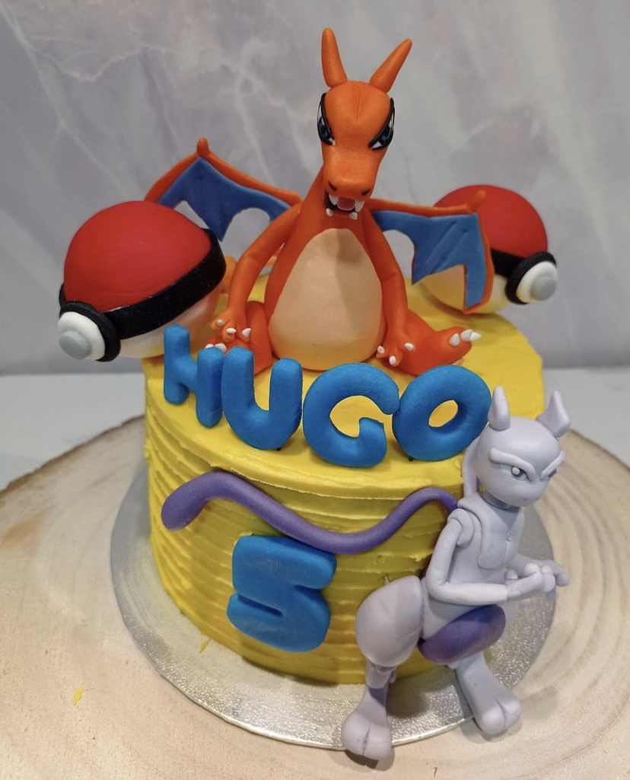
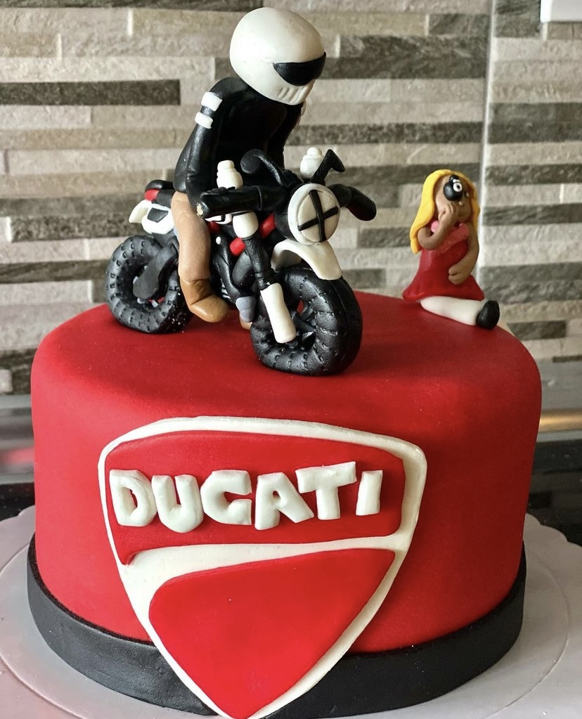
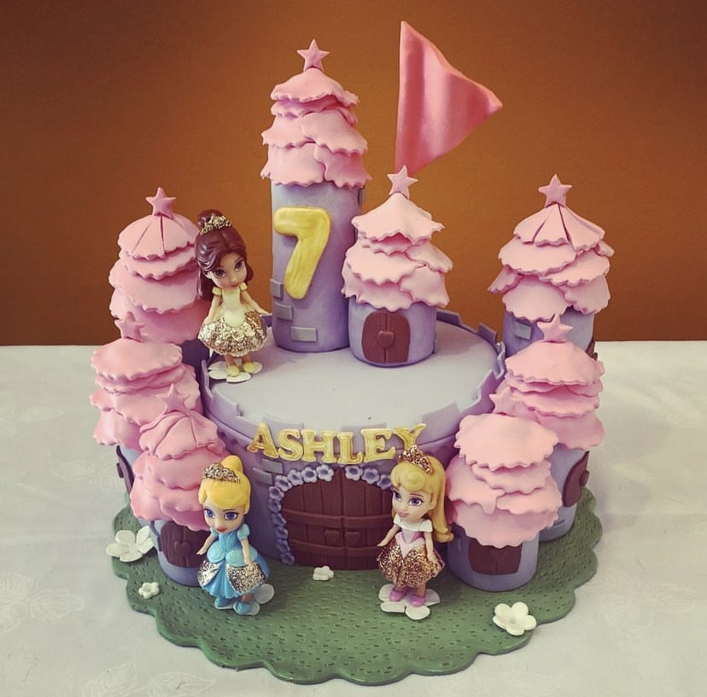
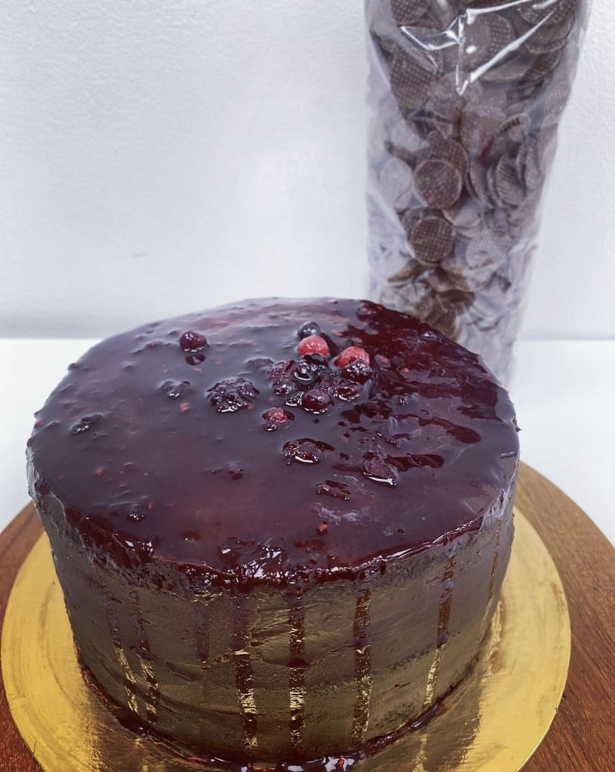
MAIN PROJECT
Predict the price of a cake based on the customer’s needs.

Slide 3
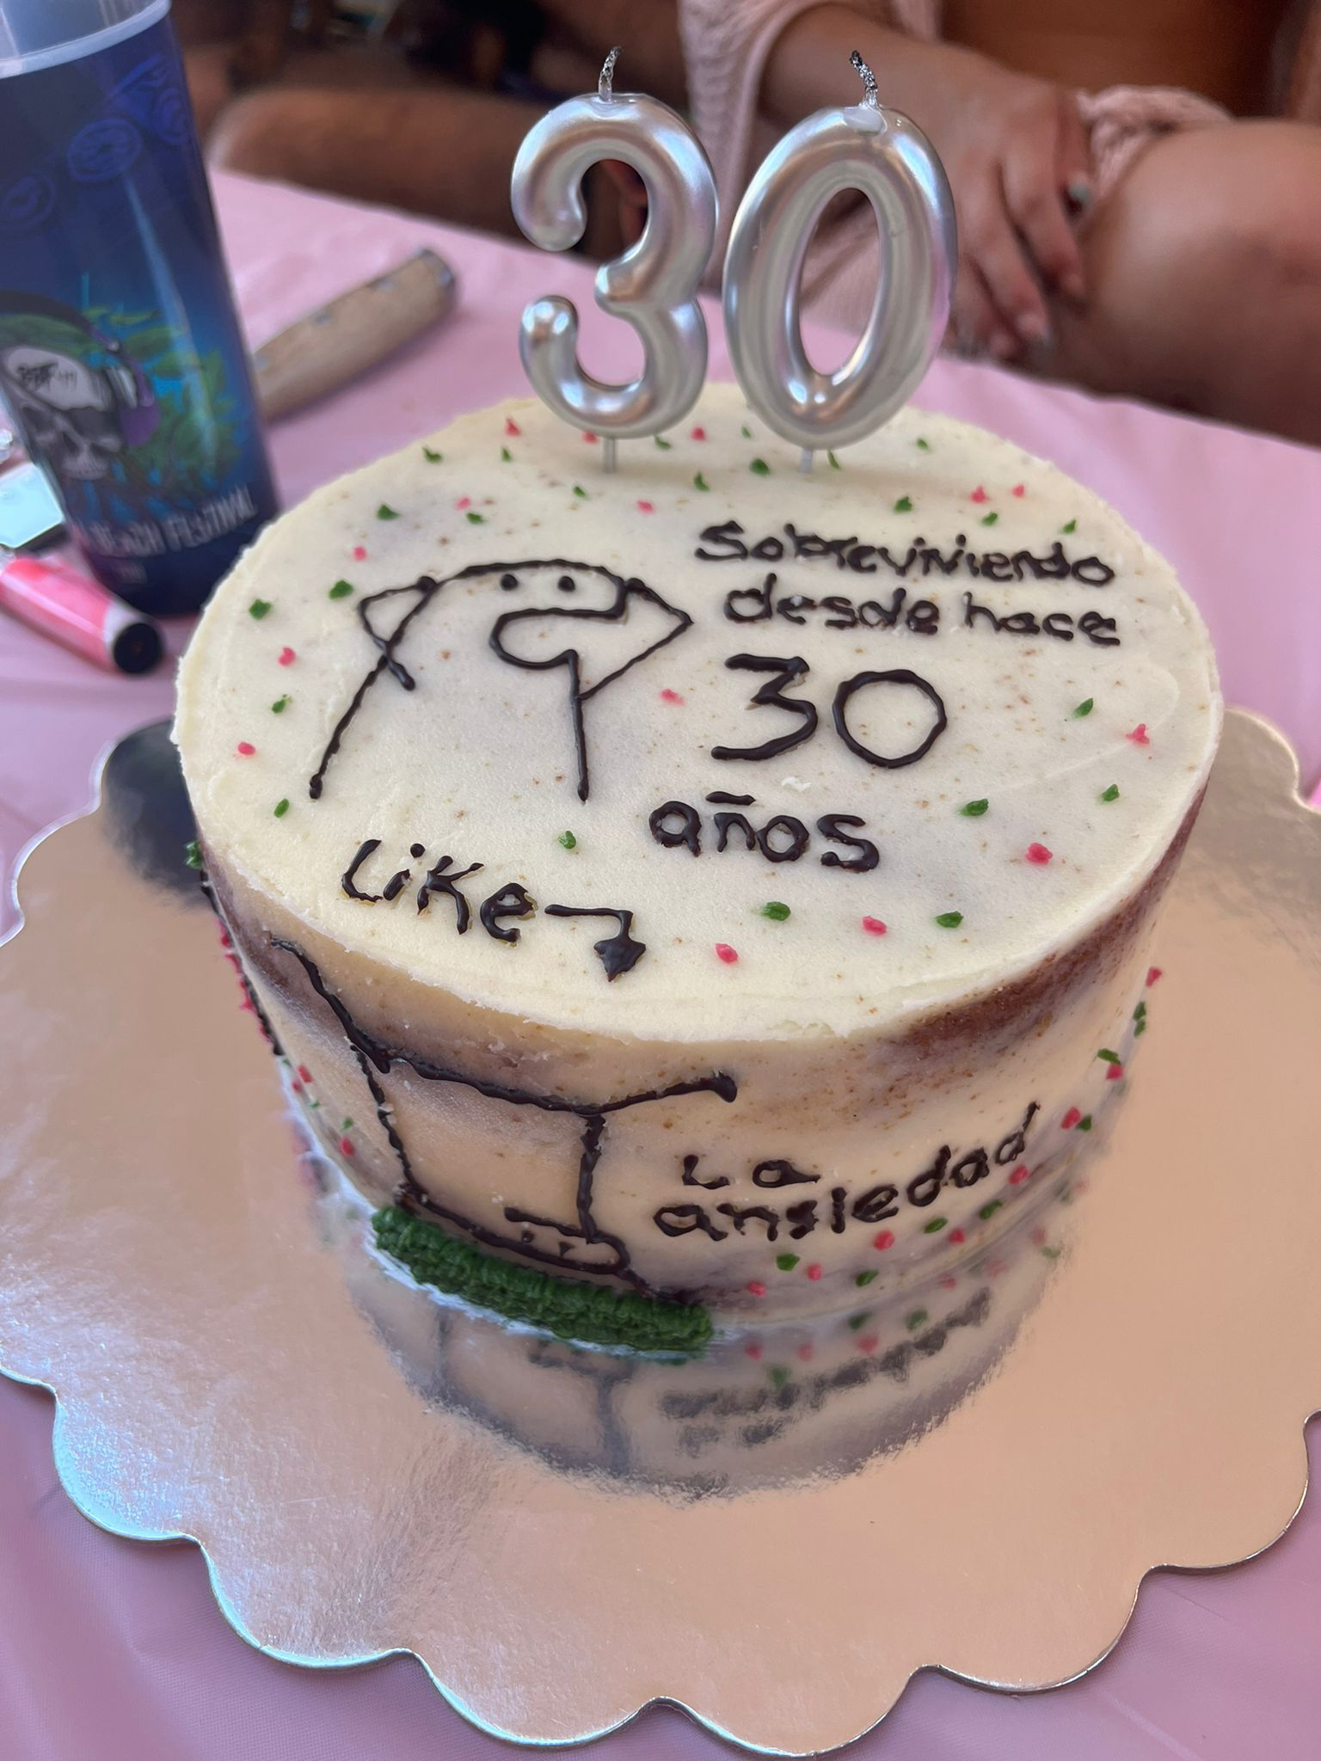
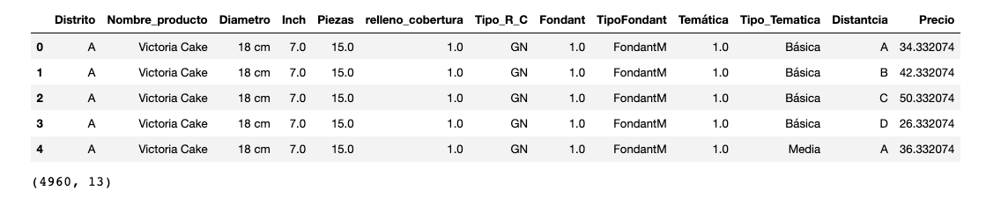
Features
Cake type
Diameter
Piece
Topping
Fondant
Design

Slide 4
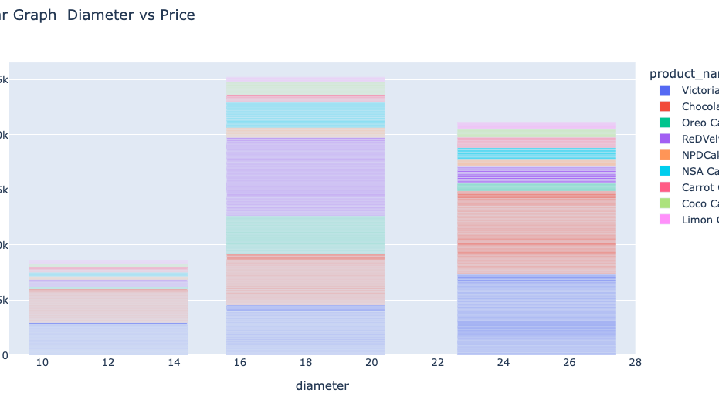
Graph

Slide 5
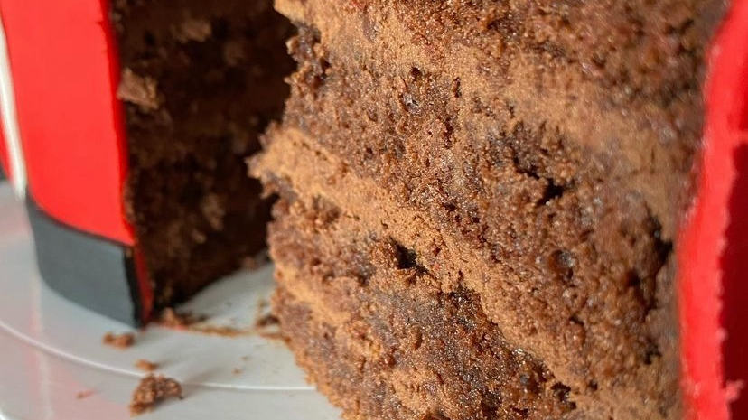
Thank you for you attention.
Questions?

