Slide 1
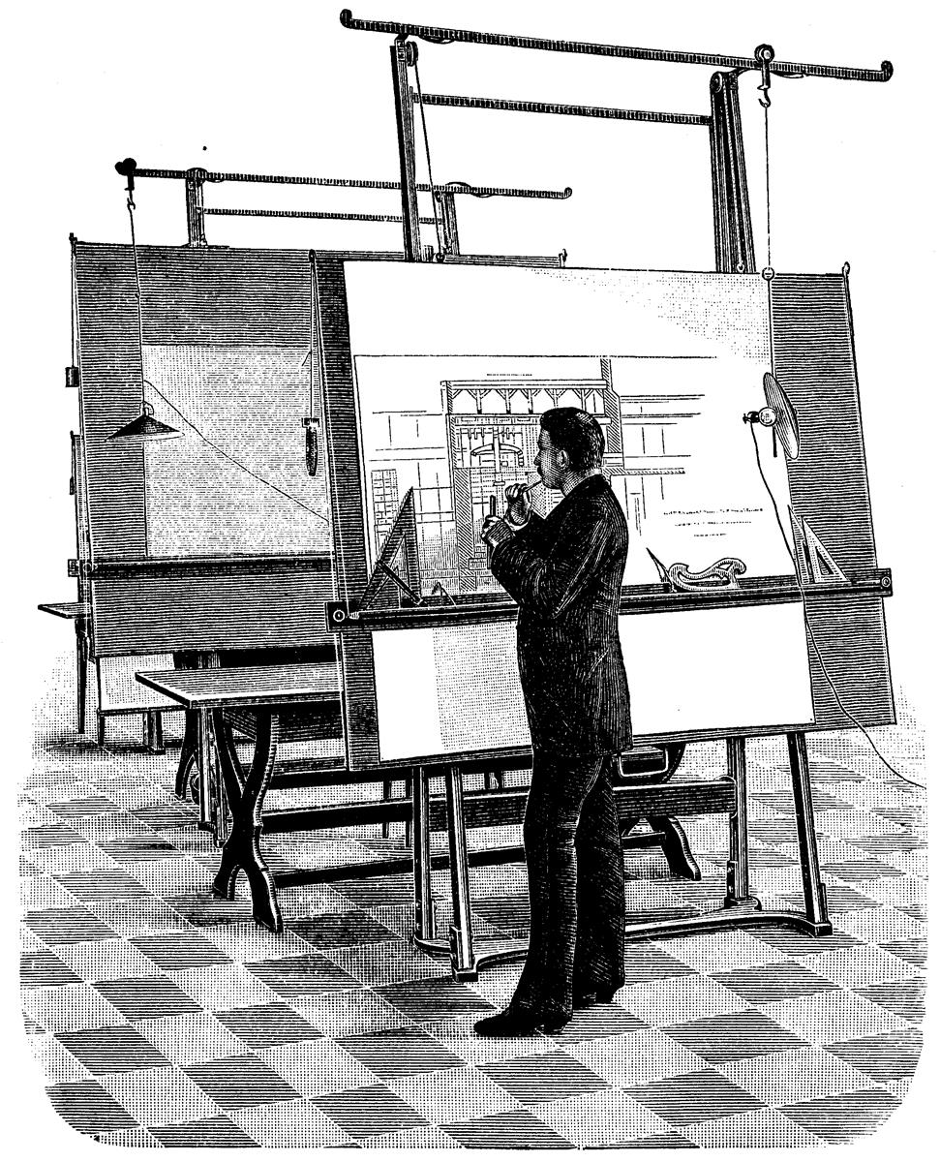
Architect
Architect is a technical leader who defines and evolves a software and/or service design, which involves using people and technology skills to build principles, design patterns, standards that become blue-print for execution with engineering and business to achieve business objectives.

Slide 2
Skills
Strategy & Business ( domain) Knowledge
Ability to zoom-in ( detailed) and zoom-out ( big picture).
Interpersonal
Decision Making
Keep up with technological trends and trade-offs
Keep up with compliance needs.
Enablement
Language Skills – Translator – Engineer to Executive

Slide 3
Roles : Enabler
Technology
Process
Solution
Option Provider
Guardrail Provider

Slide 4
BUILD stable and efficient systems HOW:
Foundations for Stable and Efficient Systems.
Design Principles, frameworks and Patterns.
Tradeoffs
Best Practices, Standards, Naming Conventions etc.

Slide 5
ROLE of ARCHITECTS
Developer Oriented
Software Architect
Business Oriented
Enterprise Architect
Data Architect
Application Architect
Security Architect
Chief Architect
Cloud Architect
Site Reliability Architect
Network Architect
Solution Architect
Vendor Oriented
Operations Oriented

Slide 6
reference
Enterprise Architecture
https://architectelevator.com/architecture/architects-zoom/
Software Architecture
https://www.oreilly.com/library/view/fundamentals-of-software/9781663728357/
https://www.redhat.com/architect/what-is-software-architect
Operations Oriented : A Novel by Gene Kim. One of the main characters is an architect.
https://www.amazon.com/Phoenix-Project-DevOps-Helping-Business/dp/0988262592
Cloud Architects:
https://docs.aws.amazon.com/wellarchitected/latest/framework/welcome.html
https://aws.amazon.com/blogs/apn/the-6-pillars-of-the-aws-well-architected-framework/

