Slide 1
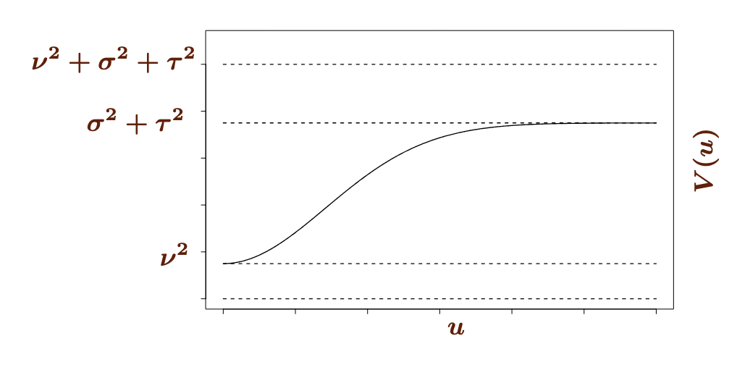



Total variation
$$σ_{0}^{2}+σ_{c}^{2}+σ_{ε}^{2}$$
$$σ_{c}^{2}+σ_{ε}^{2}$$
Variation due to measurement error + serial correlation
$$σ_{ε}^{2}$$
Variation due to measurement error
Time lag

Slide 2

$$σ_{0}^{2}+σ_{c}^{2}+σ_{ε}^{2}$$
Evidence of random intercept
$$σ_{c}^{2}+σ_{ε}^{2}$$
Variance increasing with time lag → evidence of serial correlation
$$σ_{ε}^{2}$$
Evidence of measurement error
Time lag

