Slide 1

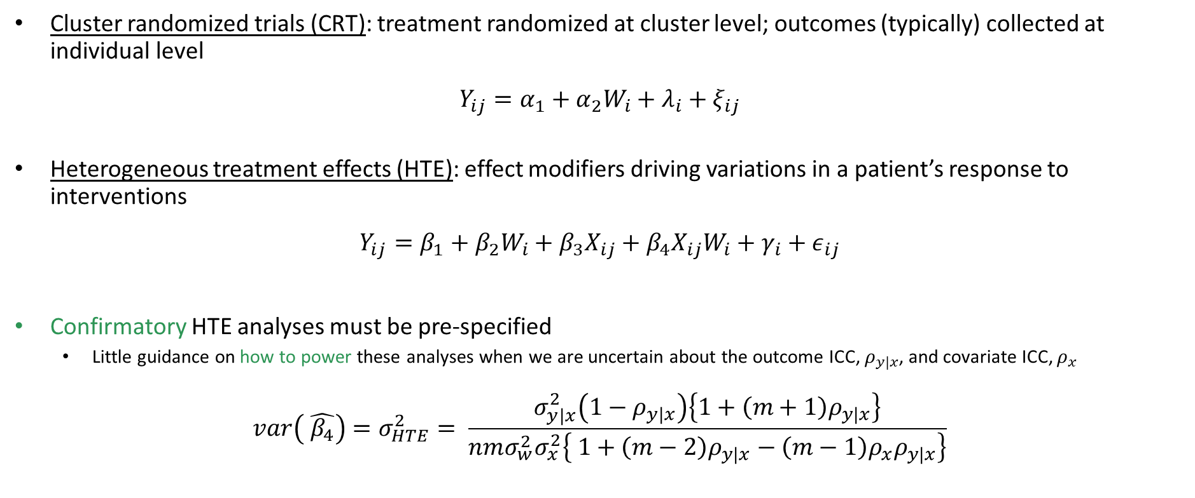
Introduction
Cluster randomized trials (CRT): treatment randomized at cluster level; outcomes (typically) collected at individual level
$$Y_{ij}=α_{1}+α_{2}W_{i}+λ_{i}+ξ_{ij}$$
Heterogeneous treatment effects (HTE): effect modifiers driving variations in a patient’s response to interventions
$$Y_{ij}=β_{1}+β_{2}W_{i}+β_{3}X_{ij}+β_{4}X_{ij}W_{i}+γ_{i}+ε_{ij}$$
Confirmatory HTE analyses must be pre-specified
Little guidance on how to power these analyses when we are uncertain about the outcome ICC, $ρ_{y|x}$, and covariate ICC, $ρ_{x}$
$$var\left( \hat{β_{4}}\right)=σ_{HTE}^{2}= \frac{σ_{y|x}^{2}\left(1−ρ_{y|x}\right)\left\{1+\left(m+1\right)ρ_{y|x}\right\}}{nmσ_{w}^{2}σ_{x}^{2}\left\{ 1+\left(m−2\right)ρ_{y|x}−\left(m−1\right)ρ_{x}ρ_{y|x}\right\}}$$
(1)
Treatment effect
(1)
Covariate effect
HTE
cluster size
(2)
# clusters
[Yang et al.,
(2020)]
Outcome ICC
Covariate ICC

Slide 2

Maximin Optimal Cluster Randomized Designs Accounting for Treatment Effect Heterogeneity
Mary M. Ryan, PhD;
Denise Esserman PhD; Fan Li, PhD
Department of Biostatistics, Yale University
August 11, 2022

Slide 3

Disclosures
Research in this presentation was supported by a Patient-Centered Outcomes Research Institute Award® (PCORI® Award ME-2020C3-21072), and by CTSA Grant Number UL1 TR001863 from the National Center for Advancing Translational Science (NCATS), a component of the National Institutes of Health (NIH). The statements presented in this article are solely the responsibility of the authors and do not necessarily represent the views of PCORI®, its Board of Governors or Methodology Committee, or the National Institutes of Health.
mary.ryan@yale.edu Yale School of Public Health @Marym_Ryan

Slide 4
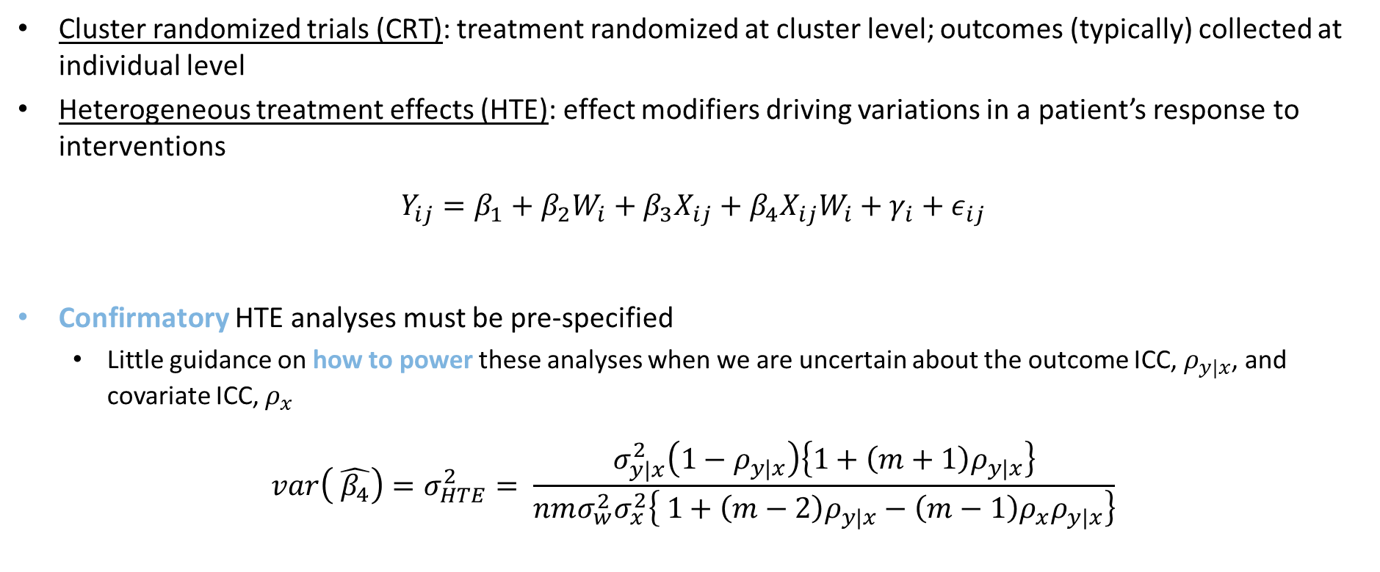
Introduction
Cluster randomized trials (CRT): treatment randomized at cluster level; outcomes (typically) collected at individual level
Heterogeneous treatment effects (HTE): effect modifiers driving variations in a patient’s response to interventions
$$Y_{ij}=β_{1}+β_{2}W_{i}+β_{3}X_{ij}+β_{4}X_{ij}W_{i}+γ_{i}+ε_{ij}$$
Confirmatory HTE analyses must be pre-specified
Little guidance on how to power these analyses when we are uncertain about the outcome ICC, $ρ_{y|x}$, and covariate ICC, $ρ_{x}$
$$var\left( \hat{β_{4}}\right)=σ_{HTE}^{2}= \frac{σ_{y|x}^{2}\left(1−ρ_{y|x}\right)\left\{1+\left(m+1\right)ρ_{y|x}\right\}}{nmσ_{w}^{2}σ_{x}^{2}\left\{ 1+\left(m−2\right)ρ_{y|x}−\left(m−1\right)ρ_{x}ρ_{y|x}\right\}}$$
Cluster treatment indicator
(1)
Individual covariate
HTE
cluster size
(2)
# clusters
[Yang et al.,(2020)]
Outcome ICC
Covariate ICC
mary.ryan@yale.edu Yale School of Public Health @Marym_Ryan

Slide 5
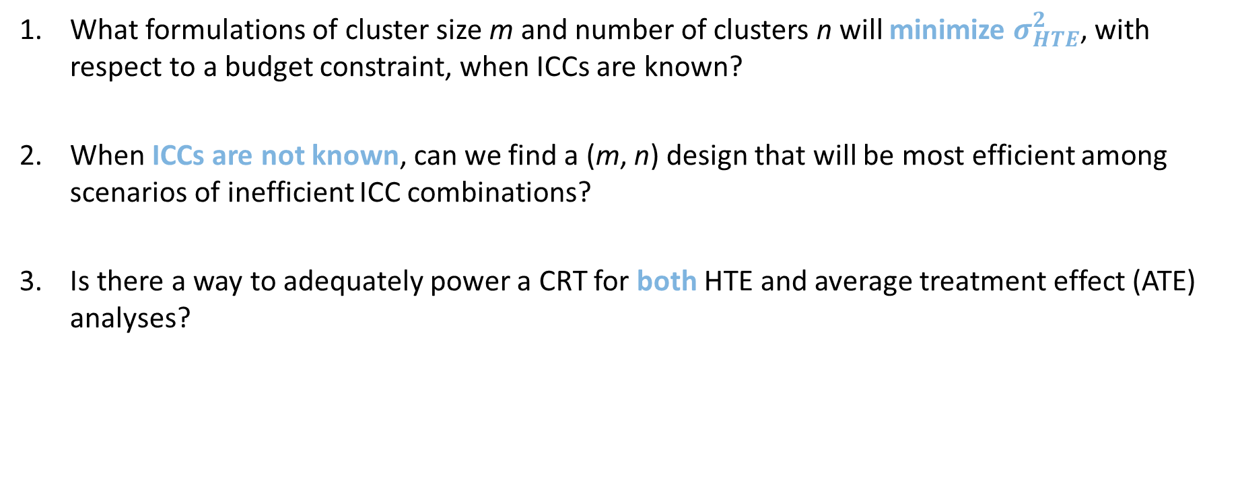
Knowledge Gaps
What formulations of cluster size m and number of clusters n will minimize $σ_{HTE}^{2}$, with respect to a budget constraint, when ICCs are known?
When ICCs are not known, can we find a (m, n) design that will be most efficient among scenarios of inefficient ICC combinations?
Is there a way to adequately power a CRT for both HTE and average treatment effect (ATE) analyses?
mary.ryan@yale.edu Yale School of Public Health @Marym_Ryan

Slide 6

Application to the K-DPP Study
Kerala Diabetes Prevention Program
[Thankappan et al., 2018]
CRT of peer-support lifestyle diabetes intervention
Secondary outcome: change in Indian Diabetes Risk Score
Post-hoc HTE: IDRS interaction with BMI
60 clusters with 10-23 participants each
mary.ryan@yale.edu Yale School of Public Health @Marym_Ryan

Slide 7
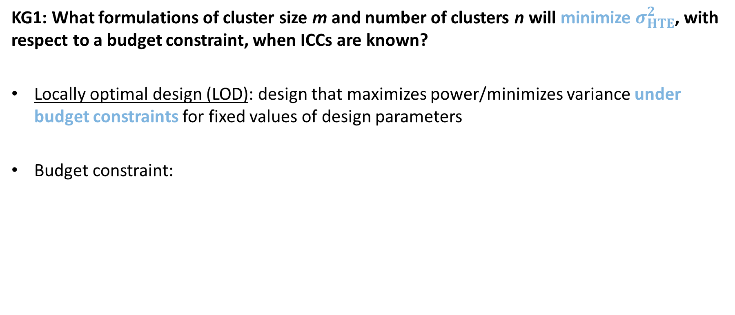
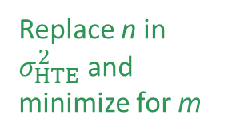

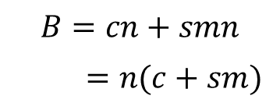
KG1: HTE Locally Optimal Design
KG1: What formulations of cluster size m and number of clusters n will minimize $σ_{HTE}^{2}$, with respect to a budget constraint, when ICCs are known?
Locally optimal design (LOD): design that maximizes power/minimizes variance under budget constraints for fixed values of design parameters
Budget constraint:
per-cluster cost
per-subject cost
Replace n in $σ_{HTE}^{2}$ and minimize for m
$$B=cn+smn$$
$=n(c+sm)$
$$⇒n=\frac{B}{c+sm}$$
(3)
mary.ryan@yale.edu Yale School of Public Health @Marym_Ryan

Slide 8

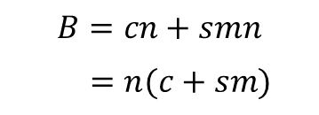
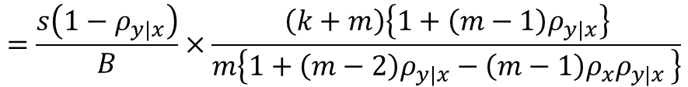
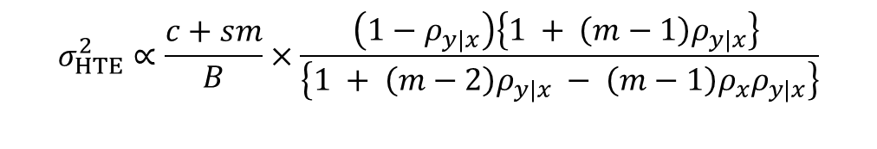
KG1: HTE Locally Optimal Design
Budget constraint:
Write variance in terms of budget:
Per-subject cost
per-cluster cost
$$B=cn+smn$$
$=n(c+sm)$
$$⇒n=\frac{B}{c+sm}$$
(4)
$$σ_{HTE}^{2}∝\frac{c+sm}{B}×\frac{\left(1−ρ_{y|x}\right)\left\{1 + \left(m−1\right)ρ_{y|x}\right\} }{\left\{1 + \left(m−2\right)ρ_{y|x} − \left(m−1\right)ρ_{x}ρ_{y|x}\right\}}$$
c/s
$$=\frac{s\left(1−ρ_{y|x}\right)}{B}×\frac{\left(k+m\right)\left\{1+\left(m−1\right)ρ_{y|x}\right\}}{m\left\{1+\left(m−2\right)ρ_{y|x}−\left(m−1\right)ρ_{x}ρ_{y|x }\right\}}$$

Slide 9

KG1: HTE Locally Optimal Design
Proposition 1 - Minimizing $σ_{HTE}^{2}$ with respect to m, the HTE LOD for a given minimum number of clusters, $\underline{n}$, is:
If $\frac{ρ_{y|x}\left(k+1\right)}{ρ_{y|x}k+1}<ρ_{x}≤1$ and $m_{opt}≤\frac{B/\underline{n}−c}{s}$
Otherwise
$$m_{opt}=\frac{\left(1−ρ_{y|x}\right)\left(1−ρ_{x}\right)+ \sqrt{ρ_{y|x}^{−1}k^{−1}\left(1−ρ_{y|x}\right)\left(ρ_{x}−ρ_{y|x}\right)\left\{ 1−\left(k+2\right)ρ_{y|x}+k+1\right)ρ_{x}ρ_{y|x}\} }}{k^{−1}\left(ρ_{x}−ρ_{y|x}\right)−ρ_{y|x}\left(1−ρ_{x}\right)}$$
(4)
$$n_{opt}=\frac{B}{c+sm_{opt}}$$
Only depends on cost ratio (c/s)
$$m_{opt}=\frac{B/\underline{n}−c}{s}$$
$$n_{opt}=\frac{B}{c+sm_{opt}}$$
mary.ryan@yale.edu Yale School of Public Health @Marym_Ryan

Slide 10


KG1: Application to K-DPP
Intervention cluster- to -individual cost ratio $k≈30$
Accounting for cheaper control arm, assume $k=20$ and $B=\$20,000$
$Δ_{IDRS}=−1.5$; $Δ_{HTE}=0.25×Δ_{IDRS}=−0.375$
$ρ_{y|x}=0.028$, $ρ_{x}=0.055$
If minimum of 66 clusters (maximum m of 40):
LOD: $m_{opt}=40$, $n_{opt}=66$
mary.ryan@yale.edu Yale School of Public Health @Marym_Ryan

Slide 11
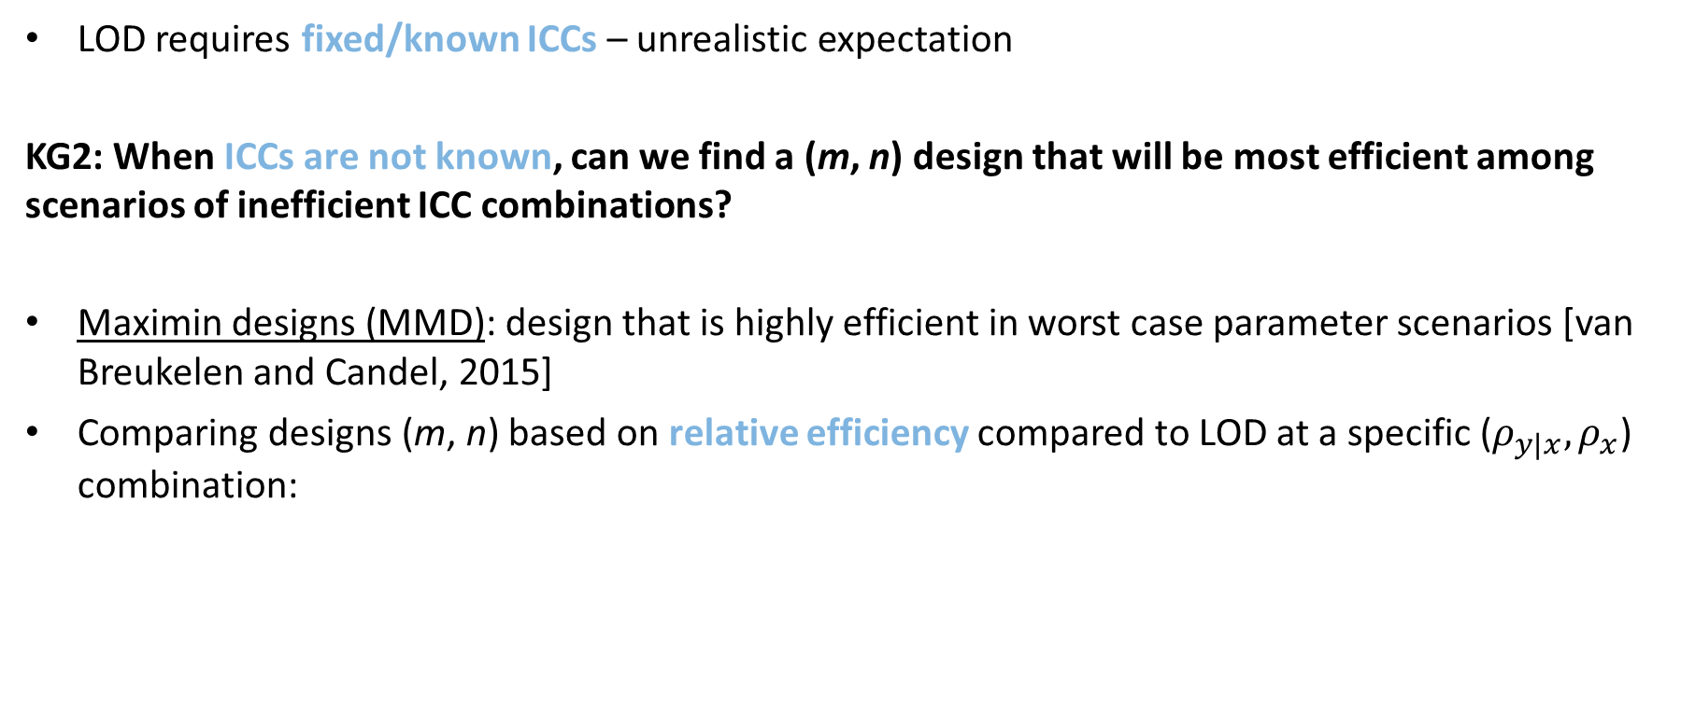
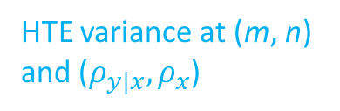
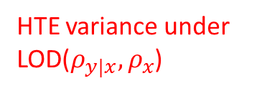

KG2: HTE Maximin Design
LOD requires fixed/known ICCs – unrealistic expectation
KG2: When ICCs are not known, can we find a (m, n) design that will be most efficient among scenarios of inefficient ICC combinations?
Maximin designs (MMD): design that is highly efficient in worst case parameter scenarios [van Breukelen and Candel, 2015]
Comparing designs (m, n) based on relative efficiency compared to LOD at a specific ($ρ_{y|x}, ρ_{x}$) combination:
HTE variance under LOD($ρ_{y|x}, ρ_{x}$)
$$RE_{HTE}=\frac{{σ^{2}}_{HTE}^{∗}}{σ_{HTE}^{2}}$$
HTE variance at (m, n) and ($ρ_{y|x}, ρ_{x}$)
mary.ryan@yale.edu Yale School of Public Health @Marym_Ryan

Slide 12
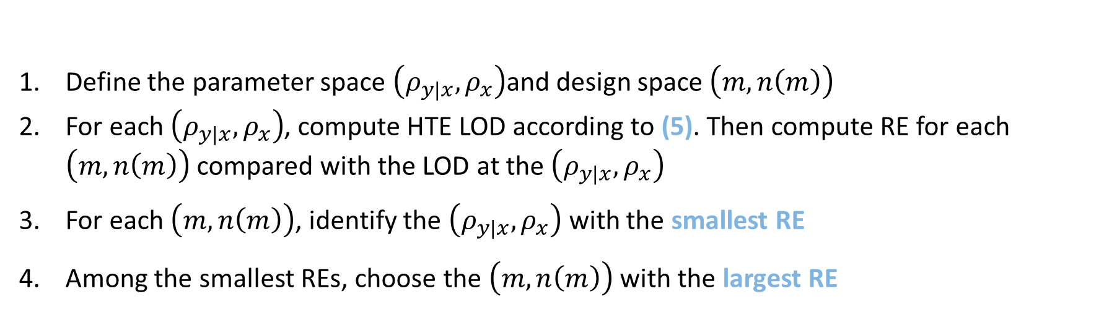
KG2: HTE Maximin Design
MMD for assessing HTE in CRTs
Define the parameter space $\left(ρ_{y|x}, ρ_{x}\right)$and design space $\left(m, n\left(m\right)\right)$
For each $\left(ρ_{y|x}, ρ_{x}\right)$, compute HTE LOD according to (5). Then compute RE for each $\left(m, n\left(m\right)\right)$ compared with the LOD at the $\left(ρ_{y|x}, ρ_{x}\right)$
For each $\left(m, n\left(m\right)\right)$, identify the $\left(ρ_{y|x}, ρ_{x}\right)$ with the smallest RE
Among the smallest REs, choose the $\left(m, n\left(m\right)\right)$ with the largest RE

Slide 13
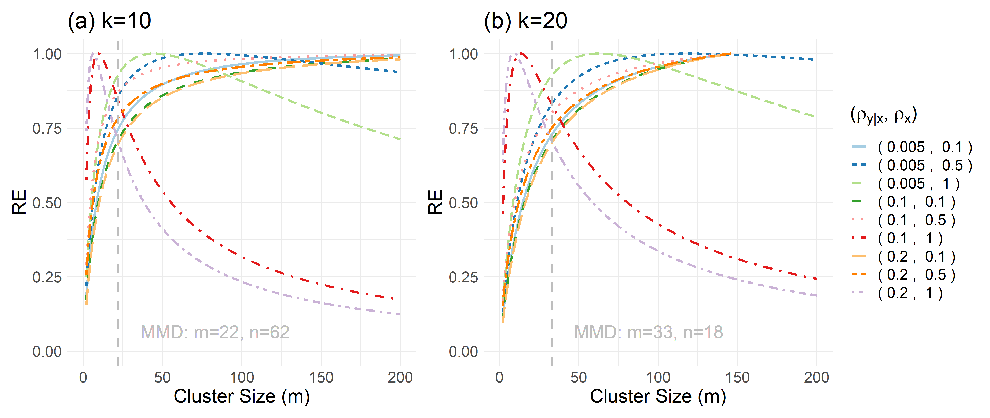
KG2: HTE Maximin Design
Only gain efficiency if ICCs improve
Most efficient design in worst case scenarios
Least efficient scenarios

Slide 14
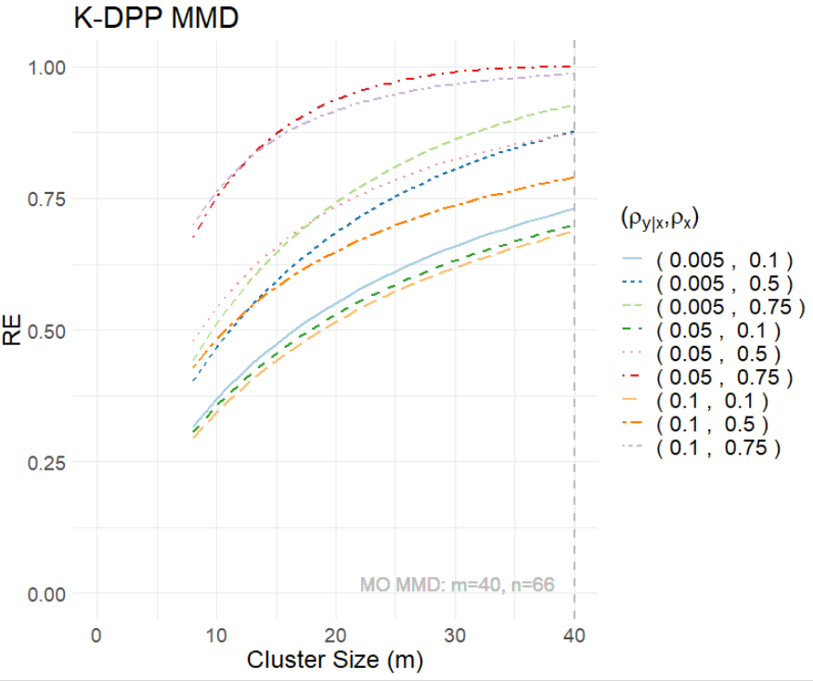
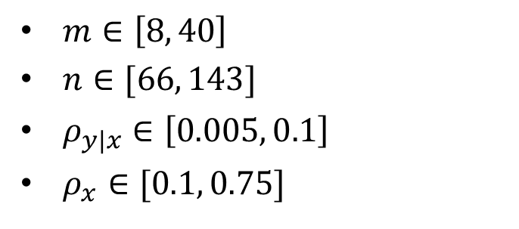
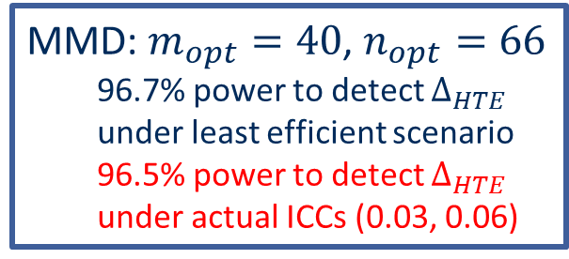
KG2: Application to K-DPP
Only gain relative efficiency if ICCs improve
$m∈\left[8, 40\right]$
$n∈[66, 143]$
$ρ_{y|x}∈\left[0.005, 0.1\right]$
$ρ_{x}∈[0.1, 0.75]$
Most efficient design in worst case scenario
Least efficient scenario
MMD: $m_{opt}=40$, $n_{opt}=66$
96.7% power to detect $Δ_{HTE}$ under least efficient scenario
96.5% power to detect $Δ_{HTE}$ under actual ICCs (0.03, 0.06)
mary.ryan@yale.edu Yale School of Public Health @Marym_Ryan

Slide 15
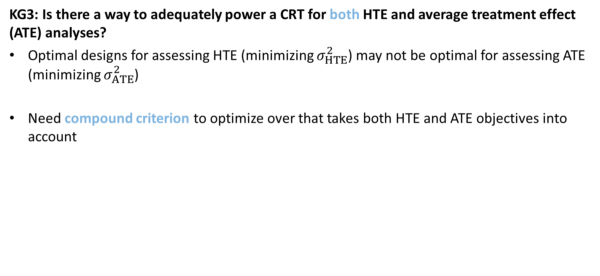
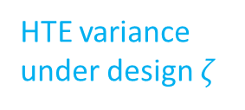

KG3: Compound Objective
KG3: Is there a way to adequately power a CRT for both HTE and average treatment effect (ATE) analyses?
Optimal designs for assessing HTE (minimizing $σ_{HTE}^{2}$) may not be optimal for assessing ATE (minimizing $σ_{ATE}^{2}$)
Need compound criterion to optimize over that takes both HTE and ATE objectives into account
Weighted combo of single objective REs
LOD under ATE
$$Θ\left(ζ\right|λ)=λ\frac{Θ_{ATE}\left(ζ_{ATE}^{∗}\right)}{Θ_{ATE}\left(ζ\right)}+\left(1−λ\right)\frac{Θ_{HTE}\left(ζ_{HTE}^{∗}\right)}{Θ_{HTE}\left(ζ\right)}$$
(6)
Priority weight
HTE variance under design $ζ$
mary.ryan@yale.edu Yale School of Public Health @Marym_Ryan

Slide 16
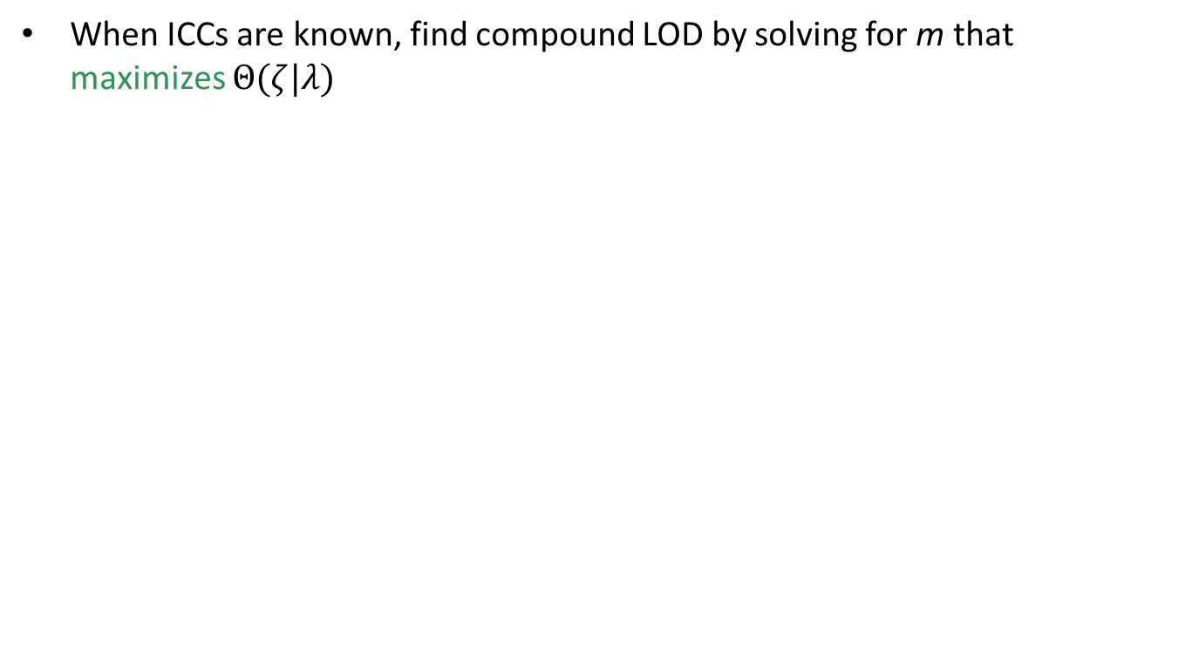
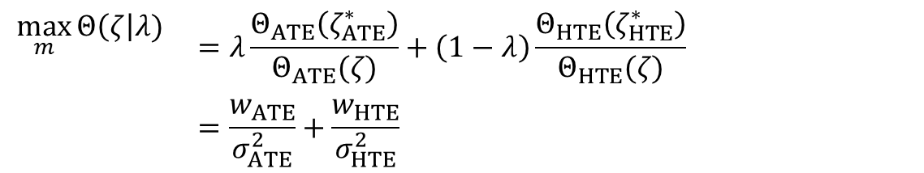
KG3.1: Compound LOD
When ICCs are known, find compound LOD by solving for m that maximizes $Θ(ζ|λ)$
$$\max_{m}{Θ\left(ζ\right|λ) }$$ | $$=λ\frac{Θ_{ATE}\left(ζ_{ATE}^{∗}\right)}{Θ_{ATE}(ζ)}+\left(1−λ\right)\frac{Θ_{HTE}\left(ζ_{HTE}^{∗}\right)}{Θ_{HTE}(ζ)}$$
 | $$=\frac{w_{ATE}}{σ_{ATE}^{2}}+\frac{w_{HTE}}{σ_{HTE}^{2}}$$
(6)

Slide 17
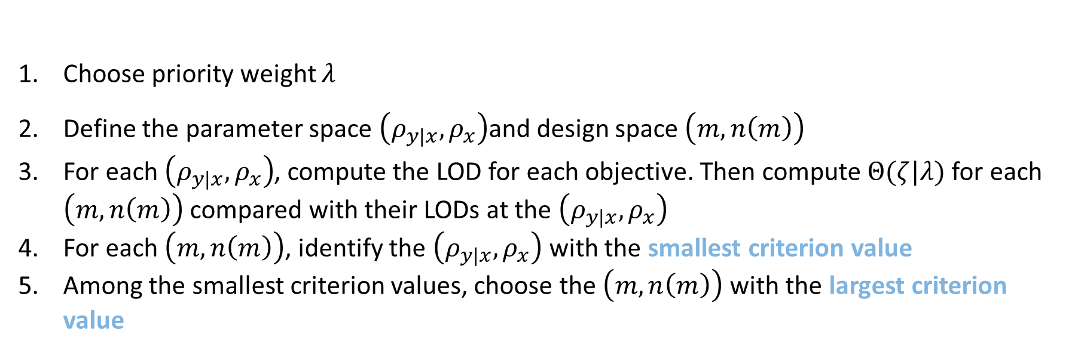
KG3: Compound Maximin
When there is uncertainty around ICC values:
Compound MMD for assessing HTE and ATE in CRTs
Choose priority weight $λ$
Define the parameter space $\left(ρ_{y|x}, ρ_{x}\right)$and design space $\left(m, n\left(m\right)\right)$
For each $\left(ρ_{y|x}, ρ_{x}\right)$, compute the LOD for each objective. Then compute $Θ(ζ|λ)$ for each $\left(m, n\left(m\right)\right)$ compared with their LODs at the $\left(ρ_{y|x}, ρ_{x}\right)$
For each $\left(m, n\left(m\right)\right)$, identify the $\left(ρ_{y|x}, ρ_{x}\right)$ with the smallest criterion value
Among the smallest criterion values, choose the $\left(m, n\left(m\right)\right)$ with the largest criterion value
mary.ryan@yale.edu Yale School of Public Health @Marym_Ryan

Slide 18
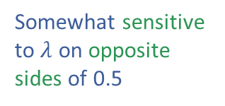


KG3.2: Compound Maximin
Somewhat sensitive to $λ$ on opposite sides of 0.5
(c) k=10, $λ$=0.85
(d) k=20, $λ$=0.85

Slide 19

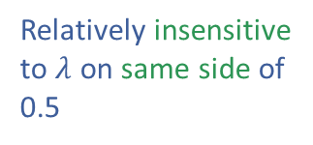

KG3.2: Compound Maximin
(a) k=10, $λ$=0.6
(b) k=20, $λ$=0.6
Relatively insensitive to $λ$ on same side of 0.5
(c) k=10, $λ$=0.85
(d) k=20, $λ$=0.85

Slide 20
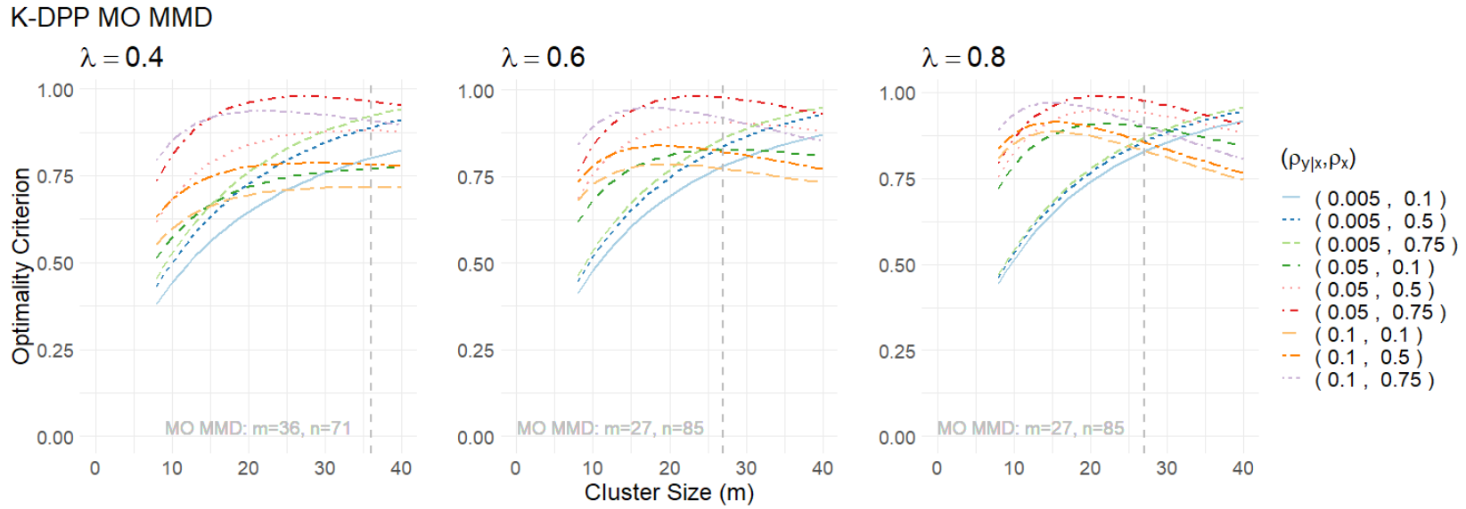
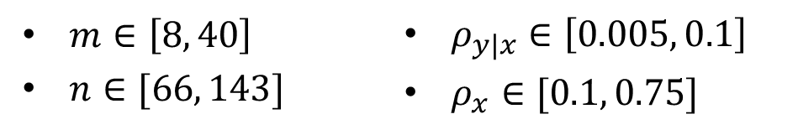
KG3: Application to K-DPP
$m∈\left[8, 40\right]$
$n∈[66, 143]$
$ρ_{y|x}∈\left[0.005, 0.1\right]$
$ρ_{x}∈[0.1, 0.75]$
Calculate power under the worse of the intersecting ICC scenarios
ATE Power: 45.0%
HTE Power: 96.2%
ATE Power: 49.7%
HTE Power: 94.3%
ATE Power: 49.7%
HTE Power: 94.3%
Power under actual ICCs (0.03, 0.06)
ATE: 76.0%
HTE: 96.0%
Power under actual ICCs (0.03, 0.06)
ATE: 77.2%
HTE: 94.1%
Power under actual ICCs (0.03, 0.06)
ATE: 77.2%
HTE: 94.1%
mary.ryan@yale.edu Yale School of Public Health @Marym_Ryan

Slide 21
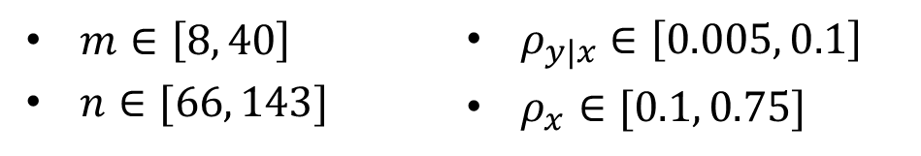
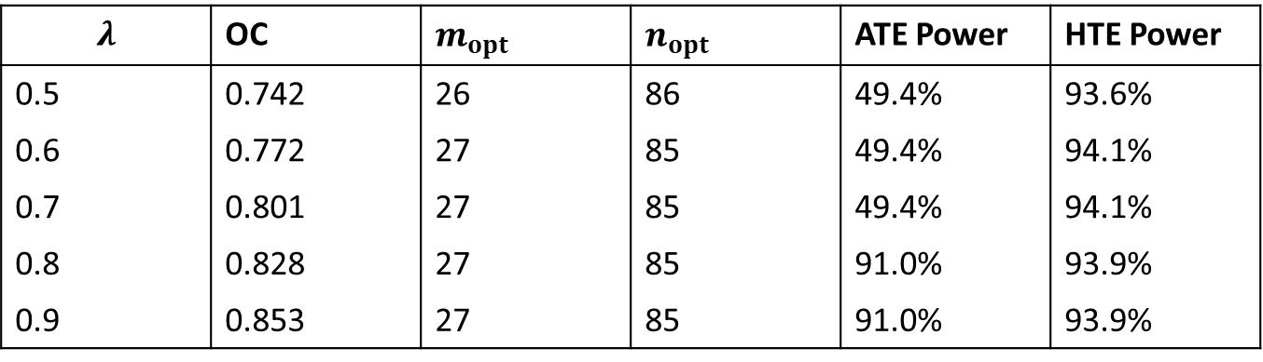
KG3: Application to K-DPP
$m∈\left[8, 40\right]$
$n∈[66, 143]$
$ρ_{y|x}∈\left[0.005, 0.1\right]$
$ρ_{x}∈[0.1, 0.75]$
$$λ$$ | OC | $$m_{opt}$$ | $$n_{opt}$$ | ATE Power | HTE Power
0.5 | 0.742 | 26 | 86 | 49.4% | 93.6%
0.6 | 0.772 | 27 | 85 | 49.4% | 94.1%
0.7 | 0.801 | 27 | 85 | 49.4% | 94.1%
0.8 | 0.828 | 27 | 85 | 91.0% | 93.9%
0.9 | 0.853 | 27 | 85 | 91.0% | 93.9%

Slide 22
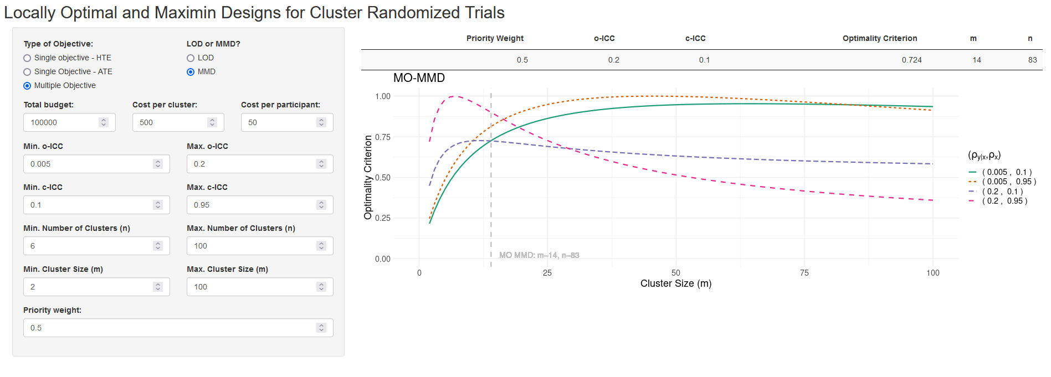
Online Application
Shiny App: https://mary-ryan.shinyapps.io/HTE-MMD-app/
mary.ryan@yale.edu Yale School of Public Health @Marym_Ryan

Slide 23
Conclusions
Understanding treatment effect heterogeneity crucial for improving how and to whom future interventions can be designed and delivered
Optimal designs free of effect size within budget constraint
Possible to find maximin designs robust to ICC value misspecification that jointly consider both HTE and ATE objectives
M.M. Ryan, D. Esserman, F. Li. Maximin optimal cluster randomized designs for assessing treatment effect heterogeneity. (In Revision).
mary.ryan@yale.edu Yale School of Public Health @Marym_Ryan

Slide 24
Limitations
Only focus on univariate HTE covariate, might be of interest to extend to a joint test for HTE with respect to multiple/multivariate effect modifiers
Assume constant cluster size, when in reality cluster sizes vary due to a variety of factors
Assume cost ratio equal across arms, when heterogeneous ratio may lead to differential locally optimal or maximin designs
M.M. Ryan, D. Esserman, F. Li. Maximin optimal cluster randomized designs for assessing treatment effect heterogeneity. (Under Review).

Slide 25
References
Yang, S., Li, F., Starks, M.A., Hernandez, A.F., Mentz, R.J., Choudhury, K.R. (2020). Sample size requirements for detecting treatment effect heterogeneity in cluster randomized trials. Statistics in Medicine 39(28): 4218–4237. doi:10.1002/sim.8721
Thankappan KR, Sathish T, Tapp RJ, et al (2018). A peer-support lifestyle intervention for preventing type 2 diabetes in India: A cluster-randomized controlled trial of the Kerala Diabetes Prevention Program. PLOS Medicine 15(6): e1002575. doi:10.1371/journal.pmed.1002575
Van Breukelen, G.J. and Candel, M.J. (2015). Efficient design of cluster randomized and multicentre trials with unknown intraclass correlation. Statistical Methods in Medical Research 24(5): 540–556. doi:10.1177/0962280211421344
mary.ryan@yale.edu Yale School of Public Health @Marym_Ryan

Slide 26

Thank you!
Mary Ryan, PhD
Department of Biostatistics, Yale University
Email: mary.ryan@yale.edu
Twitter: @marym_ryan
Shiny App: https://mary-ryan.shinyapps.io/HTE-MMD-app/
Questions?
mary.ryan@yale.edu Yale School of Public Health @Marym_Ryan

Slide 27

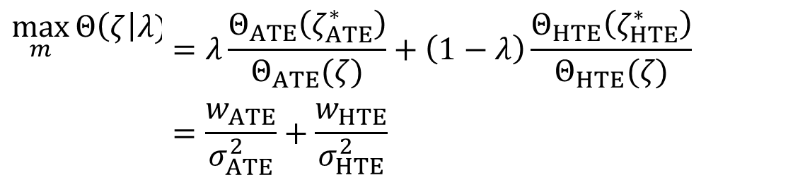
KG3.1: Compound LOD
When ICCs are known, find compound LOD by solving for m that maximizes $Θ(ζ|λ)$
$$\max_{m}{Θ\left(ζ\right|λ) }$$ | $$=λ\frac{Θ_{ATE}\left(ζ_{ATE}^{∗}\right)}{Θ_{ATE}(ζ)}+\left(1−λ\right)\frac{Θ_{HTE}\left(ζ_{HTE}^{∗}\right)}{Θ_{HTE}(ζ)}$$
 | $$=\frac{w_{ATE}}{σ_{ATE}^{2}}+\frac{w_{HTE}}{σ_{HTE}^{2}}$$
mary.ryan@yale.edu Yale School of Public Health @Marym_Ryan

Slide 28
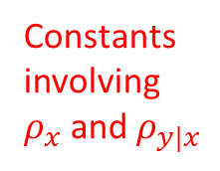

Appendix: Compound LOD
Proposition 2 - Locally optimal compound design
If $w_{ATE}>w_{HTE}\left\{\left(k+1\right)ρ_{y|x}−ρ_{x}\left(kρ_{y|x}+1\right)\right\}$ and $m_{opt}≤\frac{B/\underline{n}−c}{s}$
Otherwise
$$m_{opt}=\frac{−w_{HTE}ka_{2}− \sqrt{w_{HTE}^{2}k^{2}a_{2}^{2}−4\left\{w_{HTE}\left(ka_{1}−b_{1}\right)−w_{ATE}ρ_{y|x}\right\}\left\{w_{ATE}k\left(1−ρ_{y|x}\right)+w_{HTE}ka_{3}\right\} }}{2\left\{w_{HTE}\left(ka_{1}−b_{1}\right)−w_{ATE}ρ_{y|x}\right\}}$$
(A1)
Constants involving $ρ_{x}$ and $ρ_{y|x}$
$$n_{opt}=\frac{B}{c+sm_{opt}}$$
$$m_{opt}=\frac{B/\underline{n}−c}{s}$$
$$n_{opt}=\frac{B}{c+sm_{opt}}$$
mary.ryan@yale.edu Yale School of Public Health @Marym_Ryan

Slide 29
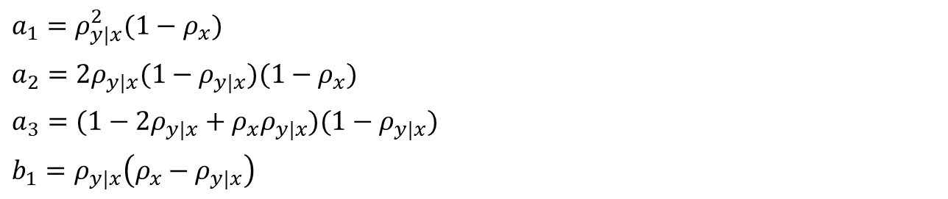
Appendix: Compound LOD
Extraneous terms in (A1):
$$a_{1}=ρ_{y|x}^{2}(1−ρ_{x})$$
$$a_{2}=2ρ_{y|x}(1−ρ_{y|x})(1−ρ_{x})$$
$$a_{3}=(1−2ρ_{y|x}+ρ_{x}ρ_{y|x})(1−ρ_{y|x})$$
$$b_{1}=ρ_{y|x}\left(ρ_{x}−ρ_{y|x}\right)$$
mary.ryan@yale.edu Yale School of Public Health @Marym_Ryan

