Slide 1
Proto
Casey Gilray
Katie Gonzalez
Marysa Mckay
Tulio Meyer
Tina Roper
interactive educational software for
Teachers and their students

Slide 2
About Proto Proto is an interactive educational application designed to improve student quality of reading, writing and spelling skills.
33% of eighth-graders and 24% of 12th graders cannot write at or above proficiency (2012 National Assessment of Education Progress)
Only 60% of students can write at a benchmark level (2011-2012 Washington State's Measures of Student Progress)
4-6% of school children have an identified learning disability (Vital Health Statistics, 2008)
Through targeting the user experience to those of all skill levels we hope to see improvements for students with learning disabilities as well as those without.

Slide 3
Brief User Overview
Teacher
Student
Reviewer
Upload video
Register students
Access student stories
Access to reviews
…
Watch videos
Use drawing template
Write stories
…
Watch training videos
Access student work
Provide feedback and score student work
Compare scores with others
…

Slide 4
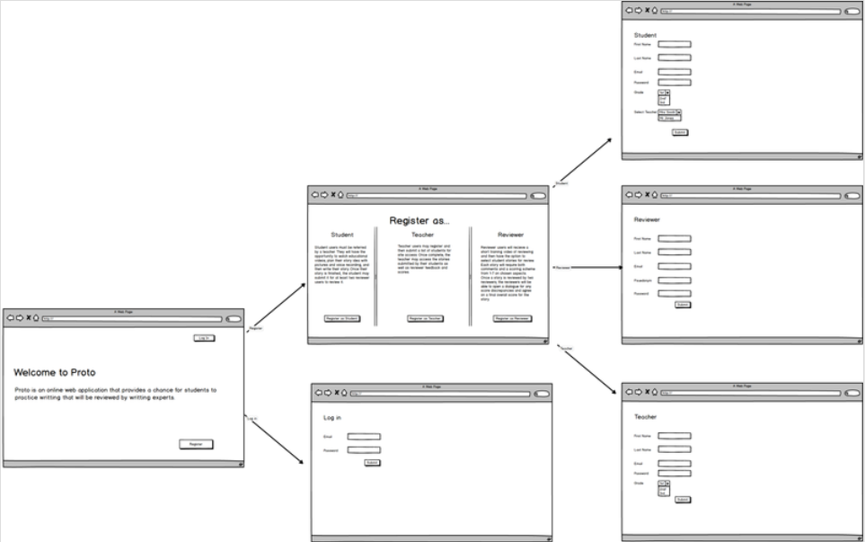
MVC based Registration Mock-up

Slide 5
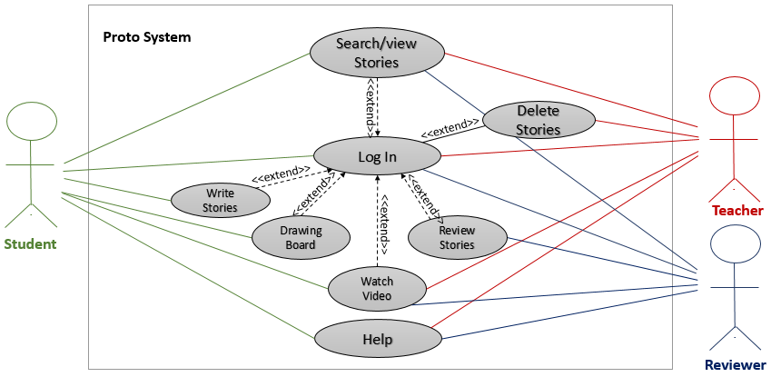
Use Case

Slide 6
Database Glimpse
Teacher
teacherID
Student
studentID
teacher
Reviewer
reviewerID
student
1
M
M
N
MySQL
hosted by http://db.encs.vancouver.wsu.edu/

Slide 7
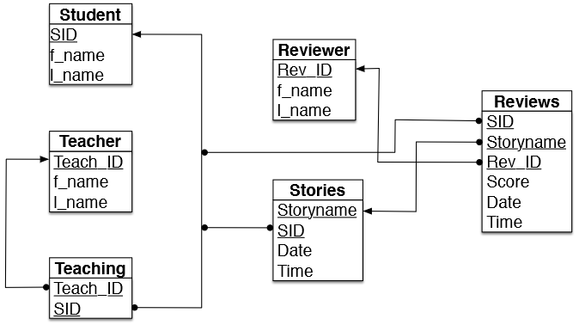
Database Plan - UML

Slide 8
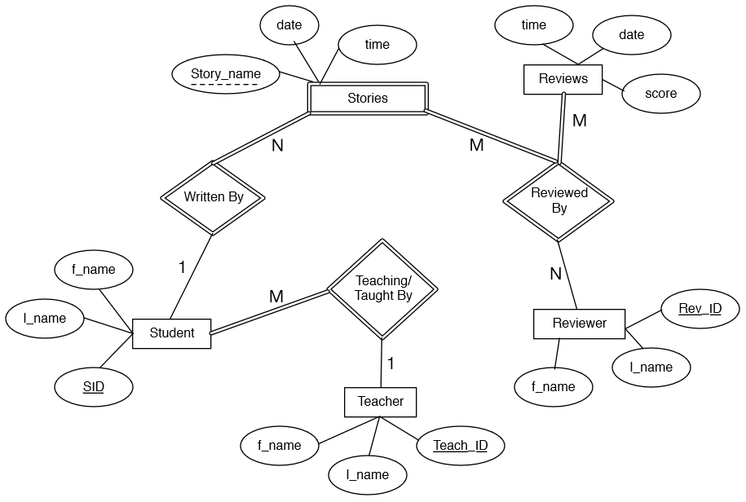
Database Plan - Entity Relationship

Slide 9



Tools
Visual Studios
Version Control
Open Source and Web Based
C#
JavaScript
bootstrap
GitHub
CKEditor
Sketchpad

Slide 10
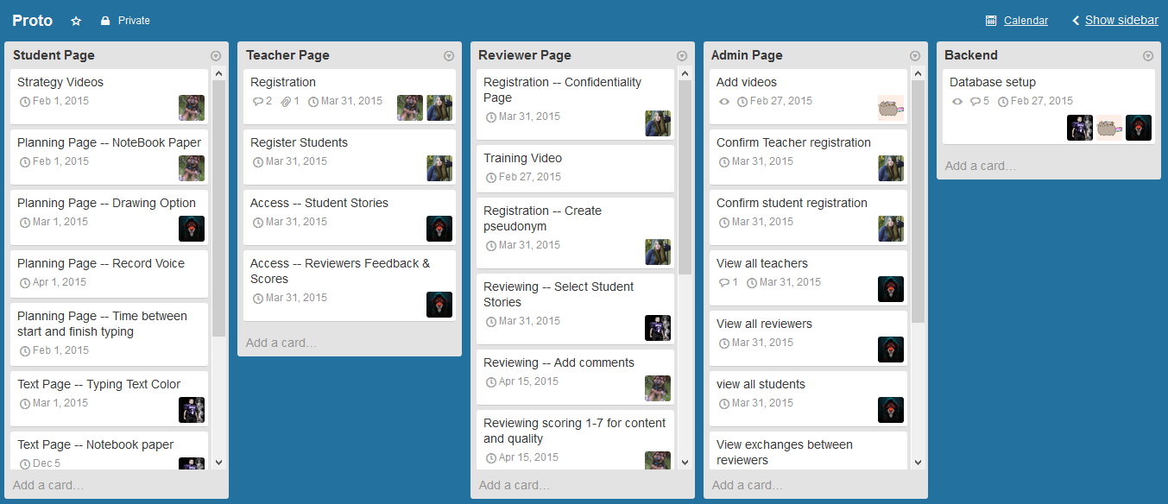
Manage time and keep track of tasks with Trello
A screen-shot of the Proto development plan utilizing Trello, https://trello.com/

Slide 11
Future of Proto for the 2015 Academic Year
Our most immediate focus regarding the future of Proto will be to implement the database and to integrate the application functions that require its existence
Function timers
Reviewer input for scores and comments implemented
January - May

Slide 12
Thank You

