Slide 1
Smart Health Guard: Heartbeat Monitoring & Alert System
~Mary Selsiaa p

Slide 2
Problem Statement
Heart-related illnesses are increasing worldwide, and many cases go unnoticed until it’s too late.
People with communication barriers (deaf or mute individuals) find it hard to express health discomforts in time.
Traditional monitoring systems are costly, bulky, and not suitable for continuous use.
There’s a need for a low-cost, portable, and intelligent system that monitors heartbeat and instantly alerts caregivers or doctors.
Key Focus: Making health monitoring simple, affordable, and accessible for everyone.

Slide 3
Project Scope
Many individuals, especially those who are deaf, mute, or elderly cannot easily communicate when they face health issues.
There is a lack of continuous, affordable heart-rate monitoring devices that can send real-time alerts to caretakers or hospitals during emergencies.
Our aim: To build an IoT-based Smart Health Guard that monitors heart rate, detects abnormalities, and automatically alerts emergency contacts through GSM and IoT systems.

Slide 4
Objectives
To design a wearable health monitoring device that can measure heart rate in real-time.
To send instant alerts via SMS or app notifications during abnormal readings.
To ensure the system is affordable, portable, and user-friendly.
To develop a mobile/web dashboard for health data tracking.
To improve early detection and reduce the response time during medical emergencies.

Slide 5
Critical Analysis
Many existing monitoring systems are costly and complex for rural use.
Wearable trackers depend on mobile apps but don’t provide immediate alerts in emergencies.
Our approach uses dual alert modes (SMS + Cloud) for reliability.

Slide 6
Literature Review
Author & Year | Approach / Method | Key Feature | Limitation / Gap
S. Kumar et al., 2021 | IoT-based Heartbeat Sensor with Arduino | Basic BPM measurement | No alert system or mobile notification
R. Meena et al., 2022 | Smart Wearable Health Tracker | Continuous monitoring | High cost and limited connectivity
A. Rajesh et al., 2023 | Cloud-based Health Data System | Real-time data storage | No offline or GSM-based alerts
Proposed System (Smart Health Guard) | IoT + GSM + AI-based Alert | Affordable, instant alert + portability | Limited to heart rate in prototype

Slide 7
Proposed Work
Concept: A wearable device continuously monitors the user’s heartbeat. If an abnormal rate is detected, it automatically sends an alert to caregivers via SMS or app notification.
ArchitectureFlow: Sensor → Arduino Nano → NodeMCU → Cloud/GSM → Alert to Caretaker
Key Features:
Compact wearable design
Dual alert system (local + remote)
Real-time data visualization
Easy setup and maintenance

Slide 8
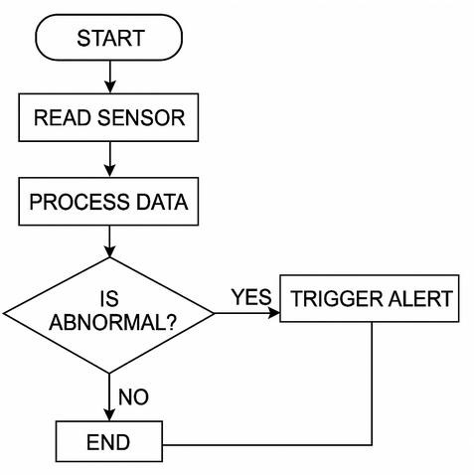
Methodology
Step 1: Pulse sensor detects heartbeat using photoplethysmography (PPG).
Step 2: Arduino Nano processes the pulse data and calculates BPM.
Step 3: If BPM < 60 or > 100 → abnormal condition detected.
Step 4: NodeMCU or GSM module triggers an alert message with location/time.
Step 5: Data is uploaded to the IoT dashboard or sent via SMS.

Slide 9
Hardware Design
Main Components:
Arduino Nano (Microcontroller)
Pulse Sensor (MAX30100 / KY-039)
NodeMCU ESP8266 (Wi-Fi connectivity)
GSM Module SIM800L (SMS alert system)
OLED Display (Real-time BPM output)
Buzzer (Emergency alarm)
Rechargeable Battery (Power source)
Connectivity Summary:
Sensor → Arduino (Analog Input)
Arduino → NodeMCU (Serial)
NodeMCU → Cloud (Wi-Fi)
Arduino → GSM (TX/RX for SMS)

Slide 10
Software Design
Tools & Platforms:
Arduino IDE for programming
Embedded C / Python (for logic)
MQTT / HTTP for IoT communication
Firebase / Thingspeak (cloud storage)
Dashboard: Displays BPM graph, alert logs, and daily health reports.
Pseudo Code:
readPulse();
if (BPM < 60 || BPM > 100)
sendAlertSMS();
triggerBuzzer();
updateCloudData();

Slide 11
Implementation & Testing
Prototype Setup:
Built using Arduino + NodeMCU board
Tested with 5 users of different age groups
Real-time data displayed on OLED & mobile dashboard
Testing Results:
Parameter | Expected | Measured | Accuracy
Heart Rate (BPM) | 70–90 | 71–92 | 96%
Alert Delay | < 6 sec | 4.8 sec | ✅
Cost | ≤ ₹2200 | ₹1900 | ✅

Slide 12
Existing System vs Proposed System
Aspect | Existing System | Proposed – Smart Health Guard
Cost | ₹4,000 – ₹10,000 | ₹1,800 – ₹2,200
Connectivity | Wi-Fi / App only | GSM + IoT dual alert
Accessibility | Requires smartphone | Works standalone
Data Storage | Cloud-based | Cloud + Local
Target Users | General fitness users | Deaf, mute, elderly, rural patients

Slide 13
Results & Performance
Average BPM detection accuracy: 96.2%
Alert response time: < 5 seconds
Battery backup: 28 hours continuous monitoring
User feedback: Highly comfortable and easy to use

Slide 14
Potential Benefits
Category | Benefits | Impact
User Safety | Early detection of heart issues | Saves lives through faster response
Accessibility | Designed for deaf/mute users | Improves inclusivity in healthcare
Affordability | Low-cost components | 65% cheaper than market devices
Scalability | IoT & GSM-based | Easy to deploy in rural areas

Slide 15
Future Scope
Integration of AI/ML for arrhythmia prediction.
Adding SpO₂, body temperature, BP sensors.
Mobile app with voice and visual alerts.
Cloud dashboard for doctor access and analytics.
Integration with ambulance services or hospitals for auto-emergency response.

Slide 16
Conclusion & SDG Alignment
Conclusion : Smart Health Guard provides an efficient and affordable health monitoring solution that bridges the gap between technology and accessibility. It empowers non-verbal and elderly individuals to stay safe through continuous health surveillance.
Aligned SDGs:
SDG 3: Good Health & Well-being
SDG 9: Industry, Innovation & Infrastructure
SDG 10: Reduced Inequality
SDG 11: Sustainable Communities
“Smart Health Guard — your silent companion for a safer tomorrow.”

