Slide 1
ONLINE NIGHT 1 · 5:30 PM – 8:00 PM CST
Pregnancy Physiology
& When Pregnancy Goes Wrong
Mary's Hands Network
ICEA Certified Birth Doula
Hybrid Training

Slide 2
TONIGHT'S FOCUS
Learning Objectives
Pregnancy by trimester — physical & emotional
Common discomforts — evidence-based comfort
Prenatal testing + doula's prenatal role
Recognize preeclampsia & complications
Advocacy + Louisiana health disparities
Mary's Hands Network · ICBD Hybrid Training · Night 1
Notes:
--- Original objectives ---
Explain the physical and emotional changes that occur during each trimester of pregnancy
Offer evidence-based comfort strategies for the most common pregnancy discomforts
Describe major prenatal tests and your role in supporting clients through them
Describe the doula's role during the prenatal period, including scope of practice
Recognize the warning signs of preeclampsia and other complications requiring immediate attention
Practice advocacy language for when a client's concerns are minimized or dismissed
Describe the impact of racial health disparities on maternal outcomes in Louisiana

Slide 3
Normal Pregnancy:
Physiology & the Doula's Role

Slide 4
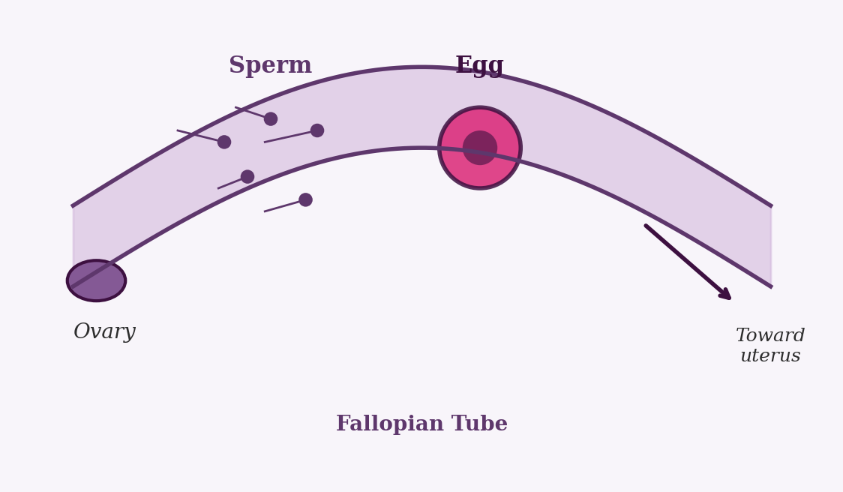
HOW PREGNANCY BEGINS · STEP 1
Fertilization
Sperm meets egg in fallopian tube
Zygote begins dividing immediately
Genetic blueprint fixed at conception
Pregnancy is dated from last period
Many are 2 weeks "pregnant" already
Mary's Hands Network · ICBD Hybrid Training · Night 1
Notes:
--- Original detailed content ---
Sperm meets egg in the fallopian tube, forming a fertilized egg called a zygote
The zygote immediately begins dividing as it travels toward the uterus
The genetic blueprint is fixed at this exact moment — chromosomes, biological sex, and many inherited traits are set here
Pregnancy is dated from the first day of the last menstrual period — not from conception
Most people are already 2 weeks "pregnant" before conception even occurs

Slide 5
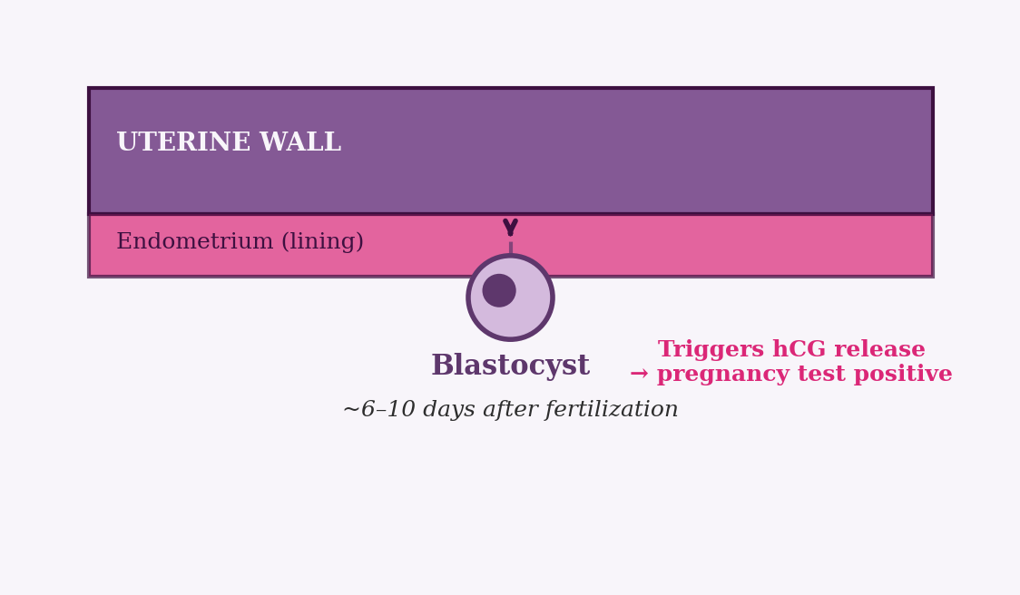
HOW PREGNANCY BEGINS · STEP 2
Implantation
6–10 days after fertilization
Blastocyst burrows into uterine lining
Triggers hCG — pregnancy test positive
Some notice light spotting
If it fails, period follows
Mary's Hands Network · ICBD Hybrid Training · Night 1
Notes:
--- Original detailed content ---
Around days 6–10 after fertilization, the blastocyst burrows into the uterine lining (the endometrium)
This triggers the release of hCG — human chorionic gonadotropin — the hormone pregnancy tests detect
Some people notice light spotting at implantation and mistake it for a period
If implantation fails, the lining sheds as a normal period — most very early pregnancies end this way
The person will never know they were briefly pregnant

Slide 6
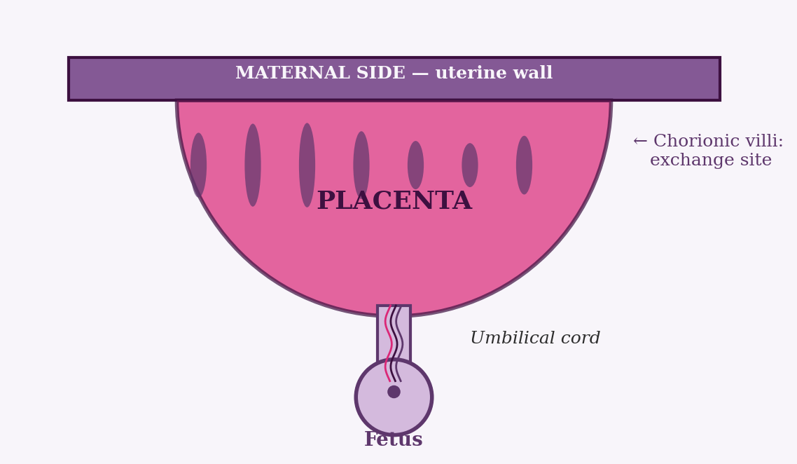
HOW PREGNANCY BEGINS · THE LIFE SUPPORT SYSTEM
The Placenta
The only organ the human body grows — and then discards.
Delivers Oxygen & Nutrients
Removes Fetal Waste
Produces Key Hormones
Development & Delivery
Maternal and fetal blood never directly mix. The placenta acts as a selective barrier — passing oxygen, glucose, and vitamins through to the fetus while blocking most pathogens and toxins.
Carbon dioxide and metabolic waste products from the fetus cross back through the placenta into the mother's circulation for disposal.
Takes over hormone production around week 10 — producing hCG, progesterone, and estrogen to sustain the pregnancy and drive physical changes.
Fully functional by weeks 12–16. Continues growing until birth, ultimately weighing about 1–1.5 lbs. Delivered as the third stage of labor.
Mary's Hands Network · ICBD Hybrid Training · Night 1

Slide 7
THE HORMONES OF PREGNANCY · OVERVIEW
Six Hormones Drive Every Symptom Your Client Feels
Understanding these hormones lets you explain exactly why your client feels the way she does.
hCG
Progesterone
Estrogen
Causes nausea, detected by pregnancy tests, peaks at week 10
Maintains the uterine lining, causes heartburn, fatigue
Drives growth, blood flow, skin changes, the pregnancy glow
Relaxin
Oxytocin
Cortisol
Loosens ALL ligaments — causes back pain, SPD, clumsiness
Builds through pregnancy, triggers labor, drives bonding
Rises throughout pregnancy — chronic stress elevation = risk
Mary's Hands Network · ICBD Hybrid Training · Night 1

Slide 8
THE HORMONES OF PREGNANCY
hCG — Human Chorionic Gonadotropin
The hormone that tells the body: pregnancy is happening.
Produced by the placenta
Doubles every 48–72 hours early on
Peaks around week 10
Triggers the nausea center
Pauses ovulation for the pregnancy
Mary's Hands Network · ICBD Hybrid Training · Night 1
Notes:
--- Original detailed content ---
Produced by the placenta starting at implantation
The hormone pregnancy tests detect — levels double every 48–72 hours in early pregnancy
Surges dramatically in the first trimester, peaks around week 10, then drops off
Triggers the nausea center in the brainstem — explains why first-trimester nausea is worst at the peak
Also signals the ovaries to stop producing eggs for the duration of the pregnancy

Slide 9
THE HORMONES OF PREGNANCY
Progesterone — "The Pregnancy Hormone"
Without progesterone, the uterus cannot sustain the pregnancy.
Maintains the uterine lining
Suppresses contractions, protects pregnancy
Relaxes smooth muscle everywhere
Sedating — drives T1 fatigue
Sudden postpartum drop → baby blues
Mary's Hands Network · ICBD Hybrid Training · Night 1
Notes:
--- Original detailed content ---
Maintains the uterine lining so the embryo stays implanted
Suppresses uterine contractions to protect the pregnancy
Relaxes smooth muscle throughout the entire body — causes heartburn, constipation, and bloating
Has a sedating effect — directly responsible for first-trimester fatigue
Rises steadily throughout pregnancy; a sudden drop after birth contributes to baby blues

Slide 10
THE HORMONES OF PREGNANCY
Estrogen — Growth, Blood Flow & Change
Estrogen drives visible physical transformation — from the glow to the stretch marks.
Drives uterine growth
Develops breast tissue for lactation
Creates the "pregnancy glow"
Also: nasal congestion, bleeding gums
Stretch marks, linea nigra, melasma
Mary's Hands Network · ICBD Hybrid Training · Night 1
Notes:
--- Original detailed content ---
Drives uterine growth to accommodate the expanding baby
Stimulates breast tissue development in preparation for lactation
Increases blood flow to the skin — responsible for the "pregnancy glow"
That same blood flow also causes nasal congestion, nosebleeds, and bleeding gums
Drives skin changes: stretch marks, linea nigra (the dark midline), and melasma (facial pigmentation)

Slide 11
THE HORMONES OF PREGNANCY
Relaxin — The Joint & Ligament Relaxer
It loosens the pelvic ligaments for birth — and every other ligament along with them.
Loosens pelvic ligaments for birth
Loosens ALL ligaments — not just pelvic
Back pain, SPD, round ligament pain
Causes "pregnancy clumsiness"
Resolves after breastfeeding ends
Mary's Hands Network · ICBD Hybrid Training · Night 1
Notes:
--- Original detailed content ---
Primary job: loosen the pelvic ligaments so the pelvis can widen enough for birth
The problem: it loosens ALL ligaments in the body, not just pelvic ones
Causes back pain, round ligament pain (sharp lower belly pains), and symphysis pubis dysfunction (SPD)
The "pregnancy clumsiness" clients describe — dropping things, misjudging distances — is relaxin destabilizing joints
Levels peak in the first trimester, stay elevated throughout, and resolve after birth or after breastfeeding ends

Slide 12
THE HORMONES OF PREGNANCY
Oxytocin — "The Love Hormone"
Your calm, warm, reassuring presence as a doula is not just emotional support — it is hormonal support.
Builds gradually, peaks at labor
Drives contractions (Pitocin is synthetic)
Responds to touch, eye contact, safety
Powers skin-to-skin bonding
Triggers milk let-down reflex
Mary's Hands Network · ICBD Hybrid Training · Night 1
Notes:
--- Original detailed content ---
Builds gradually throughout pregnancy and peaks at the onset of labor
Triggers and sustains uterine contractions — Pitocin is synthetic oxytocin
Released in response to touch, eye contact, warm skin contact, and emotional safety
Drives maternal bonding after birth — skin-to-skin contact floods the system with oxytocin
Also responsible for the milk let-down reflex during breastfeeding

Slide 13
THE HORMONES OF PREGNANCY
Cortisol — The Stress Hormone
Rising cortisol in pregnancy is normal. Chronic stress-driven elevation is where doulas make a difference.
Rises throughout pregnancy — normal
Adapts immune system to tolerate fetus
Supports fetal lung development
Chronic elevation → preterm risk
Doula presence measurably lowers it
Mary's Hands Network · ICBD Hybrid Training · Night 1
Notes:
--- Original detailed content ---
Rises steadily throughout pregnancy — this is normal and necessary
Adapts the immune system to tolerate the fetus, which is genetically foreign tissue
Supports fetal lung and organ development in the third trimester
Chronically elevated cortisol from unmanaged stress is linked to increased preterm labor risk and lower birth weight
Doula presence reduces cortisol — this is one mechanism behind the Cochrane Review data showing improved outcomes

Slide 14
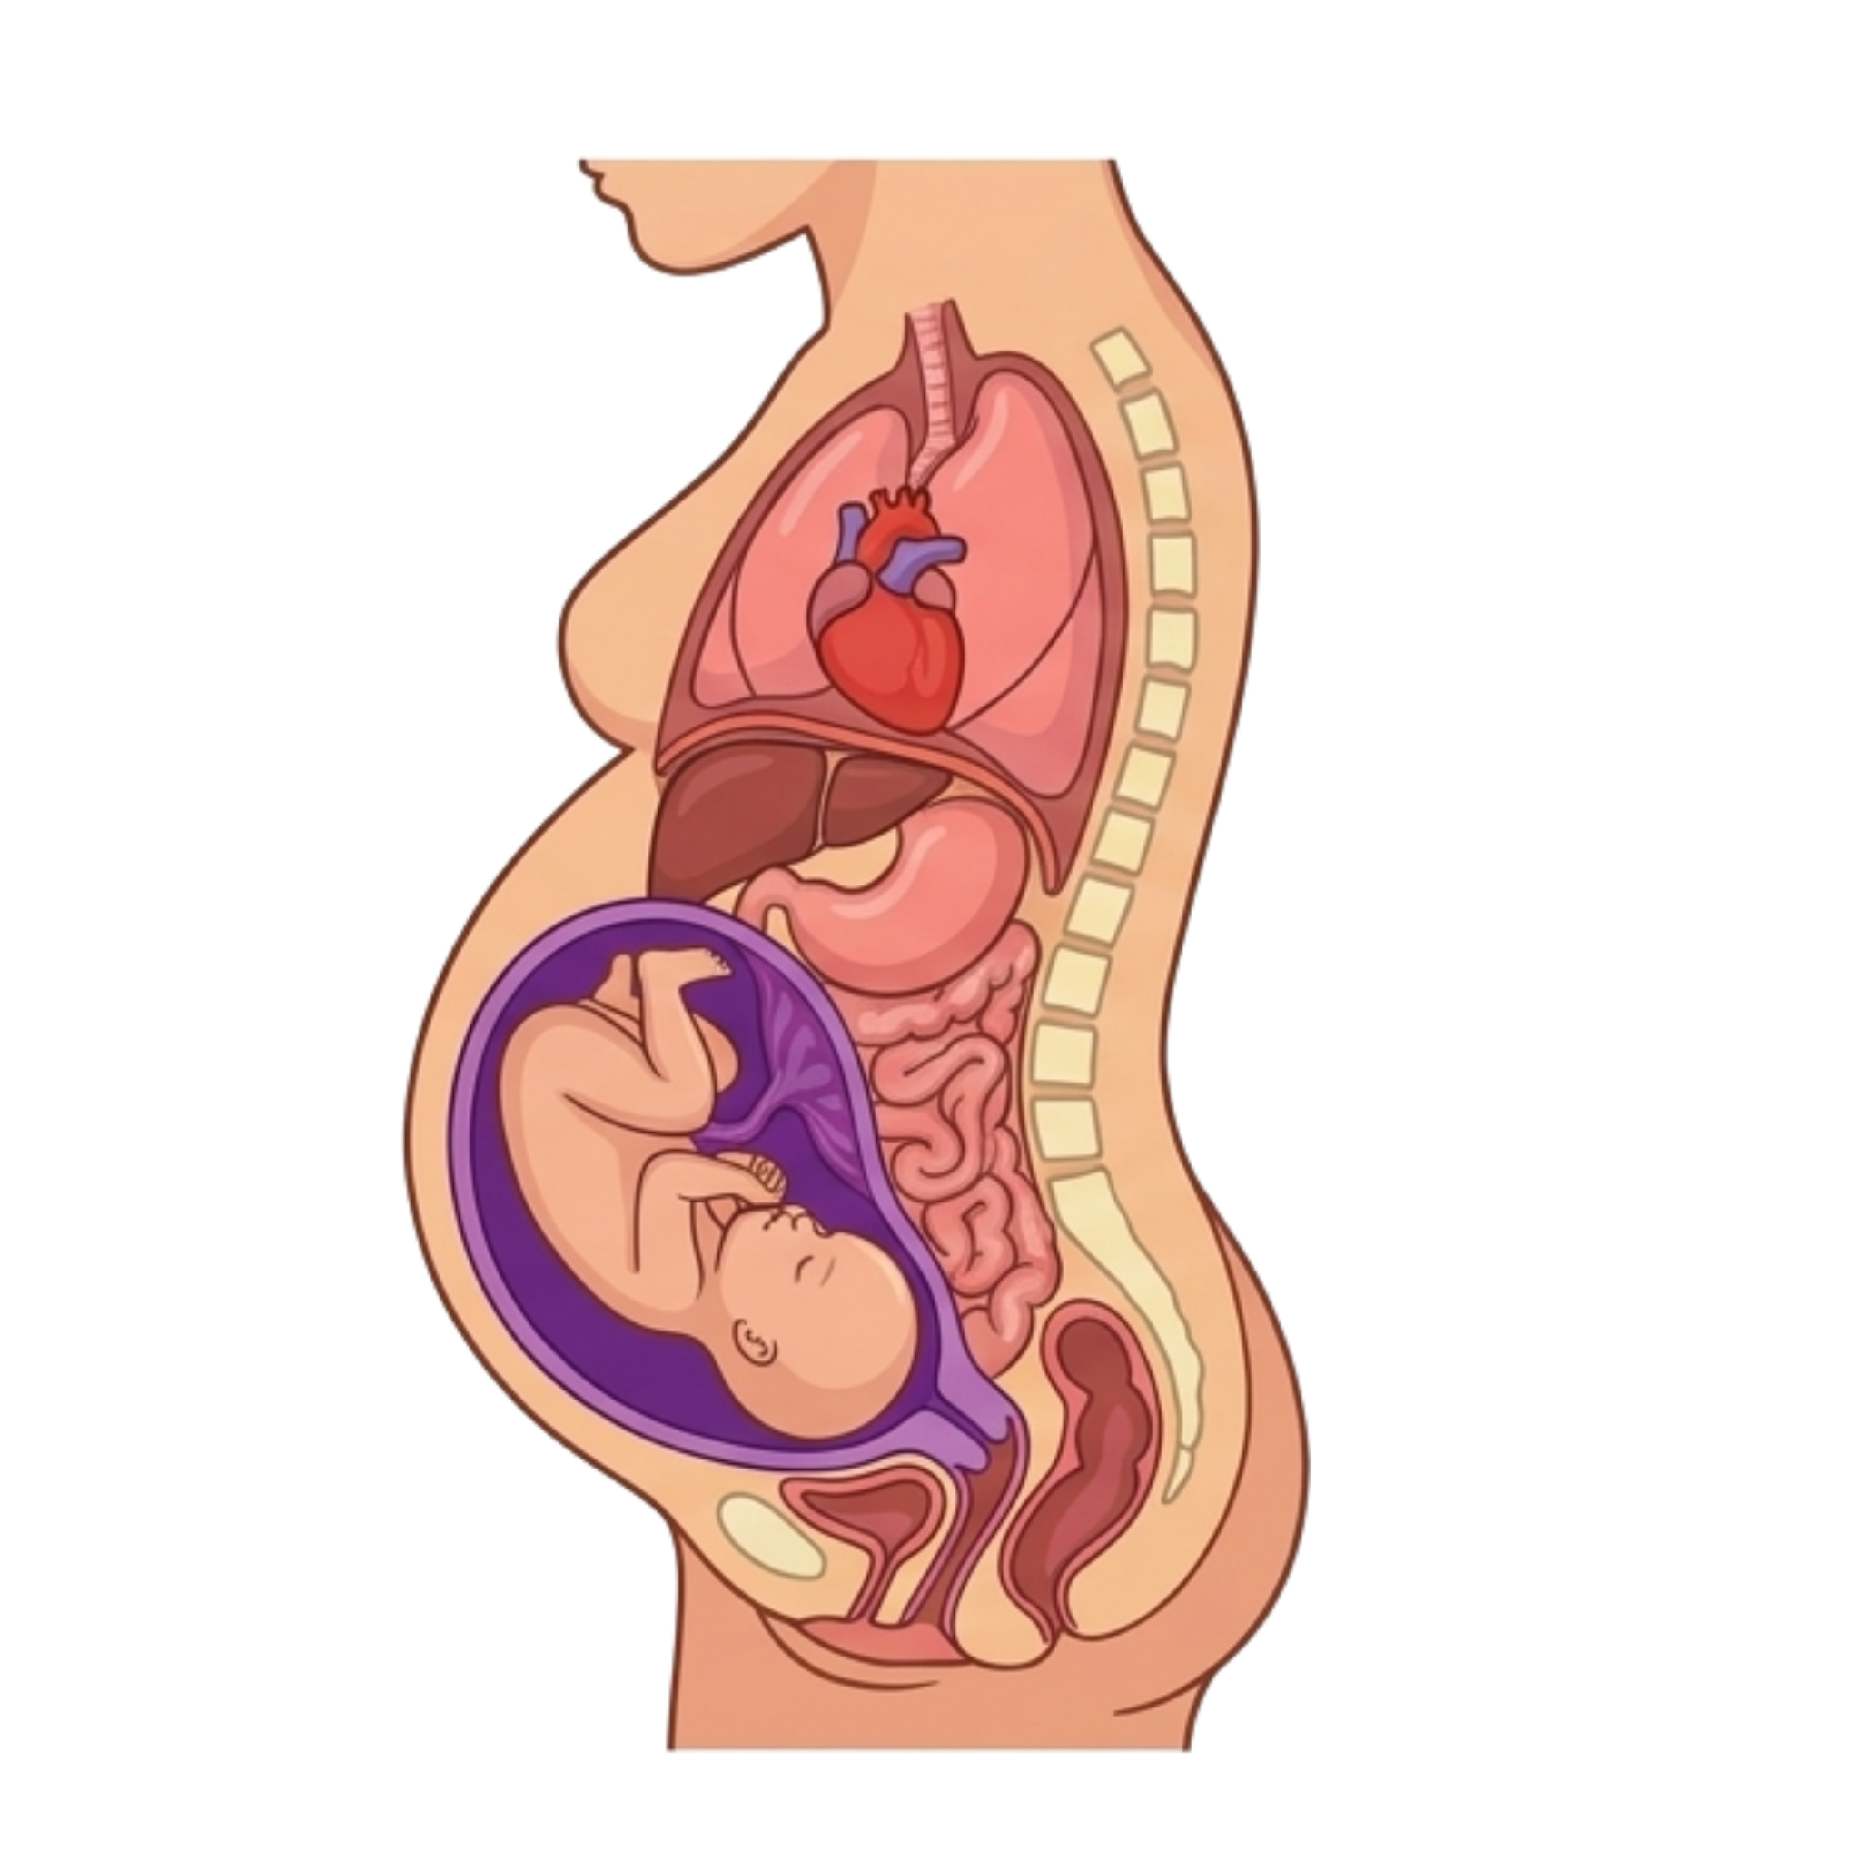
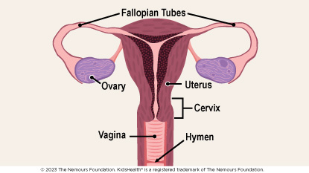
ANATOMY & PHYSIOLOGY · HOW THE BODY REORGANIZES
Where Does Everything Go?
Mary's Hands Network · ICBD Hybrid Training · Night 1

Slide 15
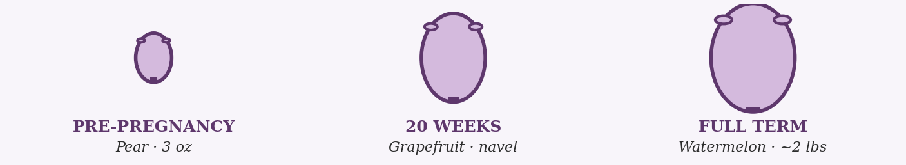
ANATOMY & PHYSIOLOGY · UPPER BODY
The Uterus — The Engine of It All
From pear-sized to watermelon-sized. Everything else moves to make room.
Pear-sized, 3 oz pre-pregnancy
Watermelon-sized, ~2 lbs at term
Pushes every organ upward and aside
Drives most T3 symptoms
One of the body's strongest muscles
Mary's Hands Network · ICBD Hybrid Training · Night 1
Notes:
--- Original detailed content ---
Starts as a pear-sized, 3-ounce organ tucked deep in the pelvis
By full term it is the size of a watermelon and weighs about 2 pounds
Pushes every organ in the abdominal cavity upward, outward, and to the sides
This single structural change causes the majority of third-trimester symptoms
The uterine muscle must contract powerfully during labor — it is one of the strongest muscles in the human body

Slide 16
ANATOMY & PHYSIOLOGY · UPPER BODY
Stomach, Intestines & Diaphragm
Stomach & Intestines
Pushed upward and compressed by the growing uterus. Progesterone slows gut motility. Result: heartburn, constipation, bloating, and slower digestion. Heartburn worsens after meals and when lying flat.
T2 onward, worst in T3
Diaphragm
Pushed upward by about 4 cm in T3, reducing lung capacity. Causes shortness of breath — especially lying flat or climbing stairs. Most clients feel relief when the baby drops (lightening) in late T3.
Third trimester
Mary's Hands Network · ICBD Hybrid Training · Night 1

Slide 17
ANATOMY & PHYSIOLOGY · LOWER BODY & SYSTEMIC
Bladder, Kidneys & Cardiovascular System
Bladder
Compressed by hCG in T1 and by the baby's head in T3. Frequent urination is entirely structural. Clients who reduce fluids to cope risk dehydration and UTIs.
T1 and T3
Kidneys
Filtration rate increases 60–80% to handle expanded blood volume. Mild glucose in urine (glycosuria) is normal — the kidneys are simply filtering more than usual.
Throughout pregnancy
Heart & Circulation
Blood volume increases 40–50%. Heart rate rises 10–20 bpm. Cardiac output increases 30–50%. This explains fatigue, dizziness on standing, and the swelling that comes from fluid redistribution.
T1 through birth
Mary's Hands Network · ICBD Hybrid Training · Night 1

Slide 18
BREAK
6:20 PM — 6:30 PM · 10 minutes
Step away, stretch, hydrate, reset.
Back at 6:30 PM — trimesters & discomforts up next.

Slide 19
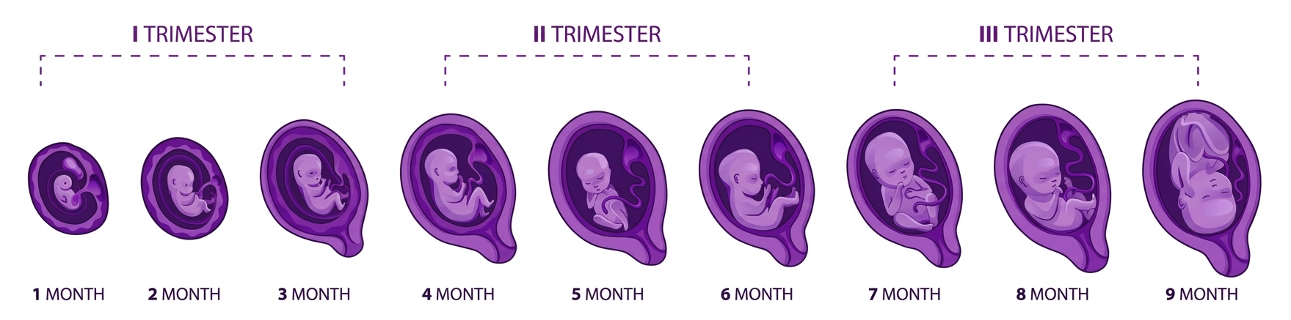
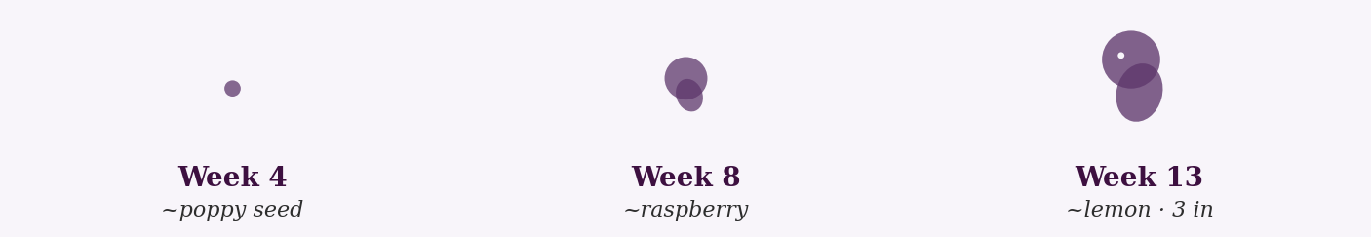
FIRST TRIMESTER
The Foundation — Critical Development
Day 28: neural tube closes
Weeks 5–8: all major organs form
Week 8: now a fetus — fingers form
Week 10: placenta takes over
Week 13: 3 inches, facial features
Mary's Hands Network · ICBD Hybrid Training · Night 1
Notes:
--- Original detailed content ---
Days 1–14: Fertilization, cell division, and implantation into the uterine wall
Week 4: Neural tube forms — closes by day 28. Heart tube begins beating
Weeks 5–8: All major organ systems established — heart, brain, kidneys, liver, lungs
Week 8: Now called a fetus. Fingers and toes forming. About 1 inch long
Week 10: Placenta takes over hormone production from the corpus luteum
Week 13: Facial features recognizable, vocal cords forming — 3 inches and 1 ounce

Slide 20
FIRST TRIMESTER
Often the Hardest — With No Visible Bump
Nausea (70–80%) — not just morning
Extreme fatigue — building a placenta
Heightened smell, food aversions
Pregnancy feels surreal — no bump yet
Highest miscarriage risk — anxiety work
Mary's Hands Network · ICBD Hybrid Training · Night 1
Notes:
--- Original detailed content ---
Nausea and vomiting — affects 70–80% of pregnant people and can happen all day, not just morning
Extreme fatigue — the body is building a placenta; this is physiologically exhausting
Breast tenderness, frequent urination, food aversions, heightened sense of smell
Emotional ups and downs from hormonal surges — fear, ambivalence, and excitement can all coexist
No visible bump yet — pregnancy can feel abstract or surreal, especially for first-time parents
Miscarriage risk is highest now — your most anxiety-containing work happens in T1

Slide 21
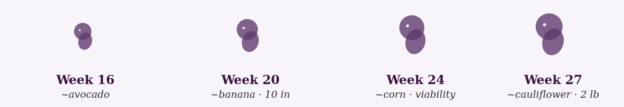
SECOND TRIMESTER
The Growth Surge — Senses & Viability
Week 16: fingerprints form
Weeks 18–22: quickening — first kicks felt
Week 20: swallows, tastes, hears
Week 24: viability threshold
Week 27: eyes beginning to open
Mary's Hands Network · ICBD Hybrid Training · Night 1
Notes:
--- Original detailed content ---
Weeks 14–16: Making facial expressions, sucking movements, hiccupping
Week 16: Fingerprints form; skeleton hardening from cartilage to bone
Week 18–22: Quickening — the pregnant person begins feeling fetal movement for the first time
Week 20: Baby can swallow amniotic fluid, taste, and hear sounds from outside the womb
Week 24: Threshold of viability — with intensive NICU care, survival is possible
Week 27: Eyes beginning to open — about 14 inches and 2 pounds

Slide 22
SECOND TRIMESTER
The Honeymoon Period — Energy Returns
Nausea fades, energy returns
Baby bump becomes visible
Round ligament pain (sharp belly)
Skin changes: glow, stretch marks, melasma
Prime relationship-building time
Prime prenatal relationship-building time.
Mary's Hands Network · ICBD Hybrid Training · Night 1
Notes:
--- Original detailed content ---
Nausea often subsides and energy returns — many people feel more like themselves
Baby bump becomes visible — can feel affirming and real for the first time
Round ligament pain begins — sharp lower abdominal pains as the uterus expands
Nasal congestion, nosebleeds, and bleeding gums from increased blood volume
Skin changes: the pregnancy glow, stretch marks, linea nigra, melasma
Begin discussing birth preferences and fears — this is prime prenatal relationship-building time

Slide 23
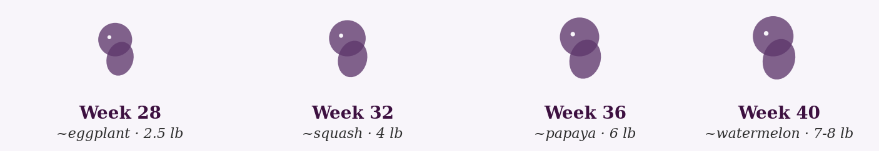
THIRD TRIMESTER
The Final Preparations — Fat, Lungs & Position
Weeks 28–32: rapid weight gain
Weeks 32–36: surfactant produced
Week 37: "early term" — brain still growing
Weeks 39–40: developmentally optimal
Full term: 19–21 in, 6–9 lbs
Mary's Hands Network · ICBD Hybrid Training · Night 1
Notes:
--- Original detailed content ---
Weeks 28–32: Rapid weight gain, body fat accumulating for temperature regulation after birth
Weeks 32–36: Lungs produce surfactant — the substance that keeps air sacs open after birth
Week 37: "Early term" — lungs functional but brain still developing rapidly through week 39
Weeks 39–40: Developmentally optimal; baby settles head-down as space shrinks
Full term: 19–21 inches, 6–9 lbs, all systems ready

Slide 24
THIRD TRIMESTER · Weeks 28–40+ · FOR THE PREGNANT PERSON
The Home Stretch — Intensity & Anticipation
Discomfort, poor sleep, breathlessness
Heartburn intensifies
Pelvic pressure, "lightning crotch"
Swelling: sudden severe = red flag
Nesting + emotional intensity
Anticipation, fear, excitement, impatience — all at once.
Mary's Hands Network · ICBD Hybrid Training · Night 1
Notes:
--- Original detailed content ---
Increasing discomfort — carrying extra weight, difficulty sleeping, shortness of breath
Heartburn and indigestion intensify as the uterus presses on the stomach
Pelvic pressure, lightning crotch (sharp pelvic pains), and frequent urination return
Swelling in feet, ankles, and hands — normal if gradual; sudden severe swelling is a red flag
Nesting instinct — a sudden urge to clean, organize, and prepare
Emotional intensity — anticipation, fear, excitement, and impatience all at once

Slide 25
COMMON PREGNANCY DISCOMFORTS
Nausea & Vomiting
Affects 70–80% of pregnant people. Can happen any time of day.
What you can offer:
When to refer to provider:
Small, frequent meals
Ginger — tea, candies, or fresh
Vitamin B6 (with provider OK)
Sea-Bands (acupressure)
Avoid known triggers
Inability to keep fluids down for 24 hours, weight loss, or vomiting more than 3–4 times per day may indicate hyperemesis gravidarum — refer to provider.
Doula script:
"Morning sickness is miserable and I'm sorry you're dealing with it. Try eating small amounts frequently — even crackers or toast. Protein helps. And ginger really works for some people."
Mary's Hands Network · ICBD Hybrid Training · Night 1
Notes:
--- Nausea offers (original) ---
Small, frequent meals — an empty stomach worsens nausea
Ginger: tea, candies, or fresh ginger — evidence supports its effectiveness
Vitamin B6 with provider approval
Acupressure wristbands (Sea-Bands)
Avoid known triggers — certain smells, foods, or activities

Slide 26
COMMON PREGNANCY DISCOMFORTS
Heartburn & Indigestion
Up to 80% of pregnant people experience this — especially in the third trimester.
What you can offer:
When to refer to provider:
Small, frequent meals
Avoid spicy, acidic, fatty foods
Don't lie down 2–3 hrs after eating
Sleep with head elevated
Chew gum to neutralize acid
If severe or not responding to dietary changes, the provider can recommend safe antacids for use during pregnancy.
Doula script:
"Heartburn is so common in pregnancy because hormones relax the valve at the top of your stomach and the baby is pushing everything upward. Small meals and sleeping propped up really help."
Mary's Hands Network · ICBD Hybrid Training · Night 1
Notes:
--- Heartburn offers (original) ---
Small, frequent meals instead of large ones
Avoid spicy, acidic, fatty, or fried foods
Don't lie down for 2–3 hours after eating
Sleep with the head elevated — gravity keeps acid down
Chew gum: increases saliva, which neutralizes acid

Slide 27
COMMON PREGNANCY DISCOMFORTS
Swelling (Edema)
Normal in the feet, ankles, and hands — especially in the third trimester. Blood volume has increased 40–50%.
What you can offer:
When to refer to provider:
Elevate feet when resting
Avoid prolonged standing
Stay hydrated — reduces swelling
Reduce sodium intake
Compression stockings if needed
Sudden, severe swelling in the face, hands, or around the eyes — especially with headache or vision changes — requires immediate evaluation. One leg significantly more swollen than the other may indicate a blood clot.
Doula script:
"Swelling in your feet and ankles is really common, especially in the heat or at the end of the day. Elevating your feet helps. Drinking water actually helps reduce it, even though that seems backward."
Mary's Hands Network · ICBD Hybrid Training · Night 1
Notes:
--- Swelling offers (original) ---
Elevate feet when sitting or resting
Avoid standing for long periods
Stay hydrated — counterintuitively, this reduces swelling
Reduce sodium intake
Compression stockings if swelling is significant

Slide 28
COMMON PREGNANCY DISCOMFORTS
Back & Pelvic Pain
Caused by shifted center of gravity, relaxin loosening ligaments, and a growing uterus.
What you can offer:
When to refer to provider:
Posture: shoulders back, pelvis tucked
Supportive shoes — avoid heels
Prenatal yoga, gentle stretching
Heat for muscle pain (not belly)
Side-lying with pillow between knees
Severe, persistent pain or symphysis pubis dysfunction (SPD) may benefit from a referral to a prenatal physical therapist.
Doula script:
"Your body is doing a lot of shifting and adjusting. Back pain is really common. Stretching helps, heat helps, and changing positions often helps. If it gets bad, prenatal PTs do amazing work."
Mary's Hands Network · ICBD Hybrid Training · Night 1
Notes:
--- Back pain offers (original) ---
Good posture coaching — shoulders back, pelvis tucked
Supportive shoes — avoid heels
Prenatal yoga or gentle stretching
Heat for muscle pain (not directly on belly)
Side-lying with a pillow between the knees for sleep

Slide 29
COMMON PREGNANCY DISCOMFORTS
Fatigue
Real, intense, and often underestimated — especially in T1 and again in T3.
What you can offer:
When to refer to provider:
Permission to rest — not laziness
Short naps (20–30 minutes)
Protein + complex carbs for energy
Hydration — dehydration worsens fatigue
Gentle movement (walking) helps
Extreme, debilitating fatigue beyond what is typical may indicate anemia — encourage provider to check iron levels.
Doula script:
"Your body is working so hard right now — harder than it would running a marathon. Of course you're tired. Rest when you can. This isn't laziness. This is your body doing exactly what it needs to do."
Mary's Hands Network · ICBD Hybrid Training · Night 1
Notes:
--- Fatigue offers (original) ---
Give explicit permission to rest — this is essential, not lazy
Short naps (20–30 minutes) if possible
Protein and complex carbs for steady energy
Hydration — dehydration worsens fatigue
Gentle movement, like walking, can actually increase energy

Slide 30
COMMON PREGNANCY DISCOMFORTS
Braxton Hicks Contractions
Practice contractions — irregular, usually painless, and stop with position change or hydration.
What you can offer:
When to refer to provider:
Hydration first — common trigger
Position change often stops them
Rest if frequent
Reassurance: uterus practicing, not labor
If contractions become regular (every 5–10 minutes), are accompanied by pain, bleeding, or pelvic pressure before 37 weeks — call the provider. When in doubt, get it checked out.
Doula script:
"Those are Braxton Hicks contractions — your uterus is practicing for labor. They're normal and actually helpful. But if they become regular or painful before 37 weeks, always check in. When in doubt, get it checked out."
Mary's Hands Network · ICBD Hybrid Training · Night 1
Notes:
--- Braxton Hicks offers (original) ---
Hydration — dehydration is a common trigger
Position change — often stops them immediately
Rest if they are frequent
Reassurance that this is the uterus practicing for labor, not early labor

Slide 31
PRENATAL CARE · NAVIGATION & INFORMED DECISION-MAKING
Prenatal Testing — What Your Clients Go Through
Test
Timing
What It Screens
Your Role
First Trimester Screening
10–13 wks
Chromosomal risk assessment. Blood + nuchal translucency ultrasound. A risk estimate — NOT a diagnosis.
Help clients understand a high-risk result is not a diagnosis. Many lead to healthy babies.
Anatomy Scan
18–22 wks
Detailed fetal anatomy, placenta, fluid. Often reveals biological sex if parents want to know.
Normalize both the excitement and the anxiety. Help them write down questions beforehand.
Glucose Screening
24–28 wks
Screens for gestational diabetes. A high 1-hour result does not automatically mean GDM.
Encourage bringing a snack for after. Normalize the test.
Group B Strep
36–37 wks
Normal bacteria in 25–30% of pregnant people. GBS+ = IV antibiotics during labor.
Normalize the positive result. Not an infection. Not from anything they did wrong.
Mary's Hands Network · ICBD Hybrid Training · Night 1

Slide 32
PRENATAL CARE · CLINICAL NOTE
Prenatal Vitamins — Why They Matter
Folic acid prevents neural tube defects — which occur in the first 28 days, often before the person knows they are pregnant. Supplementation reduces the risk by 50–70%. Iron is equally critical — blood volume expands 40–50% and iron deficiency affects up to 52% of pregnant people globally.
When clients can't or won't take them:
"They make me nauseous." Try taking them at night, with food, or switch to gummies (note: gummies often lack iron)
"I can't afford them." WIC provides free prenatal vitamins. Community health centers and OB offices often have samples
"I keep forgetting." Set a daily phone alarm. Keep them next to something used every day
Mary's Hands Network · ICBD Hybrid Training · Night 1

Slide 33
PRENATAL CARE · CLINICAL NOTE
"Pregnancy Brain" Is Real — And Adaptive
2016 Nature Neuroscience study
Brain remodels: social cognition, empathy
Persists 2+ years postpartum
Strengthens maternal-infant bonding
Short-term memory dips — adaptive trade-off
Doula Script
"Your brain is literally rewiring itself right now to help you bond with and care for your baby. Research shows these changes are actually preparing you for parenthood. So yes, you might forget where you put your phone — but your brain is getting really good at reading your baby's cues. It's a trade-off, and it's temporary."
Mary's Hands Network · ICBD Hybrid Training · Night 1
Notes:
--- Pregnancy Brain (original) ---
A 2016 study in Nature Neuroscience found that pregnancy causes measurable remodeling of the brain — specifically in areas governing social cognition, empathy, and understanding others. These changes persist for at least two years postpartum and correlate with stronger maternal-infant bonding. Short-term memory and executive function take a hit. This is adaptive — not pathological.

Slide 34
THE DOULA'S ROLE IN THE PRENATAL PERIOD
Scope of Practice — Knowing the Line
Within Your Scope
Outside Your Scope
Provide accurate information about normal pregnancy
Help clients formulate good questions for their providers
Recognize when symptoms need medical evaluation
Support clients through normal discomforts
Normalize prenatal testing and monitoring
Support birth partners in their evolving role
Diagnosing any condition or symptom
Recommending specific medications or treatments
Interpreting lab results or test findings
Advising clients to delay seeking medical care
Telling clients whether to accept or decline interventions
Overriding or contradicting medical advice
Mary's Hands Network · ICBD Hybrid Training · Night 1

Slide 35
BREAKOUT DISCUSSION · 10 MINUTES
Imagine a client at 36 weeks who has been Googling everything.
Based on what you just learned, what kinds of questions do you think she might bring to a prenatal visit? Pick 2–3 your group comes up with and work through how you would respond — and where scope of practice starts to matter.
Each group shares with the full class:
What is the question?
What would you say?
What would you NOT say — and why?
Mary's Hands Network · ICBD Hybrid Training · Night 1

Slide 36
BREAK
7:20 PM — 7:30 PM · 10 minutes
Step away, stretch, hydrate, reset.
Back at 7:30 PM — When Pregnancy Goes Wrong.

Slide 37
When Pregnancy Goes Wrong:
Danger Signs & Complications
Your job is not to diagnose. Your job is to recognize, advocate, and act.

Slide 38
BEFORE WE BEGIN PART TWO
Scope of Practice Still Applies Here
Important — Scope Reminder
You are not a medical provider. You do not diagnose. You do not prescribe. You do not override medical advice.
But you ARE an educated support person who knows when something is not right.
Sometimes that means calmly and clearly saying:
"We need to call your provider right now."
That is not overstepping. That is exactly what doulas do.
Mary's Hands Network · ICBD Hybrid Training · Night 1

Slide 39

PREECLAMPSIA · A LIFE-THREATENING COMPLICATION
What It Is
Preeclampsia
High blood pressure (≥140/90) developing after 20 weeks of pregnancy, with signs of organ stress — protein in urine, liver dysfunction, kidney problems, or low platelets.
Clinical Note
5–8%
of all
pregnancies
Severe features: BP ≥160/110
Only cure is delivery
HELLP variant: 10–20% of severe cases
Can develop after birth (up to 6 wks)
Mary's Hands Network · ICBD Hybrid Training · Night 1
Notes:
--- Original detailed content ---
Severe features begin at BP ≥160/110 — stroke risk rises dramatically at this threshold
The ONLY cure is delivery — all other treatments buy time
HELLP syndrome is a severe variant — affects 10–20% of severe preeclampsia cases
Preeclampsia can develop AFTER birth — up to 6 weeks postpartum

Slide 40






WARNING SIGNS · MEMORIZE THESE COLD
Every doula must know these.
01
02
03
Severe
Persistent Headache
Vision Changes
Upper Abdominal Pain
Not responding to Tylenol
Blurred, spots, flashing lights
Especially on the right side
04
05
06
Sudden Severe Swelling
New Nausea or Vomiting
Decreased Fetal Movement
Face, hands, around the eyes
Onset in the third trimester
Always take seriously

Slide 41
PREECLAMPSIA · TREATMENT & POSTPARTUM RISK
What Happens After Diagnosis
Treatment
Postpartum Risk
Only cure is delivery
Magnesium sulfate prevents seizures
Antihypertensives prevent stroke
Monitoring: BP, labs, NST, BPP
1 in 4 eclamptic seizures postpartum
Most occur in first 48 hours
Can develop up to 6 weeks postpartum
Many had no symptoms during pregnancy
Mary's Hands Network · ICBD Hybrid Training · Night 1
Notes:
--- Original detailed content ---
The ONLY cure is delivery — all treatment buys time until delivery is safe
Magnesium sulfate prevents seizures — causes intense heat, weakness, and foggy feeling
Antihypertensive medications prevent stroke by lowering dangerously high BP
Close monitoring: BP checks, blood work, non-stress tests, biophysical profiles
--- Postpartum Risk (original) ---
About 1 in 4 eclamptic seizures occur postpartum — most in the first 48 hours after birth
But postpartum preeclampsia can occur up to 6 weeks after delivery
Many cases occur in women who did NOT have preeclampsia during pregnancy
This is why your postpartum check-in visits are not optional — you may catch something no one else does

Slide 42
WHAT TO SAY WHEN CONCERNS ARE DISMISSED
Doula Scripts — Advocacy in Practice
When a provider minimizes symptoms:
"I understand that might be a normal variation, but she's really concerned, and these are classic warning signs. Could we check her blood pressure and urine just to give everyone peace of mind?"
When the headache has lasted all day:
"She's saying this is the worst headache of her life and it's not responding to Tylenol. Given her history, could we have her evaluated today?"
When your client hesitates to call:
"I know you don't want to bother them — but this is exactly what they're there for. It's better to check and have it be nothing. Let's call together."
Mary's Hands Network · ICBD Hybrid Training · Night 1

Slide 43
HEALTH EQUITY & MATERNAL MORTALITY IN LOUISIANA
The disparity is not a coincidence — it is a system.
2–3x
60%
2x
more likely to die
more likely to develop preeclampsia
Louisiana's maternal mortality rate
Black women face 2–3x higher pregnancy-related mortality than white women nationally
Higher rates and worse outcomes when they do
Nearly double the national average — gap is most severe for Black mothers
Clinical Note
This disparity holds across income and education levels — structural racism, not individual risk, is the primary driver. Symptoms are more often minimized in Black patients. Your informed, persistent advocacy is not optional — it is a clinical intervention.
Mary's Hands Network · ICBD Hybrid Training · Night 1

Slide 44
FULL GROUP DISCUSSION · 10 MINUTES
Where have you seen, read about, or heard stories of racism in healthcare?
In the news. In your own family. In your community. In your own experience as a patient.
How does knowing this change what you think a doula's role should look like?
There are no wrong answers. No requirement to have a birth work story to contribute.
Your instructor will hold space for whatever comes up.
What surprised you most about the statistics?
What would it look like for a doula to address this in practice?
What feels uncertain or hard about this conversation for you?
Mary's Hands Network · ICBD Hybrid Training · Night 1

Slide 45
COMPLICATIONS DOULAS ENCOUNTER — BEYOND PREECLAMPSIA
An Orientation to Other Common Complications
Gestational Diabetes
Preterm Labor
Affects 6–9% of pregnancies. Managed with diet, exercise, sometimes insulin. Increases risk of macrosomia, induction, and cesarean.
Contractions + cervical change before 37 weeks. Signs: regular contractions, pelvic pressure, low backache, watery discharge.
Doula: Normalize the diagnosis. Support diet changes without judgment.
Doula: Encourage immediate evaluation. Do not wait and see.
Placenta Previa & Abruption
Hyperemesis Gravidarum
Previa: placenta covers cervix — vaginal birth not possible. Abruption: placenta separates — life-threatening emergency.
Severe, persistent nausea/vomiting requiring medical treatment. Not "just" morning sickness. May require IV fluids and hospitalization.
Doula: Painless vaginal bleeding in T3 = emergency evaluation NOW.
Doula: Validate the severity — it is often dismissed. Your presence matters.
Mary's Hands Network · ICBD Hybrid Training · Night 1

Slide 46
CASE STUDY · BREAKOUT DISCUSSION · 10 MINUTES
What Would You Do?
The Scenario
Your client is 34 weeks pregnant. She texts you at 9:00 PM: "I have a terrible headache and my face looks puffy. It came on fast. Should I be worried?" Her sister had preeclampsia last year.
In your group, discuss:
What do you text back — word for word?
What would change if she said the headache started yesterday?
She already called her provider and was told to "just rest and drink water" — what now?
WHAT IF she also mentions seeing spots? → 911 or immediate drive to L&D. Do not wait.

Slide 47
KEY TAKEAWAYS · NIGHT 1
What to carry with you from tonight
01
A 40-week transformation. Understand it to support it.
02
Prenatal period is where trust is built.
03
Normalize discomforts. Evidence-based strategies are clinical skills.
04
Memorize warning signs. Preeclampsia can develop postpartum.
05
Maternal disparities are systemic. Your advocacy matters.
06
Your scope: observe, educate, advocate, support — never diagnose.
Mary's Hands Network · ICBD Hybrid Training · Night 1
Notes:
--- Takeaway original ---
Pregnancy is a 40-week transformation. Understand it deeply enough to support it well.
--- Takeaway original ---
The prenatal period is where your client relationship is built. Trust before labor makes everything easier during it.
--- Takeaway original ---
Common discomforts are real and sometimes severe. Normalizing and offering evidence-based strategies is a clinical skill.
--- Takeaway original ---
Memorize the warning signs — severe headache, vision changes, upper abdominal pain, sudden severe swelling. Preeclampsia can also develop after birth.
--- Takeaway original ---
Racial health disparities in maternal care are real, documented, and rooted in systemic racism. Your advocacy is part of the solution.
--- Takeaway original ---
Your scope is observation, education, advocacy, and support — never diagnosis, never medical advice.

