Slide 1

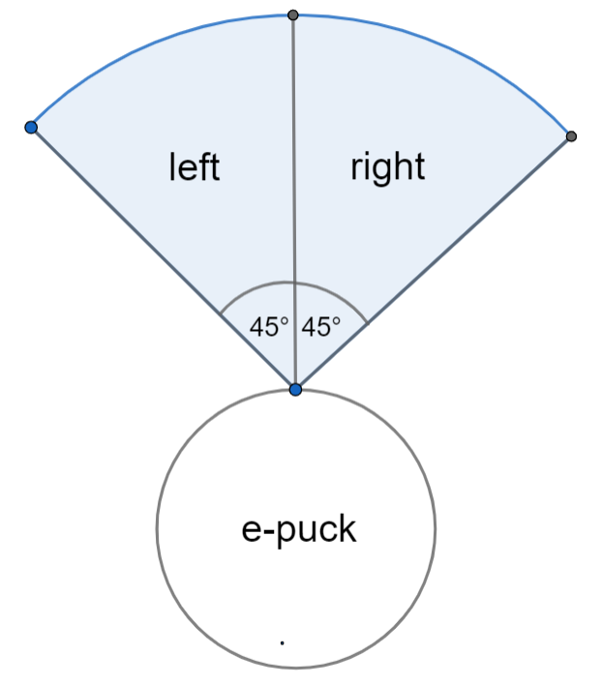
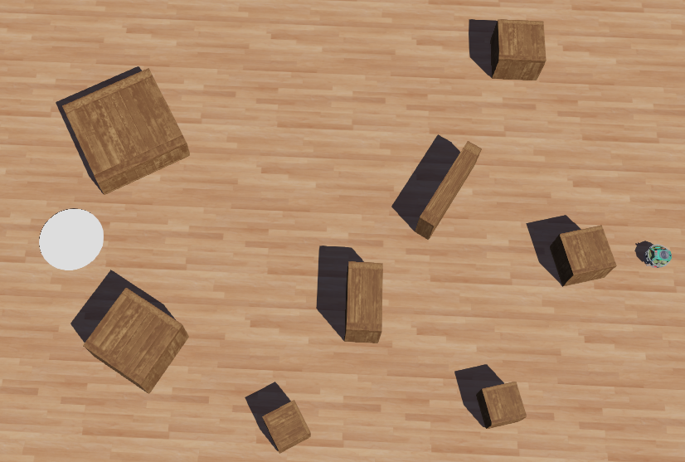
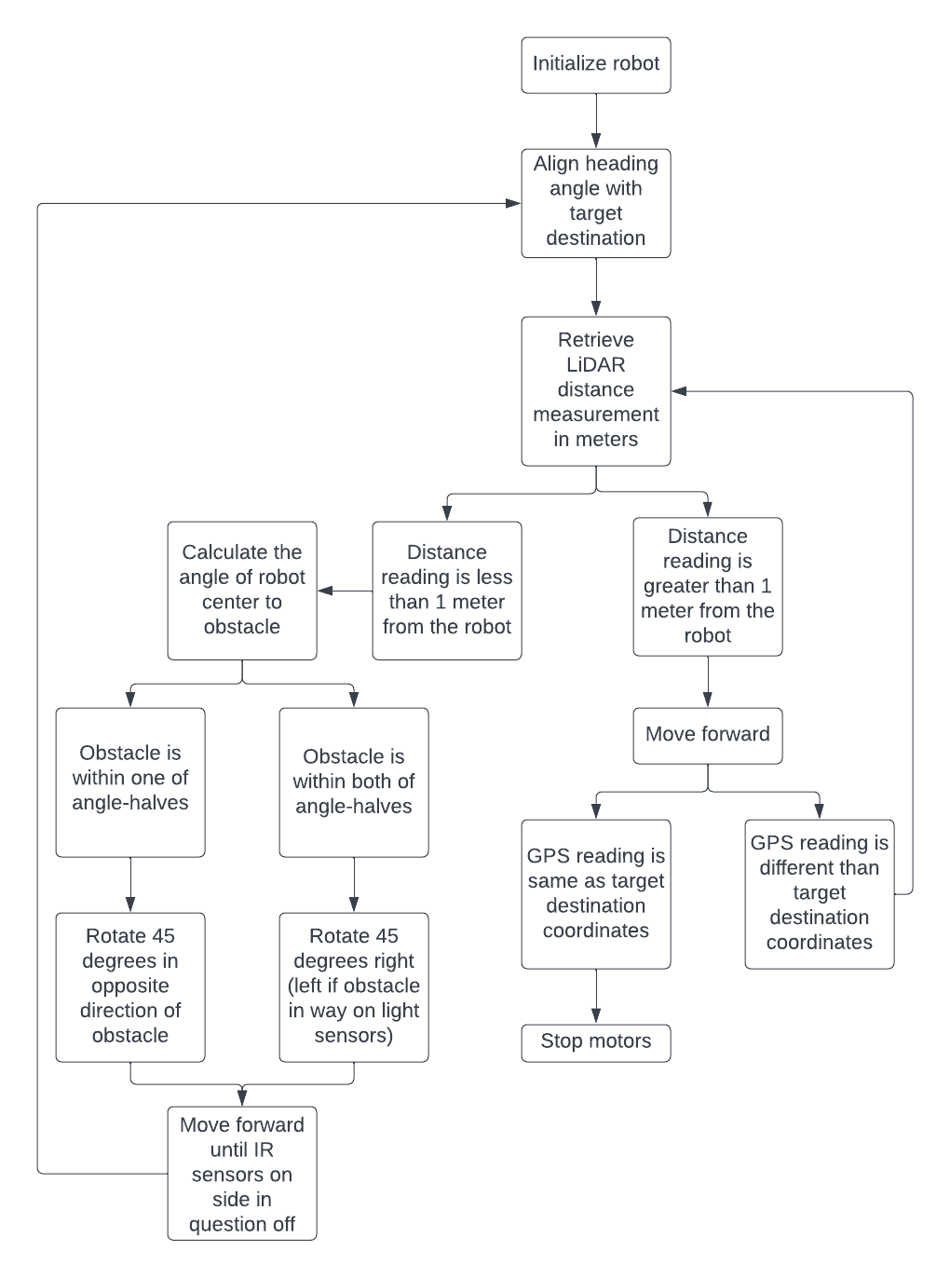
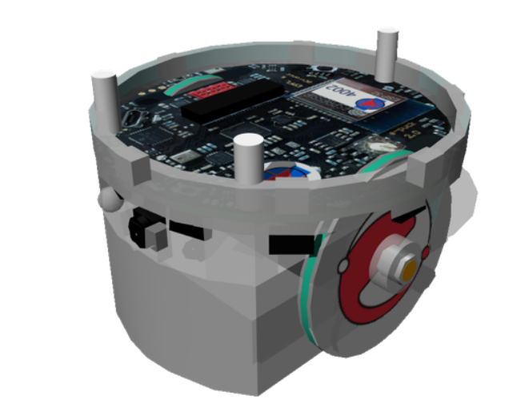
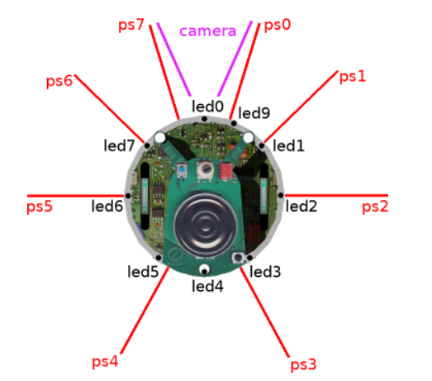
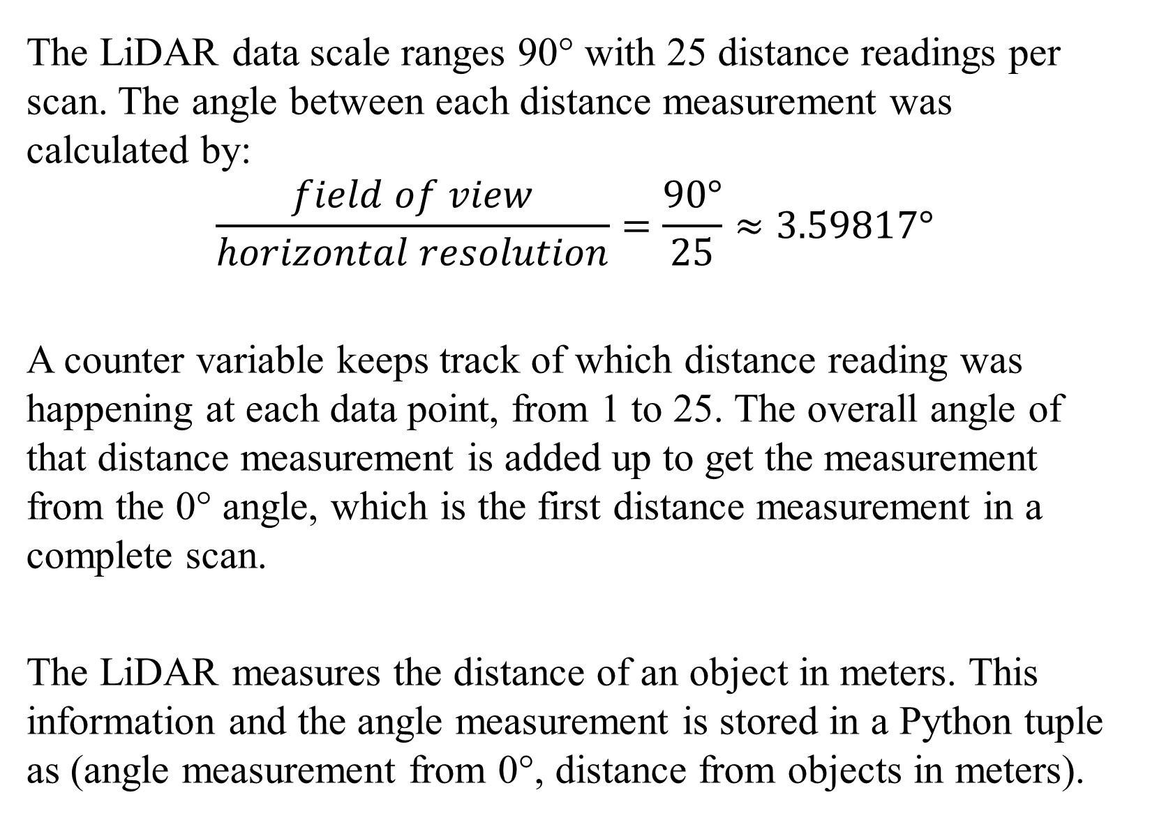
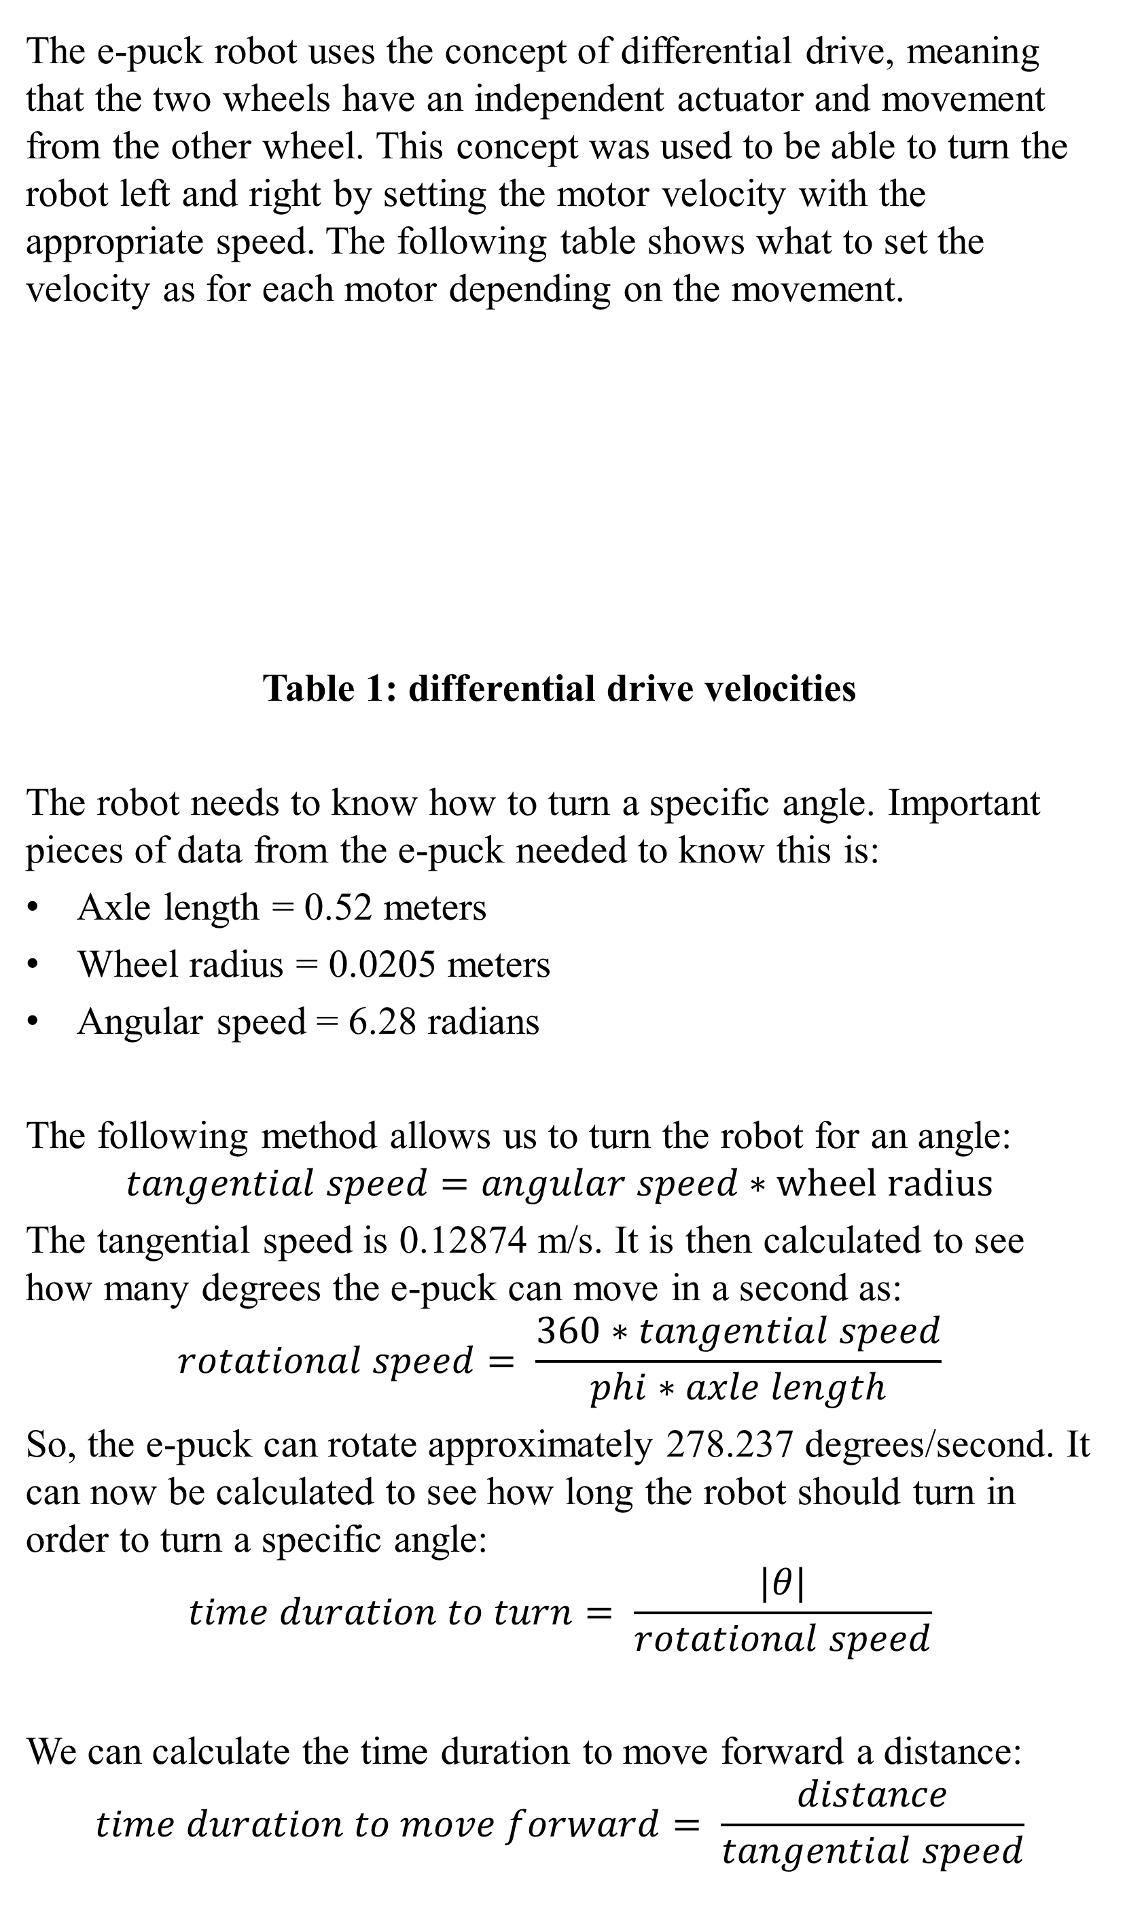
Robotic Collision Avoidance Simulation Using a Two-Wheeled Robot and LiDAR Sensor
Mary Stirling Brown and Dr. Brian Toone
Samford University, Department of Computer Science
Abstract
LiDAR Data Collection
Collision Avoidance Algorithm
Testing Environment
ABSTRACT
The LiDAR data scale ranges 90° with 25 distance readings per scan. The angle between each distance measurement was calculated by:
$$\frac{field of view}{horizontal resolution}=\frac{90°}{25}≈3.59817°$$
A counter variable keeps track of which distance reading was happening at each data point, from 1 to 25. The overall angle of that distance measurement is added up to get the measurement from the 0° angle, which is the first distance measurement in a complete scan.
The LiDAR measures the distance of an object in meters. This information and the angle measurement is stored in a Python tuple as (angle measurement from 0°, distance from objects in meters).
A collision avoidance algorithm is designed for the robot to reach a target destination without running into obstacles. The LiDAR’s 90° field of view is split into two 45° angles with a left and right side.
Figure 2: LiDAR field of view for collision avoidance
The collision avoidance algorithm developed utilizes the LiDAR and eight IR sensors. The IR sensors have LED lights that light up when an object is within 4 centimeters. The following explains the collision avoidance and movement algorithm for the robot to reach its target destination.
Figure 3: flowchart of the collision avoidance algorithm
When the robot is moving in a different direction to avoid the obstacle, the robot will not adjust its heading angle until the IR sensors on the side with the obstacle are no longer lit up. This would mean that the obstacle would have been passed.
The collision avoidance algorithm was not able to be tested due to the Webots software crashing and time limitations. However, a simulation environment in a Webots world was developed with various boxes for the robot to navigate around to its target destination. The white circle is the robot’s target destination.
Figure 4: world environment for simulation
Autonomous vehicles typically use a variety of sensors, including LiDAR sensors, to navigate through an environment and avoid obstacles without intervention. A LiDAR works by measuring the time it takes for the radiated laser to be reflected off an object back to the sensor in order to obtain a distance measurement to objects in the environment. In this research, a two-wheeled robot with a single-layer, rotating LiDAR sensor is used to test a collision avoidance algorithm in a simulated environment using Webots software. The collision avoidance algorithm is based on algorithms used in previous research. The created algorithm analyzes the LiDAR data to turn a specific angle away from the object to reach its target destination without collision. The robot has GPS and compass to aid in navigation towards its target destination. An environment with various obstacles is set up to test the algorithms. The proposed algorithm was unable to be tested due to a software bug and time limitations.
Differential Drive Procedure
Conclusion
The e-puck robot uses the concept of differential drive, meaning that the two wheels have an independent actuator and movement from the other wheel. This concept was used to be able to turn the robot left and right by setting the motor velocity with the appropriate speed. The following table shows what to set the velocity as for each motor depending on the movement.
Table 1: differential drive velocities
The robot needs to know how to turn a specific angle. Important pieces of data from the e-puck needed to know this is:
Axle length = 0.52 meters
Wheel radius = 0.0205 meters
Angular speed = 6.28 radians
The following method allows us to turn the robot for an angle:
$$tangential speed=angular speed∗wheel radius$$
The tangential speed is 0.12874 m/s. It is then calculated to see how many degrees the e-puck can move in a second as:
$$rotational speed= \frac{360∗tangential speed}{phi∗axle length}$$
So, the e-puck can rotate approximately 278.237 degrees/second. It can now be calculated to see how long the robot should turn in order to turn a specific angle:
$$time duration to turn= \frac{|θ|}{rotational speed}$$
We can calculate the time duration to move forward a distance:
$$time duration to move forward= \frac{distance}{tangential speed}$$
The purpose of this project was to study and learn more about the field of robotics and collision avoidance algorithms. Even though it was not able to be developed and tested fully due to a software bug and time limitations, there were many concepts that were studied:
Webots connects physical elements to a virtual environment through the creation of worlds and controllers.
LiDAR data was able to be stored and manipulated for obstacle detection without integration of a point cloud, which takes up a lot of data and time when doing collision avoidance algorithms.
Differential drive can be manipulated to turn specific angles and move forward or backward for a specific amount of time.
Future research can include fully implementing the collision avoidance algorithm in Webots to see if it can reach its target destination in the simulated environment created.
Software and Hardware
Webots is an open-source robot simulation software that has the following features:
Development of 3-D environments in a world
Code is integrated to control the robot through controllers
Time step to connect virtual time to real-world physics
The robot in this research is the GCTronic’s e-puck in Figure 1(a).
(a) e-puck model (b) sensor diagram
Figure 1: e-puck robot
The e-puck is a two-wheeled robot that has differential drive. It has eight infra-red (IR) sensors and eight proximity sensors surrounding the edge of the e-puck, as seen in Figure 1(b).
The LiDAR used is placed at the top front of the e-puck robot and has the following features:
Single layer
90° field of view
25 horizontal resolution (25 distance readings per layer)
GPS integration is used to keep track of the robot’s position and the target destination’s coordinates. A compass is needed to be able to turn the robot toward its target destination.
Movement | Left motor velocity | Right motor velocity
Forward | + | +
Backward | - | -
Right turn | + | -
Left turn | - | +
Acknowledgements
This research is supported by the Department of Mathematics and Computer Science at Samford University.
References
Albert Alfrianta. 2021. Simple avoidance algorithm, implemented on e-puck robot and simulated on Webots Robot simulator. (August 2021). Retrieved April 14, 2022 from https://medium.com/@albert.brucelee/3143c096d285
Cyberbotics. 1998. Webots: robot simulator. Retrieved from https://cyberbotics.com#cyberbotics
D. Hutabarat, M. Rivai, D. Purwanto and H. Hutomo, "Lidar-based Obstacle Avoidance for the Autonomous Mobile Robot," 2019 12th International Conference on Information & Communication Technology and System (ICTS), 2019, pp. 197-202, doi: 10.1109/ICTS.2019.8850952.
Kajal Gada. 2021. How to use Lidars in Webots? // Webots Lidar Code in Python Tutorial (September 2021). Retrieved April 14, 2022 from How to use Lidars in Webots? // Webots Lidar Code in Python Tutorial - YouTube
Kajal Gada. 2020. Webots tutorial 3: Controller code to drive a differential drive robot // Webots tutorial python. (November 2020). Retrieved April 14, 2022 from https://www.youtube.com/watch?v=CDOrTKQAOqs
Min Gyu Park, Jae Hyun Jeon and Min Cheol Lee, "Obstacle avoidance for mobile robots using artificial potential field approach with simulated annealing," ISIE 2001. 2001 IEEE International Symposium on Industrial Electronics Proceedings (Cat. No.01TH8570), 2001, pp. 1530-1535 vol.3, doi: 10.1109/ISIE.2001.931933.
N. Baras, G. Nantzios, D. Ziouzios and M. Dasygenis, "Autonomous Obstacle Avoidance Vehicle Using LIDAR and an Embedded System," 2019 8th International Conference on Modern Circuits and Systems Technologies (MOCAST), 2019, pp. 1-4, doi: 10.1109/MOCAST.2019.8742065.Fröhlich, B. and Plate, J. The cubic mouse: a new device for three-dimensional iput. In Proceedings of the SIGCHI conference on Human factors in computing systems
(CHI ’00) (The Hague, The Netherlands, April 1-6, 2000). ACM Press, New York, NY, 2000, 526-531
P. Wu, S. Xie, H. Liu, J. Luo and Q. Li, "A novel algorithm of autonomous obstacle-avoidance for mobile robot based on LIDAR data," 2015 IEEE International Conference on Robotics and Biomimetics (ROBIO), 2015, pp. 2377-2382, doi: 10.1109/ROBIO.2015.7419694.Sannella, M. J. Constraint Satisfaction and Debugging for Interactive User Interfaces. Ph.D. Thesis, University of Washington, Seattle, WA, 1994.

