Slide 1
HE Lab Launch links HEKA Series #2
... the missing link

Slide 2
Quick Process Overview
URL received at <internalServer> server
Session opened with middleware
CMS queried for validation
CMS returns additional lab specific information
Launch page displayed with spinning sparky
middleware contacted with full lab information
middleware performs lookups
middleware sends RMI window full launch string
VM Launched

Slide 3
There’s MUCH more
Focus today:
How to find the CMS data
Brief look at CMS
Metadata spreadsheet
The searchable CMS plus!
composing a unique login string
What’s mandatory; what’s optional; what’s just wrong!
troubleshooting
TWA
CMS
<internalServer>
Metadata spreadsheet
ZDC

Slide 4
CMS
In the Beginning:
Lab Subtype registered with a Lab Type
i.e. MSV Lab Type has MSV-INTCONF2 Lab SubType
Lab Subtype registered with a labID
PCD defined
folders for labguides; scenarios; etc. defined on PCD
lab Type and lab SubType defined on PCD
labID defined on PCD
PCD tied to PKD
PKD tied to PID
PKD tied to CID (group)
PKD Published
Simple changes are not so simple in CMS!

Slide 5
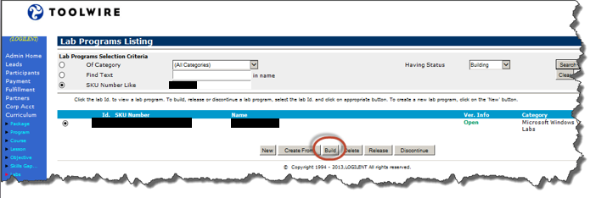
CMS Lookups: Lab Information
Curriculum->Labs->SKU Number Like:
L<PCD>
Search
Build

Slide 6
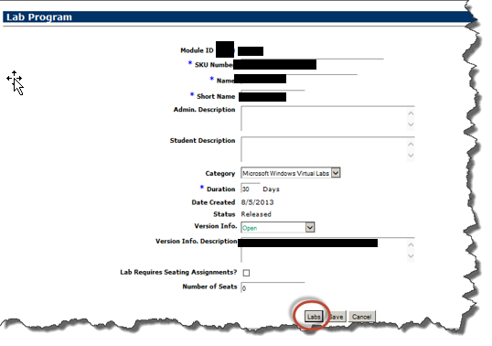
CMS Lookups: Lab Info
Skip this page by selecting Labs:

Slide 7
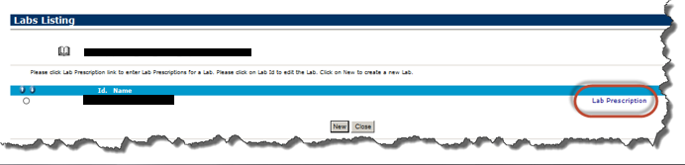
CMS Lookups: Lab Info
Navigate through this page by selecting Lab Prescription:

Slide 8
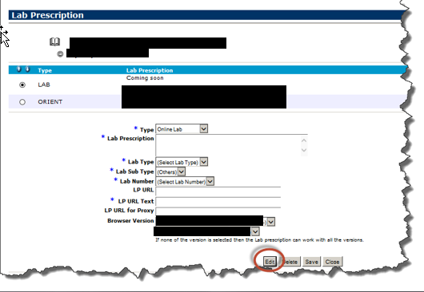
CMS Lookups: Lab Info
Select Labs, then Edit:
(just NEVER Save!!!)

Slide 9
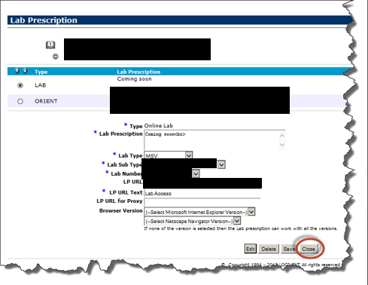
CMS Lookups: LabID, LabSubTypes
The page of interest: labID, labSubType ...

Slide 10
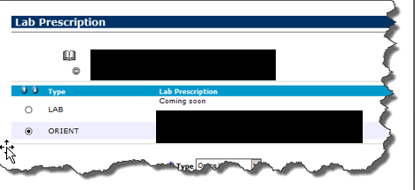
CMS Lookups: Lab Guides/Scenario Locations
Return to lab prescription page and select Orient:

Slide 11
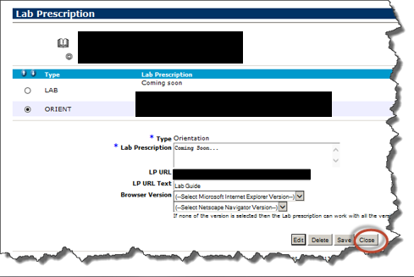
CMS Lookups: Lab Guides/Scenario Locations
For the folder location on lab guides and scenarios:

Slide 12
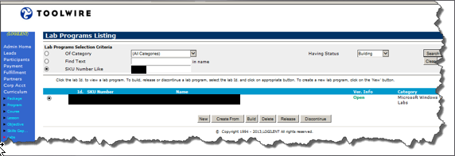
CMS Lookups: CID, PID, PKG lookups
Close out of all the windows until you return back to the search window to continue navigation:

Slide 13
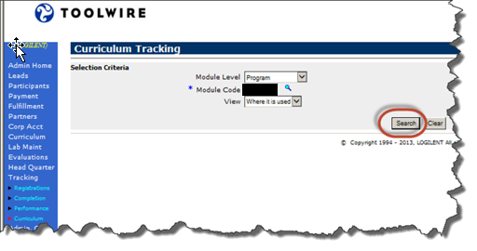
CMS Lookups: CID, PID, PKG lookups
Select Tracking->Curriculum
Select Program, enter the PCD, then Search:

Slide 14
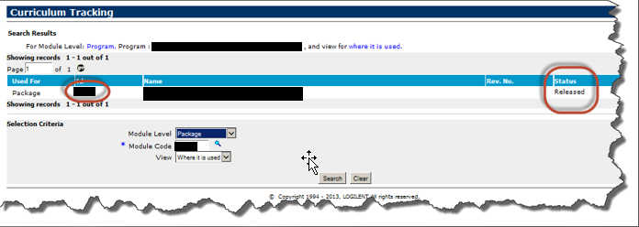
CMS Lookups: CID, PID, PKG lookups
Select Package pull-down
Enter package from display

Slide 15
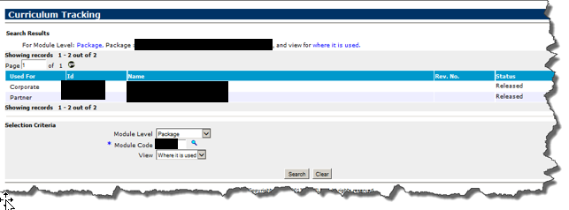
CMS Lookups: CID, PID, PKG lookups
The PID’s and CID’s that this PKD is published under are shown in this search:

Slide 16
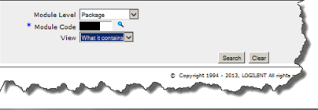
CMS Lookups: CID, PID, PKG lookups
Changing View to What it Contains, then selecting search yields more information:

Slide 17
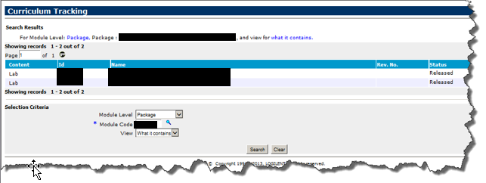
CMS Lookups: CID, PID, PKG lookups
All the PCD’s published in this PKD for the CID’s and PIDs shown in the previous screen:

Slide 18
CMS: What’s searchable?
Easily?
PKD’s
PCD’s
Not so much!
No search capability for a specific LabID
No search capability for LabID’s that use a specific SubType

Slide 19
Enter: Metadata Spreadsheets
Duplicates pertinent CMS information to construct launch links
Searchable (yay!)
Expandable: More engineering information
Not perfect – but really, really close!
One for every customer

Slide 20
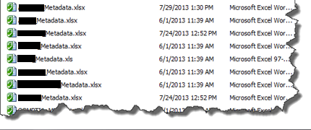
Metadata contents
CMS data
Additional engineering data
Formulas to compose lab launch URL’s for testing

Slide 21
CMS Data in Metadata Spreadsheet
Organized into groups on one row:
The first section contains customer information:
Then CMS specific information
Finally, Engineering specific information:

Slide 22
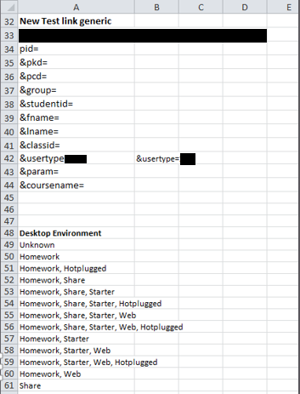
Formulas
Data tab – for formulas
Pull down menus
Data validation

Slide 23
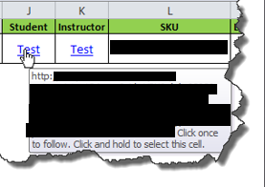
Links
Hovering over link displays contents
Copy link to editor, then edit link will yield the same contents

Slide 24
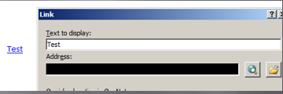
Copy Full Link
Copied to OneNote, right click link and select “Edit Link”, full text is in edit box:

Slide 25
Formulas: Wahoo!
=HYPERLINK(CONCATENATE(Data!A$33,Data!A$34,A2,Data!A$35,C2,Data!A$36,D2,Data!A$37,B2,Data!A$38,Q2,Data!A$39,(ROW()),Data!A$40,Q$1,Data!A$41,Q$1,"-00000000",Data!A$42,Data!A$43,AB2,Data!A$44,Q$1),"Test")
Concatenate function just strings values together.
Data!A$33: Take column A, row 33 from the data tab. $ indicates do NOT increment this if you copy the value from row to row.
ROW() function returns the row number you’re currently on.
HYPERLINK(string, “Test”)

Slide 26


Additional Formulas
Course Name (taken from tab name): =(MID(CELL("filename",A1),FIND("]",CELL("filename",A1))+1,256))
StudentID: Tab name, row name, and literal value used: =CONCATENATE(Q$1,"Student",(ROW()))
Params: Set by the selection of My Files:
=IF(OR(AA2=Data!A$55, AA2=Data!A$56, AA2=Data!A$58, AA2=Data!A$59, AA2=Data!A$60, AA2=Data!A$63, AA2=Data!A$64, AA2=Data!A$66, AA2=Data!A$69, AA2=Data!A$70, AA2=Data!A$72, AA2=Data!A$73), 2, 0)

Slide 27
Metadata
Searchable
Provides additional course information
Location of image (which farms)
Desktop environment (My Files; Shortcuts)
Software installed

Slide 28
Voucher Sites
Newer metadata, easily identifiable:
Each course has 3 sections
Base lab
Pointer lab for Students (SKU ends with “URL”)
Pointer lab for Instructors (SKU ends with “INST”)
Must have voucher site login and access codes. URL’s will not work!
Older metadata: Not so much
Drew working on identifying voucher site identifiers

Slide 29
Access Codes
Standard Activation Duration:
Students: 30 days [some customers set longer]
Instructors: 90 days [ditto]
May be extended by CMS change
Does not need to expire to extend
Email LATeam to request expiration set to 5 years.
Activation Codes located at:
http://subversioin.internal.site/pathToCodes/codes.xlsx
Access codes specific to student or inst accts.
ALWAYS check in your access code check-outs!
Record your name next to the code before activating.
Check the spreadsheet into subversion immediately!

Slide 30
Disassembling the Link
http://<internalServer>.toolwire.com/INTCONF/internal.asp?pid=INTCONF&pcd=9999&pkd=9998&group=INTCONFACCT&studentid=TWINTCONF&fname=Test&lname=Toolwire&classid=TEST21-00000000&usertype=A125&param=QA2&coursename=test21
http://<internalServer>.toolwire.com : <internalServer> server
/INTCONF : folder located at c:\<internalServer>\INTCONF
internal.asp : launches session with middleware; communicates with CMS
Next 4 validated by CMS:
PID, PCD, PKD, Group
No validation: No spinning sparky. “Access denied”

Slide 31
Disassembling the Link
http://<internalServer>.toolwire.com/INTCONF/internal.asp?pid=CONF&pcd=9999&pkd=9998&group=CONFINTL&studentid=TWINTCONF&fname=Test2&lname=Toolwire&classid=TEST-0&usertype=A125&param=QA2&coursename=test21
studentid, fname, lname: No error checking: MD5 hash created for AD MD5.
fname, lname + “-xxxx” : PublicID created by Nexus.
PublicID used for <thestudent> server directory
Used for Student Homework folder for instructor account

Slide 32
Disassembling the Link
http://<internalServer>.toolwire.com/INTCONF/internal.asp?pid=INTCONF&pcd=99999&pkd=9998&group=INTLCONF&studentid=TWINTCONFTest&fname=Test2&lname=Toolwire&classid=TEST-0&usertype=A125&param=QA2&coursename=test
classid: Customer will create this as they wish. Character and length restrictions
Used to create the course instance folder on the course share volume;
Where share and student homework folders are stored
No error checking on classID

Slide 33
Disassembling the Link
http://<internalServer>.toolwire.com/INTCONF/internal.asp?pid=INTCONF&pcd=99998&pkd=9999&group=INTCONF&studentid=Test&fname=Tester2&lname=Toolwire&classid=TEST&usertype=A125&param=9&coursename=test21
usertype: A125= student; Z954=instructor
param [was used for assessments – not used now]:
A3- no website, no email
B8 - no website, has email
C2 - has website, no email
D1 - has website, has email
coursename: assigned by customer; used for lab folder name in My Files

Slide 34
Additional URL Format Information
Toolwire CMS Integration Guide
Specifies length and composition of fields
Specifies fields required for voucher sites
Specifies fields required for Higher Education
Newer LTI version TW is moving towards: http://internal.path/to/toolwire/documentation
Toolwire CMS Integration Guide (older vers.)
http://internal.path/to/toolwire/documentation

Slide 35
Show Stoppers
http://<internalServer>.toolwire.com/INTCONF/internal.asp?pid=INTCONF&pcd=99998&pkd=9999&group=INTERCONF&studentid=TWTest&fname=Tester2&lname=Toolwire&classid=TEST21-9999&usertype=A125&param=QA2&coursename=test21
PID=INTCONF and folder with same name on c:\<internalServer> OR must be in voucher directory
pid, pkd, group MUST exist in CMS
studentid, fname, lname, classid, usertype, param and coursename not validated using internal.asp

Slide 36
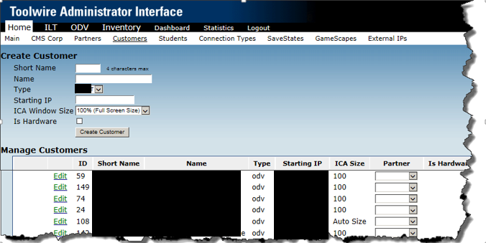
TWA Show Stoppers
Customer farm must exist: <Demonstrates farm name in screenshot>

Slide 37
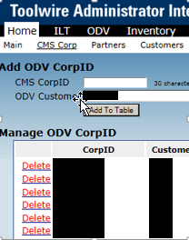
TWA: CID must be tied to farm
INTCONFACCT : Test Link
Won’t work unless it is tied to the farms;
<demonstrates CorpID INTCONFACCT is tied to customer in middleware lookup table>

Slide 38
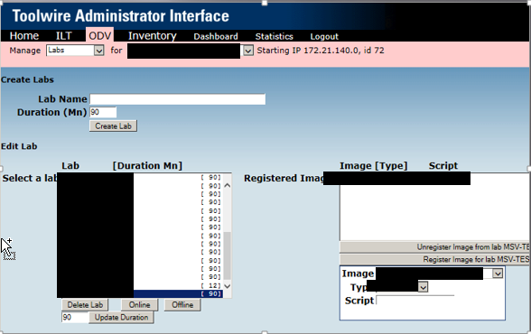
TWA Image tied to Lab
Lab must be turned online as well...
<demonstrates LabID is tied to an image name in middleware lookup tables>

Slide 39
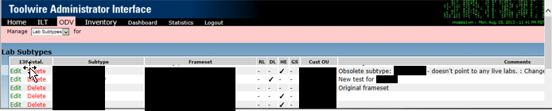
Lab Subtype tied to custOU
Set to RL, DL, HE, GS, and set Cust OU to pass through to frameset.
Frameset tied to two custou’s requires:
Two different subtypes – point to same frameset
Each frameset then points to different custou’s

Slide 40
TWA - Framesets – Script CustOU Conflicts
TWA guarantees user exists in custou before launching lab
gets custou from frameset/subtype association in TWA
Framesets may hard code custou (details later)
This will be the value passed through to the scripts
May conflict with custou where TWA assigned the student
Scripts (older versions) hard code custou
Newer scripts pass custou through from middleware
May also conflict with custou where TWA assigned student
TWA is the definitive source of where the lab should launch
Framesets, scripts both should match TWA

Slide 41
TWA - Frameset – Script CustOU Conflicts: Example
Middleware creates the student account in the A.D. OU that’s indicated in TWA’s frameset / subtype association
Middleware passes studentMD5, student password, student publicID, and custOU where student was created in AD
Scripts mount filer (custxxx_c or custxxx_s) based upon custOU either received from frameset (not TWA – but the frameset file), OR if hardcoded in scripts,
No studentID, publicID, or password matches – as custou in scripts/frameset files does not match where TWA created the student.

Slide 42
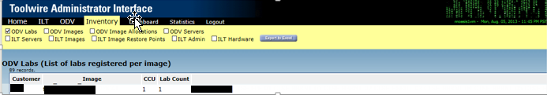
One lab for one farm
If you’re using a test link, like TESTXX, make sure it’s removed from any other farms.
Use Inventory->ODV Labs to verify:

Slide 43
Bugger 1: internal.asp
Sometimes internal.asp doesn’t pass through all parameters.
Look at RMI window on CCU to see params passed in.
Look at internal.asp to verify all params are being passed through.

Slide 44
RMI Window – No params
No params being passed, but internal.asp is passing them?
look at RMI window: What is the IP address shown? Is it the same as assigned – or the original IP set on the base image?
sethostip.vbs: what local area connection (1, 2, 3) is this file referencing?
look at vm: what local area connection is the vm using? If mismatched – IP address won’t be set

Slide 45


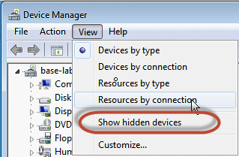
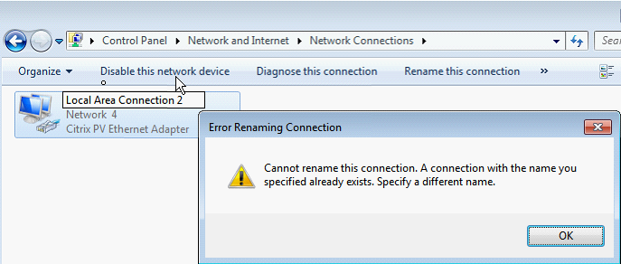

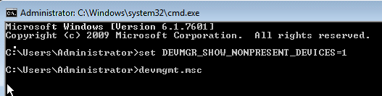
Local Area Ctn won’t rename
Delete the hidden device, then
rename:

Slide 46
Bugger 2: Voucher Sites
You’ve checked everything else and still no lab is launching.
Access denied should be your message
Lab Under Maintenance or Currently Unavailable?
Check expiration date on access code
Ask Learner Advocacy to extend access

Slide 47
Bugger 3: Framesets Hardcoded
Framesets are located at: http://<internalPathToFramesets>
Frameset files may reference other files. Examine the framesetFile.jsp file for other .jsp file references and examine these files as well.
Files sometimes hard code custOU’s.
Shouldn’t effect lab launching; but will affect ability to prepare folders; setup My Files on the desktop;
Check for presence of string in navigation file:
"&pre=xyz“ is the hard coded assignment of the custOU.
Student account will be created by the frameset definition in TWA
Folders will attempt to be created using this custou.
"&pre=<%=getUserCustOu(session)%>“
This retrieves the customer OU from the SubType definition in TWA (middleware) and passes it through to the lab prep scripts.

