Slide 1
Virtualization and Persistence
A 50,000’ view

Slide 2
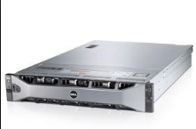
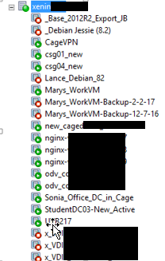
Why virtualization?
One behemoth machine
One archive (master image)
Clone quickly, destroy quickly
Portable for redundancy
Your PC : Run Linux and Windows simultaneously
Here at Toolwire:
Student Desktops : Destroy and relaunch
Employee workstations : Virus? Destroy and relaunch

Slide 3
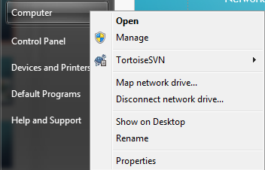
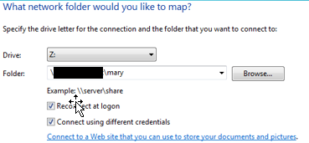
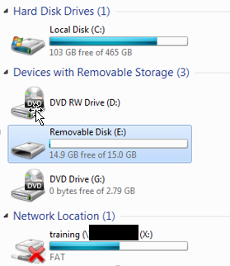
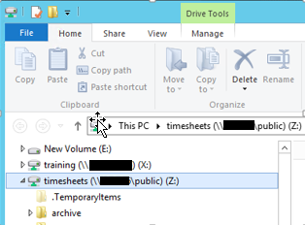
PERSISTENCE
Two forms:
Network mounts
My Files U:\ drive
Removable Storage
Thumb drive
External drive
For VM’s:
Hotplug Drives
NOTE: C: drive is NOT persistent!

Slide 4

HOW DOES virtualization WORK?
Imagine the United Nations
One language speaker
Many languages communicating with speaker
How can one person understand?
We need someone who speaks all languages

Slide 5
Virtualized translator : The Hypervisor
Many different O/S … different languages
Linux/Unix
ls -al
Windows
dir

Slide 6
Hypervisor layer
Unix
Windows
Linux
HYPERVISOR
Xen Server

Slide 7
Xen tools User Interface to Server
Xen Tools
Xen Server
Just a Linux Server with Citrix installed

Slide 8
HYPERVISOR = TRANSLATOR
Windows Virtual Machine
Manages system resources for virtual machines
CPU
Memory (RAM)
Local Storage
Exposes system resources to virtual machines
Exposes system hardware to virtual machines
HYPERVISOR
Xen Server

Slide 9
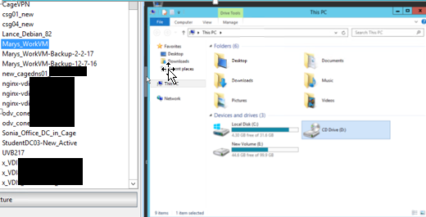
XEN CONSOLE : Window to Xen’s soul

Slide 10
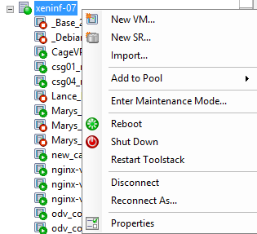
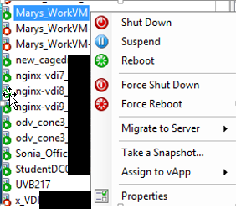
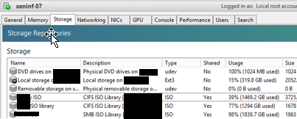
MORE ON XEN CONSOLE

Slide 11
HOTPLUGGING – Walks like a duck
Virtualized hard drive
Flat file
Binary
Must be virtually plugged into a VM
Looks like your “D:” drive
Virtually unplugged when done
Flat file (D: drive) stored on filer

Slide 12
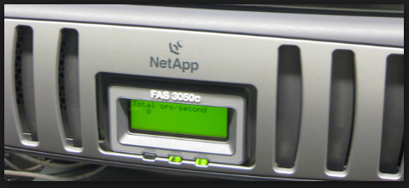
What’S A FILER
External Storage
Terrabytes of storage
Stores:
Student’s U:\ drive folders
Hot plug drives

