Slide 1


Farmware App
FYP-II
Maryam Nadeem (2437-2021 ) Muhammad Mujtaba (1985-2021) Hamza Bin Asif (1961-2021) Supervisor
Mr. Faheem Ahmed
Department of Computing, FEST
Hamdard University
1

Slide 2
Summary
2
Problem Statement
Project Scope
Project Milestones
FYP Deliverables
Project Front-end
Project Back-end
Project Demonstration

Slide 3
Problem Statement
3
Farmers often struggle to detect cow diseases early because they cannot easily recognize symptoms or access quick medical advice. This can lead to serious health problems for the animals, and even death.
There is a need for a simple tool that can help farmers identify possible diseases based on symptoms and get suggestions for treatment. Our project, Farmware, aims to solve this problem by using machine learning
to predict cow diseases and provide helpful guidance to farmers.

Slide 4
Project Scope
4
Farmware is designed to help farmers and vets with cow health. It
will:
Collect symptoms from the farmer using toggle buttons
Use machine learning to predict possible cow diseases
Suggest basic treatments based on the prediction
Store disease and symptom data in one place for future use
Let farmers and vets see past disease records

Slide 5
Project Milestones
5
Finalized the list of cow diseases and related symptoms
Designed and created the database for storing symptoms and disease data
Collected and cleaned real-world cow health data for training
Trained and tested the machine learning model for disease prediction
Developed the user-friendly app interface for symptom input and results display
Performed testing to check prediction accuracy and app usability

Slide 6
Project Deliverables
6
FYP-I Evaluation
FYP-II Evaluation
SRS Document SDS Document UI Design
Database Design Prototype model Project Report - I
Funding Proposal (optional)
Back-end development Testing and Debugging Source Code
Demo
Project Report – II
User Manual Proposed System

Slide 7
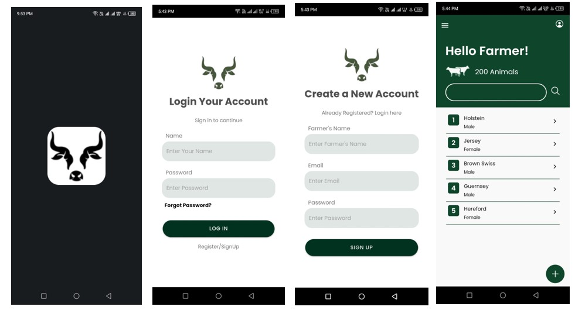
Project Front-end
7

Slide 8
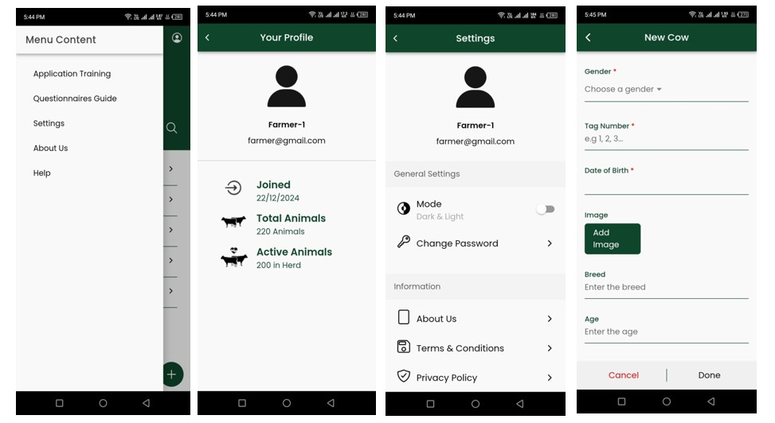
Project Front-end
8
Disease Prediction

Slide 9
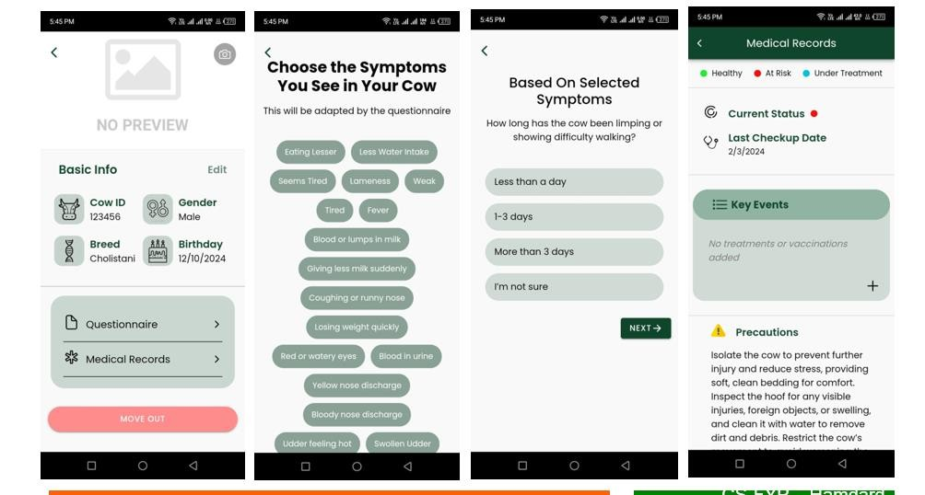
Project Front-end
9

Slide 10
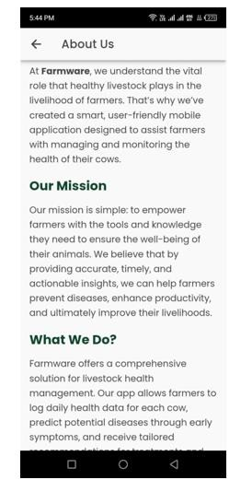
Project Front-end
10

Slide 11
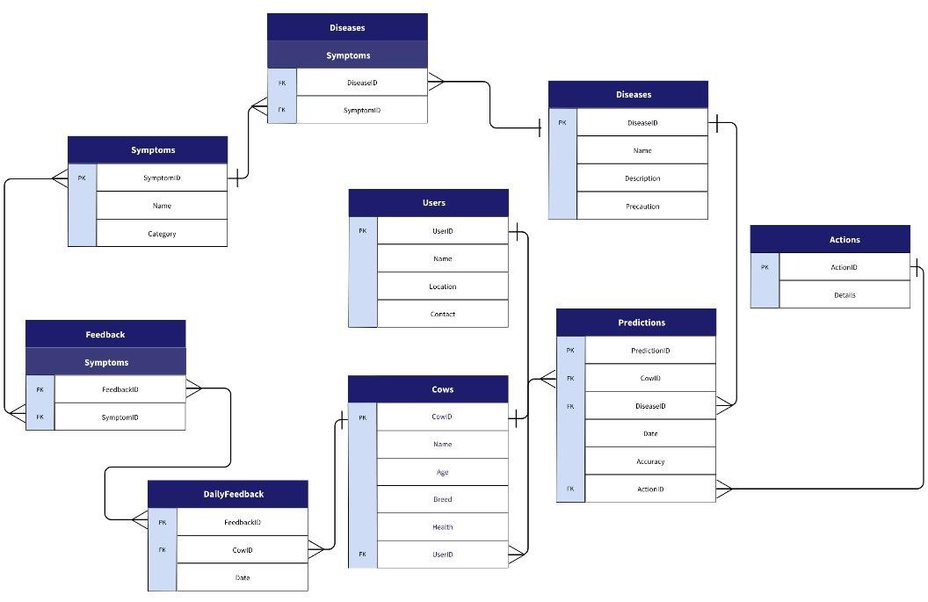
Project Back-end
11

Slide 12
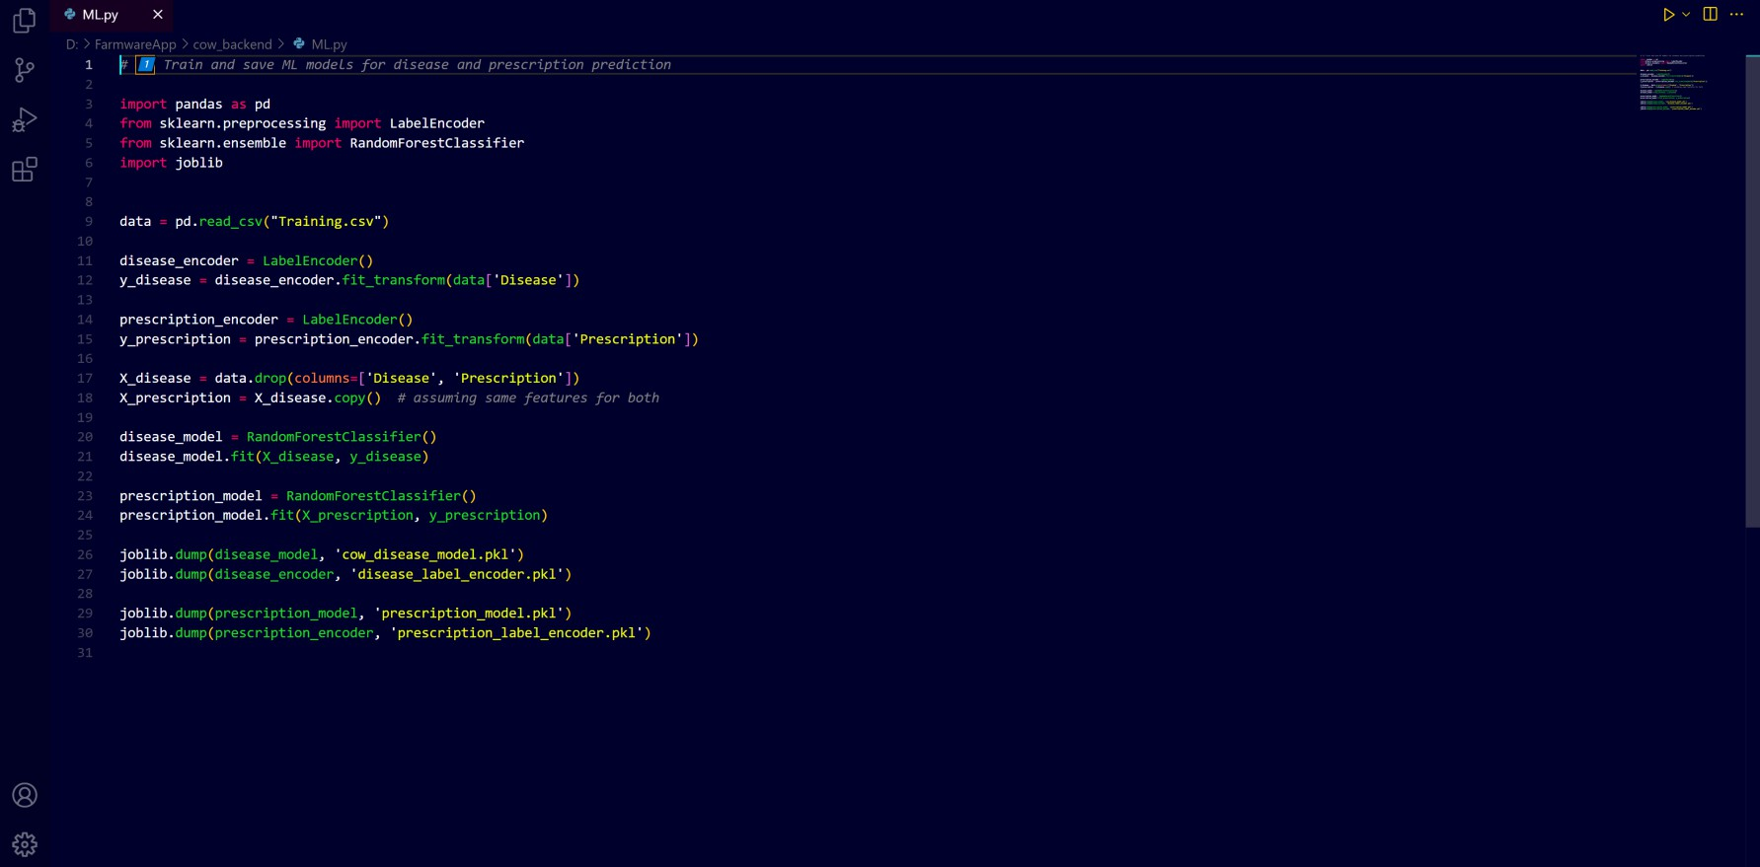
Project Back-end
12

Slide 13
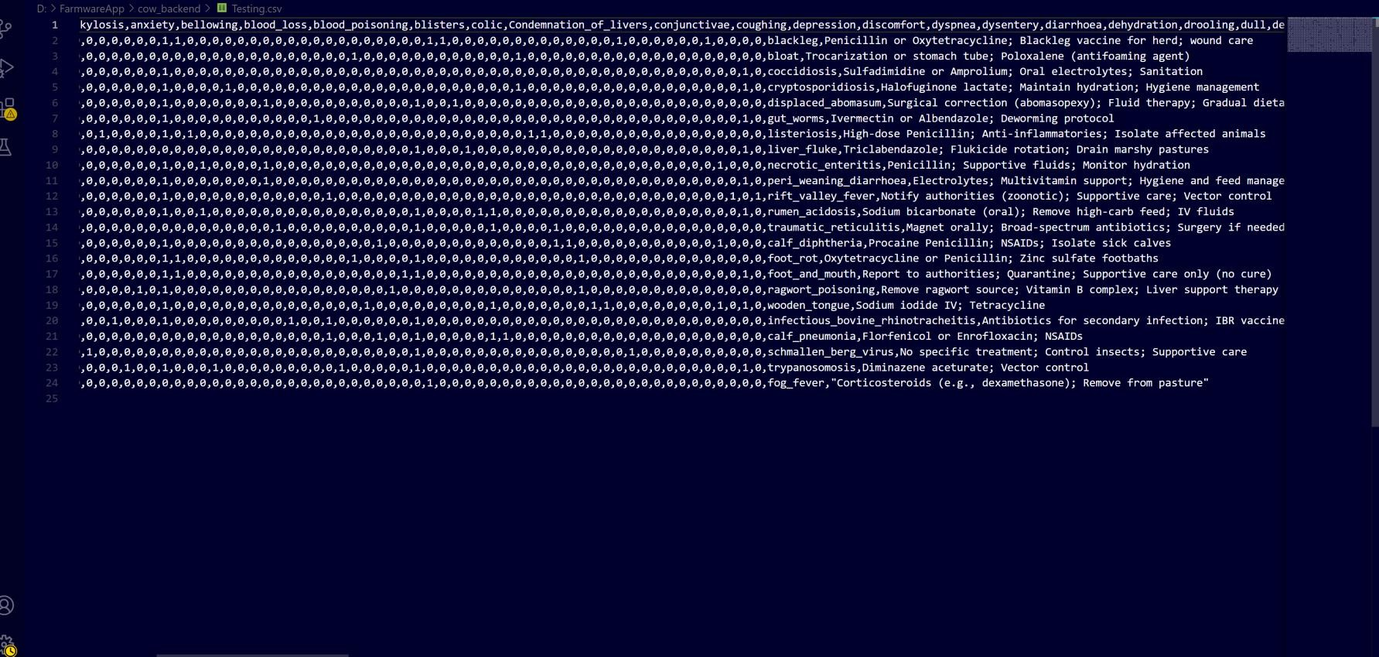
Project Back-end
13

Slide 14
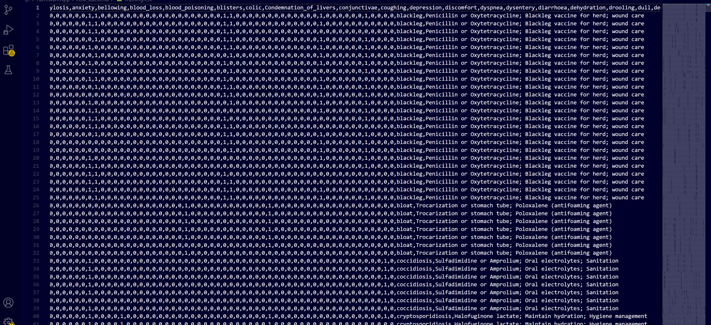
Project Back-end
14

Slide 15
Project Demonstration
15
Project Demo

Slide 16
16

