Slide 1
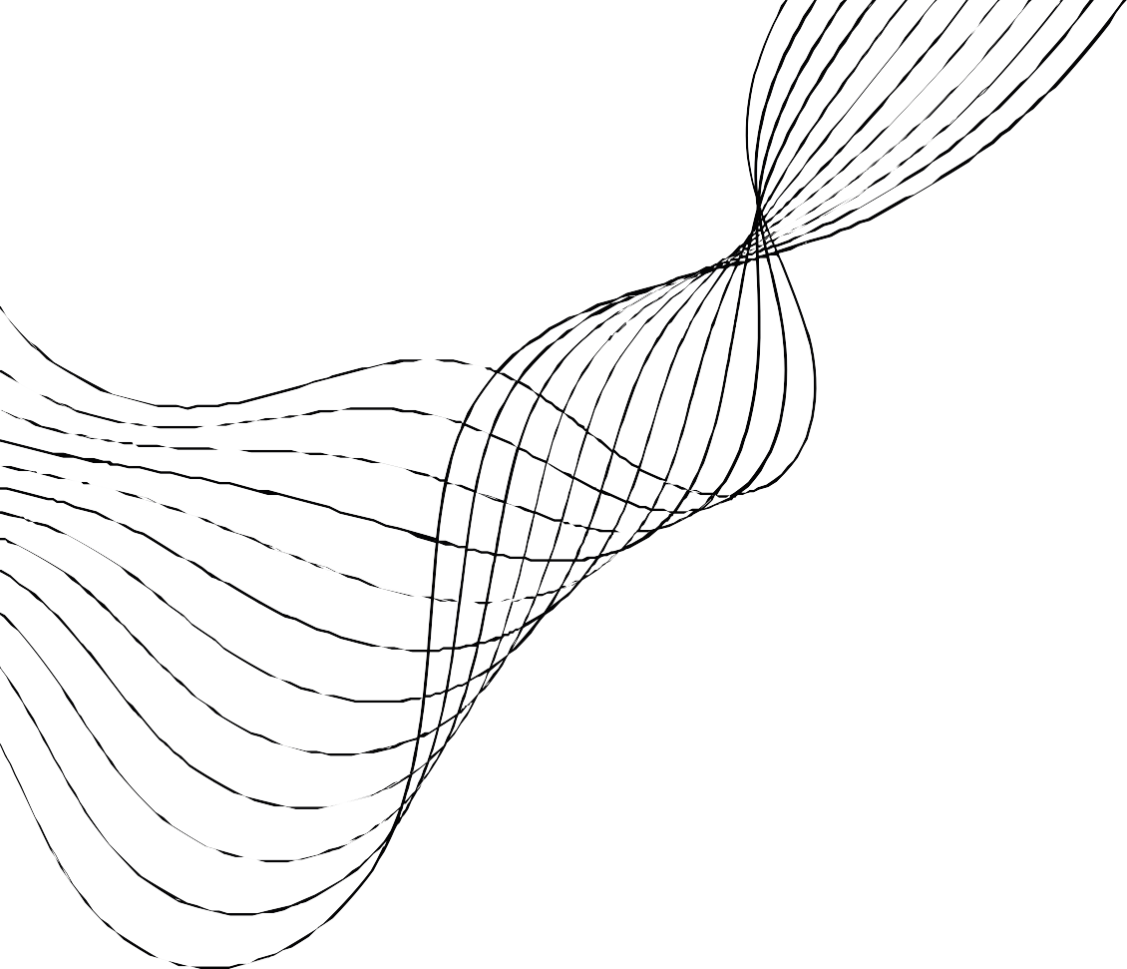
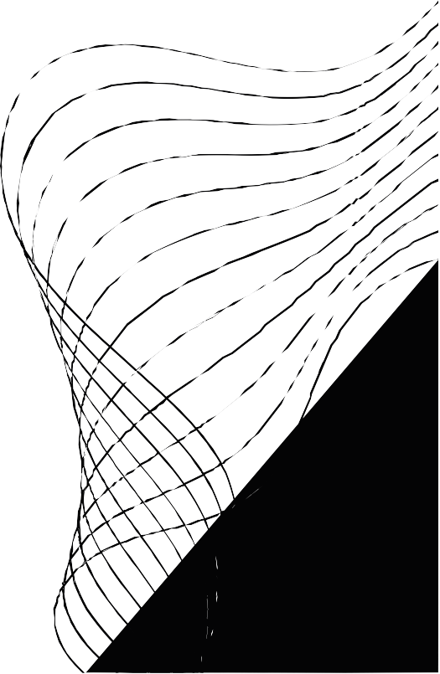
Advanced Project

Slide 2


Ethical Considerations
Privacy Protection:
The robot uses LiDAR sensors, not cameras, to avoid capturing personal images. Data is securely encrypted to protect privacy.
Informed Consent:
Daycare staff and parents were fully informed about the robot’s functions and data use, with their consent obtained.
Staff and Child Well-being:
The robot assists staff, reducing their workload while improving child safety, without replacing human caregivers.

Slide 3
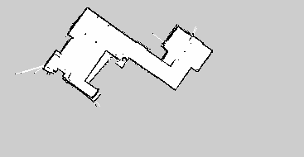
Results and Future Improvements
Results:
Simulated Experiments:
Successfully created 2D maps in Gazebo simulations using Gmapping at an optimal speed of 0.1 m/s.
Efficient navigation with global and local cost maps for obstacle avoidance.
Real-World Experiments:
In an apartment, the robot mapped with a 5.45% error rate when comparing 2D map data with real-world measurements.
Autonomous navigation was successful with accurate localization and real-time obstacle avoidance.
Object | Actual Measurement | 2D Map Measurement
Table | 0.80 m | 0.73 m
Couch | 2.43 m | 2.23 m
Width of Thin Corridor | 1.00 m | 0.94 m

Slide 4
Results and Future Improvements
Future Improvements:
Advanced Sensors: Consider 3D SLAM and depth cameras for improved mapping.
AI & Machine Learning: Use machine learning for smarter path planning and real-time adaptation.
Human Interaction: Add voice/gesture recognition for better interaction.
Energy Efficiency: Improve battery life for longer operation.

Slide 5
Conclusion
Summary:
The robot enhances daycare safety using 2D SLAM and LiDAR sensors, supporting staff by reducing their workload while ensuring privacy.
Results:
Real-world tests demonstrated a 5.45% error rate in mapping accuracy, with successful autonomous navigation and obstacle avoidance.
Future Vision:
Future enhancements in sensors (3D SLAM), AI for path planning, human-robot interaction (voice/gesture control), and energy efficiency will make the robot a more valuable tool for daycares.

Slide 6
THANK YOU!
ANY QUESTIONS?

