Slide 1
Keylogger
CAPSTONE PROJECT
Presented By:
Mary Rinisha J
Jeppiaar Institute of Technology
Artificial Intelligence and Data Science

Slide 2
OUTLINE
Problem Statement Proposed System/Solution
System Development Approach
Algorithm & Deployment
Result (Output Image)
Conclusion
Future Scope
References

Slide 3
Problem Statement
This project aims to create a dependable keylogging application using Python and Tkinter, tailored for cybersecurity experts. Its primary goal is to offer a reliable tool for monitoring user interactions, capturing key presses, holds, and releases comprehensively. The user-friendly interface features Start and Stop buttons for easy control of the logging process. Error handling mechanisms ensure stability, while logging in both text and JSON formats allows for seamless analysis. By adhering to coding best practices, this project seeks to empower security professionals in identifying and mitigating potential threats, thus contributing to cybersecurity efforts.

Slide 4
PROPOSED SOLUTION
The proposed solution aims to address the challenge of developing a robust keylogging application for security monitoring and analysis. The solution will encompass the following components:
Data Collection:
Gather keyboard activity data, including presses, holds, and releases.
Explore additional data sources for comprehensive insights.
Data Preprocessing:
Clean and preprocess data to handle inconsistencies.
Extract features for analysis.
Machine Learning (Optional):
Implement anomaly detection algorithms.
Train models on labeled data for behavior analysis.
Application Development:
Develop Tkinter interface for user interaction.
Provide real-time visualization and analysis features.
Deployment:
Ensure platform compatibility and accessibility.
Implement security measures for data protection.
Evaluation:
Assess performance metrics like accuracy and user satisfaction.
Incorporate feedback for optimization and improvement.

Slide 5
System Approach
SYSTEM REQUIREMENTS
HARDWARE
Processor: Minimum Intel Core i5 or equivalent
RAM: 8 GB
Storage: 256 GB SSD or higher
SOFTWARE
Operating System: Windows 10, macOS 10.15, Ubuntu 20.04 LTS
Programming Language: Python 3.8 or higher
Library required to build the model
Tkinter: Required for developing the GUI of the keylogger application.
pynput: Essential library for capturing keyboard events and interactions.
json: Utilized for storing logged keyboard data in JSON format.
datetime: Facilitates timestamping of keyboard events for chronological analysis.

Slide 6
Algorithm & Deployment
Algorithm Selection:
Selected Method: Basic event detection for keylogging.
Rationale: Considering the direct nature of keylogging, intricate machine learning algorithms are deemed excessive.
Data Input:
Input Elements: Keyboard activities (key press, hold, release) recorded via the pynput library.
Supplementary Details: Timestamps included for chronological organization.
Training Procedure:
There is no conventional training phase.
Setup and customization carried out prior to application launch.
Prediction Procedure:
Immediate logging of keyboard actions in real-time.
Instantaneous processing without necessitating prediction.

Slide 7
Result
The completed keylogger application effectively records keyboard events, encompassing key presses, holds, and releases, in real-time. Utilizing Tkinter, the interface offers user-friendly controls to initiate and halt the keylogging procedure. Data logging is executed seamlessly, offering flexibility to save logs in text or JSON formats. The application showcases stability and dependability, supported by error-handling mechanisms to maintain smooth functionality, even amidst unforeseen circumstances.

Slide 8
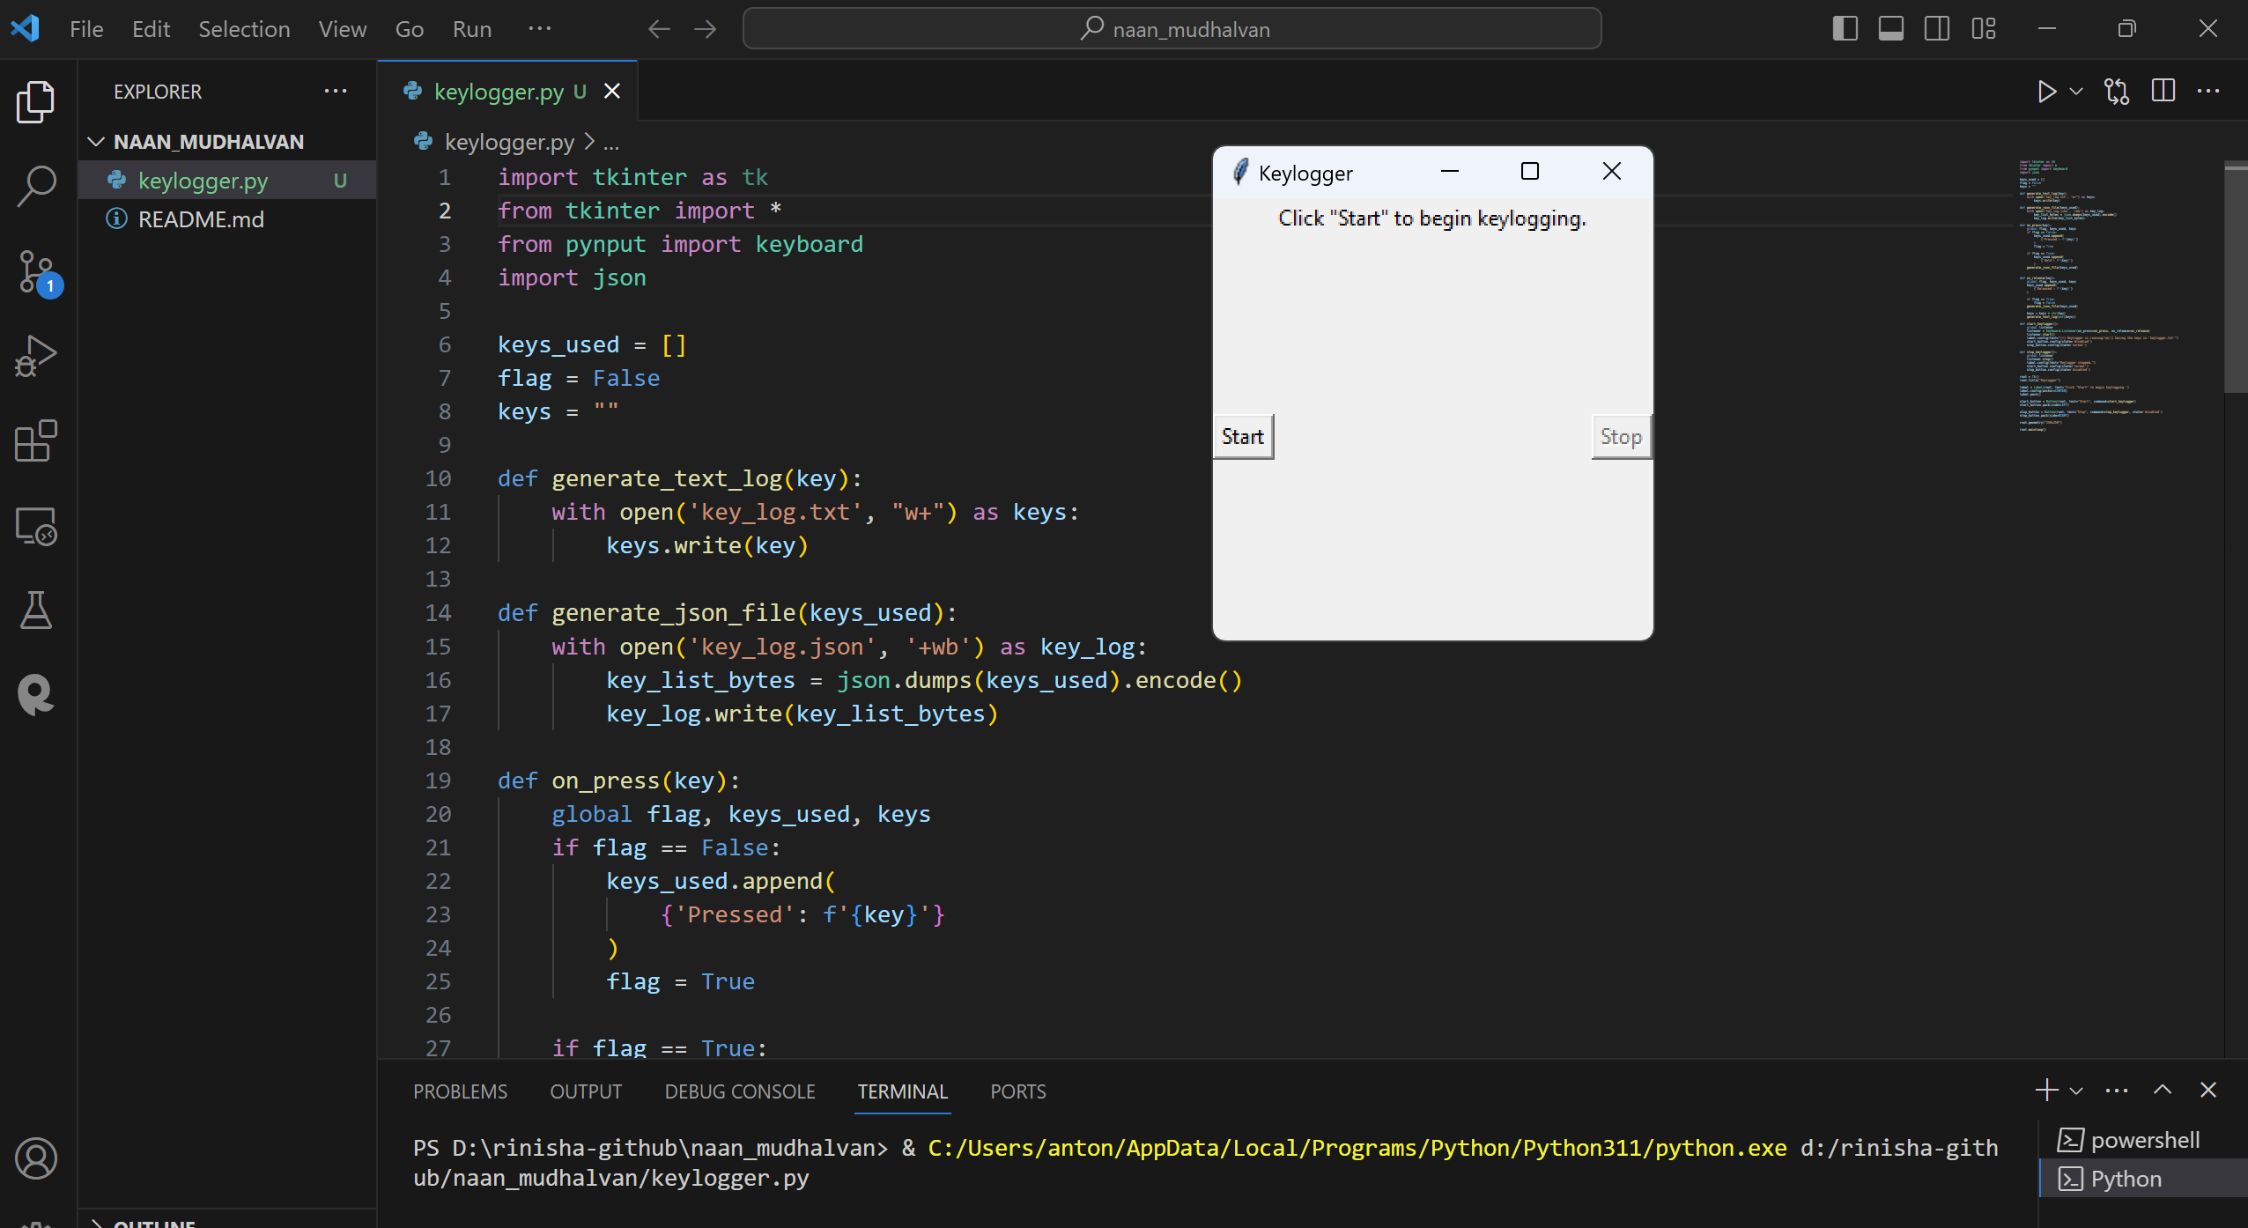

Slide 9
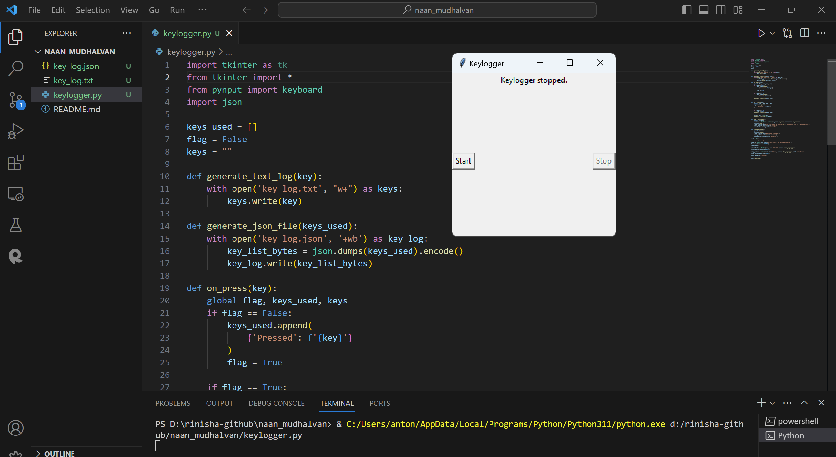

Slide 10
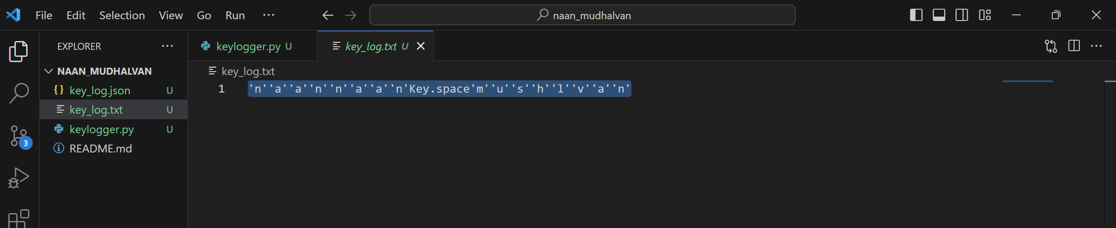

Slide 11
Conclusion
The keylogger application presents a valuable asset for security monitoring and analysis. Its straightforward yet efficient design empowers cybersecurity experts to monitor user interactions with keyboards, aiding in threat detection and behavior analysis. This project underscores the significance of employing robust data collection and preprocessing methods, alongside user-friendly interfaces for smooth interaction. Through adherence to coding best practices and integration of user feedback, the keylogger application proves its efficacy in bolstering security measures and empowering professionals in their cybersecurity endeavors.

Slide 12
Future scope
Moving forward, there are several avenues for further improvement and expansion of the keylogger application:
Integrating machine learning techniques to enhance anomaly detection and behavior analysis, improving the application's capability to identify suspicious activities.
Implementing advanced logging functionalities, such as capturing application-specific keyboard events or monitoring system-wide activities.
Introducing remote monitoring capabilities, enabling users to access keylogging data from various devices or locations.
Strengthening security measures to safeguard sensitive data collected by the keylogger, including encryption and access controls.
Collaborating with cybersecurity experts and organizations to gather insights and feedback for continuous enhancement and optimization of the application.

Slide 13
References
Python Software Foundation. (n.d.). Tkinter documentation. Retrieved from https://docs.python.org/3/library/tkinter.html
Pynput Documentation. (n.d.). Retrieved from https://pypi.org/project/pynput/
JSON. (n.d.). Retrieved from https://www.json.org/json-en.html
https://github.com/techtrainer20/TNSDC.git .

Slide 14
THANK YOU

